Slide 1
Addition Pyramids 1: Whole numbers
1)
 |  |  |  |  | 8
1 |  | 2 |  | 3 |  | 5
2)
 | 7 |  |  |  | 3
3 |  |  |  |  |  | 1
3)
 |  | 10
 | 7
5 |  |  |  |  |  | 9
4)
 |  | 12
 |  |  | 7 |  | 5
 |  | 3
5)
 |  | 12 |  | 13
 |  | 3 |  | 3
6)
 |  | 17
6 |  |  |  | 1 |  | 2
7) |  |  | 27
 | 7 |  |  |  | 8
3
8) |  |  | 28
9 |  |  |  | 2 |  | 1
9) |  |  | 29

Slide 2
Addition Pyramids 1: Solutions
1) |  |  | 21
 |  | 8 |  | 13
 | 3 |  | 5 |  | 8
1 |  | 2 |  | 3 |  | 5
2) |  |  | 22
 |  | 13 |  | 9
 | 7 |  | 6 |  | 3
3 |  | 4 |  | 2 |  | 1
3) |  |  | 23
 |  | 10 |  | 13
 | 7 |  | 3 |  | 10
5 |  | 2 |  | 1 |  | 9
4) |  |  | 24
 |  | 12 |  | 12
 | 5 |  | 7 |  | 5
2 |  | 3 |  | 4 |  | 1
5) |  |  | 25
 |  | 12 |  | 13
 | 6 |  | 6 |  | 7
3 |  | 3 |  | 3 |  | 4
6) |  |  | 26
 |  | 17 |  | 9
 | 11 |  | 6 |  | 3
6 |  | 5 |  | 1 |  | 2
7) |  |  | 27
 |  | 13 |  | 14
 | 7 |  | 6 |  | 8
3 |  | 4 |  | 2 |  | 6
8) |  |  | 28
 |  | 19 |  | 9
 | 13 |  | 6 |  | 3
9 |  | 4 |  | 2 |  | 1
9) |  |  | 29

Slide 3
Addition Pyramids 2: Negatives
1)
 | 4
6 |  | -2 |  | 9 |  | 3
2)
6 |  | -4 |  | 1 |  | 23
3)
27 |  | -4 |  | -2 |  | 1
4)
 | 11 |  |  |  | -11
5 |  |  |  |  |  | -5
5)
 |  | -4
 | -3
-5 |  |  |  |  |  | -2
6)
 |  | -13 |  | -7
 |  | -6 |  | 1
7) |  |  | -30
 |  | -11
 | -2
1
8) |  |  | -40
 | -8 |  |  |  | -10
-9
9) |  |  | -50

Slide 4
Addition Pyramids 2: Solutions
1) |  |  | 30
 |  | 11 |  | 19
 | 4 |  | 7 |  | 12
6 |  | -2 |  | 9 |  | 3
2) |  |  | 20
 |  | -1 |  | 21
 | 2 |  | -3 |  | 24
6 |  | -4 |  | 1 |  | 23
3) |  |  | 10
 |  | 17 |  | -7
 | 23 |  | -6 |  | -1
27 |  | -4 |  | -2 |  | 1
4) |  |  | 0
 |  | 11 |  | -11
 | 11 |  | 0 |  | -11
5 |  | 6 |  | -6 |  | -5
5) |  |  | -10
 |  | -4 |  | -6
 | -3 |  | -1 |  | -5
-5 |  | 2 |  | -3 |  | -2
6) |  |  | -20
 |  | -13 |  | -7
 | -8 |  | -5 |  | -2
-2 |  | -6 |  | 1 |  | -3
7) |  |  | -30
 |  | -11 |  | -19
 | -2 |  | -9 |  | -10
1 |  | -3 |  | -6 |  | -4
8) |  |  | -40
 |  | -19 |  | -21
 | -8 |  | -11 |  | -10
-9 |  | 1 |  | -12 |  | 2
9) |  |  | -50

Slide 5
Addition Pyramids 3: Decimals
1)
 |  |  |  |  | 2.2
1 |  | 0.2 |  | 0.6 |  | 1.6
2)
 | 3 |  |  |  | 1.2
2.4 |  |  |  |  |  | 0.9
3)
 |  | 2.8
 | 1.8
1.45 |  |  |  |  |  | 2.55
4)
 |  |  |  | 2.8
 | 1.3 |  | 1.4
 |  | 0.7
5)
 |  |  |  | 3.66
 | 1.42
1.1 |  |  |  | 1.2
6)
 |  | 4.03
 | 2 |  |  |  | 1.64
1.03
7) |  |  | 5.55
 |  | 2.22
0.2 |  |  |  | 0.02
8) |  |  | 4.44
 | 1.09 |  |  |  | 1.13
0.54
9) |  |  | 3.33

Slide 6
Addition Pyramids 3: Solutions
1) |  |  | 5
 |  | 2 |  | 3
 | 1.2 |  | 0.8 |  | 2.2
1 |  | 0.2 |  | 0.6 |  | 1.6
2) |  |  | 6
 |  | 3.9 |  | 2.1
 | 3 |  | 0.9 |  | 1.2
2.4 |  | 0.6 |  | 0.3 |  | 0.9
3) |  |  | 7
 |  | 2.8 |  | 4.2
 | 1.8 |  | 1 |  | 3.2
1.45 |  | 0.35 |  | 0.65 |  | 2.55
4) |  |  | 5.5
 |  | 2.7 |  | 2.8
 | 1.3 |  | 1.4 |  | 1.4
0.6 |  | 0.7 |  | 0.7 |  | 0.7
5) |  |  | 6.6
 |  | 2.94 |  | 3.66
 | 1.42 |  | 1.52 |  | 2.14
1.1 |  | 0.32 |  | 1.2 |  | 0.94
6) |  |  | 7.7
 |  | 4.03 |  | 3.67
 | 2 |  | 2.03 |  | 1.64
1.03 |  | 0.97 |  | 1.06 |  | 0.58
7) |  |  | 5.55
 |  | 2.22 |  | 3.33
 | 1.2 |  | 1.02 |  | 2.31
0.2 |  | 1 |  | 0.02 |  | 2.29
8) |  |  | 4.44
 |  | 1.2 |  | 2.24
 | 1.09 |  | 1.11 |  | 1.13
0.54 |  | 0.55 |  | 0.56 |  | 0.57
9) |  |  | 3.33

Slide 7
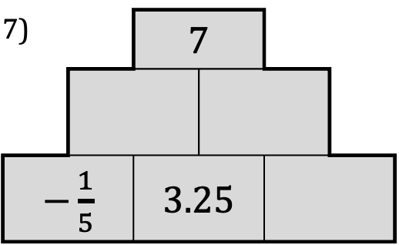
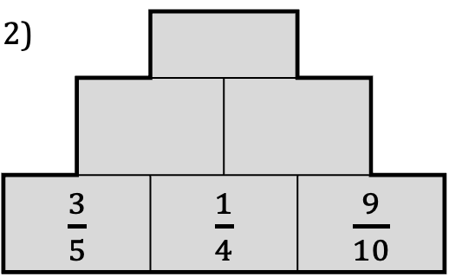
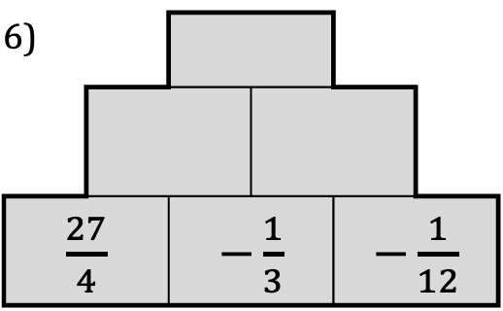
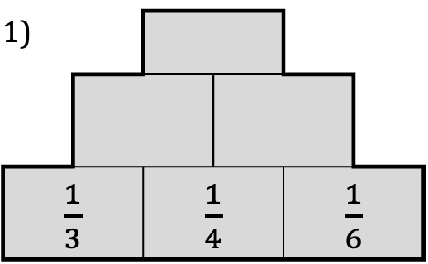
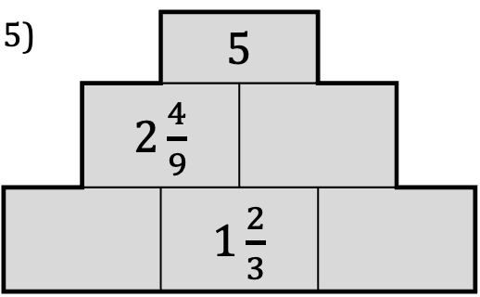
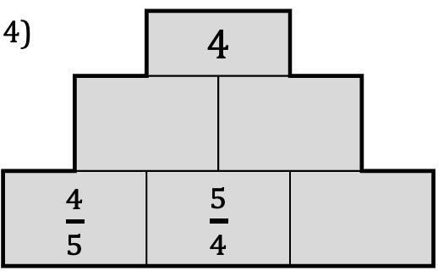
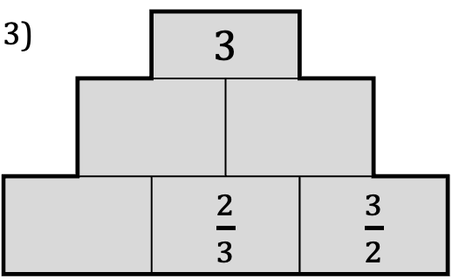
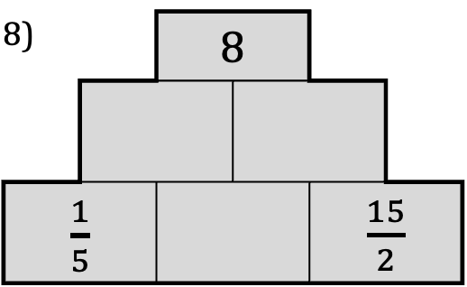
Addition Pyramids 4: Fractions
1)
$\frac{1}{3}$ |  | $\frac{1}{4}$ |  | $\frac{1}{6}$
2)
$\frac{3}{5}$ |  | $\frac{1}{4}$ |  | $\frac{9}{10}$
3) |  | 3
 |  | $\frac{2}{3}$ |  | $\frac{3}{2}$
4) |  | 4
$\frac{4}{5}$ |  | $\frac{5}{4}$
5) |  | 5
 | $2\frac{4}{9}$
 |  | $1\frac{2}{3}$
6)
$\frac{27}{4}$ |  | $−\frac{1}{3}$ |  | $−\frac{1}{12}$
7) |  | 7
$−\frac{1}{5}$ |  | $3.25$
8) |  | 8
$\frac{1}{5}$ |  |  |  | $\frac{15}{2}$
9) |  | 9

Slide 8
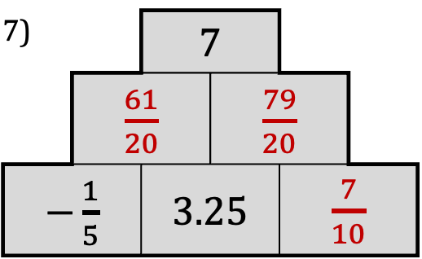
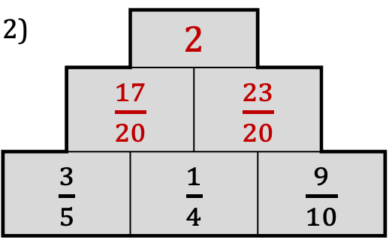
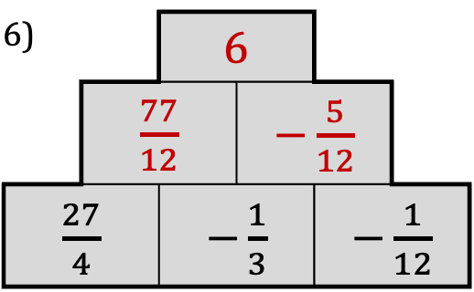
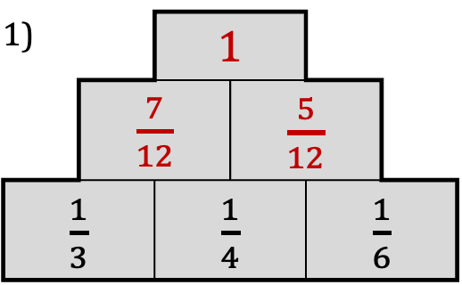
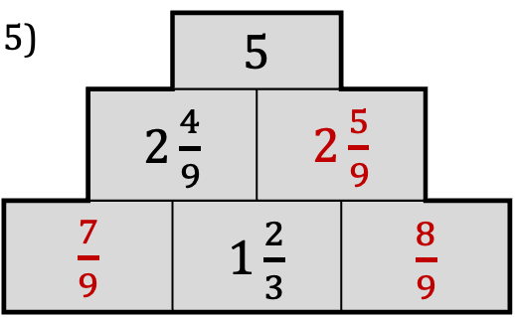
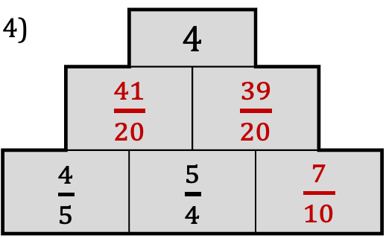
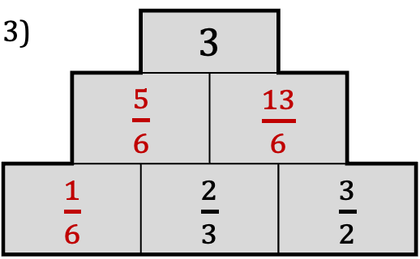
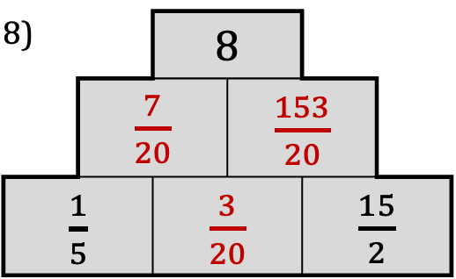
Addition Pyramids 4: Solutions
1) |  | 1
 | $\frac{7}{12}$ |  | $\frac{5}{12}$
$\frac{1}{3}$ |  | $\frac{1}{4}$ |  | $\frac{1}{6}$
2) |  | 2
 | $\frac{17}{20}$ |  | $\frac{23}{20}$
$\frac{3}{5}$ |  | $\frac{1}{4}$ |  | $\frac{9}{10}$
3) |  | 3
 | $\frac{5}{6}$ |  | $\frac{13}{6}$
$\frac{1}{6}$ |  | $\frac{2}{3}$ |  | $\frac{3}{2}$
4) |  | 4
 | $\frac{41}{20}$ |  | $\frac{39}{20}$
$\frac{4}{5}$ |  | $\frac{5}{4}$ |  | $\frac{7}{10}$
5) |  | 5
 | $2\frac{4}{9}$ |  | $2\frac{5}{9}$
$\frac{7}{9}$ |  | $1\frac{2}{3}$ |  | $\frac{8}{9}$
6) |  | 6
 | $\frac{77}{12}$ |  | $−\frac{5}{12}$
$\frac{27}{4}$ |  | $−\frac{1}{3}$ |  | $−\frac{1}{12}$
7) |  | 7
 | $\frac{61}{20}$ |  | $\frac{79}{20}$
$−\frac{1}{5}$ |  | $3.25$ |  | $\frac{7}{10}$
8) |  | 8
 | $\frac{7}{20}$ |  | $\frac{153}{20}$
$\frac{1}{5}$ |  | $\frac{3}{20}$ |  | $\frac{15}{2}$
9) |  | 9

Slide 9
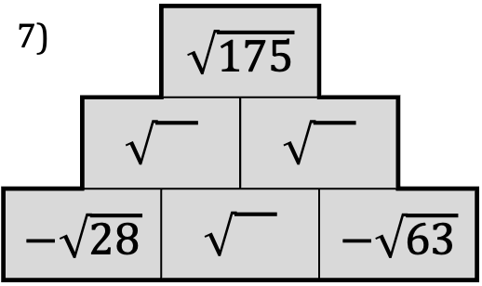
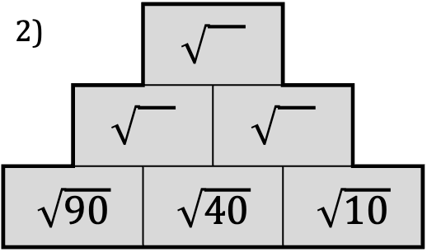
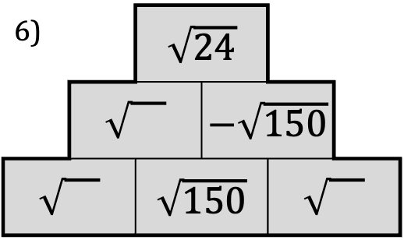
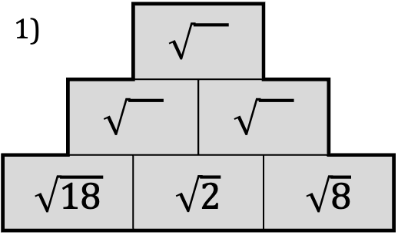
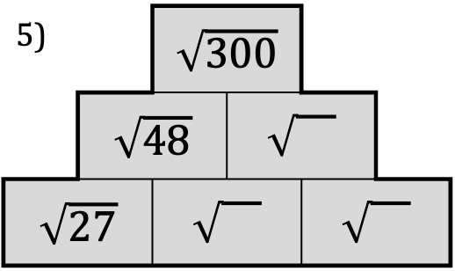
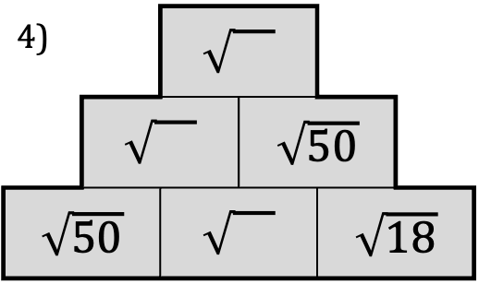
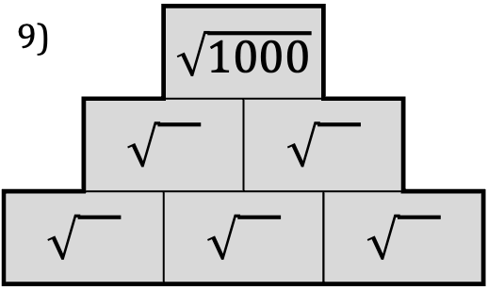
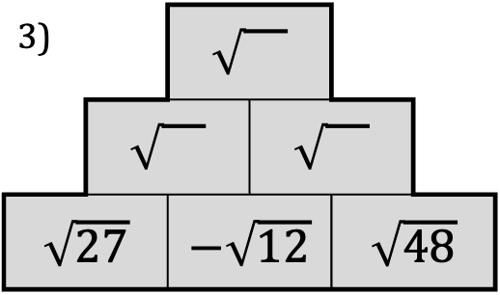
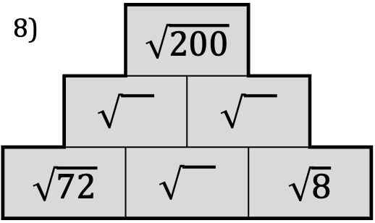
Addition Pyramids 6: Surds
1)
$\sqrt{18}$ |  | $\sqrt{2}$ |  | $\sqrt{8}$
2)
$\sqrt{90}$ |  | $\sqrt{40}$ |  | $\sqrt{10}$
3)
$\sqrt{27}$ |  | $−\sqrt{12}$ |  | $\sqrt{48}$
4)
 |  |  | $\sqrt{50}$
$\sqrt{50}$ |  |  |  | $\sqrt{18}$
5) |  | $\sqrt{300}$
 | $\sqrt{48}$
$\sqrt{27}$
6) |  | $\sqrt{24}$
 |  |  | $−\sqrt{150}$
 |  | $\sqrt{150}$
7) |  | $\sqrt{175}$
$−\sqrt{28}$ |  |  |  | $−\sqrt{63}$
8) |  | $\sqrt{200}$
$\sqrt{72}$ |  |  |  | $\sqrt{8}$
9) |  | $\sqrt{1000}$

Slide 10
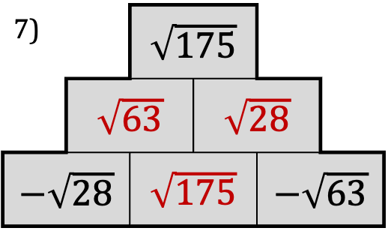
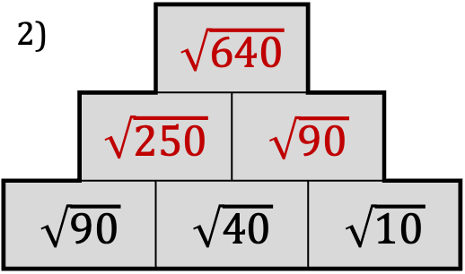
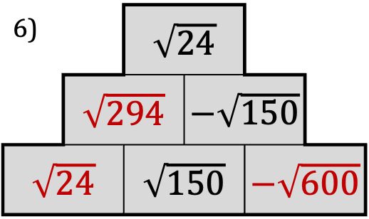
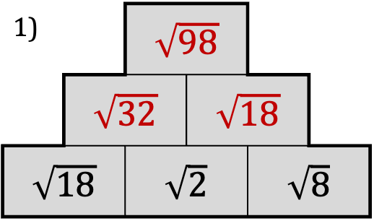
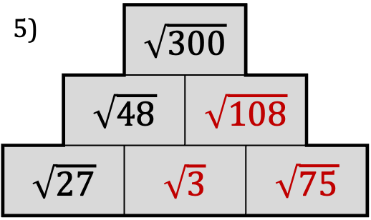
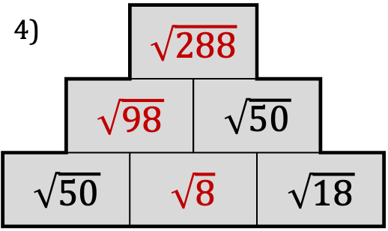
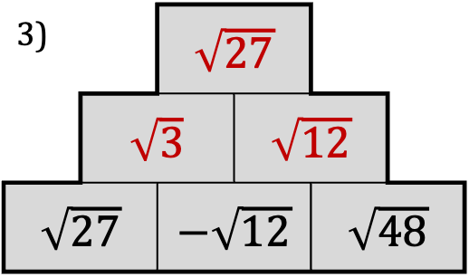
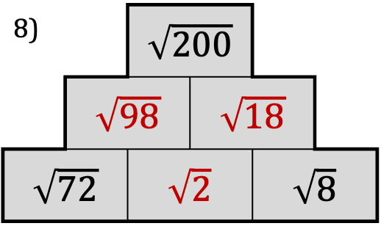
Addition Pyramids 6: Solutions
1) |  | $\sqrt{98}$
 | $\sqrt{32}$ |  | $\sqrt{18}$
$\sqrt{18}$ |  | $\sqrt{2}$ |  | $\sqrt{8}$
2) |  | $\sqrt{640}$
 | $\sqrt{250}$ |  | $\sqrt{90}$
$\sqrt{90}$ |  | $\sqrt{40}$ |  | $\sqrt{10}$
3) |  | $\sqrt{27}$
 | $\sqrt{3}$ |  | $\sqrt{12}$
$\sqrt{27}$ |  | $−\sqrt{12}$ |  | $\sqrt{48}$
4) |  | $\sqrt{288}$
 | $\sqrt{98}$ |  | $\sqrt{50}$
$\sqrt{50}$ |  | $\sqrt{8}$ |  | $\sqrt{18}$
5) |  | $\sqrt{300}$
 | $\sqrt{48}$ |  | $\sqrt{108}$
$\sqrt{27}$ |  | $\sqrt{3}$ |  | $\sqrt{75}$
6) |  | $\sqrt{24}$
 | $\sqrt{294}$ |  | $−\sqrt{150}$
$\sqrt{24}$ |  | $\sqrt{150}$ |  | $−\sqrt{600}$
7) |  | $\sqrt{175}$
 | $\sqrt{63}$ |  | $\sqrt{28}$
$−\sqrt{28}$ |  | $\sqrt{175}$ |  | $−\sqrt{63}$
8) |  | $\sqrt{200}$
 | $\sqrt{98}$ |  | $\sqrt{18}$
$\sqrt{72}$ |  | $\sqrt{2}$ |  | $\sqrt{8}$
9) |  | $\sqrt{1000}$

Slide 11
Addition Pyramids 10: Solutions
1) |  |  | 24
 |  | 13 |  | 11
 | 6 |  | 7 |  | 4
1 |  | 5 |  | 2 |  | 2
2) |  |  | 24
 |  | 11 |  | 13
 | 7 |  | 4 |  | 9
4 |  | 3 |  | 1 |  | 8
3) |  |  | 24
 |  | 14 |  | 10
 | 7 |  | 7 |  | 3
1 |  | 6 |  | 1 |  | 2
4) |  |  | 24
 |  | 5 |  | 19
 | 1 |  | 4 |  | 15
-5 |  | 6 |  | -2 |  | 17
5) |  |  | 24
 |  | -1 |  | 25
 | -9 |  | 8 |  | 17
-11 |  | 2 |  | 6 |  | 11
6) |  |  | 24
 |  | 1 |  | 23
 | -9 |  | 10 |  | 13
-4 |  | -5 |  | 15 |  | -2
7) |  |  | 24
 |  | 10.2 |  | 13.8
 | 4.2 |  | 6 |  | 7.8
1.2 |  | 3 |  | 3 |  | 4.8
8) |  |  | 24
 |  | 13.25 |  | 10.75
 | 7.25 |  | 6 |  | 4.75
5.25 |  | 2 |  | 4 |  | 0.75
9) |  |  | 24
 |  | 8.8 |  | 15.2
 | -0.2 |  | 9 |  | 6.2
-1.2 |  | 1 |  | 8 |  | -1.8

Slide 12
Addition Pyramids: Generalising 1
1 |  | 1 |  | 1 |  | 1 |  | 1
1 |  | 1
1 |  | 1 |  | 1
1 |  | 1 |  | 1 |  | 1
Predict:
1 |  | 1 |  | 1 |  | 1 |  | 1 |  | 1
1 |  | 1 |  | 1 |  | 1 |  | 1 |  | 2

Slide 13
Addition Pyramids: Generalising 2
 |  |  |  | 81
 |  |  | 27
 |  | 9
 | 3
1
 | 3
1
 |  | 9
 | 3
1
 |  |  | 27
 |  | 9
 | 3
1
Predict:
 |  |  |  |  | 243
 |  |  |  | 81
 |  |  | 27
 |  | 9
 | 3
1
 |  |  |  |  | 1024
 |  |  |  | 256
 |  |  | 64
 |  | 16
 | 4
1

Slide 14
Addition Pyramids: Generalising 3
 |  |  |  | 1
 |  |  | 2
 |  | 4
 | 8
16
 | 1
2
 |  | 1
 | 2
4
 |  |  | 1
 |  | 2
 | 4
8
Predict:
 |  |  |  |  | 1
 |  |  |  | 2
 |  |  | 4
 |  | 8
 | 16
32
 |  |  |  |  | 1
 |  |  |  |  |  | 2
 |  |  |  |  | 4
 |  |  |  | 8
 |  |  | 16
 |  | 32

Slide 15
Addition Pyramids: Generalising 4
0 |  | 1 |  | 0 |  | 0 |  | 0
0 |  | 1
0 |  | 1 |  | 0
0 |  | 1 |  | 0 |  | 0
Predict:
0 |  | 1 |  | 0 |  | 0 |  | 0 |  | 0
1 |  | 1 |  | 0 |  | 0 |  | 0 |  | 0

