Slide 1
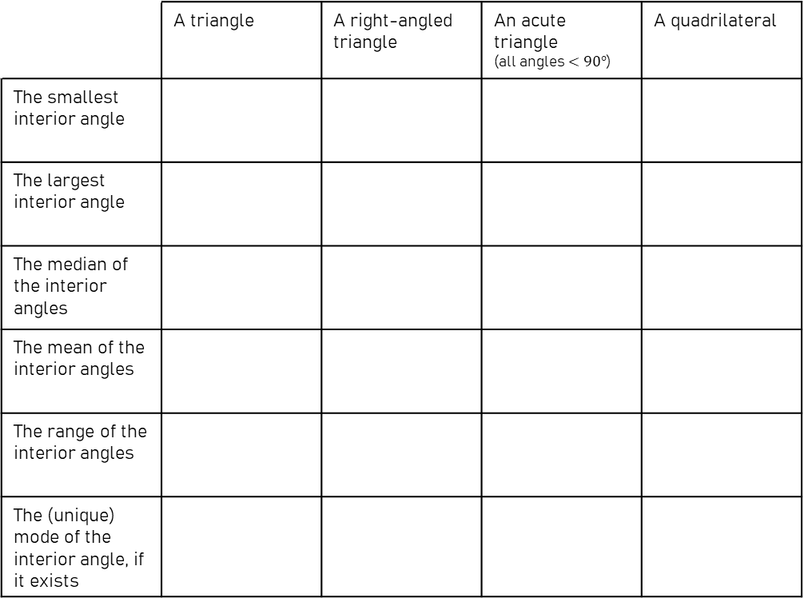

Angles in a Triangle - Inequalities
Warm Up
What’s the largest size the smallest interior angle of a triangle can be?
Draw a triangle where the smallest interior angle is that size.
What’s the smallest size the smallest interior angle can be?
Can we draw a triangle with an angle that small?
If $x$ is the size of the smallest interior angle of a triangle, how can we use our answers to (1) and (2) to create an inequality for $x$?
(Be careful when choosing between $<$ and $≤.)$
How about if the triangle must have a right angle?
How does that affect your answers to questions (1)-(3)?
The Task
Using a similar thought process, complete the table below, writing an inequality in each box.
5) Now complete the same table for exterior angles instead of interior angles.
Can you use your original table to help you?
6) What do you notice about the range of the interior angles and range of the exterior angles in any triangle?
 | A triangle | A right-angled triangle | An acute triangle (all angles $<90°$) | A quadrilateral
The smallest interior angle | $$0°<x≤60°$$ | $$0°<x≤45°$$ | $$0°<x≤60°$$ | $$0°<x≤90°$$
The largest interior angle | $$60°≤x<180°$$ | $$x=90°$$ | $$60°≤x<90°$$ | $$90°≤x<360°$$
The median of the interior angles | $$0°<x<90°$$ | $$45°≤x<90°$$ | $$45°<x<90°$$ | $$0°<x<120°$$
The mean of the interior angles | $$x=60°$$ | $$x=60°$$ | $$x=60°$$ | $$x=90°$$
The range of the interior angles | $$0°≤x<180°$$ | $$45°≤x<90°$$ | $$0°≤x<90°$$ | $$0°≤x<360°$$
The (unique) mode of the interior angle, if it exists | $$0°<x<90°$$ | $$x=45°$$ | $$45°<x<90°$$ | $$0°<x<180°$$

Slide 2
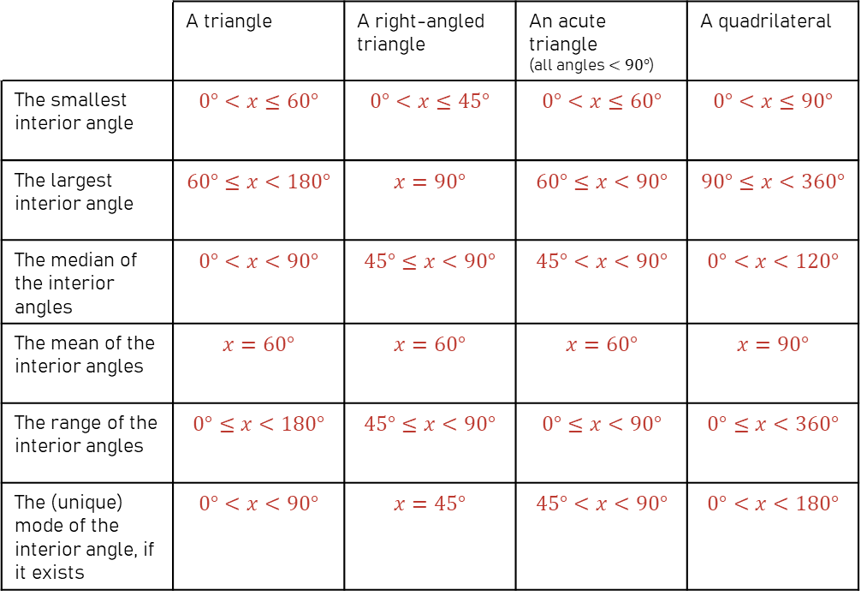

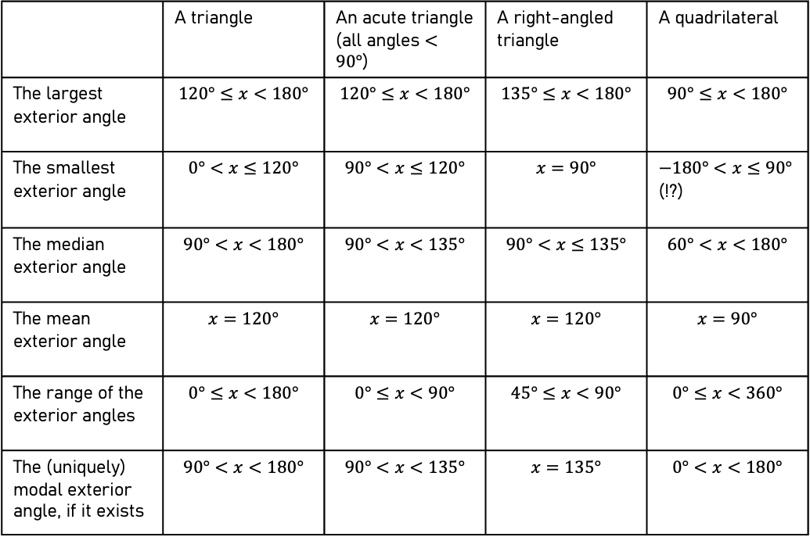
Angles in a Triangle – Inequalities - Answers
Warm Up
What’s the largest size the smallest interior angle of a triangle can be? $60°$
Draw a triangle where the smallest interior angle is that size. An equilateral triangle
What’s the smallest size the smallest interior angle can be? $0°$
Can we draw a triangle with an angle that small?
No, the smallest angle can be as close to $0°$ as we like, but never equal to $0°$.
If $x$ is the size of the smallest interior angle of a triangle, how can we use our answers to (1) and (2) to create an inequality for $x$? $0°<x≤60°$
(Be careful when choosing between $<$ and $≤.)$
How about if the triangle must have a right angle?
How does that affect your answers to questions (1)-(3)?
  $0°<x<45°$, as the other two angles together must sum to $90°$.
The Task
Using a similar thought process, complete the table below, writing an inequality in each box.
5) Now complete the same table for exterior angles instead of interior angles.
Can you use your original table to help you?
6) What do you notice about the range of the interior angles and range of the exterior angles in any triangle?
 | A triangle | A right-angled triangle | An acute triangle (all angles $<90°$) | A quadrilateral
The smallest interior angle | $$0°<x≤60°$$ | $$0°<x≤45°$$ | $$0°<x≤60°$$ | $$0°<x≤90°$$
The largest interior angle | $$60°≤x<180°$$ | $$x=90°$$ | $$60°≤x<90°$$ | $$90°≤x<360°$$
The median of the interior angles | $$0°<x<90°$$ | $$45°≤x<90°$$ | $$45°<x<90°$$ | $$0°<x<120°$$
The mean of the interior angles | $$x=60°$$ | $$x=60°$$ | $$x=60°$$ | $$x=90°$$
The range of the interior angles | $$0°≤x<180°$$ | $$45°≤x<90°$$ | $$0°≤x<90°$$ | $$0°≤x<360°$$
The (unique) mode of the interior angle, if it exists | $$0°<x<90°$$ | $$x=45°$$ | $$45°<x<90°$$ | $$0°<x<180°$$
 | A triangle | An acute triangle (all angles $<90°$) | A right-angled triangle | A quadrilateral
The largest exterior angle | $$120°≤x<180°$$ | $$120°≤x<180°$$ | $$135°≤x<180°$$ | $$90°≤x<180°$$
The smallest exterior angle | $$0°<x≤120°$$ | $$90°<x≤120°$$ | $$x=90°$$ | $−180°<x≤90°$ (!?)
The median exterior angle | $$90°<x<180°$$ | $$90°<x<135°$$ | $$90°<x≤135°$$ | $$60°<x<180°$$
The mean exterior angle | $$x=120°$$ | $$x=120°$$ | $$x=120°$$ | $$x=90°$$
The range of the exterior angles | $$0°≤x<180°$$ | $$0°≤x<90°$$ | $$45°≤x<90°$$ | $$0°≤x<360°$$
The (uniquely) modal exterior angle, if it exists | $$90°<x<180°$$ | $$90°<x<135°$$ | $$x=135°$$ | $$0°<x<180°$$

