Slide 1

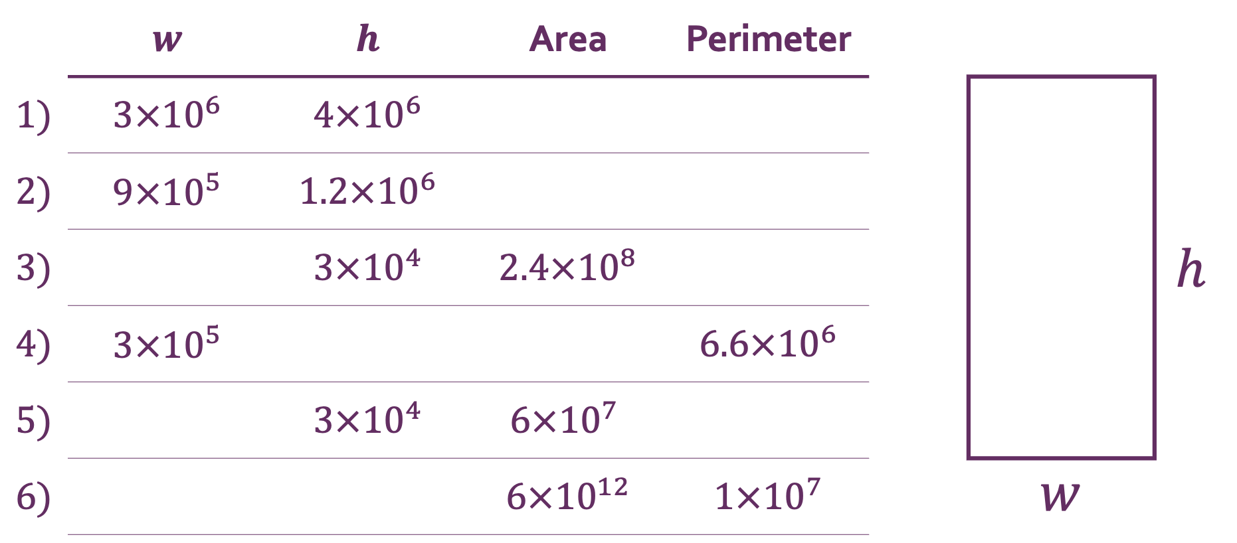
InterwovenMaths.com
Standard Form
Area and Perimeter with…
Fill in the gaps, giving all answers in standard form.
 | $w$ | $h$ | Area | Perimeter
1) | $3×{10}^{6}$ | $4×{10}^{6}$
2) | $9×{10}^{5}$ | $1.2×{10}^{6}$
3) |  | $3×{10}^{4}$ | $2.4×{10}^{8}$ |  |  |  | $h$
4) | $3×{10}^{5}$ |  |  | $6.6×{10}^{6}$
5) |  | $3×{10}^{4}$ | $$6×{10}^{7}$$
6) |  |  | $6×{10}^{12}$ | $1×{10}^{7}$ |  | $w$
@Jshmtn

Slide 2
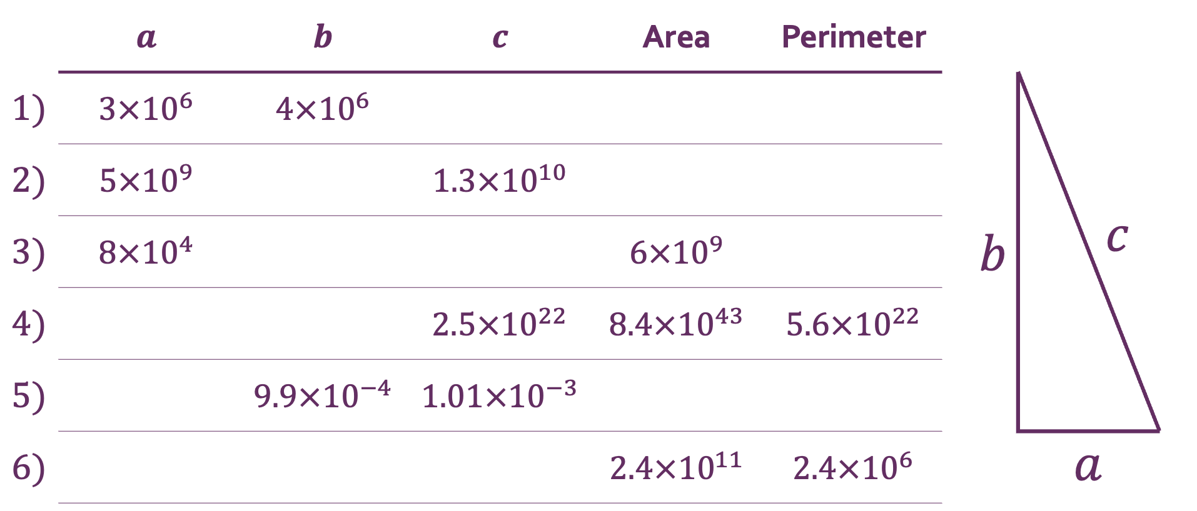
InterwovenMaths.com
Standard Form
Area, Perimeter, and Pythagoras with…
Fill in the gaps, giving all answers in standard form.
 | $a$ | $b$ | $c$ | Area | Perimeter
1) | $3×{10}^{6}$ | $4×{10}^{6}$ |  |  |  |  | $c$
2) | $5×{10}^{9}$ |  | $1.3×{10}^{10}$
3) | $8×{10}^{4}$ |  |  | $6×{10}^{9}$ |  | $b$
4) |  |  | $2.5×{10}^{22}$ | $8.4×{10}^{43}$ | $5.6×{10}^{22}$
5) |  | $9.9×{10}^{−4}$ | $1.01×{10}^{−3}$
6) |  |  |  | $2.4×{10}^{11}$ | $2.4×{10}^{6}$ |  | $a$
@nathanday314

Slide 3
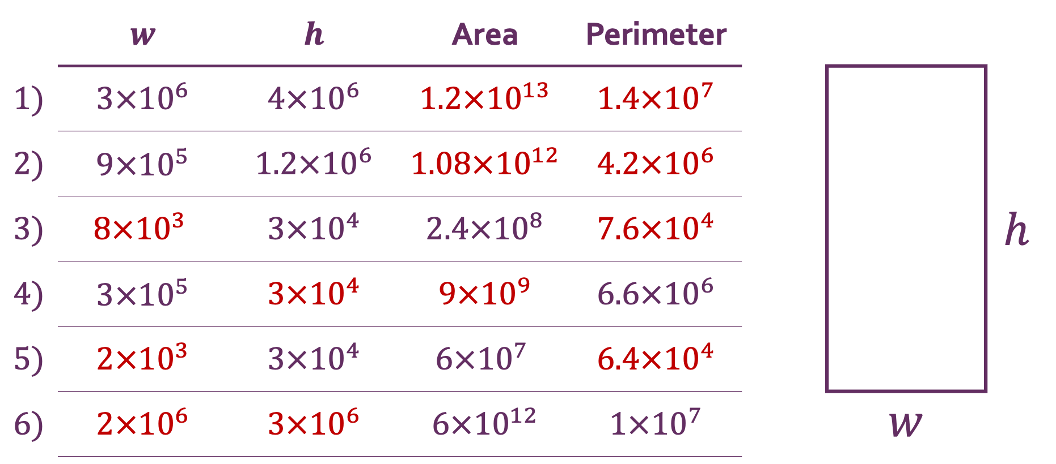
InterwovenMaths.com
Standard Form
Solutions
Area and Perimeter with…
 | $w$ | $h$ | Area | Perimeter
1) | $3×{10}^{6}$ | $4×{10}^{6}$ | $1.2×{10}^{13}$ | $1.4×{10}^{7}$
2) | $9×{10}^{5}$ | $1.2×{10}^{6}$ | $1.08×{10}^{12}$ | $4.2×{10}^{6}$
3) | $$8×{10}^{3}$$ | $3×{10}^{4}$ | $2.4×{10}^{8}$ | $7.6×{10}^{4}$ |  |  | $h$
4) | $3×{10}^{5}$ | $3×{10}^{4}$ | $9×{10}^{9}$ | $6.6×{10}^{6}$
5) | $2×{10}^{3}$ | $3×{10}^{4}$ | $$6×{10}^{7}$$ | $6.4×{10}^{4}$
6) | $2×{10}^{6}$ | $3×{10}^{6}$ | $6×{10}^{12}$ | $1×{10}^{7}$ |  | $w$
@Jshmtn

Slide 4
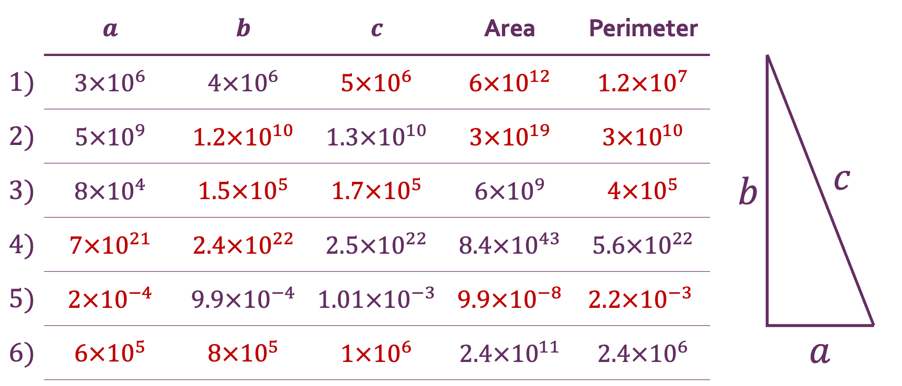
InterwovenMaths.com
Standard Form
Area, Perimeter, and Pythagoras with…
Solutions
 | $a$ | $b$ | $c$ | Area | Perimeter
1) | $3×{10}^{6}$ | $4×{10}^{6}$ | $5×{10}^{6}$ | $6×{10}^{12}$ | $1.2×{10}^{7}$ |  | $c$
2) | $5×{10}^{9}$ | $1.2×{10}^{10}$ | $1.3×{10}^{10}$ | $3×{10}^{19}$ | $3×{10}^{10}$
3) | $8×{10}^{4}$ | $1.5×{10}^{5}$ | $1.7×{10}^{5}$ | $6×{10}^{9}$ | $4×{10}^{5}$ | $b$
4) | $7×{10}^{21}$ | $2.4×{10}^{22}$ | $2.5×{10}^{22}$ | $8.4×{10}^{43}$ | $5.6×{10}^{22}$
5) | $2×{10}^{−4}$ | $9.9×{10}^{−4}$ | $1.01×{10}^{−3}$ | $9.9×{10}^{−8}$ | $$2.2×{10}^{−3}$$
6) | $6×{10}^{5}$ | $8×{10}^{5}$ | $1×{10}^{6}$ | $2.4×{10}^{11}$ | $2.4×{10}^{6}$ |  | $a$
@nathanday314

