Slide 1
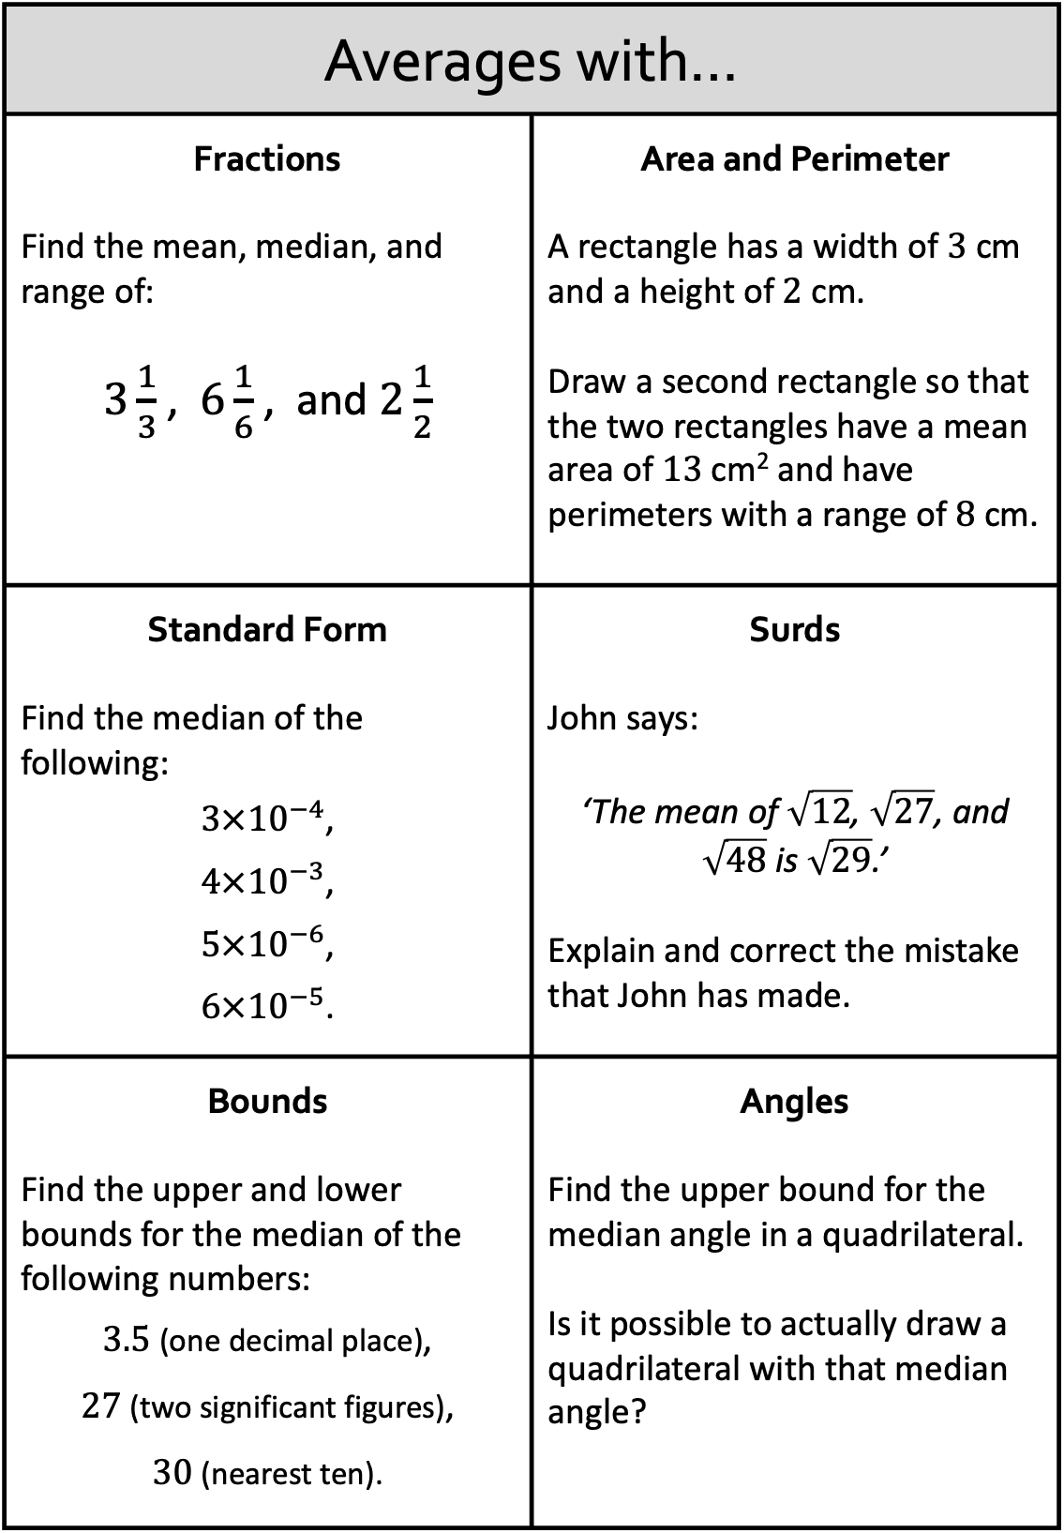
Averages with…
Fractions Find the mean, median, and range of: $3\frac{1}{3}$ , $6\frac{1}{6}$ , and $2\frac{1}{2}$ | Area and Perimeter A rectangle has a width of $3$ cm and a height of $2$ cm. Draw a second rectangle so that the two rectangles have a mean area of 13 cm² and have perimeters with a range of 8 cm.
Standard Form Find the median of the following: $3×{10}^{−4}$, $4×{10}^{−3}$, $5×{10}^{−6}$, $6×{10}^{−5}$. | Surds John says: ‘The mean of $\sqrt{12}$, $\sqrt{27}$, and $\sqrt{48}$ is $\sqrt{29}$.’ Explain and correct the mistake that John has made.
Bounds Find the upper and lower bounds for the median of the following numbers: $3.5$ (one decimal place), $27$ (two significant figures), $30$ (nearest ten). | Angles Find the upper bound for the median angle in a quadrilateral. Is it possible to actually draw a quadrilateral with that median angle?

Slide 2
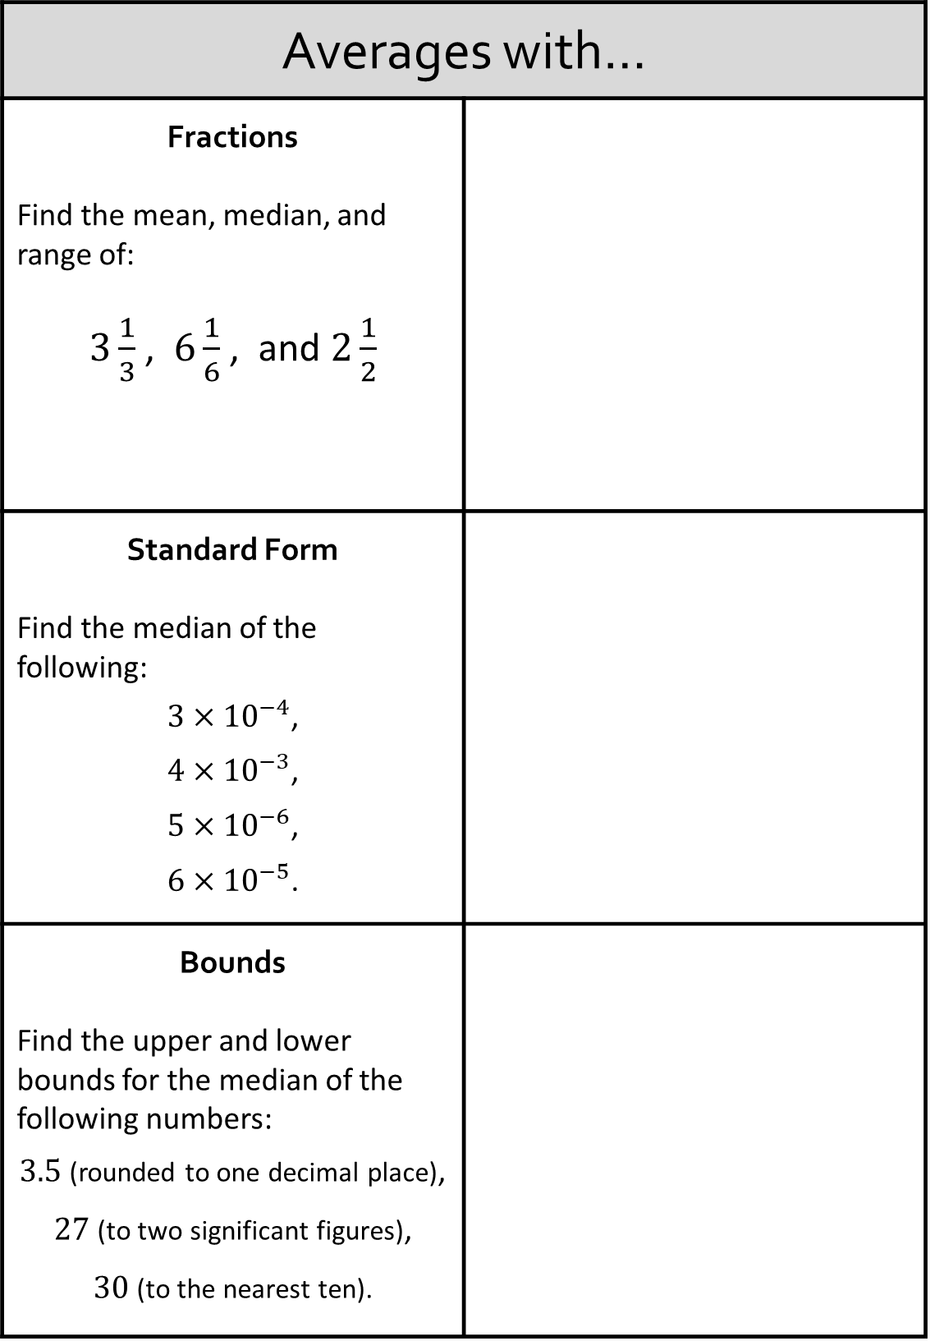
Averages with…
Fractions Find the mean, median, and range of: $3\frac{1}{3}$ , $6\frac{1}{6}$ , and $2\frac{1}{2}$
Standard Form Find the median of the following: $3×{10}^{−4}$, $4×{10}^{−3}$, $5×{10}^{−6}$, $6×{10}^{−5}$.
Bounds Find the upper and lower bounds for the median of the following numbers: $3.5$ (rounded to one decimal place), $27$ (to two significant figures), $30$ (to the nearest ten).

Slide 3
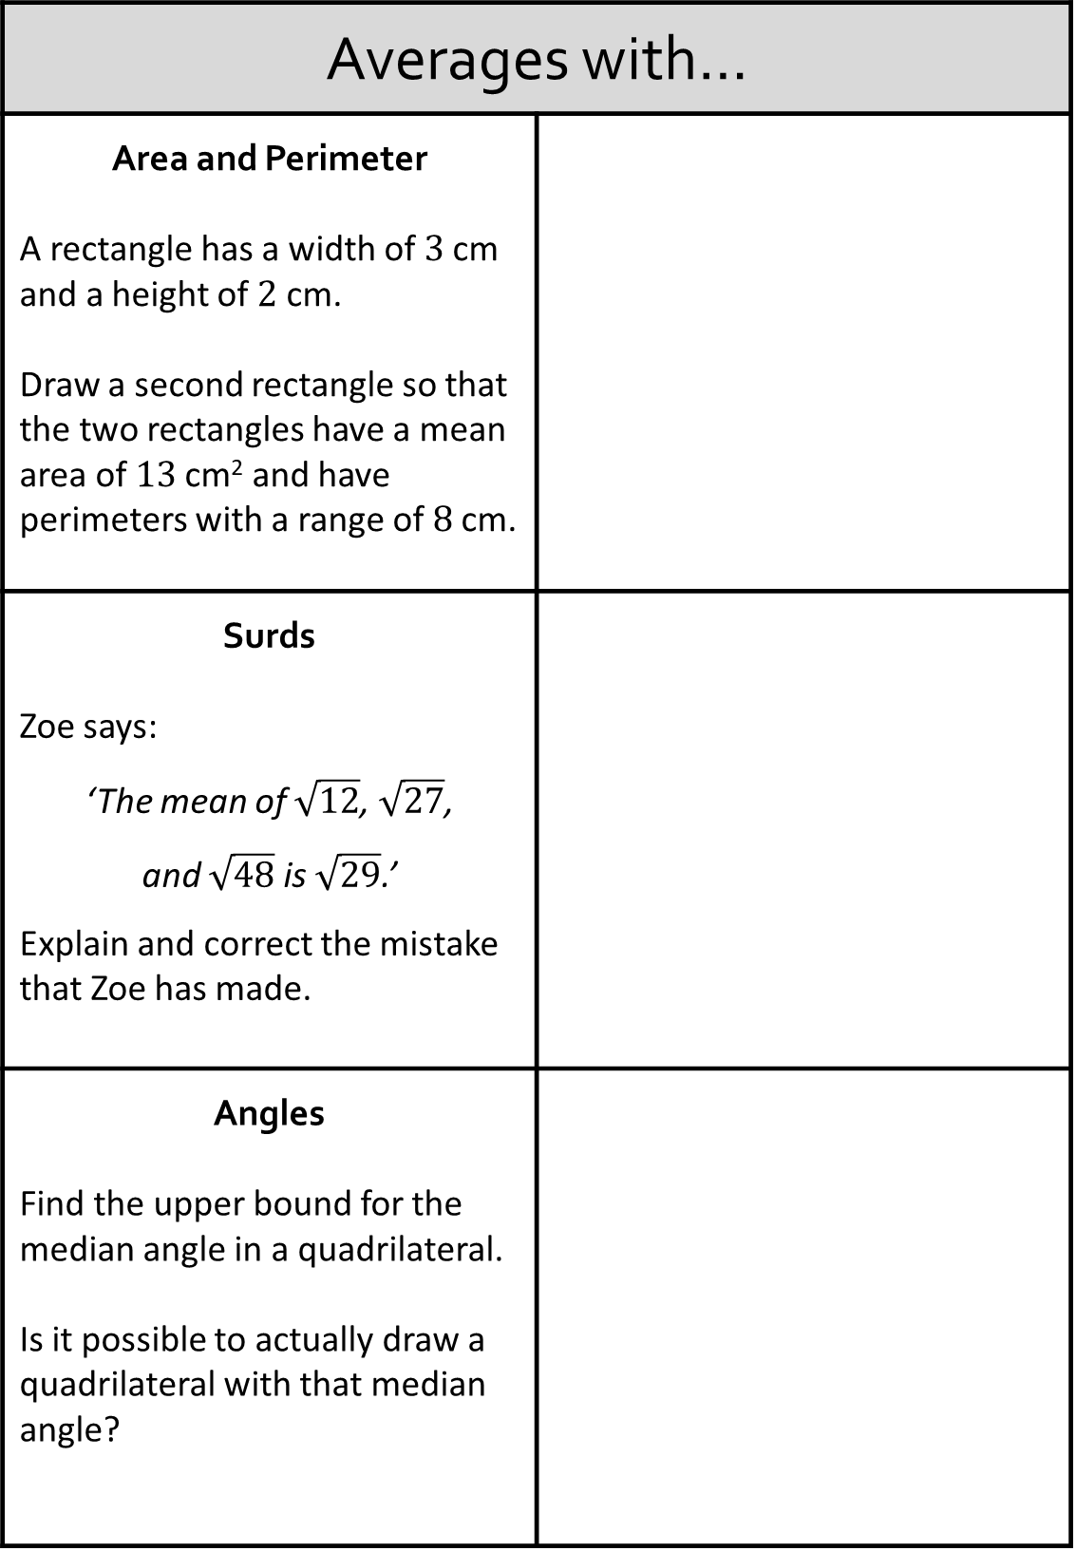
Averages with…
Area and Perimeter A rectangle has a width of $3$ cm and a height of $2$ cm. Draw a second rectangle so that the two rectangles have a mean area of 13 cm² and have perimeters with a range of 8 cm.
Surds Zoe says: ‘The mean of $\sqrt{12}$, $\sqrt{27}$, and $\sqrt{48}$ is $\sqrt{29}$.’ Explain and correct the mistake that Zoe has made.
Angles Find the upper bound for the median angle in a quadrilateral. Is it possible to actually draw a quadrilateral with that median angle?

Slide 4
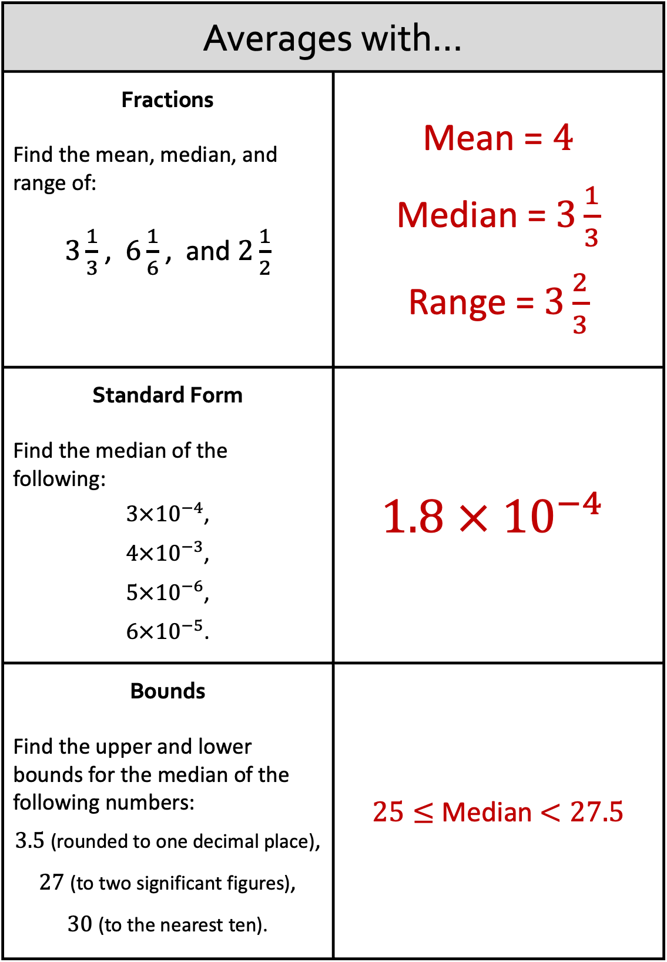
Averages with…
Fractions Find the mean, median, and range of: $3\frac{1}{3}$ , $6\frac{1}{6}$ , and $2\frac{1}{2}$ | Mean = $4$ Median = $3\frac{1}{3}$ Range = $3\frac{2}{3}$
Standard Form Find the median of the following: $3×{10}^{−4}$, $4×{10}^{−3}$, $5×{10}^{−6}$, $6×{10}^{−5}$. | $$1.8 × {10}^{−4}$$
Bounds Find the upper and lower bounds for the median of the following numbers: $3.5$ (rounded to one decimal place), $27$ (to two significant figures), $30$ (to the nearest ten). | $25≤$ Median $<27.5$

Slide 5
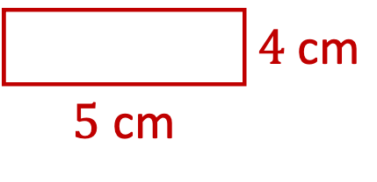
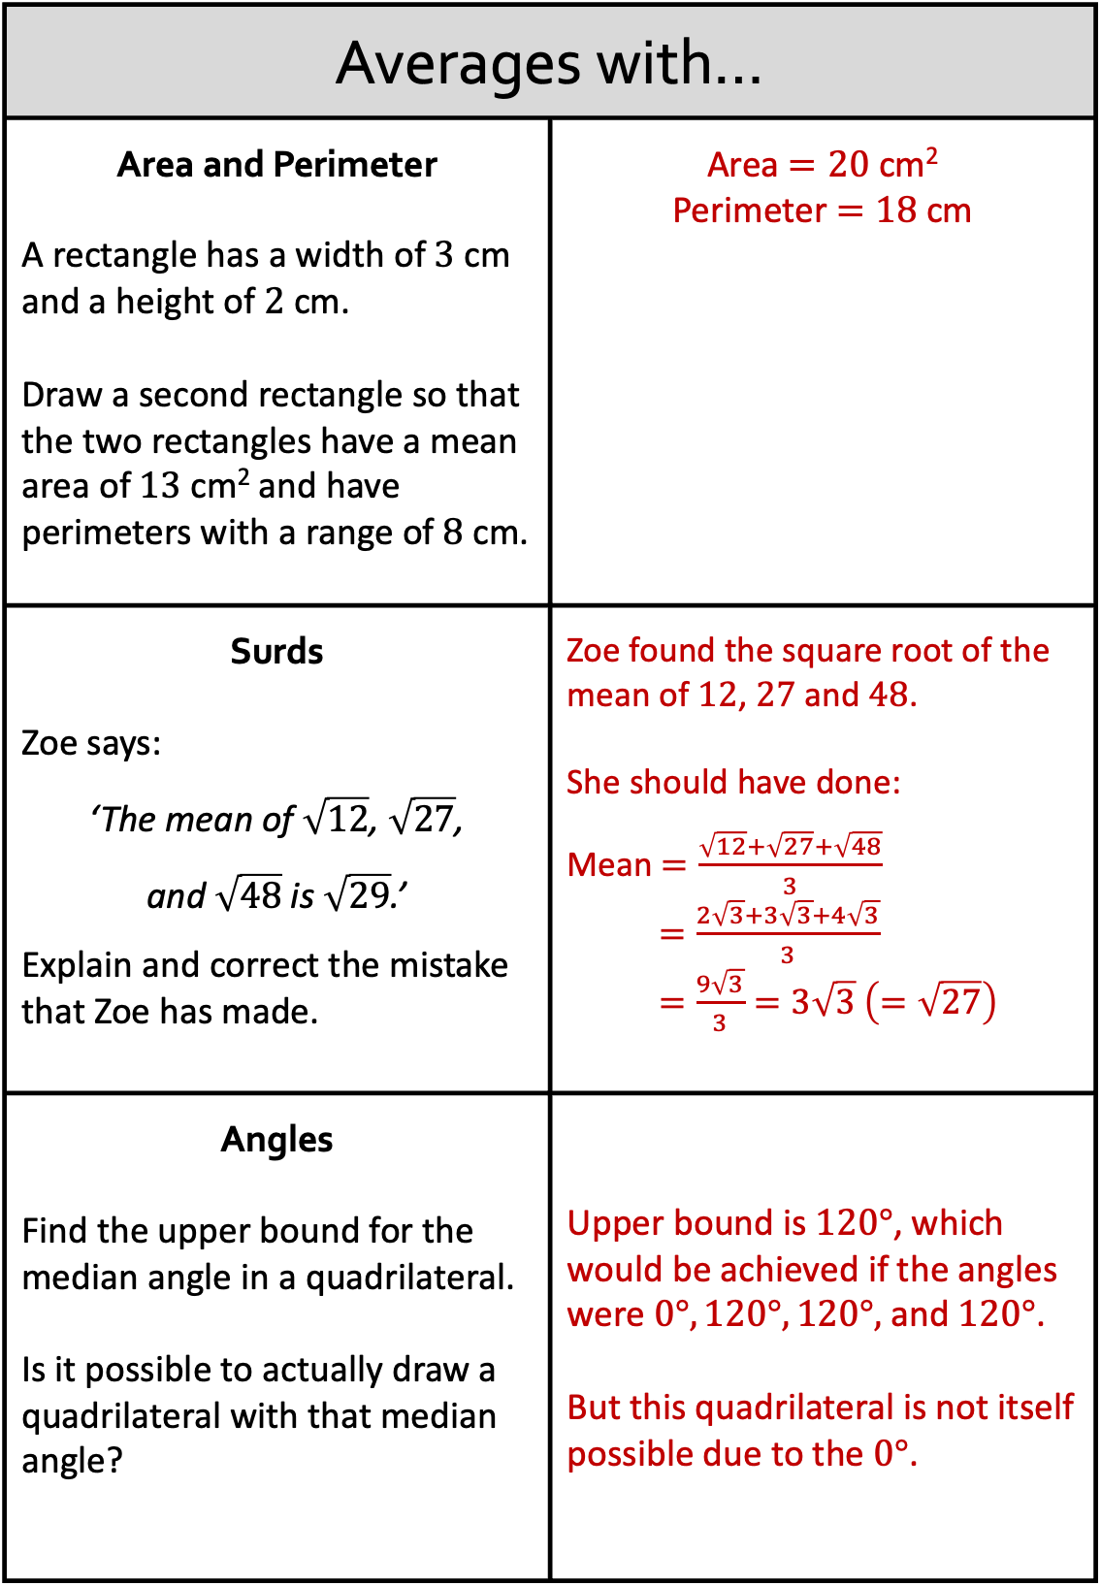
Averages with…
Area and Perimeter A rectangle has a width of $3$ cm and a height of $2$ cm. Draw a second rectangle so that the two rectangles have a mean area of 13 cm² and have perimeters with a range of 8 cm. | Area $=20$ cm² Perimeter $=18$ cm
Surds Zoe says: ‘The mean of $\sqrt{12}$, $\sqrt{27}$, and $\sqrt{48}$ is $\sqrt{29}$.’ Explain and correct the mistake that Zoe has made. | Zoe found the square root of the mean of $12$, $27$ and $48$. She should have done: Mean $=\frac{\sqrt{12}+\sqrt{27}+\sqrt{48}}{3}$ $=\frac{2\sqrt{3}+3\sqrt{3}+4\sqrt{3}}{3}$ $=\frac{9\sqrt{3}}{3}=3\sqrt{3} \left(=\sqrt{27}\right)$
Angles Find the upper bound for the median angle in a quadrilateral. Is it possible to actually draw a quadrilateral with that median angle? | Upper bound is $120°$, which would be achieved if the angles were $0°, 120°, 120°,$ and $120°$. But this quadrilateral is not itself possible due to the $0°$.
 | $4$ cm
$5$ cm

