Slide 1
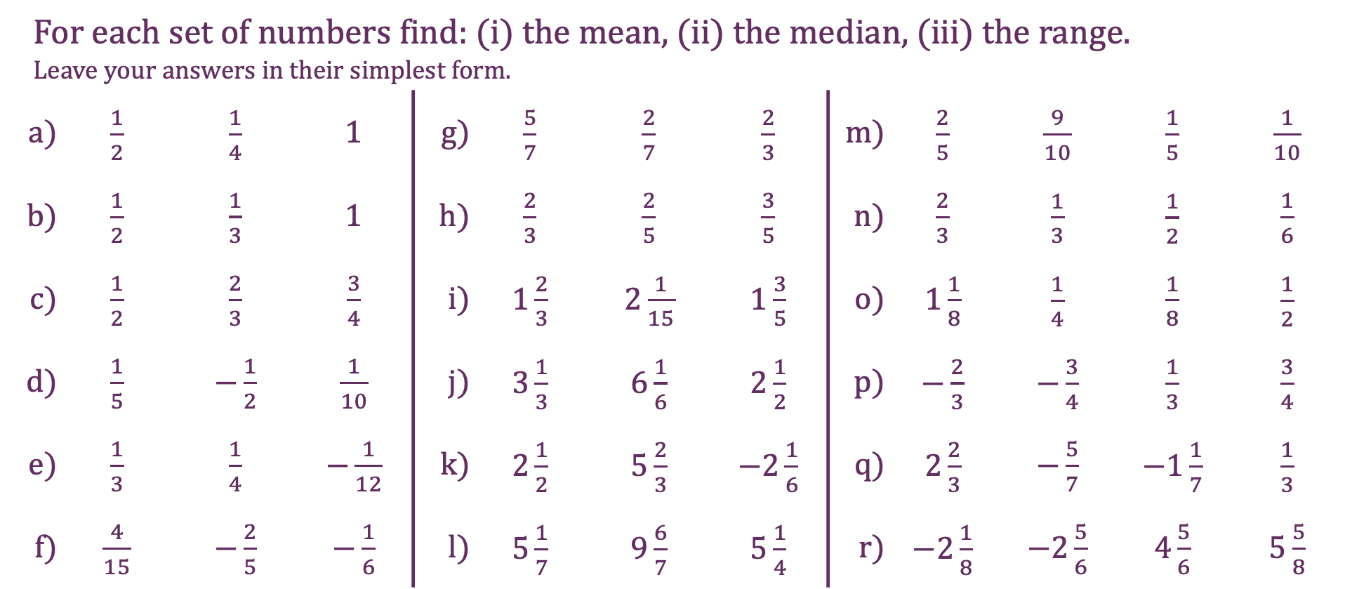
Fractions
For each set of numbers find: (i) the mean, (ii) the median, (iii) the range. Leave your answers in their simplest form.
a) | $\frac{1}{2}$ | $\frac{1}{4}$ | $1$ | g) | $\frac{5}{7}$ | $\frac{2}{7}$ | $\frac{2}{3}$ | m) | $\frac{2}{5}$ | $\frac{9}{10}$ | $\frac{1}{5}$ | $\frac{1}{10}$
b) | $\frac{1}{2}$ | $\frac{1}{3}$ | $1$ | h) | $\frac{2}{3}$ | $\frac{2}{5}$ | $\frac{3}{5}$ | n) | $\frac{2}{3}$ | $\frac{1}{3}$ | $\frac{1}{2}$ | $\frac{1}{6}$
c) | $\frac{1}{2}$ | $\frac{2}{3}$ | $\frac{3}{4}$ | i) | $1\frac{2}{3}$ | $2\frac{1}{15}$ | $1\frac{3}{5}$ | o) | $1\frac{1}{8}$ | $\frac{1}{4}$ | $\frac{1}{8}$ | $\frac{1}{2}$
d) | $\frac{1}{5}$ | $−\frac{1}{2}$ | $\frac{1}{10}$ | j) | $3\frac{1}{3}$ | $6\frac{1}{6}$ | $2\frac{1}{2}$ | p) | $−\frac{2}{3}$ | $−\frac{3}{4}$ | $\frac{1}{3}$ | $\frac{3}{4}$
e) | $\frac{1}{3}$ | $\frac{1}{4}$ | $−\frac{1}{12}$ | k) | $2\frac{1}{2}$ | $5\frac{2}{3}$ | $−2\frac{1}{6}$ | q) | $2\frac{2}{3}$ | $−\frac{5}{7}$ | $−1\frac{1}{7}$ | $\frac{1}{3}$
f) | $\frac{4}{15}$ | $−\frac{2}{5}$ | $−\frac{1}{6}$ | l) | $5\frac{1}{7}$ | $9\frac{6}{7}$ | $5\frac{1}{4}$ | r) | $−2\frac{1}{8}$ | $−2\frac{5}{6}$ | $4\frac{5}{6}$ | $5\frac{5}{8}$

Slide 2
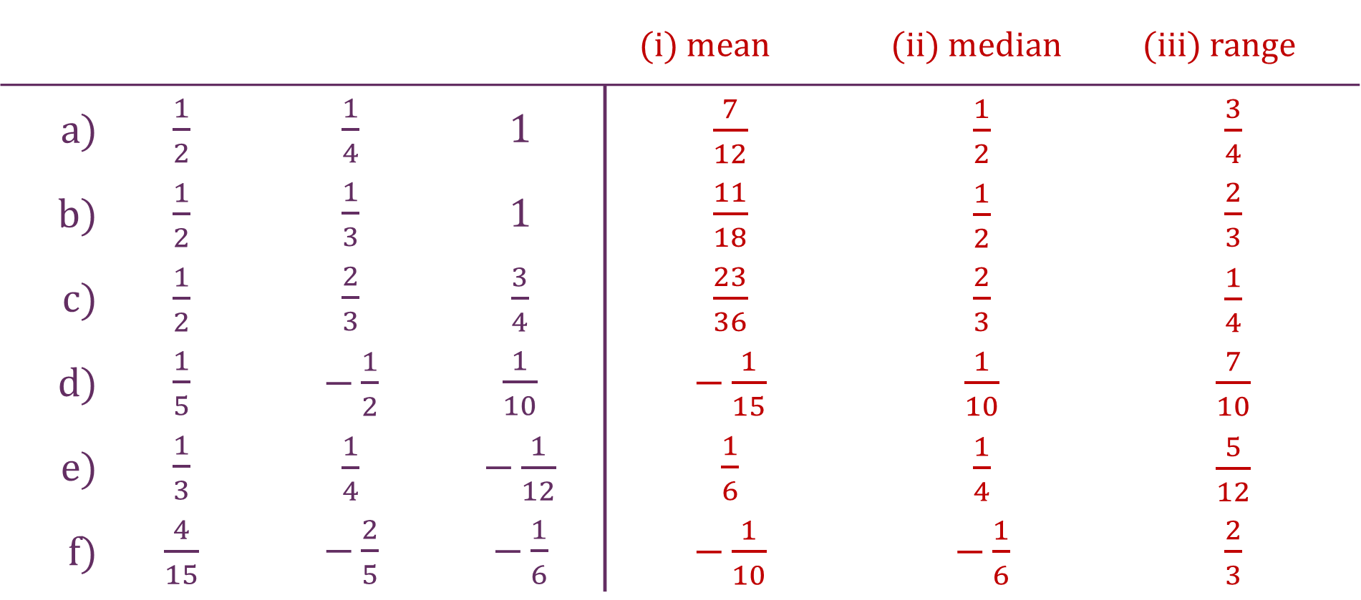
Fractions
 |  |  |  | (i) mean | (ii) median | (iii) range
a) | $\frac{1}{2}$ | $\frac{1}{4}$ | $1$ | $\frac{7}{12}$ | $\frac{1}{2}$ | $\frac{3}{4}$
b) | $\frac{1}{2}$ | $\frac{1}{3}$ | $1$ | $\frac{11}{18}$ | $\frac{1}{2}$ | $\frac{2}{3}$
c) | $\frac{1}{2}$ | $\frac{2}{3}$ | $\frac{3}{4}$ | $\frac{23}{36}$ | $\frac{2}{3}$ | $\frac{1}{4}$
d) | $\frac{1}{5}$ | $−\frac{1}{2}$ | $\frac{1}{10}$ | $−\frac{1}{15}$ | $\frac{1}{10}$ | $\frac{7}{10}$
e) | $\frac{1}{3}$ | $\frac{1}{4}$ | $−\frac{1}{12}$ | $\frac{1}{6}$ | $\frac{1}{4}$ | $\frac{5}{12}$
f) | $\frac{4}{15}$ | $−\frac{2}{5}$ | $−\frac{1}{6}$ | $−\frac{1}{10}$ | $−\frac{1}{6}$ | $\frac{2}{3}$

Slide 3
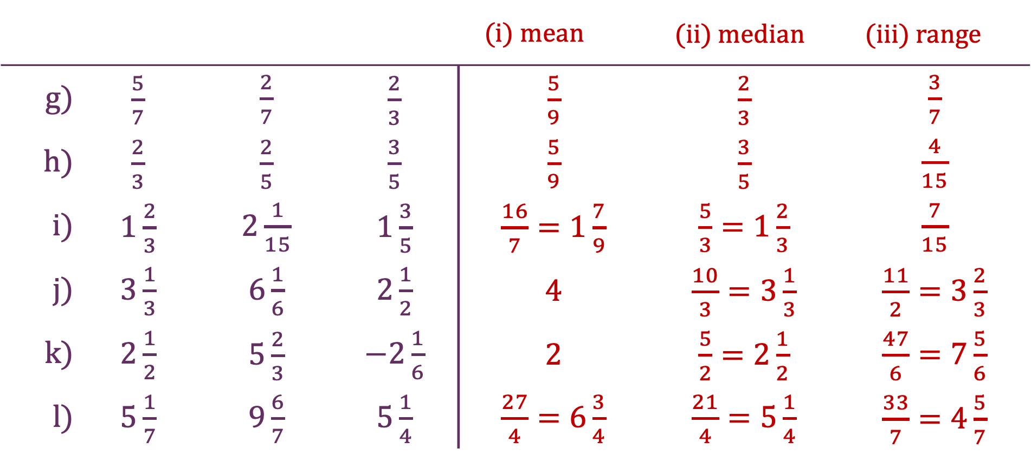
Fractions
 |  |  |  | (i) mean | (ii) median | (iii) range
g) | $\frac{5}{7}$ | $\frac{2}{7}$ | $\frac{2}{3}$ | $\frac{5}{9}$ | $\frac{2}{3}$ | $\frac{3}{7}$
h) | $\frac{2}{3}$ | $\frac{2}{5}$ | $\frac{3}{5}$ | $\frac{5}{9}$ | $\frac{3}{5}$ | $\frac{4}{15}$
i) | $1\frac{2}{3}$ | $2\frac{1}{15}$ | $1\frac{3}{5}$ | $\frac{16}{7}=1\frac{7}{9}$ | $\frac{5}{3}=1\frac{2}{3}$ | $\frac{7}{15}$
j) | $3\frac{1}{3}$ | $6\frac{1}{6}$ | $2\frac{1}{2}$ | $4$ | $\frac{10}{3}=3\frac{1}{3}$ | $\frac{11}{2}=3\frac{2}{3}$
k) | $2\frac{1}{2}$ | $5\frac{2}{3}$ | $−2\frac{1}{6}$ | $2$ | $\frac{5}{2}=2\frac{1}{2}$ | $\frac{47}{6}=7\frac{5}{6}$
l) | $5\frac{1}{7}$ | $9\frac{6}{7}$ | $5\frac{1}{4}$ | $\frac{27}{4}=6\frac{3}{4}$ | $\frac{21}{4}=5\frac{1}{4}$ | $\frac{33}{7}=4\frac{5}{7}$

Slide 4
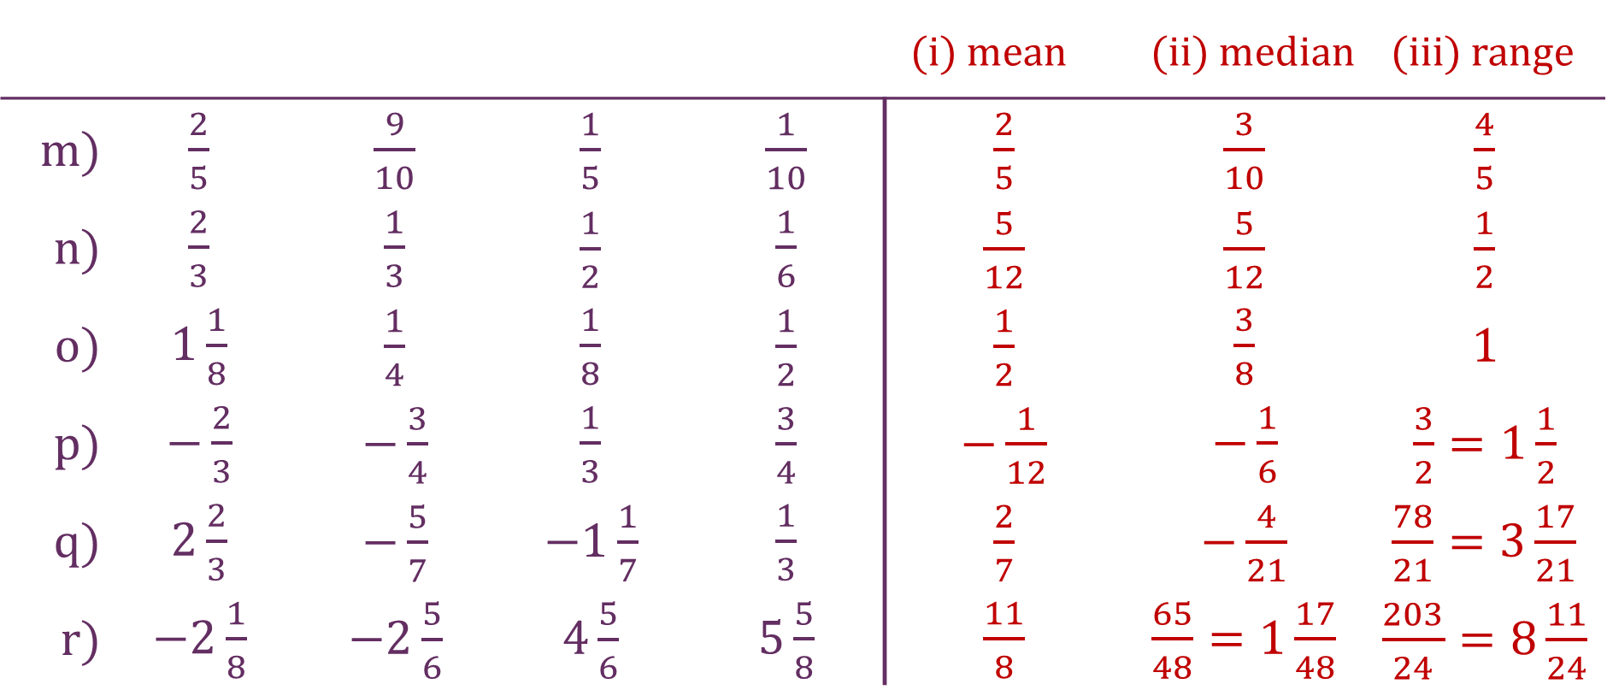
Fractions
 |  |  |  |  | (i) mean | (ii) median | (iii) range
m) | $\frac{2}{5}$ | $\frac{9}{10}$ | $\frac{1}{5}$ | $\frac{1}{10}$ | $\frac{2}{5}$ | $\frac{3}{10}$ | $\frac{4}{5}$
n) | $\frac{2}{3}$ | $\frac{1}{3}$ | $\frac{1}{2}$ | $\frac{1}{6}$ | $\frac{5}{12}$ | $\frac{5}{12}$ | $\frac{1}{2}$
o) | $1\frac{1}{8}$ | $\frac{1}{4}$ | $\frac{1}{8}$ | $\frac{1}{2}$ | $\frac{1}{2}$ | $\frac{3}{8}$ | $1$
p) | $−\frac{2}{3}$ | $−\frac{3}{4}$ | $\frac{1}{3}$ | $\frac{3}{4}$ | $−\frac{1}{12}$ | $−\frac{1}{6}$ | $\frac{3}{2}=1\frac{1}{2}$
q) | $2\frac{2}{3}$ | $−\frac{5}{7}$ | $−1\frac{1}{7}$ | $\frac{1}{3}$ | $\frac{2}{7}$ | $−\frac{4}{21}$ | $\frac{78}{21}=3\frac{17}{21}$
r) | $−2\frac{1}{8}$ | $−2\frac{5}{6}$ | $4\frac{5}{6}$ | $5\frac{5}{8}$ | $\frac{11}{8}$ | $\frac{65}{48}=1\frac{17}{48}$ | $\frac{203}{24}=8\frac{11}{24}$

