Slide 1
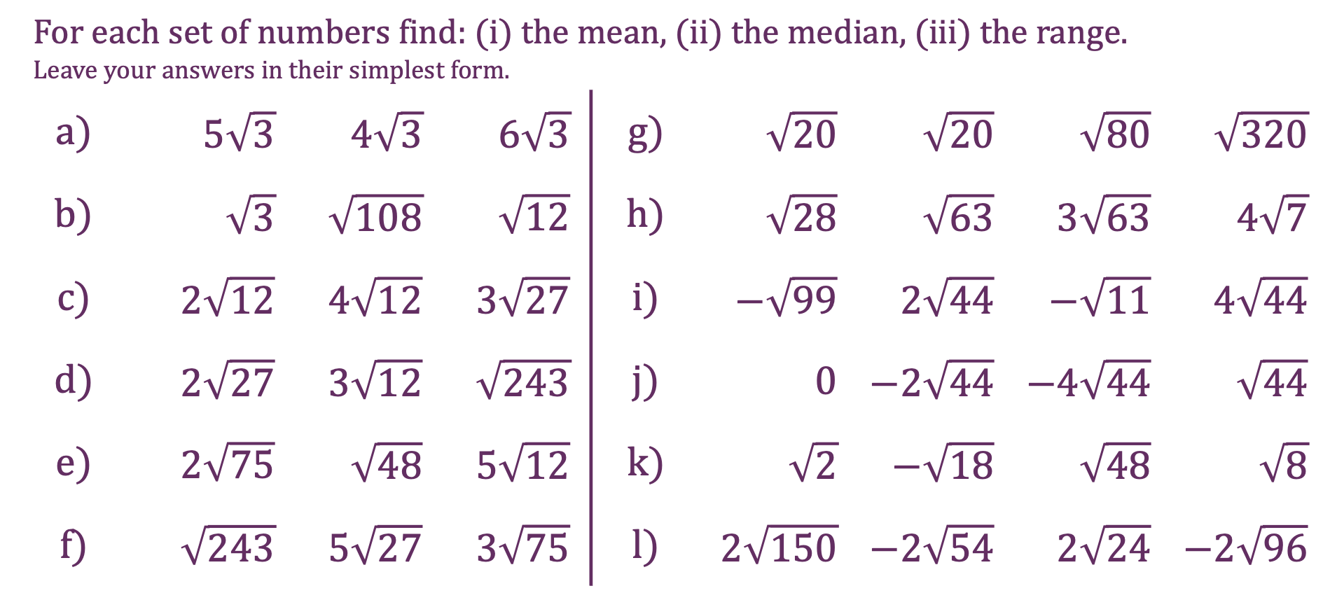
Surds
For each set of numbers find: (i) the mean, (ii) the median, (iii) the range. Leave your answers in their simplest form.
a) | $5\sqrt{3}$ | $4\sqrt{3}$ | $6\sqrt{3}$ | g) | $\sqrt{20}$ | $\sqrt{20}$ | $\sqrt{80}$ | $\sqrt{320}$
b) | $\sqrt{3}$ | $\sqrt{108}$ | $\sqrt{12}$ | h) | $\sqrt{28}$ | $\sqrt{63}$ | $3\sqrt{63}$ | $4\sqrt{7}$
c) | $2\sqrt{12}$ | $4\sqrt{12}$ | $3\sqrt{27}$ | i) | $−\sqrt{99}$ | $2\sqrt{44}$ | $−\sqrt{11}$ | $4\sqrt{44}$
d) | $2\sqrt{27}$ | $3\sqrt{12}$ | $\sqrt{243}$ | j) | $0$ | $−2\sqrt{44}$ | $−4\sqrt{44}$ | $\sqrt{44}$
e) | $2\sqrt{75}$ | $\sqrt{48}$ | $5\sqrt{12}$ | k) | $\sqrt{2}$ | $−\sqrt{18}$ | $\sqrt{48}$ | $\sqrt{8}$
f) | $\sqrt{243}$ | $5\sqrt{27}$ | $3\sqrt{75}$ | l) | $2\sqrt{150}$ | $−2\sqrt{54}$ | $2\sqrt{24}$ | $−2\sqrt{96}$

Slide 2
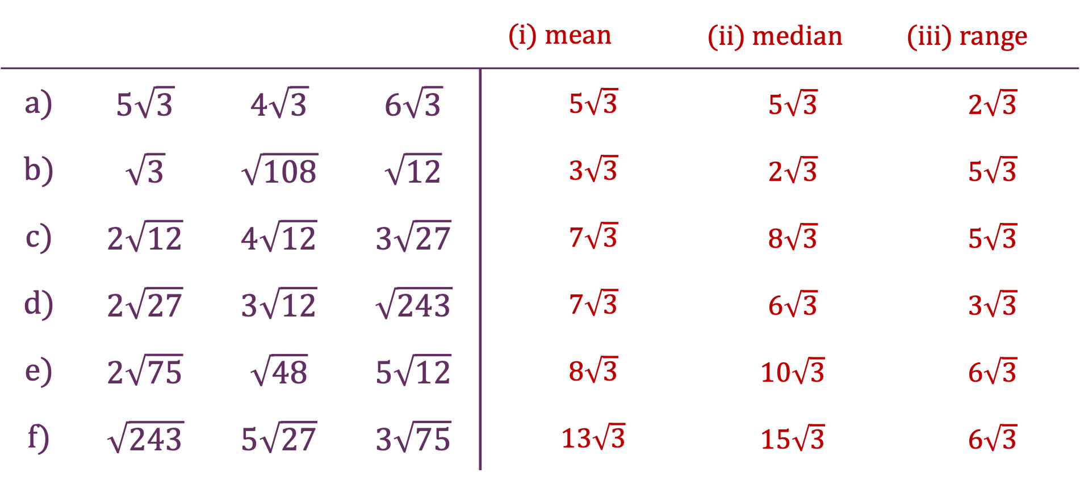
Surds
 |  |  |  | (i) mean | (ii) median | (iii) range
a) | $5\sqrt{3}$ | $4\sqrt{3}$ | $6\sqrt{3}$ | $5\sqrt{3}$ | $5\sqrt{3}$ | $2\sqrt{3}$
b) | $\sqrt{3}$ | $\sqrt{108}$ | $\sqrt{12}$ | $3\sqrt{3}$ | $2\sqrt{3}$ | $5\sqrt{3}$
c) | $2\sqrt{12}$ | $4\sqrt{12}$ | $3\sqrt{27}$ | $7\sqrt{3}$ | $8\sqrt{3}$ | $5\sqrt{3}$
d) | $2\sqrt{27}$ | $3\sqrt{12}$ | $\sqrt{243}$ | $7\sqrt{3}$ | $6\sqrt{3}$ | $3\sqrt{3}$
e) | $2\sqrt{75}$ | $\sqrt{48}$ | $5\sqrt{12}$ | $8\sqrt{3}$ | $10\sqrt{3}$ | $6\sqrt{3}$
f) | $\sqrt{243}$ | $5\sqrt{27}$ | $3\sqrt{75}$ | $13\sqrt{3}$ | $15\sqrt{3}$ | $6\sqrt{3}$

Slide 3
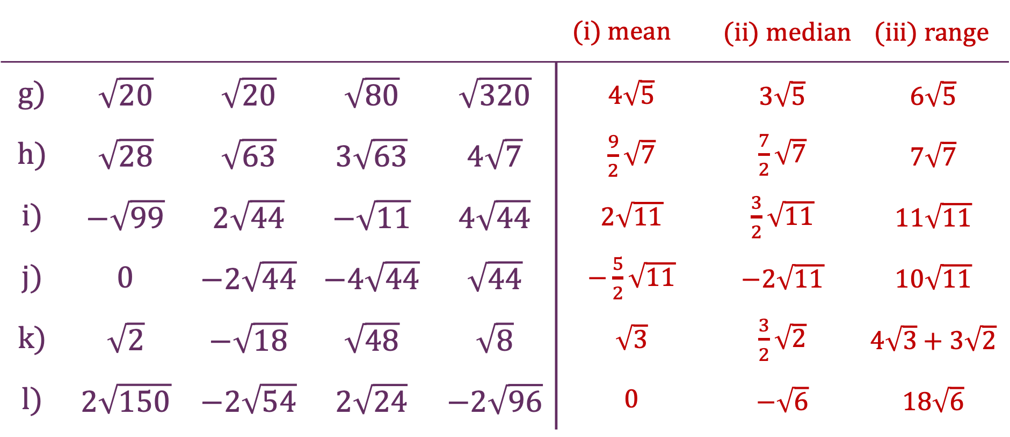
Surds
 |  |  |  |  | (i) mean | (ii) median | (iii) range
g) | $\sqrt{20}$ | $\sqrt{20}$ | $\sqrt{80}$ | $\sqrt{320}$ | $4\sqrt{5}$ | $3\sqrt{5}$ | $6\sqrt{5}$
h) | $\sqrt{28}$ | $\sqrt{63}$ | $3\sqrt{63}$ | $4\sqrt{7}$ | $\frac{9}{2}\sqrt{7}$ | $\frac{7}{2}\sqrt{7}$ | $7\sqrt{7}$
i) | $−\sqrt{99}$ | $2\sqrt{44}$ | $−\sqrt{11}$ | $4\sqrt{44}$ | $2\sqrt{11}$ | $\frac{3}{2}\sqrt{11}$ | $11\sqrt{11}$
j) | $0$ | $−2\sqrt{44}$ | $−4\sqrt{44}$ | $\sqrt{44}$ | $−\frac{5}{2}\sqrt{11}$ | $−2\sqrt{11}$ | $10\sqrt{11}$
k) | $\sqrt{2}$ | $−\sqrt{18}$ | $\sqrt{48}$ | $\sqrt{8}$ | $\sqrt{3}$ | $\frac{3}{2}\sqrt{2}$ | $4\sqrt{3}+3\sqrt{2}$
l) | $2\sqrt{150}$ | $−2\sqrt{54}$ | $2\sqrt{24}$ | $−2\sqrt{96}$ | $0$ | $−\sqrt{6}$ | $18\sqrt{6}$

