Slide 1

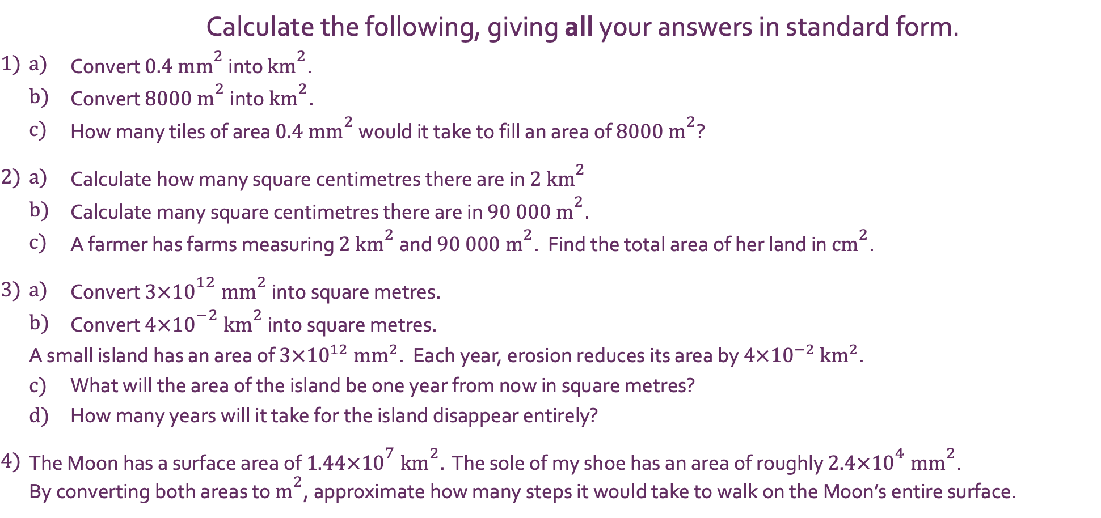
InterwovenMaths.com
Converting units of area with…
Standard Form
 |  | Calculate the following, giving all your answers in standard form.
1) | a) | Convert $0.4 {\text{mm}}^{2}$ into ${\text{km}}^{2}$.
 | b) | Convert $8000 {\text{m}}^{2}$ into ${\text{km}}^{2}$.
 | c) | How many tiles of area $0.4 {\text{mm}}^{2}$ would it take to fill an area of $8000 {\text{m}}^{2}$?
2) | a) | Calculate how many square centimetres there are in $2 {\text{km}}^{2}$
 | b) | Calculate many square centimetres there are in $90 000 {\text{m}}^{2}$.
 | c) | A farmer has farms measuring $2 {\text{km}}^{2}$ and $90 000 {\text{m}}^{2}$. Find the total area of her land in ${\text{cm}}^{2}$.
3) | a) | Convert $3×{10}^{12} {\text{mm}}^{2}$ into square metres.
 | b) | Convert $4×{10}^{−2} {\text{km}}^{2}$ into square metres.
 | A small island has an area of $3×{10}^{12} {\text{mm}}^{2}$. Each year, erosion reduces its area by $4×{10}^{−2} {\text{km}}^{2}$.
 | c) | What will the area of the island be one year from now in square metres?
 | d) | How many years will it take for the island disappear entirely?
4) | The Moon has a surface area of $1.44×{10}^{7} {\text{km}}^{2}.$ The sole of my shoe has an area of roughly $2.4×{10}^{4} {\text{mm}}^{2}$. By converting both areas to ${\text{m}}^{2}$, approximate how many steps it would take to walk on the Moon’s entire surface.
@Jshmtn

Slide 2
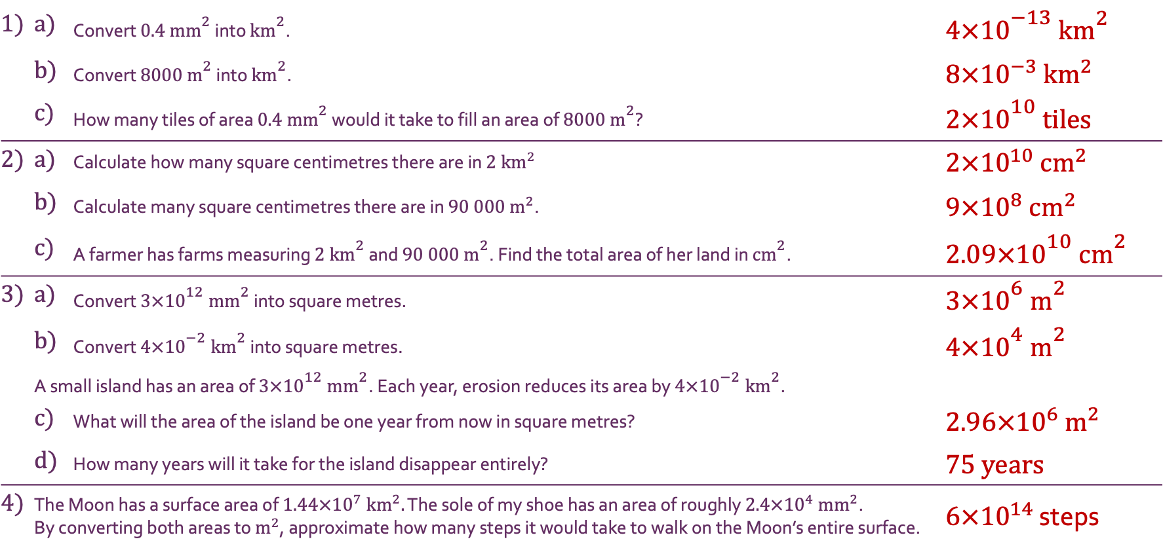
InterwovenMaths.com
Converting units of area with…
Standard Form
Solutions
1) | a) | Convert $0.4 {\text{mm}}^{2}$ into ${\text{km}}^{2}$. | $4×{10}^{−13}$ ${\text{km}}^{2}$
 | b) | Convert $8000 {\text{m}}^{2}$ into ${\text{km}}^{2}$. | $8×{10}^{−3}$ ${\text{km}}^{2}$
 | c) | How many tiles of area $0.4 {\text{mm}}^{2}$ would it take to fill an area of $8000 {\text{m}}^{2}$? | $2×{10}^{10}$ tiles
2) | a) | Calculate how many square centimetres there are in $2 {\text{km}}^{2}$ | $2×{10}^{10}$ ${\text{cm}}^{2}$
 | b) | Calculate many square centimetres there are in $90 000 {\text{m}}^{2}$. | $9×{10}^{8}$ ${\text{cm}}^{2}$
 | c) | A farmer has farms measuring $2 {\text{km}}^{2}$ and $90 000 {\text{m}}^{2}$. Find the total area of her land in ${\text{cm}}^{2}$. | $2.09×{10}^{10}$ ${\text{cm}}^{2}$
3) | a) | Convert $3×{10}^{12} {\text{mm}}^{2}$ into square metres. | $3×{10}^{6}$ ${\text{m}}^{2}$
 | b) | Convert $4×{10}^{−2} {\text{km}}^{2}$ into square metres. | $4×{10}^{4}$ ${\text{m}}^{2}$
 | A small island has an area of $3×{10}^{12} {\text{mm}}^{2}$. Each year, erosion reduces its area by $4×{10}^{−2} {\text{km}}^{2}$.
 | c) | What will the area of the island be one year from now in square metres? | $2.96×{10}^{6}$ ${\text{m}}^{2}$
 | d) | How many years will it take for the island disappear entirely? | 75 years
4) | The Moon has a surface area of $1.44×{10}^{7} {\text{km}}^{2}.$ The sole of my shoe has an area of roughly $2.4×{10}^{4} {\text{mm}}^{2}$. By converting both areas to ${\text{m}}^{2}$, approximate how many steps it would take to walk on the Moon’s entire surface. |  | $6×{10}^{14}$ steps
@Jshmtn

