Slide 1
Distributivity
Name
 | ‘Do Now’ Tracker
 | ① | Powers and Roots | 1 | 2 | 3 | 4
 |  |  | 5 | 6 | 7 | 8
 | ② | Rounding | 1 | 2 | 3 | 4
 |  |  | 5 | 6 | 7 | 8
 | ③ | Standard Form | 1 | 2 | 3 | 4
 |  |  | 5 | 6 | 7 | 8
 | ④ | Connected Calculations | 1 | 2 | 3 | 4
 |  |  | 5 | 6 | 7 | 8

Slide 2
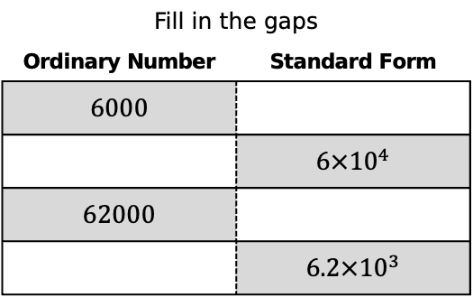
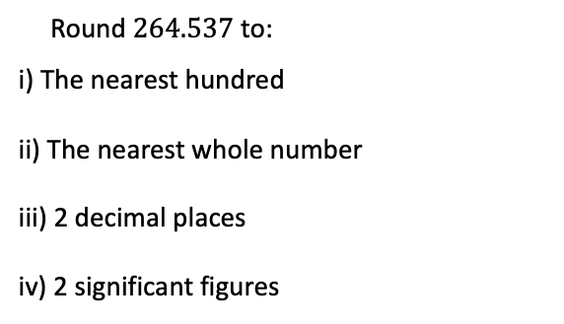
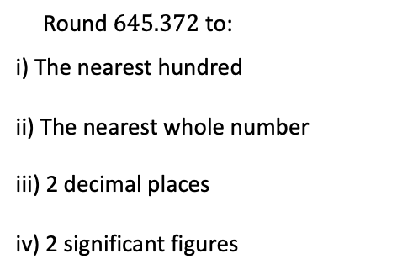
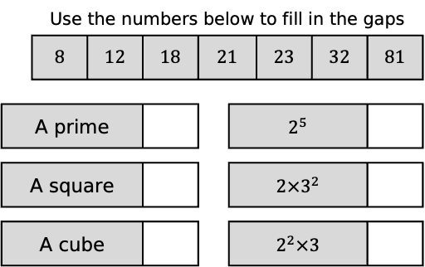
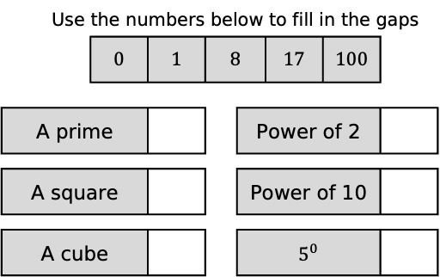
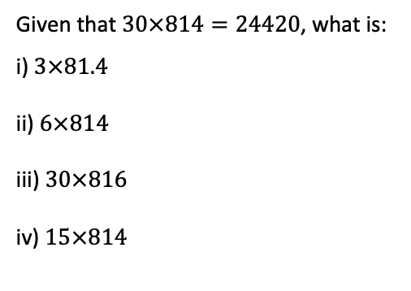
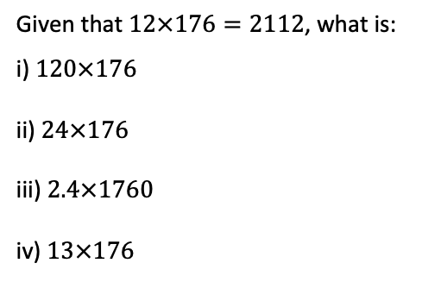
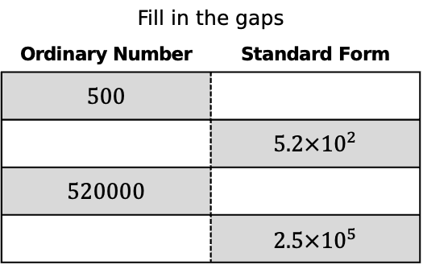
1
Round $264.537$ to:
i) The nearest hundred
ii) The nearest whole number
iii) 2 decimal places
iv) 2 significant figures
 | Use the numbers below to fill in the gaps
 |  | 0 | 1 | 8 |  | 17 | 100
A prime |  |  |  |  | Power of 2
A square |  |  |  |  | Power of 10
A cube |  |  |  |  | $5^{0}$
Fill in the gaps
Ordinary Number | Standard Form
$6000$
 | $6×{10}^{4}$
$62000$
 | $6.2×{10}^{3}$
Given that $12×176=2112$, what is:
i) $120×176$
ii) $24×176$
iii) $2.4×1760$
iv) $13×176$
2
Round $645.372$ to:
i) The nearest hundred
ii) The nearest whole number
iii) 2 decimal places
iv) 2 significant figures
 | Use the numbers below to fill in the gaps
 | 8 | 12 | 18 | 21 |  | 23 | 32 | 81
A prime |  |  |  |  | $2^{5}$
A square |  |  |  |  | $2×3^{2}$
A cube |  |  |  |  | $2^{2}×3$
Fill in the gaps
Ordinary Number | Standard Form
$500$
 | $5.2×{10}^{2}$
$520000$
 | $2.5×{10}^{5}$
Given that $30×814=24420$, what is:
i) $3×81.4$
ii) $6×814$
iii) $30×816$
iv) $15×814$

Slide 3
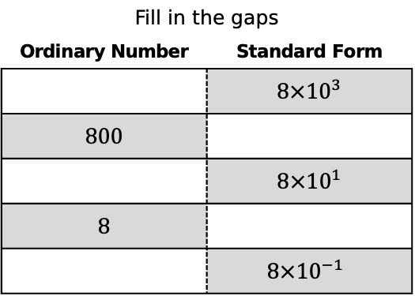
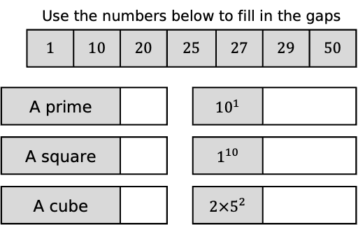
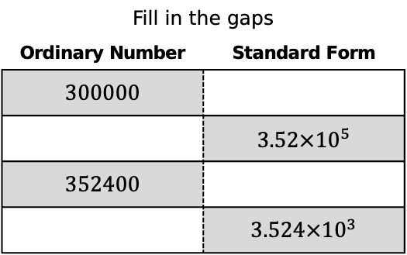
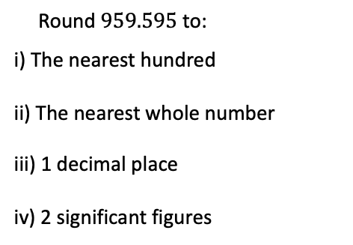
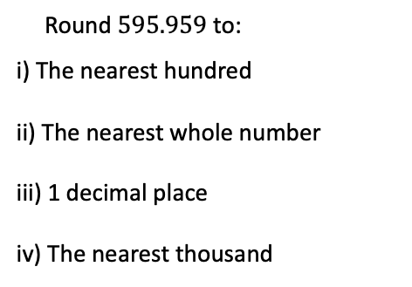
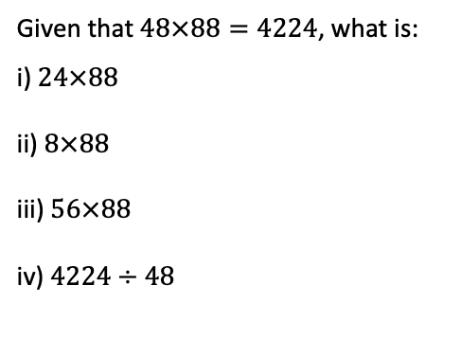
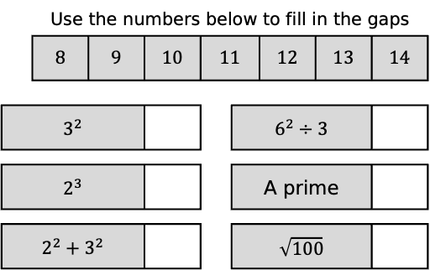
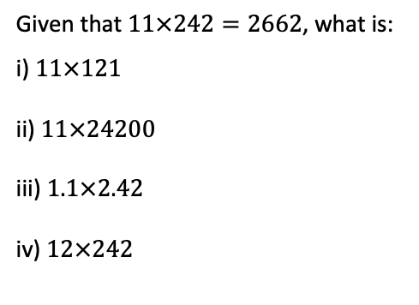
3
Round $595.959$ to:
i) The nearest hundred
ii) The nearest whole number
iii) 1 decimal place
iv) The nearest thousand
 | Use the numbers below to fill in the gaps
 | 1 | 10 | 20 | 25 |  | 27 | 29 | 50
A prime |  |  |  |  | ${10}^{1}$
A square |  |  |  |  | $1^{10}$
A cube |  |  |  |  | $2×5^{2}$
Fill in the gaps
Ordinary Number | Standard Form
$300000$
 | $3.52×{10}^{5}$
$352400$
 | $3.524×{10}^{3}$
Given that $11×242=2662$, what is:
i) $11×121$
ii) $11×24200$
iii) $1.1×2.42$
iv) $12×242$
4
Round $959.595$ to:
i) The nearest hundred
ii) The nearest whole number
iii) 1 decimal place
iv) 2 significant figures
 | Use the numbers below to fill in the gaps
 | 8 | 9 | 10 | 11 |  | 12 | 13 | 14
$3^{2}$ |  |  |  |  | $6^{2}÷3$
$2^{3}$ |  |  |  |  | A prime
$2^{2}+3^{2}$ |  |  |  |  | $\sqrt{100}$
Fill in the gaps
Ordinary Number | Standard Form
 | $8×{10}^{3}$
$800$
 | $8×{10}^{1}$
$8$
 | $$8×{10}^{−1}$$
Given that $48×88=4224$, what is:
i) $24×88$
ii) $8×88$
iii) $56×88$
iv) $4224÷48$

Slide 4





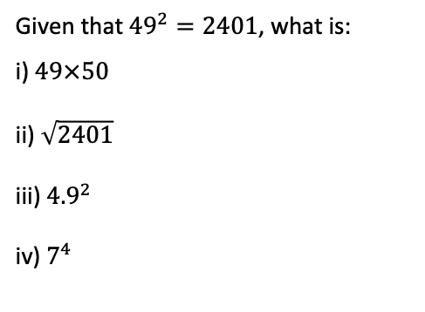

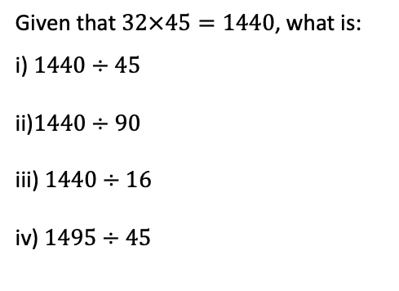
5
A number has been rounded to the nearest $100$, becoming $600$.
What could the number have been?
 | Use the numbers below to fill in the gaps
 | 4 | 8 | 9 | 27 |  | 30 | 100 | 1000
$\sqrt{64}$ |  |  |  |  | ${10}^{3}$
$\sqrt[3]{64}$ |  |  |  |  | $\sqrt{81}$
$3^{3}$ |  |  |  |  | $8^{2}+6^{2}$
Fill in the gaps
Ordinary Number | Standard Form
$76$
 | $7.6×{10}^{0}$
$0.76$
 | $7.6×{10}^{−2}$
Given that $32×45=1440$, what is:
i) $1440÷45$
ii)$1440÷90$
iii) $1440÷16$
iv) $1495÷45$
6
A number has been rounded two decimal places, becoming $17.23$.
What could the number have been?
 | Use the numbers below to fill in the gaps
 | 7 | 8 | 10 | 11 |  | 18 | 25 | 36
${\left(2+3\right)}^{2}$ |  |  |  |  | $2+2^{3}$
$2+3^{2}$ |  |  |  |  | ${\left(2×3\right)}^{2}$
$2^{2}+3$ |  |  |  |  | $2×3^{2}$
Fill in the gaps
Ordinary Number | Standard Form
$8230$
 | $8.23×{10}^{1}$
$0.823$
 | $8.23×{10}^{−3}$
Given that ${49}^{2}=2401$, what is:
i) $49×50$
ii) $\sqrt{2401}$
iii) ${4.9}^{2}$
iv) $7^{4}$

Slide 5
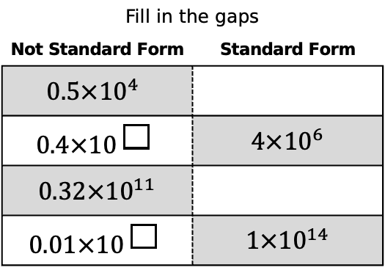

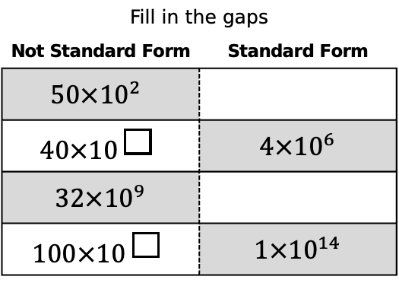


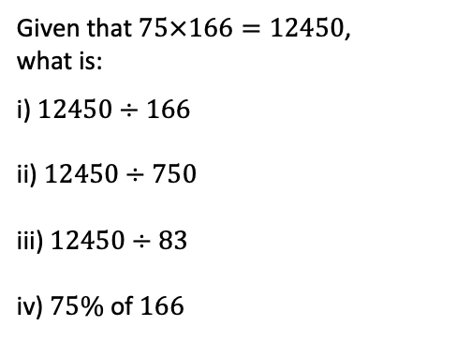

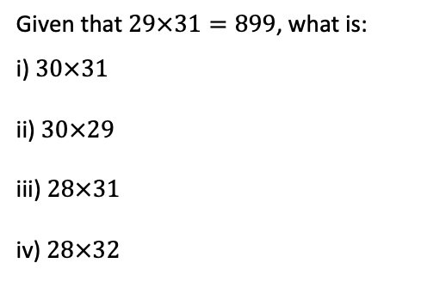
7
A number has been rounded to the nearest $10$, becoming $600$.
What could the number have been?
 | Use the numbers below to fill in the gaps
 | 10 | 25 | 27 | 32 |  | 49 | 50 | 100
${\left(2+5\right)}^{2}$ |  |  |  |  | $2×5^{2}$
$2+5^{2}$ |  |  |  |  | $2^{5}$
${\left(2×5\right)}^{2}$ |  |  |  |  | $5^{2}$
Fill in the gaps
Not Standard Form | Standard Form
$$50×{10}^{2}$$
$$40×{10 }^{\boxed{}}$$ | $4×{10}^{6}$
$32×{10}^{9}$
$$100×{10 }^{\boxed{}}$$ | $1×{10}^{14}$
Given that $29×31=899$, what is:
i) $30×31$
ii) $30×29$
iii) $28×31$
iv) $28×32$
8
A number has been rounded two decimal places, becoming $17.20$
What could the number have been?
 | Use the numbers below to fill in the gaps
 | 5 | 6 | 7 | 8 |  | 11 | 12 | 18
$\sqrt{4} × 9$ |  |  |  |  | $\sqrt{49}$
$\sqrt{4×9}$ |  |  |  |  | $4×\sqrt{9}$
$\sqrt{4}+9$ |  |  |  |  | $\sqrt{4}+\sqrt{9}$
Fill in the gaps
Not Standard Form | Standard Form
$$0.5×{10}^{4}$$
$$0.4×{10 }^{\boxed{}}$$ | $4×{10}^{6}$
$0.32×{10}^{11}$
$$0.01×{10 }^{\boxed{}}$$ | $1×{10}^{14}$
Given that $75×166=12450$,
what is:
i) $12450÷166$
ii) $12450÷750$
iii) $12450÷83$
iv) $75\%$ of $166$

Slide 6

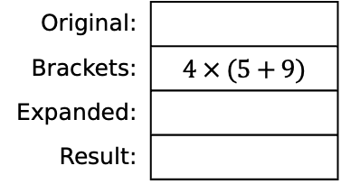
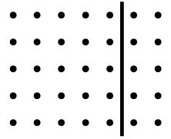

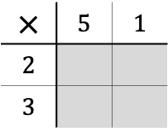
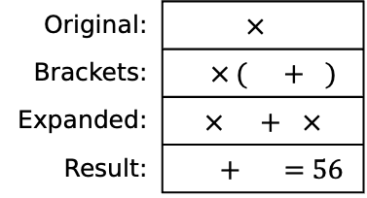

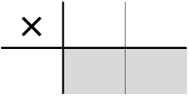
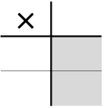
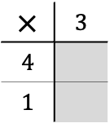



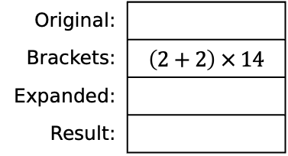
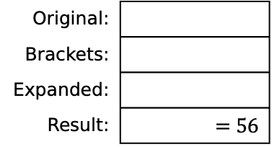

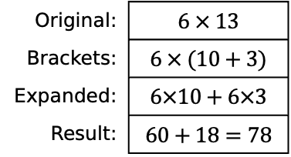
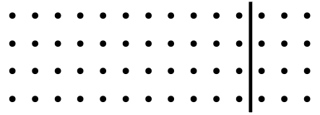
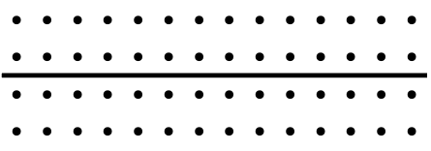
Task 1 Counting Dots
$∙$ | $∙$ | $∙$ | $∙$ | $∙$ | $∙$ | $∙$ | $∙$ | $∙$ | $∙$ | $∙$ | $∙$ | $∙$
$∙$ | $∙$ | $∙$ | $∙$ | $∙$ | $∙$ | $∙$ | $∙$ | $∙$ | $∙$ | $∙$ | $∙$ | $∙$
$∙$ | $∙$ | $∙$ | $∙$ | $∙$ | $∙$ | $∙$ | $∙$ | $∙$ | $∙$ | $∙$ | $∙$ | $∙$
$∙$ | $∙$ | $∙$ | $∙$ | $∙$ | $∙$ | $∙$ | $∙$ | $∙$ | $∙$ | $∙$ | $∙$ | $∙$
$∙$ | $∙$ | $∙$ | $∙$ | $∙$ | $∙$ | $∙$ | $∙$ | $∙$ | $∙$ | $∙$ | $∙$ | $∙$
$∙$ | $∙$ | $∙$ | $∙$ | $∙$ | $∙$ | $∙$ | $∙$ | $∙$ | $∙$ | $∙$ | $∙$ | $∙$
Original: | $6 × 13$
Brackets: | $6 × (10+3)$
Expanded: | $6×10+6×3$
Result: | $60+18=78$
Grid:
$×$ | $10$ | $3$
$6$ | $60$ | $18$
Original: | $4 × 14$
Brackets: | $4 × (10+4)$
Expanded: | $4×10+4×4$
Result: | $40+16=56$
Grid:
$∙$ | $∙$ | $∙$ | $∙$ | $∙$ | $∙$ | $∙$ | $∙$ | $∙$ | $∙$ | $∙$ | $∙$ | $∙$ | $∙$
$∙$ | $∙$ | $∙$ | $∙$ | $∙$ | $∙$ | $∙$ | $∙$ | $∙$ | $∙$ | $∙$ | $∙$ | $∙$ | $∙$
$∙$ | $∙$ | $∙$ | $∙$ | $∙$ | $∙$ | $∙$ | $∙$ | $∙$ | $∙$ | $∙$ | $∙$ | $∙$ | $∙$
$∙$ | $∙$ | $∙$ | $∙$ | $∙$ | $∙$ | $∙$ | $∙$ | $∙$ | $∙$ | $∙$ | $∙$ | $∙$ | $∙$
$×$
Original:
Brackets:
Expanded:
Result: | $=56$
Grid:
$∙$ | $∙$ | $∙$ | $∙$ | $∙$ | $∙$ | $∙$ | $∙$ | $∙$ | $∙$ | $∙$ | $∙$ | $∙$ | $∙$
$∙$ | $∙$ | $∙$ | $∙$ | $∙$ | $∙$ | $∙$ | $∙$ | $∙$ | $∙$ | $∙$ | $∙$ | $∙$ | $∙$
$∙$ | $∙$ | $∙$ | $∙$ | $∙$ | $∙$ | $∙$ | $∙$ | $∙$ | $∙$ | $∙$ | $∙$ | $∙$ | $∙$
$∙$ | $∙$ | $∙$ | $∙$ | $∙$ | $∙$ | $∙$ | $∙$ | $∙$ | $∙$ | $∙$ | $∙$ | $∙$ | $∙$
$×$
Original:
Brackets: | $4 × (5+9)$
Expanded:
Result:
Grid:
$∙$ | $∙$ | $∙$ | $∙$ | $∙$ | $∙$ | $∙$ | $∙$ | $∙$ | $∙$ | $∙$ | $∙$ | $∙$ | $∙$
$∙$ | $∙$ | $∙$ | $∙$ | $∙$ | $∙$ | $∙$ | $∙$ | $∙$ | $∙$ | $∙$ | $∙$ | $∙$ | $∙$
$∙$ | $∙$ | $∙$ | $∙$ | $∙$ | $∙$ | $∙$ | $∙$ | $∙$ | $∙$ | $∙$ | $∙$ | $∙$ | $∙$
$∙$ | $∙$ | $∙$ | $∙$ | $∙$ | $∙$ | $∙$ | $∙$ | $∙$ | $∙$ | $∙$ | $∙$ | $∙$ | $∙$
$×$
Original:
Brackets: | $\left(2+2\right) × 14$
Expanded:
Result:
Grid:
$∙$ | $∙$ | $∙$ | $∙$ | $∙$ | $∙$ | $∙$ | $∙$ | $∙$ | $∙$ | $∙$ | $∙$ | $∙$ | $∙$
$∙$ | $∙$ | $∙$ | $∙$ | $∙$ | $∙$ | $∙$ | $∙$ | $∙$ | $∙$ | $∙$ | $∙$ | $∙$ | $∙$
$∙$ | $∙$ | $∙$ | $∙$ | $∙$ | $∙$ | $∙$ | $∙$ | $∙$ | $∙$ | $∙$ | $∙$ | $∙$ | $∙$
$∙$ | $∙$ | $∙$ | $∙$ | $∙$ | $∙$ | $∙$ | $∙$ | $∙$ | $∙$ | $∙$ | $∙$ | $∙$ | $∙$
$×$
$∙$ | $∙$ | $∙$ | $∙$ | $∙$ | $∙$ | $∙$
$∙$ | $∙$ | $∙$ | $∙$ | $∙$ | $∙$ | $∙$
$∙$ | $∙$ | $∙$ | $∙$ | $∙$ | $∙$ | $∙$
$∙$ | $∙$ | $∙$ | $∙$ | $∙$ | $∙$ | $∙$
$∙$ | $∙$ | $∙$ | $∙$ | $∙$ | $∙$ | $∙$
$×$
$×$ | 2 | 6
3
Result:
Result:
$×$ | 3
4
1
$×$ | 5 | 1
2
3

Slide 7
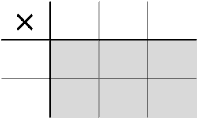
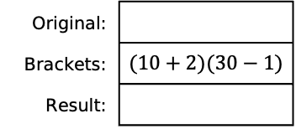

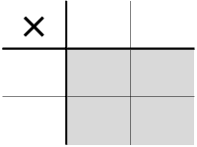
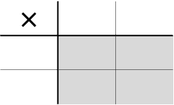
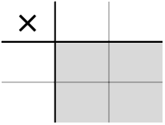
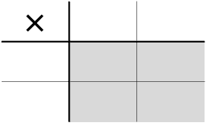
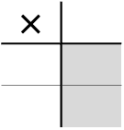




Task 2 Calculating Areas
Original: | $×$
Brackets: | $×$ ( )
Result:
Original:
Brackets:
Result:
Original:
Brackets:
Result:
$×$
$×$
$×$
 | 24
17
Original:
Brackets:
Result:
Original:
Brackets:
Result:
Original:
Brackets: | $(10+7)(20+4)$
Result:
$×$
$×$
$×$
 | 32
11
 | 61
23
 | 29
12
Original:
Brackets:
Result:
Original:
Brackets:
Result:
Original:
Brackets: | $(10+2)(30−1)$
Result:
$×$
$×$
$×$

Slide 8

























Task 3 Calculations with Negatives
Original: | $$8 × 5$$
Brackets: | $$(3+5)(1+4)$$
Original: | $$8 × 5$$
Brackets: | $$(3+5)(6−1)$$
Original:
Brackets:
$×$ | 1 | +4
3
+5
 | 3
+ | 12
+ | 5
+ | 20
= | 40
$×$ | 6 | $−1$
3
+5
 | 18
$+$ | 30
$−$ | 3
$−$ | 5
$=$ | 40
$×$ | 2 | +3
10
$−2$
$=$ | 40
Original:
Brackets:
Original:
Brackets: | $$(4+3)(10−1)$$
Original:
Brackets:
$×$ | 5 | +4
10
$−3$
=
$×$
=
$×$ | 10 | $−1$
10
$−3$
=
Original:
Brackets: | $(5−2)(7−1)$
Original:
Brackets: | $(100−1)(100+1)$
Original: | $$98 × 102$$
Brackets:
$×$
=
$×$
=
$×$
=
Original: | $$303 × 99$$
Brackets:
Original: | $$39 × 18$$
Brackets:
Original:
Brackets:
$×$
=
$×$
=
$×$ | 10 | 3
 |  | $90$
 | $$−20$$
=
Original:
Brackets:
Original:
Brackets:
Original:
Brackets:
$×$ | 5
 | 20 | 8
 |  | 6
=
$×$
 | 40 | $−5$
 | 16 | $−2$
=
$×$
 | $200$ | $−60$
 | $−10$ | 3
=

Slide 9































Task 4 Fill in the gaps and group the grids that show the same overall calculation
A | B | C
D | E | F
G | H | I
J | K | L
$×$ | 11 | $−1$
8
$×$ | 14
 | 140 | $−20$
$×$
 | 108 | $−12$
$×$
 | 112
$×$ | 11 | +1 | $−2$
 | 132
$×$ | 11
 |  | 8 | 16
$×$ | 8
14
 | $−16$
$×$ | 8
14
 | $−32$
$×$ | 10 | +2
10
$−2$
$×$ | 15 | $−1$
15
$−7$
$×$ | 20
 |  | $−160$
$−10$ |  | 80
$×$ | 11 | $−3$
10 |  |  | 20
 |  |  | $−4$
Group 1
$$10 × 8$$
Group 2
$$10 × 12$$
Group 3
C
Group 4
D
Task 5 Complete this grid in as many ways as possible, writing the calculation each time.
$×$ | 6 | 9
10 | 60 | 90
$×$
3 | 60 | 90
$×$
 | 60 | 90
$×$
 | 60 | 90
$10\left(6+9\right)=150$
$3$(
$×$
 | 60 | 90
$×$
 | 60 | 90
$×$
 | 60 | 90
$×$
 | 60 | 90
Task 6 Complete this grid in as many ways as possible, writing the calculation each time.
$×$ | 40 | $−20$ | 8
5 | 200 | $−100$ | $40$
$×$
 | 200 | $−100$ | $40$
$×$
 | 200 | $−100$ | $40$
$$5 × 28=140$$
$×$
 | 200 | $−100$ | $40$
$×$
 | 200 | $−100$ | $40$
$×$
 | 200 | $−100$ | $40$

Slide 10



























Task 7 Introducing algebra
 | $2+4$
7 | $$7(2+4)$$
 | $3+4$
7
 | $a+4$
7
 | 2 | 4
7 | $7×2$ | $7×4$
 | 3 | 4
7
 | $a$ | 4
7
 | 2 | 4
7 | $14$ | $$28$$
 | 3 | 4
7
 | $a$ | 4
7
$7\left(2+4\right)=14+28$
$7\left( \boxed{}+\boxed{} \right)=\boxed{}+\boxed{}$
$$7\left(a+4\right)=$$
 | $a+6$
5
 | $a+2$
8
 | $a+x$
$$8$$
$$5\left(a+6\right)=$$
$$8\left(a+2\right)=$$
$$8\left(a+x\right)=$$
 | $3+6$
3
 | $x+6$
$x$
 | $x+y$
$$x$$
 | 3
3 | $3^{2}$
 |  | $xy$
$$3\left(3+6\right)=$$
$$x\left(x+6\right)=$$
$$x\left(x+y\right)=$$
 | 10 | 4
10 | ${10}^{2}$ | $4×10$
3 | $3×10$ | $3×4$
 | 5 | 4
5 | $5^{2}$
3
 | $x$ | 4
$x$
3

Slide 11




































Task 8 Introducing Algebra
Brackets: | $$3(10+4)$$
Grid:
Expanded: | $30+12$
$$3(x+4)$$
$$3x+12$$
$$5(x+2)$$
$$6(x−3)$$
$×$ | 10 | 4
3 | 30 | 12
$×$ | $x$ | 4
3 | $3x$ | 12
$×$
$×$
Brackets: | $$3(20+4)$$
Grid:
Expanded: | $$60+12$$
$$3(2x+4)$$
$5(3x+2)$
$6(4x−3)$
$×$ | 20 | 4
3 | 60 | 12
$×$
 | $6x$
$×$
$×$
Brackets:
Grid:
Expanded:
$6x−9$
$×$
4 | $8x$ | $−12$
$×$
 | $10x$ | $$45$$
$×$
$×$ | 5 | $−2x$
 | 20
Brackets: | $x(x+3)$
Grid:
Expanded: | $x^{2}+3x$
$x(x−5)$
$x(x+11)$
$x^{2}−6x$
$×$ | $x$ | 3
$x$ | $x^{2}$ | $3x$
$×$
$×$
$×$
Brackets: | $(10+3)(10+2)$
Grid:
Expanded: Simplified: | $$100+20+30+6$$ $=$ $100+50+6$
$(x+3)(x+2)$
$$x^{2}+2x+3x+6$$ $=$ $$x^{2}+5x+6$$
$(x+3)(x+4)$
$(x+6)(x+2)$
$×$ | 10 | 2
10 | 100 | 20
3 | 30 | 6
$×$ | $x$ | 2
$x$ | $x^{2}$ | $2x$
3 | $3x$ | 6
$×$
$×$

Slide 12






Task 9 Expanding Single Brackets – Match them up!
A | $4(x+3)$ | B | $4(2x+3)$ | C | $x(x+4)$ | D | $x(3x+4)$ | E | $4(2x+y)$
F | $4(x−3)$ | G | $4(2x−3)$ | H | $x(x−4)$ | I |  | J | $4(2x−y)$
K | $4(3−x)$ | L | $4(3−2x)$ | M | $x(4−x)$ | N | $x(4−3x)$ | O
 | $4x−x^{2}$ |  |  | $4x−12$ |  |  | $8x−4y$
A | $4x+12$ |  | I | $3x^{2}−4x$ |  | O | $8x−2y$
 | $12−4x$ |  |  | $4x−3x^{2}$ |  |  | $12−4x$
 | $8x+12$ |  |  | $x^{2}+4x$ |  |  | $8x+4y$
G |  |  | H |  |  |  | $3x^{2}+4x$
Task 10 Fill in the blanks
 | $7\left(x+y\right)=70$ | $5\left(x+y\right)=35$ | $8\left(x−y\right)=16$ | $3\left(2x+y\right)=45$ | $x\left(y+3\right)=88$
When $x=8$, $y$ is equal to…
When $x=2$, $y$ is equal to…
When $x=11$, $y$ is equal to…
When $x=___$ , $y$ is equal to… | $14$
When $x=___$ , $y$ is equal to… |  | $6$
When $x=___$ , $y$ is equal to… |  |  |  | $8$
When $x$ is odd, $y$ is…
When $x$ is even, $y$ is...
An equation linking $x$ and $y$ is…
$7\left(x+y\right)=70$ | $5\left(x+y\right)=35$ | $8\left(x−y\right)=16$ | $3\left(2x+y\right)=45$ | $$x\left(y+3\right)=88$$
 | $x$ | $y$
$7$
$∙$ | $∙$ | $∙$ | $∙$ | $∙$ |  | $∙$ | $∙$
$∙$ | $∙$ | $∙$ | $∙$ | $∙$ | … | $∙$ | $∙$
$∙$ | $∙$ | $∙$ | $∙$ | $∙$ |  | $∙$ | $∙$
$∙$ | $∙$ | $∙$ | $∙$ | $∙$ | … | $∙$ | $∙$
$∙$ | $∙$ | $∙$ | $∙$ | $∙$ |  | $∙$ | $∙$
$∙$ | $∙$ | $∙$ | $∙$ | $∙$ | … | $∙$ | $∙$
$∙$ | $∙$ | $∙$ | $∙$ | $∙$ |  | $∙$ | $∙$
$∙$ | $∙$ | $∙$ | $∙$ | $∙$ |  | $∙$ | $∙$

Slide 13





























Task 11 Introducing Algebra – Double Brackets
Brackets: | $(x+5)(x+2)$
Grid:
Expanded: Simplified:
$\left(x+5\right)(x−2)$
$(x−5)(x+2)$
$(x−5)(x−2)$
$×$
$×$
$×$
$×$
Brackets: | $\left(x+2\right)(x−2)$
Grid:
Expanded: Simplified:
$(x+5)(x−5)$
$x^{2}−9$
$x^{2}−100$
$×$
$×$
$×$
$×$
Brackets: | $${\left(x+2\right)}^{2}$$
Grid:
Expanded: Simplified:
$${\left(x−2\right)}^{2}$$
$${\left(x+5\right)}^{2}$$
$x^{2}−10x+25$
$×$ | $x$ | 2
$x$
2
$×$
$×$
$×$
Brackets:
Grid:
Expanded: Simplified:
$x^{2}+9x+14$
$×$ | $x$ | 4
 |  | $4x$
 |  | $−8$
$×$ |  | $−3$
 | $x^{2}$ | $−3x$
 | $5x$
$×$
 | $x^{2}$ | $−6x$
 | $2x$ | $−12$
$×$

Slide 14





Task 12 Expanding Double Brackets Practice – Match them up!
A: $(x+20)(x−6)$ | B: $(x+20)(x+6)$ | C: $(x+6)(x−4)$ | D: $(x−6)(x+4)$
E: $(x+6)(x+8)$ | F: $(x−8)(x+6)$ | G: $(x+8)(x−6)$ | H: $(x+10)(x+12)$
I: $(x−4)(x+30)$ | J: $(x+24)(x+2)$ | K: $(x+24)(x−2)$ | L: $(x−10)(x+12)$
 | $x^{2}+14x+48$ |  |  | $x^{2}+26x+48$ |  |  | $x^{2}+26x+120$
A | $x^{2}+14x−120$ |  |  | $x^{2}+2x−120$ |  |  | $x^{2}+26x−120$
 | $x^{2}+2x−24$ |  |  | $x^{2}−2x−24$ |  |  | $x^{2}+22x+120$
 | $x^{2}+2x−48$ |  |  | $x^{2}−2x−48$ |  |  | $x^{2}+22x−48$
Task 13 Expanding Double Brackets - Variation Grids
$(x+14)(x+1)$ | $x(x+15)$ | $(x+16)(x−1)$ | $(x+17)(x−2)$ | $(x+18)(x−3)$
$x^{2}+15x+14$
$x(x+6)$ | $(x+7)(x−1)$ | $(x+8)(x−2)$ | $(x+9)(x−3)$
$(x+2)(x−2)$ | $(x+3)(x−3)$ | $(x+4)(x−4)$
$x(x−6)$ | $(x+1)(x−7)$
$(x−1)(x−14)$
$(x−1)(x+7)$ | $x(x+6)$ | $(x+1)(x+5)$ | $$(x+2)(x+4)$$ | ${\left(x+3\right)}^{2}$
$$x^{2}+6x−7$$ | $x^{2}+6x$ | $x^{2}+6x+5$ | $x^{2}+6x+8$ | $x^{2}+6x+9$
$(x−2)(x+6)$ | $(x−1)(x+5)$ | $x(x+4)$ | $(x+1)(x+3)$ | ${\left(x+2\right)}^{2}$
$x^{2}+4x−12$ | $x^{2}+4x−5$ | $x^{2}+4x$ | $x^{2}+4x+3$ | $x^{2}+4x+4$
$(x−3)(x+5)$ | $(x−2)(x+4)$ | $(x−1)(x+3)$ | $x(x+2)$ | ${\left(x+1\right)}^{2}$
$x^{2}+2x−15$ | $x^{2}+2x−8$ | $x^{2}+2x−3$ | $x^{2}+2x$ | $x^{2}+2x+1$
$(x−4)(x+4)$ | $(x−3)(x+3)$ | $(x−2)(x+2)$ | $(x−1)(x+1)$ | $x^{2}$
$x^{2}−16$ | $x^{2}−9$ | $x^{2}−4$ | $x^{2}−1$ | $x^{2}$
$(x−5)(x+3)$ | $(x−4)(x+2)$ | $(x−3)(x+1)$ | $x(x−2)$ | ${\left(x−1\right)}^{2}$
$x^{2}−2x−15$ | $x^{2}−2x−8$ | $x^{2}−2x−3$ | $x^{2}−2x$ | $x^{2}−2x+1$
$(x+4)(x+3)$ | ${\left(x+3\right)}^{2}$ | $(x+2)(x+3)$ | $(x+1)(x+3)$ | $x(x+3)$
$(x+4)(x−3)$ | $(x+3)(x−3)$ | $(x+2)(x−3)$
$(x−4)(x+3)$ | $(x−3)(x+3)$
$(x−4)(x−3)$

Slide 15

























Task 1 Counting Dots
$∙$ | $∙$ | $∙$ | $∙$ | $∙$ | $∙$ | $∙$ | $∙$ | $∙$ | $∙$ | $∙$ | $∙$ | $∙$
$∙$ | $∙$ | $∙$ | $∙$ | $∙$ | $∙$ | $∙$ | $∙$ | $∙$ | $∙$ | $∙$ | $∙$ | $∙$
$∙$ | $∙$ | $∙$ | $∙$ | $∙$ | $∙$ | $∙$ | $∙$ | $∙$ | $∙$ | $∙$ | $∙$ | $∙$
$∙$ | $∙$ | $∙$ | $∙$ | $∙$ | $∙$ | $∙$ | $∙$ | $∙$ | $∙$ | $∙$ | $∙$ | $∙$
$∙$ | $∙$ | $∙$ | $∙$ | $∙$ | $∙$ | $∙$ | $∙$ | $∙$ | $∙$ | $∙$ | $∙$ | $∙$
$∙$ | $∙$ | $∙$ | $∙$ | $∙$ | $∙$ | $∙$ | $∙$ | $∙$ | $∙$ | $∙$ | $∙$ | $∙$
Original: | $6 × 13$
Brackets: | $6 × (10+3)$
Expanded: | $6×10+6×3$
Result: | $60+18=78$
Grid:
$×$ | $10$ | $3$
$6$ | $60$ | $18$
Original: | $4 × 14$
Brackets: | $4 × (10+4)$
Expanded: | $4×10+4×4$
Result: | $40+16=56$
Grid:
$∙$ | $∙$ | $∙$ | $∙$ | $∙$ | $∙$ | $∙$ | $∙$ | $∙$ | $∙$ | $∙$ | $∙$ | $∙$ | $∙$
$∙$ | $∙$ | $∙$ | $∙$ | $∙$ | $∙$ | $∙$ | $∙$ | $∙$ | $∙$ | $∙$ | $∙$ | $∙$ | $∙$
$∙$ | $∙$ | $∙$ | $∙$ | $∙$ | $∙$ | $∙$ | $∙$ | $∙$ | $∙$ | $∙$ | $∙$ | $∙$ | $∙$
$∙$ | $∙$ | $∙$ | $∙$ | $∙$ | $∙$ | $∙$ | $∙$ | $∙$ | $∙$ | $∙$ | $∙$ | $∙$ | $∙$
$×$ | 10 | 4
4 | 40 | 16
Original: | $4 × 14$
Brackets: | $4 × (11+3)$
Expanded: | $4×11+4×3$
Result: | $44+12=56$
Grid:
$∙$ | $∙$ | $∙$ | $∙$ | $∙$ | $∙$ | $∙$ | $∙$ | $∙$ | $∙$ | $∙$ | $∙$ | $∙$ | $∙$
$∙$ | $∙$ | $∙$ | $∙$ | $∙$ | $∙$ | $∙$ | $∙$ | $∙$ | $∙$ | $∙$ | $∙$ | $∙$ | $∙$
$∙$ | $∙$ | $∙$ | $∙$ | $∙$ | $∙$ | $∙$ | $∙$ | $∙$ | $∙$ | $∙$ | $∙$ | $∙$ | $∙$
$∙$ | $∙$ | $∙$ | $∙$ | $∙$ | $∙$ | $∙$ | $∙$ | $∙$ | $∙$ | $∙$ | $∙$ | $∙$ | $∙$
$×$ | 11 | 3
4 | 44 | 12
Original: | $4 × 14$
Brackets: | $4 × (5+9)$
Expanded: | $4×5+4×9$
Result: | $20+36=56$
Grid:
$∙$ | $∙$ | $∙$ | $∙$ | $∙$ | $∙$ | $∙$ | $∙$ | $∙$ | $∙$ | $∙$ | $∙$ | $∙$ | $∙$
$∙$ | $∙$ | $∙$ | $∙$ | $∙$ | $∙$ | $∙$ | $∙$ | $∙$ | $∙$ | $∙$ | $∙$ | $∙$ | $∙$
$∙$ | $∙$ | $∙$ | $∙$ | $∙$ | $∙$ | $∙$ | $∙$ | $∙$ | $∙$ | $∙$ | $∙$ | $∙$ | $∙$
$∙$ | $∙$ | $∙$ | $∙$ | $∙$ | $∙$ | $∙$ | $∙$ | $∙$ | $∙$ | $∙$ | $∙$ | $∙$ | $∙$
$×$ | 5 | 9
4 | 20 | 36
Original: | $4 × 14$
Brackets: | $\left(2+2\right) × 14$
Expanded: | $2×14+2×14$
Result: | $28+28=56$
Grid:
$∙$ | $∙$ | $∙$ | $∙$ | $∙$ | $∙$ | $∙$ | $∙$ | $∙$ | $∙$ | $∙$ | $∙$ | $∙$ | $∙$
$∙$ | $∙$ | $∙$ | $∙$ | $∙$ | $∙$ | $∙$ | $∙$ | $∙$ | $∙$ | $∙$ | $∙$ | $∙$ | $∙$
$∙$ | $∙$ | $∙$ | $∙$ | $∙$ | $∙$ | $∙$ | $∙$ | $∙$ | $∙$ | $∙$ | $∙$ | $∙$ | $∙$
$∙$ | $∙$ | $∙$ | $∙$ | $∙$ | $∙$ | $∙$ | $∙$ | $∙$ | $∙$ | $∙$ | $∙$ | $∙$ | $∙$
$×$ | 14
2 | 28
2 | 28
$∙$ | $∙$ | $∙$ | $∙$ | $∙$ | $∙$ | $∙$
$∙$ | $∙$ | $∙$ | $∙$ | $∙$ | $∙$ | $∙$
$∙$ | $∙$ | $∙$ | $∙$ | $∙$ | $∙$ | $∙$
$∙$ | $∙$ | $∙$ | $∙$ | $∙$ | $∙$ | $∙$
$∙$ | $∙$ | $∙$ | $∙$ | $∙$ | $∙$ | $∙$
$×$ | 4 | 2
5 | 20 | 10
$∙$ | $∙$ | $∙$ | $∙$ | $∙$ | $∙$ | $∙$ | $∙$
$∙$ | $∙$ | $∙$ | $∙$ | $∙$ | $∙$ | $∙$ | $∙$
$∙$ | $∙$ | $∙$ | $∙$ | $∙$ | $∙$ | $∙$ | $∙$
$×$ | 2 | 6
3 | 6 | 18
Result: $30$
Result: $24$
$∙$ | $∙$ | $∙$
$∙$ | $∙$ | $∙$
$∙$ | $∙$ | $∙$
$∙$ | $∙$ | $∙$
$∙$ | $∙$ | $∙$
$×$ | 3
4 | 12
1 | 3
$∙$ | $∙$ | $∙$ | $∙$ | $∙$ | $∙$
$∙$ | $∙$ | $∙$ | $∙$ | $∙$ | $∙$
$∙$ | $∙$ | $∙$ | $∙$ | $∙$ | $∙$
$∙$ | $∙$ | $∙$ | $∙$ | $∙$ | $∙$
$∙$ | $∙$ | $∙$ | $∙$ | $∙$ | $∙$
$×$ | 5 | 1
2 | 10 | 2
3 | 15 | 3

Slide 16


















Task 2 Calculating Areas
Original: | $5×8$
Brackets: | $5×(6+2)$
Result: | $30+10=40$
Original: | $5×8$
Brackets: | $\left(3+2\right)×8$
Result: | $24+16=40$
Original: | $5×8$
Brackets: | $(3+2)(6+2)$
Result: | $18+12+6+4=40$
$×$ | 6 | 2
5 | 30 | 10
$×$ | 8
3 | 24
2 | 16
$×$ | 6 | 2
3 | 18 | 6
2 | 12 | 4
 | 24
17
Original: | $6×9$
Brackets: | $(4+2)(6+3)$
Result: | $54$
Original: | $6×9$
Brackets: | $(4+2)(2+4+3)$
Result: | $54$
Original: | $17×24$
Brackets: | $(10+7)(20+4)$
Result: | $408$
$×$ | 6 | 3
4 | 24 | 12
2 | 12 | 6
$×$ | 2 | 4 | 3
4 | 8 | 16 | 12
2 | 4 | 8 | 6
$×$ | 20 | 4
10 | 200 | 40
7 | 140 | 28
 | 32
11
 | 61
23
 | 29
12
Original: | $11×32$
Brackets: | $(10+1)(30+2)$
Result: | $352$
Original: | $23×61$
Brackets: | $(20+3)(60+1)$
Result: | $1403$
Original: | $12×29$
Brackets: | $(10+2)(30−1)$
Result: | $348$
$×$ | 30 | 2
10 | 300 | 20
1 | 30 | 2
$×$ | 60 | 1
20 | 1200 | 20
3 | 180 | 3
$×$ | 30 | $−1$
10 | 300 | $−10$
2 | $60$ | $−2$

Slide 17








































Task 3 Calculations with Negatives
Original: | $$8 × 5$$
Brackets: | $$(3+5)(1+4)$$
Original: | $$8 × 5$$
Brackets: | $$(3+5)(6−1)$$
Original: | $8 × 5$
Brackets: | $(10−2)(2+3)$
$×$ | 1 | +4
3 | 3 | 12
+5 | 5 | 20
 | 3
+ | 12
+ | 5
+ | 20
= | 40
$×$ | 6 | $−1$
3 | 18 | $−3$
+5 | 30 | $−5$
 | 18
$+$ | 30
$−$ | 3
$−$ | 5
$=$ | 40
$×$ | 2 | +3
10 | 20 | 30
$−2$ | $−4$ | $−6$
 | 20
+ | 30
$−$ | 4
$−$ | 6
$=$ | 40
Original: | $7 × 9$
Brackets: | $(10−3)(5+4)$
Original: | $7 × 9$
Brackets: | $$(4+3)(10−1)$$
Original: | $$7 × 9$$
Brackets: | $(10−3)(10−1)$
$×$ | 5 | +4
10 | 50 | $40$
$−3$ | $−15$ | $−12$
 | 50
+ | 40
$−$ | 15
$−$ | 12
= | 63
$×$ | 10 | $−1$
4 | $40$ | $−4$
+3 | $30$ | $−3$
 | 40
+ | 30
$−$ | 4
$−$ | 3
= | 63
$×$ | 10 | $−1$
10 | 100 | $−10$
$−3$ | $−30$ | 3
 | 100
$−$ | 10
$−$ | 30
+ | 3
= | 63
Original: | $3 × 6$
Brackets: | $(5−2)(7−1)$
Original: | $99 × 101$
Brackets: | $(100−1)(100+1)$
Original: | $$98 × 102$$
Brackets: | $(100−2)(100+2)$
$×$ | $7$ | $−1$
5 | 35 | $−5$
$−2$ | $−14$ | 2
 | 35
$−$ | 5
$−$ | 14
+ | 2
= | 18
$×$ | 100 | 1
100 | 10000 | 100
$−1$ | $−100$ | $−1$
10000 | 10000
+ | 100
$−$ | 100
$−$ | 1
= | 9999
$×$ | 100 | 2
100 | 10000 | 200
$−2$ | $−200$ | $−4$
10000 | 10000
+ | 200
$−$ | 200
$−$ | 4
= | 9996
Original: | $$303 × 99$$
Brackets: | $(300+3)(100−1)$
Original: | $$39 × 18$$
Brackets: | $(40−1)(20−2)$
Original: | $28 × 13$
Brackets: | $(30−2)(10+3)$
$×$ | 100 | $−1$
300 | 30000 | $−300$
3 | 300 | $−3$
30000 | 30000
+ | 300
$−$ | 300
$−$ | 3
= 29997 | 30298
$×$ | 20 | $−2$
40 | 800 | $−80$
$−1$ | $−20$ | $2$
 | 800
$−$ | 80
$−$ | 20
 | 2
= | 702
$×$ | 10 | 3
$30$ | $300$ | $90$
$−2$ | $$−20$$ | $−6$
 | 300
+ | 90
$−$ | 20
$−$ | 6
= | 364
Original: | $7 × 7$
Brackets: | $(4+3)(5+2)$
Original: | $7 × 7$
Brackets: | $(5+2)(8−1)$
Original: | $19 × 7$
Brackets: | $(20−1)(10−3)$
$×$ | 5 | 2
4 | 20 | 8
3 | 15 | 6
 | 20
+ | 15
+ | 8
+ | 6
= | 49
$×$ | 8 | $$−1$$
5 | 40 | $−5$
$2$ | 16 | $−2$
 | 40
+ | 16
$−$ | 5
$−$ | 2
= | 49
$×$ | 10 | $−3$
20 | $200$ | $−60$
$−1$ | $−10$ | 3
 | 200
$−$ | 60
$−$ | 10
+ | 3
= | 133

Slide 18








































Task 4 Fill in the gaps and group the grids that show the same overall calculation
A | B | C
D | E | F
G | H | I
J | K | L
$×$ | 11 | $−1$
8 | 88 | $−8$
$×$ | 14 | $−2$
10 | 140 | $−20$
$×$ | $9$ | $−1$
$12$ | 108 | $−12$
$×$ | 8
14 | 112
$×$ | 11 | +1 | $−2$
$12$ | 132 | +12 | $−24$
$×$ | 11 | 1 | 2
$8$ | $88$ | 8 | 16
$×$ | 8
14 | 112
$−2$ | $−16$
$×$ | 8
14 | 112
$−4$ | $−32$
$×$ | 10 | +2
10 | 100 | 20
$−2$ | $−20$ | $−4$
$×$ | 15 | $−1$
15 | $225$ | $−15$
$−7$ | $−105$ | $7$
$×$ | 20 | $−8$
$20$ | $400$ | $−160$
$−10$ | $−200$ | 80
$×$ | 11 | $−3$ | $2$
10 | 110 | $−30$ | 20
$−2$ | $−22$ | 6 | $−4$
Group 1
$$10 × 8$$
A | H | L
Group 2
$$10 × 12$$
B | E | K
Group 3
$12 × 8$
C | G | I
Group 4
$8 × 14$
D | F | J
Task 5 Complete this grid in as many ways as possible, writing the calculation each time.
$×$ | 6 | 9
10 | 60 | 90
$×$ | 20 | 30
3 | 60 | 90
$×$ | 30 | 60
2 | 60 | 90
$×$ | 12 | 18
5 | 60 | 90
$10\left(6+9\right)=150$
$3\left(20+30\right)=150$
$2\left(30+60\right)=150$
$5\left(12+18\right)=150$
$×$ | 4 | 6
15 | 60 | 90
$×$ | 2 | 3
30 | 60 | 90
$×$ | 10 | 15
6 | 60 | 90
$×$ | 60 | 90
1 | 60 | 90
$15\left(4+6\right)=150$
$30\left(2+3\right)=150$
$6\left(10+15\right)=150$
$1\left(60+90\right)=150$
Task 6 Complete this grid in as many ways as possible, writing the calculation each time.
$×$ | 40 | $−20$ | 8
5 | 200 | $−100$ | $40$
$×$ | 100 | $−50$ | 20
2 | 200 | $−100$ | $40$
$×$ | 50 | $−25$ | $10$
4 | 200 | $−100$ | $40$
$$5 × 28=140$$
$2 × 70=140$
$4 × 35=140$
$×$ | 20 | $−10$ | $4$
10 | 200 | $−100$ | $40$
$×$ | $10$ | $−5$ | $2$
20 | 200 | $−100$ | $40$
$×$ | 200 | $−100$ | 40
1 | 200 | $−100$ | $40$
$10 × 14=140$
$20 × 7=140$
$1 × 140=140$

Slide 19
































Task 7 Introducing algebra
 | $2+4$
7 | $$7(2+4)$$
 | $3+4$
7 | $$7(3+4)$$
 | $a+4$
7 | $$7(a+4)$$
 | 2 | 4
7 | $7×2$ | $7×4$
 | 3 | 4
7 | $7×3$ | $7×4$
 | $a$ | 4
7 | $7×a$ | $7×4$
 | 2 | 4
7 | $14$ | $$28$$
 | 3 | 4
7 | $21$ | $$28$$
 | $a$ | 6
7 | $7a$ | $$28$$
$$7\left(2+4\right)=14+28$$
$$7\left(3+4\right)=21+28$$
$$7\left(a+4\right)=7a+28$$
 | $a+6$
5 | $$5(a+6)$$
 | $a+2$
8 | $8(a+2)$
 | $a+x$
$$8$$ | $8(a+x)$
 | $a$ | 6
5 | $5a$ | $30$
 | $a$ | 2
8 | $8a$ | 16
 | $a$ | $x$
8 | $8a$ | $8x$
$$5\left(a+6\right)=5a+30$$
$$8\left(a+2\right)=8a+16$$
$$8\left(a+x\right)=8a+8x$$
 | $3+6$
3 | $3(3+6)$
 | $x+6$
$x$ | $x(x+6)$
 | $x+y$
$$x$$ | $x(x+y)$
 | 3 | 6
3 | $3^{2}$ | 18
 | $x$ | $6$
$x$ | $x^{2}$ | $6x$
 | $x$ | $y$
$x$ | $x^{2}$ | $xy$
$$3\left(3+6\right)=3^{2}+18$$
$$x\left(x+6\right)=x^{2}+6x$$
$$x\left(x+y\right)=x^{2}+xy$$
 | 10 | 4
10 | ${10}^{2}$ | $4×10$
3 | $3×10$ | $3×4$
 | 5 | 4
5 | $5^{2}$ | $4×5$
3 | $3×5$ | $3×4$
 | $x$ | 4
$x$ | $x^{2}$ | $4x$
3 | $3x$ | 12

Slide 20




























Task 8 Introducing Algebra
Brackets: | $$3(10+4)$$
Grid:
Expanded: | $30+12$
$$3(x+4)$$
$$3x+12$$
$$5(x+2)$$
$5x+10$
$$6(x−3)$$
$6x−18$
$×$ | 10 | 4
3 | 30 | 12
$×$ | $x$ | 4
3 | $3x$ | 12
$×$ | $x$ | 2
5 | $5x$ | 10
$×$ | $x$ | $−3$
6 | $6x$ | $−18$
Brackets: | $$3(20+4)$$
Grid:
Expanded: | $$60+12$$
$$3(2x+4)$$
$6x+12$
$5(3x+2)$
$$15x+10$$
$6(4x−3)$
$$24x−18$$
$×$ | 20 | 4
3 | 60 | 12
$×$ | $2x$ | 4
$3$ | $6x$ | 12
$×$ | $3x$ | 2
5 | $15x$ | 10
$×$ | $4x$ | $−3$
6 | $24x$ | $−18$
Brackets: | $4(2x−3)$
Grid:
Expanded: | $8x−12$
$$5(2x+9)$$
$10x+45$
$3(2x−3)$
$6x−9$
$4(5−2x)$
$20−8x$
$×$ | $2x$ | $−3$
4 | $8x$ | $−12$
$×$ | $2x$ | $9$
$5$ | $10x$ | $$45$$
$×$ | $2x$ | $−3$
3 | $6x$ | $−9$
$×$ | 5 | $−2x$
4 | 20 | $−8x$
Brackets: | $x(x+3)$
Grid:
Expanded: | $x^{2}+3x$
$x(x−5)$
$x^{2}−5x$
$x(x+11)$
$x^{2}+11x$
$x(x−6)$
$x^{2}−6x$
$×$ | $x$ | 3
$x$ | $x^{2}$ | $3x$
$×$ | $x$ | $−5$
$x$ | $x^{2}$ | $−5x$
$×$ | $x$ | 11
$x$ | $x^{2}$ | $11x$
$×$ | $x$ | $−6$
$x$ | $x^{2}$ | $−6x$
Brackets: | $(10+3)(10+2)$
Grid:
Expanded: Simplified: | $$100+20+30+6$$ $=$ $100+50+6$
$(x+3)(x+2)$
$$x^{2}+2x+3x+6$$ $=$ $$x^{2}+5x+6$$
$(x+3)(x+4)$
$$x^{2}+3x+4x+12$$ $=$ $$x^{2}+7x+12$$
$(x+6)(x+2)$
$$x^{2}+6x+2x+12$$ $=$ $$x^{2}+8x+12$$
$×$ | 10 | 2
10 | 100 | 20
3 | 30 | 6
$×$ | $x$ | 2
$x$ | $x^{2}$ | $2x$
3 | $3x$ | 6
$×$ | $x$ | 4
$x$ | $x^{2}$ | $4x$
3 | $3x$ | 12
$×$ | $x$ | 2
$x$ | $x^{2}$ | $2x$
6 | $6x$ | $12$

Slide 21


Task 9 Expanding Single Brackets – Match them up!
A | $4(x+3)$ | B | $4(2x+3)$ | C | $x(x+4)$ | D | $x(3x+4)$ | E | $4(2x+y)$
F | $4(x−3)$ | G | $4(2x−3)$ | H | $x(x−4)$ | I |  | J | $4(2x−y)$
K | $4(3−x)$ | L | $4(3−2x)$ | M | $x(4−x)$ | N | $x(4−3x)$ | O
M | $4x−x^{2}$ |  | F | $4x−12$ |  | J | $8x−4y$
A | $4x+12$ |  | I | $3x^{2}−4x$ |  | O | $8x−2y$
K | $12−4x$ |  | N | $4x−3x^{2}$ |  | K | $12−4x$
B | $8x+12$ |  | C | $x^{2}+4x$ |  | E | $8x+4y$
G | $8x−12$ |  | H | $x^{2}−4x$ |  | D | $3x^{2}+4x$
Task 10 Fill in the blanks
 | $7\left(x+y\right)=70$ | $5\left(x+y\right)=35$ | $8\left(x−y\right)=16$ | $3\left(2x+y\right)=45$ | $x\left(y+3\right)=88$
When $x=8$, $y$ is equal to… | $2$ | $−1$ | $6$ | $−1$ | $8$
When $x=2$, $y$ is equal to… | $8$ | $5$ | $0$ | $11$ | $41$
When $x=11$, $y$ is equal to… | $−1$ | $−4$ | $9$ | $−7$ | $5$
When $x=−4$, $y$ is equal to… | $14$ | $11$ | $−6$ | $17$ | $−25$
When $x=1$, $y$ is equal to… | $9$ | $6$ | $−1$ | $7$ | $85$
When $x=0.5$, $y$ is equal to… | $9.5$ | $6.5$ | $−1.5$ | $8$ | $174$
When $x$ is odd, $y$ is… | odd | even | odd | odd
When $x$ is even, $y$ is... | even | odd | even | odd
An equation linking $x$ and $y$ is… | $x+y=10$ | $x+y=7$ | $x−y=2$ | $2x+y=9$
$7\left(x+y\right)=70$ | $5\left(x+y\right)=35$ | $8\left(x−y\right)=16$ | $3\left(2x+y\right)=45$ | $$x\left(y+3\right)=88$$
 | $x$ | $y$
$7$
$∙$ | $∙$ | $∙$ | $∙$ | $∙$ |  | $∙$ | $∙$
$∙$ | $∙$ | $∙$ | $∙$ | $∙$ | … | $∙$ | $∙$
$∙$ | $∙$ | $∙$ | $∙$ | $∙$ |  | $∙$ | $∙$
$∙$ | $∙$ | $∙$ | $∙$ | $∙$ | … | $∙$ | $∙$
$∙$ | $∙$ | $∙$ | $∙$ | $∙$ |  | $∙$ | $∙$
$∙$ | $∙$ | $∙$ | $∙$ | $∙$ | … | $∙$ | $∙$
$∙$ | $∙$ | $∙$ | $∙$ | $∙$ |  | $∙$ | $∙$
$∙$ | $∙$ | $∙$ | $∙$ | $∙$ |  | $∙$ | $∙$

Slide 22
































Task 11 Introducing Algebra – Double Brackets
Brackets: | $(x+5)(x+2)$
Grid:
Expanded: Simplified: | $$x^{2}+5x+2x+10$$ $=$ $$x^{2}+7x+10$$
$\left(x+5\right)(x−2)$
$$x^{2}+5x−2x+10$$ $=$ $$x^{2}+3x−10$$
$(x−5)(x+2)$
$$x^{2}−5x+2x−10$$ $=$ $$x^{2}−3x+10$$
$(x−5)(x−2)$
$$x^{2}−5x−2x+10$$ $=$ $$x^{2}−7x+10$$
$×$ | $x$ | 2
$x$ | $x^{2}$ | $2x$
5 | $5x$ | $10$
$×$ | $x$ | $−2$
$x$ | $x^{2}$ | $−2x$
5 | $5x$ | $−10$
$×$ | $x$ | 2
$x$ | $x^{2}$ | $2x$
$−5$ | $−5x$ | $−10$
$×$ | $x$ | $−2$
$x$ | $x^{2}$ | $−2x$
$−5$ | $−5x$ | $10$
Brackets: | $\left(x+2\right)(x−2)$
Grid:
Expanded: Simplified: | $$x^{2}+2x−2x−4$$ $=$ $$x^{2}−4$$
$(x+5)(x−5)$
$$x^{2}+5x−5x+10$$ $=$ $$x^{2}−25$$
$(x+3)(x−3)$
$x^{2}−9$
$(x+3)(x−3)$
$x^{2}−100$
$×$ | $x$ | $−2$
$x$ | $x^{2}$ | $−2x$
2 | $2x$ | $−4$
$×$ | $x$ | $−5$
$x$ | $x^{2}$ | $−5x$
5 | $5x$ | $−25$
$×$ | $x$ | $−3$
$x$ | $x^{2}$ | $−3x$
3 | $3x$ | $−9$
$×$ | $x$ | $−10$
$x$ | $x^{2}$ | $−10x$
10 | $10x$ | $−100$
Brackets: | $${\left(x+2\right)}^{2}$$
Grid:
Expanded: Simplified: | $$x^{2}+2x+2x+4$$ $=$ $$x^{2}+4x+4$$
$${\left(x−2\right)}^{2}$$
$$x^{2}−2x−2x+4$$ $=$ $$x^{2}−4x+4$$
$${\left(x+5\right)}^{2}$$
$$x^{2}+5x+5x+25$$ $=$ $$x^{2}+10x+25$$
${\left(x−5\right)}^{2}$
$x^{2}−10x+25$
$×$ | $x$ | 2
$x$ | $x^{2}$ | $2x$
2 | $2x$ | $4$
$×$ | $x$ | $−2$
$x$ | $x^{2}$ | $−2x$
$−2$ | $−2x$ | $4$
$×$ | $x$ | 5
$x$ | $x^{2}$ | $5x$
5 | $5x$ | $25$
$×$ | $x$ | $−5$
$x$ | $x^{2}$ | $−5x$
$$−5$$ | $−5x$ | $25$
Brackets: | $(x−2)(x+4)$
Grid:
Expanded: Simplified: | $$x^{2}−2x+4x−8$$ $=$ $$x^{2}+2x−8$$
$(x+5)(x−3)$
$$x^{2}+5x−3x−15$$ $=$ $$x^{2}+2x−15$$
$(x+2)(x−6)$
$$x^{2}+2x−6x−12$$ $=$ $$x^{2}−4x−12$$
$(x+2)(x+7)$
$x^{2}+9x+14$
$×$ | $x$ | 4
$x$ | $x^{2}$ | $4x$
$−2$ | $−2x$ | $−8$
$×$ | $x$ | $−3$
$x$ | $x^{2}$ | $−3x$
$5$ | $5x$ | $−15$
$×$ | $x$ | $−6$
$x$ | $x^{2}$ | $−6x$
$2$ | $2x$ | $−12$
$×$ | $x$ | $7$
$x$ | $x^{2}$ | $7x$
$2$ | $2x$ | $14$

Slide 23



Task 12 Expanding Double Brackets Practice – Match them up!
A: $(x+20)(x−6)$ | B: $(x+20)(x+6)$ | C: $(x+6)(x−4)$ | D: $(x−6)(x+4)$
E: $(x+6)(x+8)$ | F: $(x−8)(x+6)$ | G: $(x+8)(x−6)$ | H: $(x+10)(x+12)$
I: $(x−4)(x+30)$ | J: $(x+24)(x+2)$ | K: $(x+24)(x−2)$ | L: $(x−10)(x+12)$
E | $x^{2}+14x+48$ |  | J | $x^{2}+26x+48$ |  | B | $x^{2}+26x+120$
A | $x^{2}+14x−120$ |  | L | $x^{2}+2x−120$ |  | I | $x^{2}+26x−120$
C | $x^{2}+2x−24$ |  | D | $x^{2}−2x−24$ |  | H | $x^{2}+22x+120$
G | $x^{2}+2x−48$ |  | F | $x^{2}−2x−48$ |  | K | $x^{2}+22x−48$
Task 13 Expanding Double Brackets - Variation Grids
$(x+14)(x+1)$ | $x(x+15)$ | $(x+16)(x−1)$ | $(x+17)(x−2)$ | $(x+18)(x−3)$
$x^{2}+15x+14$ | $x^{2}+15x$ | $$x^{2}+15x−16$$ | $x^{2}+15x−34$ | $x^{2}+15x−54$
$x(x+6)$ | $(x+7)(x−1)$ | $(x+8)(x−2)$ | $(x+9)(x−3)$ | $(x+10)(x−4)$
$x^{2}+6x$ | $x^{2}+6x−7$ | $$x^{2}+6x−16$$ | $x^{2}+6x−27$ | $x^{2}+6x−40$
$(x+2)(x−2)$ | $(x+3)(x−3)$ | $(x+4)(x−4)$ | $(x+5)(x−5)$ | $(x+6)(x−6)$
$x^{2}−4$ | $x^{2}−9$ | $x^{2}−16$ | $x^{2}−25$ | $x^{2}−36$
$x(x−6)$ | $(x+1)(x−7)$ | $(x+2)(x−8)$ | $(x+3)(x−9)$ | $(x+4)(x−10)$
$x^{2}−6x$ | $x^{2}−6x−7$ | $$x^{2}−6x−16$$ | $x^{2}−6x−27$ | $x^{2}−6x−40$
$(x−1)(x−14)$ | $x(x−15)$ | $(x+1)(x−16)$ | $(x+2)(x−17)$ | $(x+3)(x−18)$
$x^{2}−15x+14$ | $x^{2}−15x$ | $$x^{2}−15x−16$$ | $x^{2}−15x−34$ | $x^{2}−15x−54$
$(x−1)(x+7)$ | $x(x+6)$ | $(x+1)(x+5)$ | $$(x+2)(x+4)$$ | ${\left(x+3\right)}^{2}$
$$x^{2}+6x−7$$ | $x^{2}+6x$ | $x^{2}+6x+5$ | $x^{2}+6x+8$ | $x^{2}+6x+9$
$(x−2)(x+6)$ | $(x−1)(x+5)$ | $x(x+4)$ | $(x+1)(x+3)$ | ${\left(x+2\right)}^{2}$
$x^{2}+4x−12$ | $x^{2}+4x−5$ | $x^{2}+4x$ | $x^{2}+4x+3$ | $x^{2}+4x+4$
$(x−3)(x+5)$ | $(x−2)(x+4)$ | $(x−1)(x+3)$ | $x(x+2)$ | ${\left(x+1\right)}^{2}$
$x^{2}+2x−15$ | $x^{2}+2x−8$ | $x^{2}+2x−3$ | $x^{2}+2x$ | $x^{2}+2x+1$
$(x−4)(x+4)$ | $(x−3)(x+3)$ | $(x−2)(x+2)$ | $(x−1)(x+1)$ | $x^{2}$
$x^{2}−16$ | $x^{2}−9$ | $x^{2}−4$ | $x^{2}−1$ | $x^{2}$
$(x−5)(x+3)$ | $(x−4)(x+2)$ | $(x−3)(x+1)$ | $x(x−2)$ | ${\left(x−1\right)}^{2}$
$x^{2}−2x−15$ | $x^{2}−2x−8$ | $x^{2}−2x−3$ | $x^{2}−2x$ | $x^{2}−2x+1$
$(x+4)(x+3)$ | ${\left(x+3\right)}^{2}$ | $(x+2)(x+3)$ | $(x+1)(x+3)$ | $x(x+3)$
$x^{2}+7x+12$ | $x^{2}+6x+9$ | $x^{2}+5x+6$ | $x^{2}+4x+3$ | $x^{2}+3x$
$(x+4)(x−3)$ | $(x+3)(x−3)$ | $(x+2)(x−3)$ | $(x+1)(x−3)$ | $x(x−3)$
$x^{2}+x−12$ | $x^{2}−9$ | $x^{2}−x−6$ | $x^{2}−2x−3$ | $x^{2}−3x$
$(x−4)(x+3)$ | $(x−3)(x+3)$ | $(x−2)(x+3)$ | $(x−1)(x+3)$ | $x(x+3)$
$x^{2}−x−12$ | $x^{2}−9$ | $x^{2}+x−6$ | $x^{2}+2x−3$ | $x^{2}+3x$
$(x−4)(x−3)$ | $${\left(x−3\right)}^{2}$$ | $(x−2)(x−3)$ | $(x−1)(x−3)$ | $x(x−3)$
$x^{2}−7x+12$ | $x^{2}−6x+9$ | $x^{2}−5x+6$ | $x^{2}−4x+3$ | $x^{2}−3x$

