Slide 1
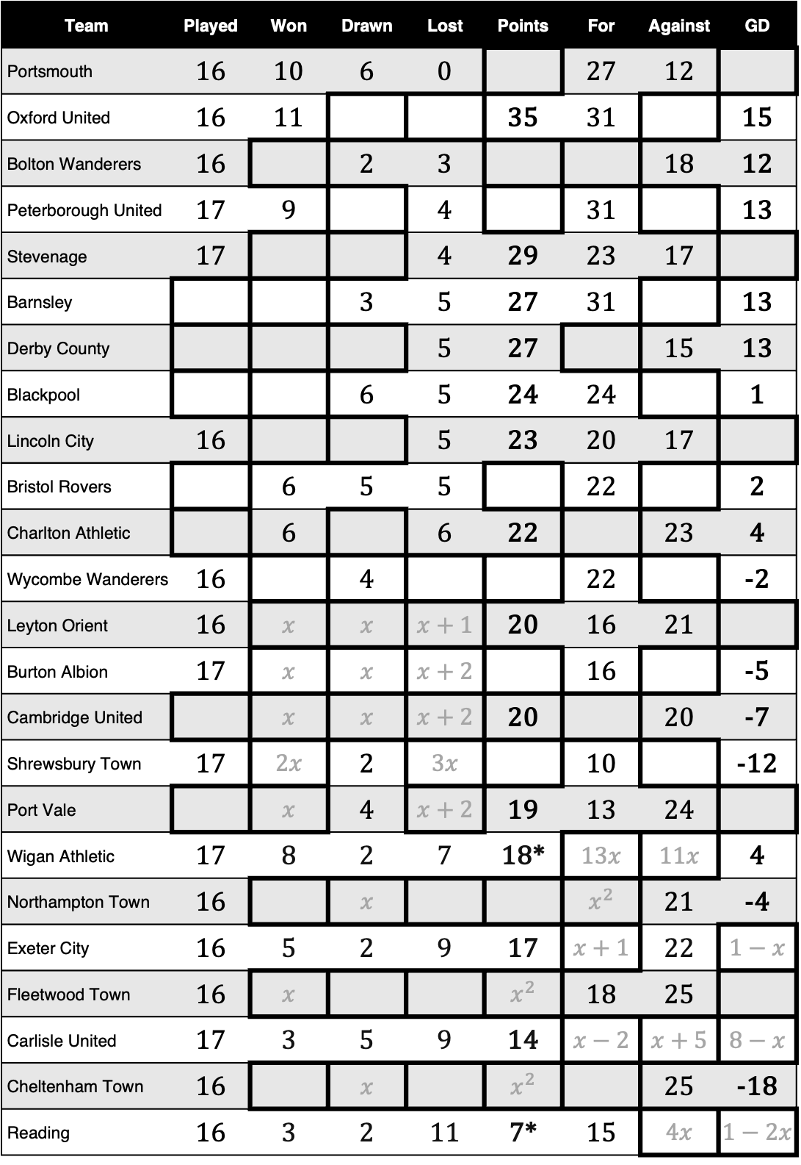
Team | Played | Won | Drawn | Lost | Points | For | Against | GD
Portsmouth | 16 | 10 | 6 | 0 |  | 27 | 12
Oxford United | 16 | 11 |  |  | 35 | 31 |  | 15
Bolton Wanderers | 16 |  | 2 | 3 |  |  | 18 | 12
Peterborough United | 17 | 9 |  | 4 |  | 31 |  | 13
Stevenage | 17 |  |  | 4 | 29 | 23 | 17
Barnsley |  |  | 3 | 5 | 27 | 31 |  | 13
Derby County |  |  |  | 5 | 27 |  | 15 | 13
Blackpool |  |  | 6 | 5 | 24 | 24 |  | 1
Lincoln City | 16 |  |  | 5 | 23 | 20 | 17
Bristol Rovers |  | 6 | 5 | 5 |  | 22 |  | 2
Charlton Athletic |  | 6 |  | 6 | 22 |  | 23 | 4
Wycombe Wanderers | 16 |  | 4 |  |  | 22 |  | -2
Leyton Orient | 16 | $x$ | $x$ | $x+1$ | 20 | 16 | 21
Burton Albion | 17 | $x$ | $x$ | $x+2$ |  | 16 |  | -5
Cambridge United |  | $x$ | $x$ | $x+2$ | 20 |  | 20 | -7
Shrewsbury Town | 17 | $2x$ | 2 | $3x$ |  | 10 |  | -12
Port Vale |  | $x$ | 4 | $x+2$ | 19 | 13 | 24
Wigan Athletic | 17 | 8 | 2 | 7 | 18* | $13x$ | $11x$ | 4
Northampton Town | 16 |  | $x$ |  |  | $x^{2}$ | 21 | -4
Exeter City | 16 | 5 | 2 | 9 | 17 | $x+1$ | 22 | $1−x$
Fleetwood Town | 16 | $x$ |  |  | $x^{2}$ | 18 | 25
Carlisle United | 17 | 3 | 5 | 9 | 14 | $x−2$ | $x+5$ | $8−x$
Cheltenham Town | 16 |  | $x$ |  | $x^{2}$ |  | 25 | -18
Reading | 16 | 3 | 2 | 11 | 7* | 15 | $4x$ | $1−2x$
League One Table (November 23) *Reading and Wigan were deducted 8 points and 4 points respectively due to Sporting Sanctions.

Slide 2
Team | Played | Won | Drawn | Lost | Points | For | Against | GD
Portsmouth | 16 | 10 | 6 | 0 | 36 | 27 | 12 | 15
Oxford United | 16 | 11 | 2 | 3 | 35 | 31 | 16 | 15
Bolton Wanderers | 16 | 11 | 2 | 3 | 35 | 30 | 18 | 12
Peterborough United | 17 | 9 | 4 | 4 | 31 | 31 | 18 | 13
Stevenage | 17 | 8 | 5 | 4 | 29 | 23 | 17 | 6
Barnsley | 16 | 8 | 3 | 5 | 27 | 31 | 18 | 13
Derby County | 16 | 8 | 3 | 5 | 27 | 28 | 15 | 13
Blackpool | 17 | 6 | 6 | 5 | 24 | 24 | 23 | 1
Lincoln City | 16 | 6 | 5 | 5 | 23 | 20 | 17 | 3
Bristol Rovers | 16 | 6 | 5 | 5 | 23 | 22 | 20 | 2
Charlton Athletic | 16 | 6 | 4 | 6 | 22 | 27 | 23 | 4
Wycombe Wanderers | 16 | 6 | 4 | 6 | 22 | 22 | 24 | -2
Leyton Orient | 16 | 5 | 5 | 6 | 20 | 16 | 21 | -5
Burton Albion | 17 | 5 | 5 | 7 | 20 | 16 | 21 | -5
Cambridge United | 17 | 5 | 5 | 7 | 20 | 13 | 20 | -7
Shrewsbury Town | 17 | 6 | 2 | 9 | 20 | 10 | 22 | -12
Port Vale | 16 | 5 | 4 | 7 | 19 | 13 | 24 | -11
Wigan Athletic | 17 | 8 | 2 | 7 | 18* | 26 | 22 | 4
Northampton Town | 16 | 5 | 2 | 9 | 17 | 17 | 21 | -4
Exeter City | 16 | 5 | 2 | 9 | 17 | 12 | 22 | -10
Fleetwood Town | 16 | 4 | 4 | 8 | 16 | 18 | 25 | -7
Carlisle United | 17 | 3 | 5 | 9 | 14 | 13 | 20 | -7
Cheltenham Town | 16 | 2 | 3 | 11 | 9 | 7 | 25 | -18
Reading | 16 | 3 | 2 | 11 | 7* | 15 | 28 | -13
League One Table (November 23) *Reading and Wigan were deducted 8 points and 4 points respectively due to Sporting Sanctions.

Slide 3
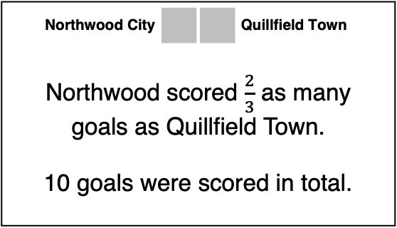
Oakford Wanderers |  |  | Elmbridge United
5 goals were scored in total. Elmbridge United scored 80% of the goals.
Drayton Rovers |  |  | Juniper Vale FC
Drayton scored more times than Oakford, but fewer than Kingswell. The game was a draw.
Amberfield Athletic |  |  | Penhurst County
Amberfield and Penhurst drew. Together, they scored as many goals as Quillfield Town.
Highbrook United |  |  | Ironbridge Town
Ironbridge scored more than Thornleigh, but they still did not win. Highbrook scored as many goals as Loxley Rangers.
Redwood Rangers |  |  | Greenford City
Greenford scored half as many times as Silverdale. Redwood scored twice as many times as Drayton Rovers.
Foxley Town |  |  | Silverdale City
Two players scored a hat-trick. Nobody else scored. Silverdale won.
Crestwood FC |  |  | Thornleigh Athletic
Crestwood scored 50% more goals than Briarhill. Thornleigh score 25% fewer goals than Northwood City.
Northwood City |  |  | Quillfield Town
Northwood scored $\frac{2}{3}$ as many goals as Quillfield Town. 10 goals were scored in total.
Merrow Park FC |  |  | Loxley Rangers
Both teams scored a number of goals that is a factor of 15 8 goals were scored.
Kingswell Albion |  |  | Briarhill United
Kingswell and Briarhill both scored a prime number of goals. Kingswell scored once more than Briarhill.

Slide 4
 | Goals
Amberfield Athletic
Briarhill United
Crestwood FC
Drayton Rovers
Elmbridge United
Foxley Town
Greenford City
Highbrook United
Ironbridge Town
Juniper Vale FC
Kingswell Albion
Loxley Rangers
Merrow Park FC
Northwood City
Oakford Wanderers
Penhurst County
Quillfield Town
Redwood Rangers
Silverdale City
Thornleigh Athletic
 | Goals
Amberfield Athletic
Briarhill United
Crestwood FC
Drayton Rovers
Elmbridge United
Foxley Town
Greenford City
Highbrook United
Ironbridge Town
Juniper Vale FC
Kingswell Albion
Loxley Rangers
Merrow Park FC
Northwood City
Oakford Wanderers
Penhurst County
Quillfield Town
Redwood Rangers
Silverdale City
Thornleigh Athletic

Slide 5
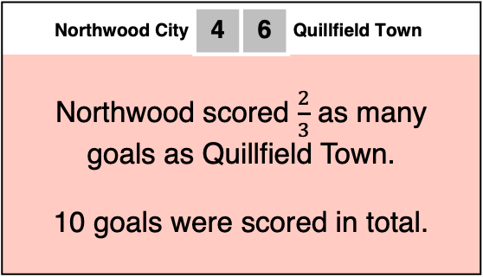
Oakford Wanderers | 1 | 4 | Elmbridge United
5 goals were scored in total. Elmbridge United scored 80% of the goals.
Drayton Rovers | 2 | 2 | Juniper Vale FC
Drayton scored more times than Oakford, but fewer than Kingswell. The game was a draw.
Amberfield Athletic | 3 | 3 | Penhurst County
Amberfield and Penhurst drew. Together, they scored as many goals as Quillfield Town.
Highbrook United | 5 | 4 | Ironbridge Town
Ironbridge scored more than Thornleigh, but they still did not win. Highbrook scored as many goals as Loxley Rangers.
Redwood Rangers | 4 | 3 | Greenford City
Greenford scored half as many times as Silverdale. Redwood scored twice as many times as Drayton Rovers.
Foxley Town | 0 | 6 | Silverdale City
Two players scored a hat-trick. Nobody else scored. Silverdale won.
Crestwood FC | 3 | 3 | Thornleigh Athletic
Crestwood scored 50% more goals than Briarhill. Thornleigh score 25% fewer goals than Northwood City.
Northwood City | 4 | 6 | Quillfield Town
Northwood scored $\frac{2}{3}$ as many goals as Quillfield Town. 10 goals were scored in total.
Merrow Park FC | 3 | 5 | Loxley Rangers
Both teams scored a number of goals that is a factor of 15 8 goals were scored.
Kingswell Albion | 3 | 2 | Briarhill United
Kingswell and Briarhill both scored a prime number of goals. Kingswell scored once more than Briarhill.

Slide 6
 | Goals
Amberfield Athletic | 3
Briarhill United | 2
Crestwood FC | 3
Drayton Rovers | 2
Elmbridge United | 4
Foxley Town | 0
Greenford City | 3
Highbrook United | 5
Ironbridge Town | 4
Juniper Vale FC | 2
Kingswell Albion | 3
Loxley Rangers | 5
Merrow Park FC | 3
Northwood City | 4
Oakford Wanderers | 1
Penhurst County | 3
Quillfield Town | 6
Redwood Rangers | 4
Silverdale City | 6
Thornleigh Athletic | 3

