Slide 1

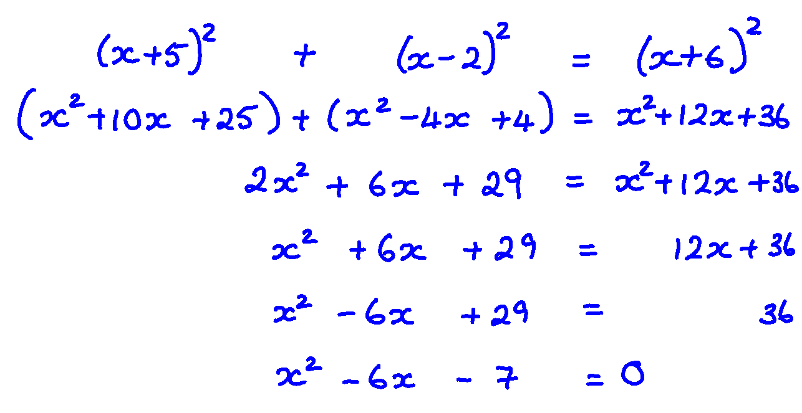

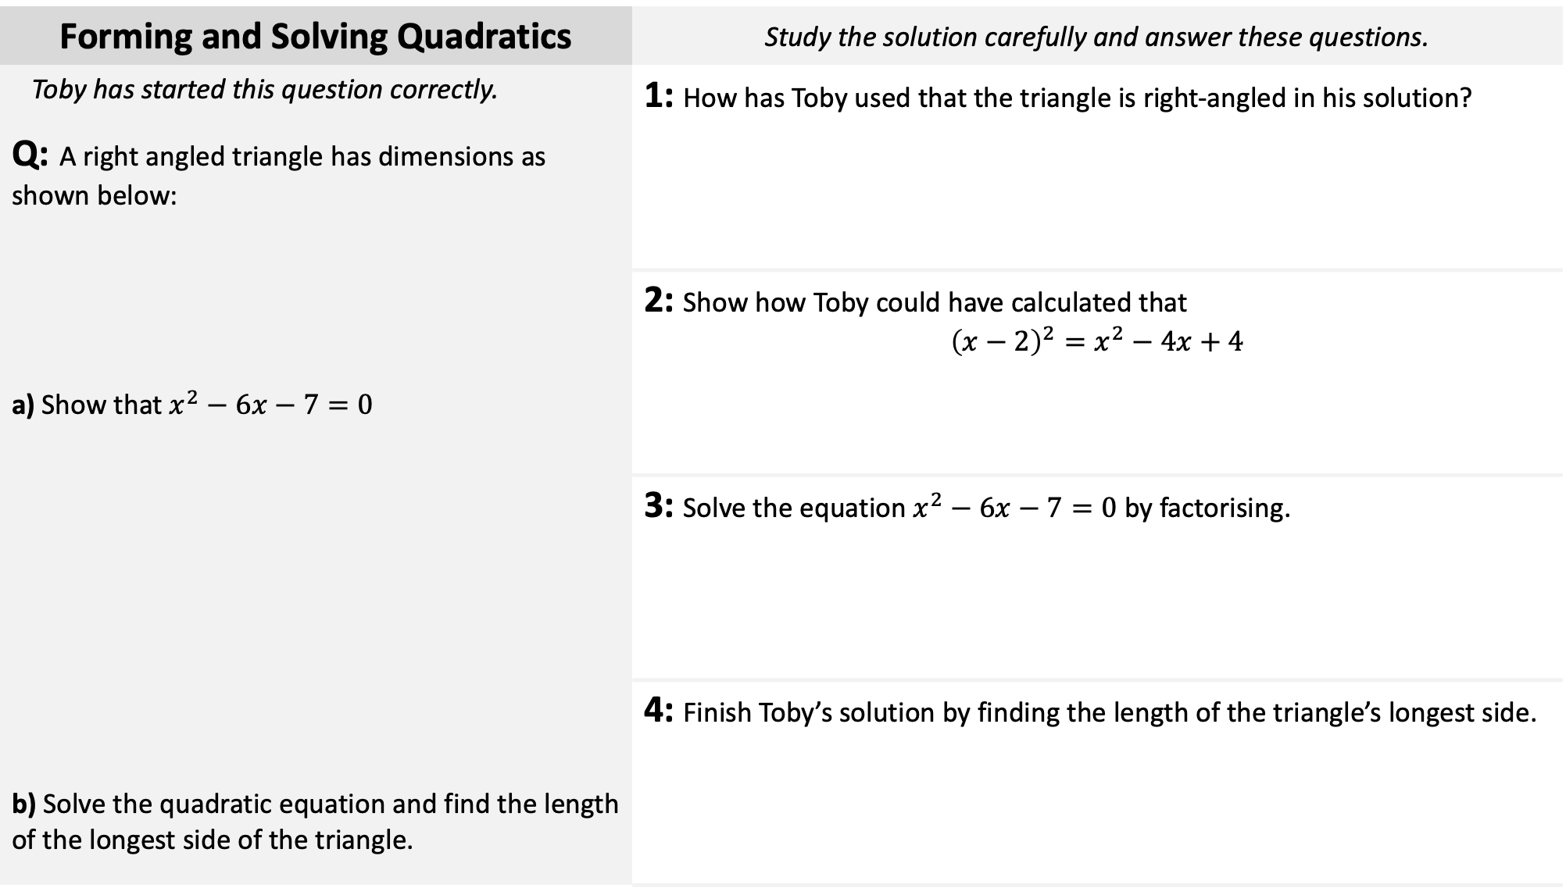


Forming and Solving Quadratics | Study the solution carefully and answer these questions.
Toby has started this question correctly. Q: A right angled triangle has dimensions as shown below: a) Show that $x^{2}−6x−7=0$ b) Solve the quadratic equation and find the length of the longest side of the triangle. | 1: How has Toby used that the triangle is right-angled in his solution?
A: | 2: Show how Toby could have calculated that $${\left(x−2\right)}^{2}=x^{2}−4x+4$$
 | 3: Solve the equation $x^{2}−6x−7=0$ by factorising.
 | 4: Finish Toby’s solution by finding the length of the triangle’s longest side.
$$\left(x+6\right) \text{cm}$$
$$\left(x−2\right) \text{cm}$$
$$\left(x+5\right) \text{cm}$$

