Slide 1
Introductions
Ratio Scaling
interwovenmaths.com/gdst2
Nathan Day
@nathanday.bsky.social | n.day@not.gdst.net | interwovenmaths.com

Slide 2
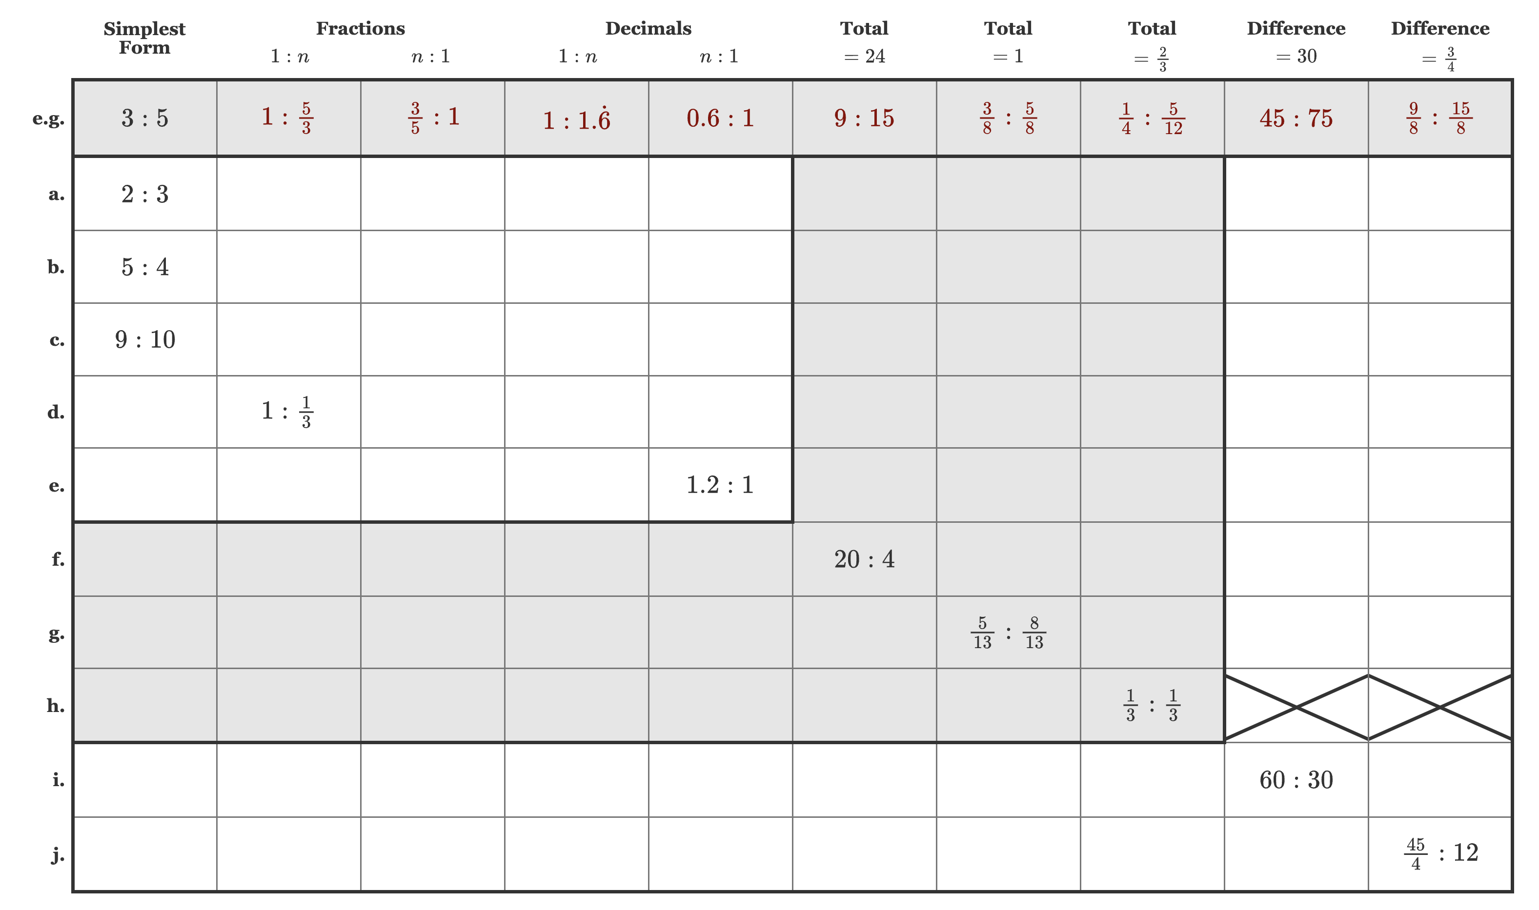
Ratio Scaling – Intro Task

Slide 3
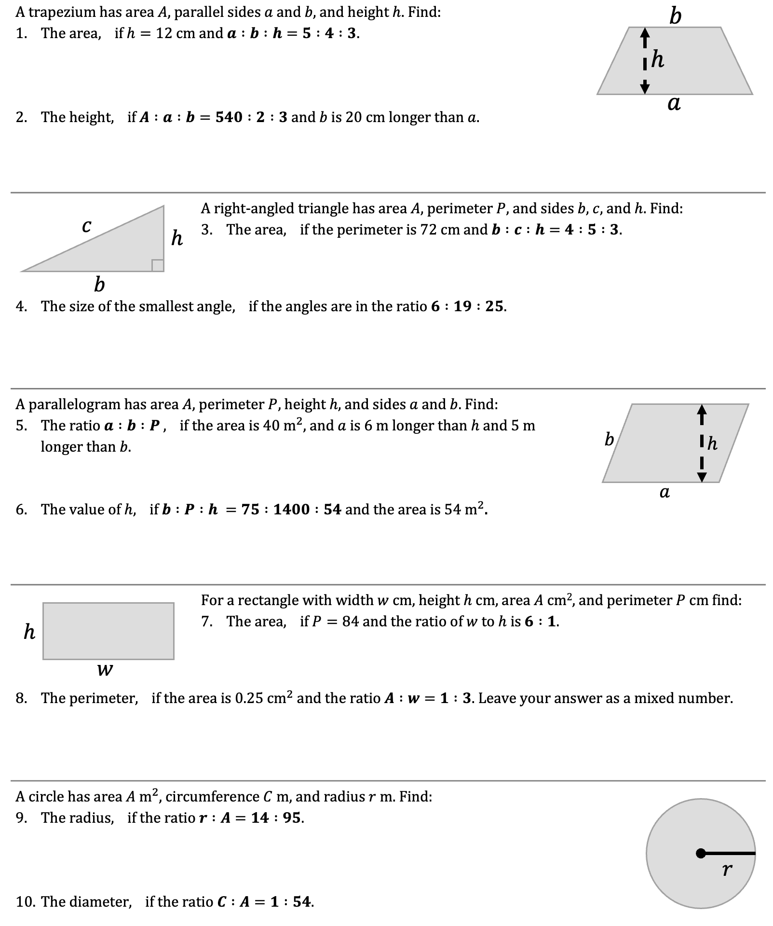
Ratio Sharing – Intro Task

Slide 4
Ratio Sharing – Intro Task

Slide 5
Ratio Sharing – Intro Task

Slide 6
Ratio Sharing – Intro Task

Slide 7
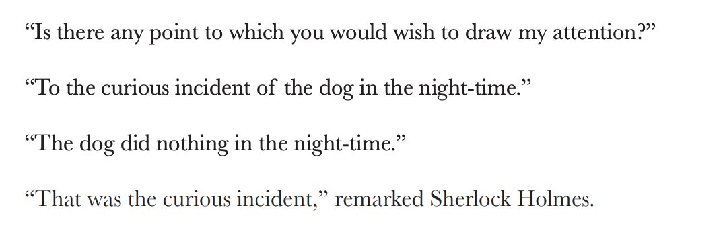
Changing Ratios - Invariance

Slide 8


Changing Ratios - Invariance
Notes:
https://kshancock.co.uk/lessonresources.html#ratioScaling

Slide 9
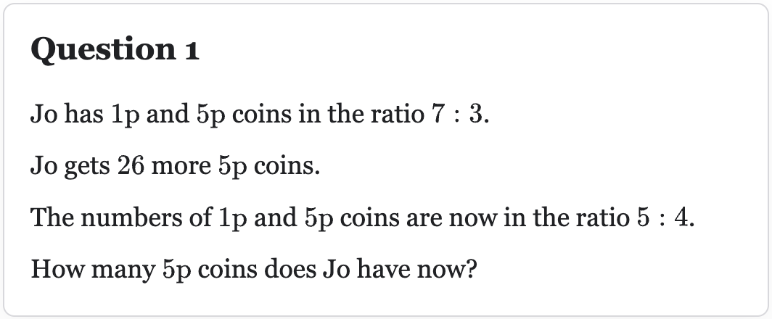
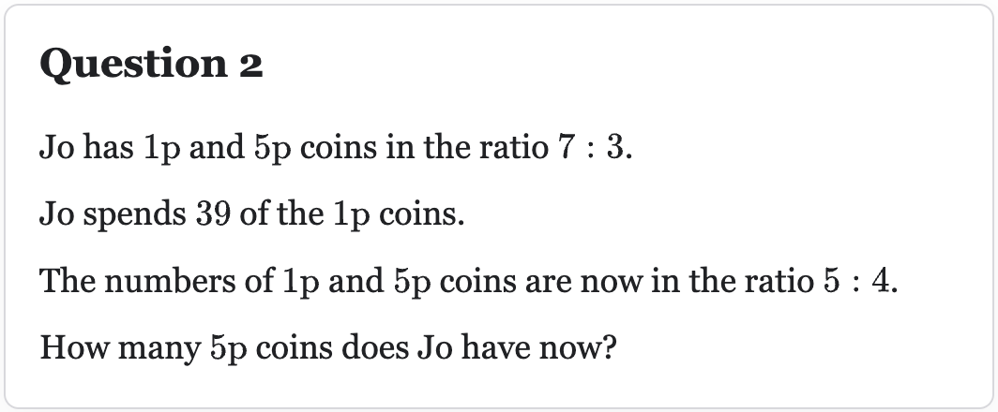
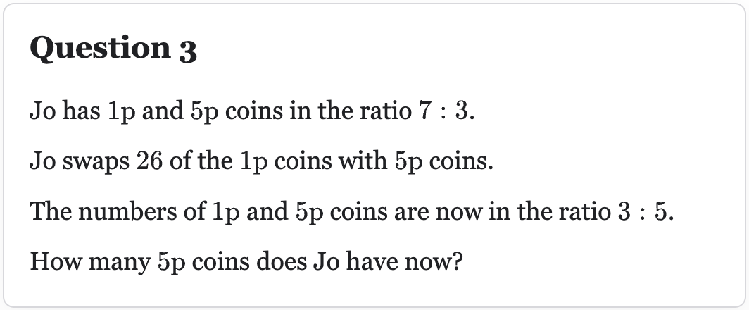
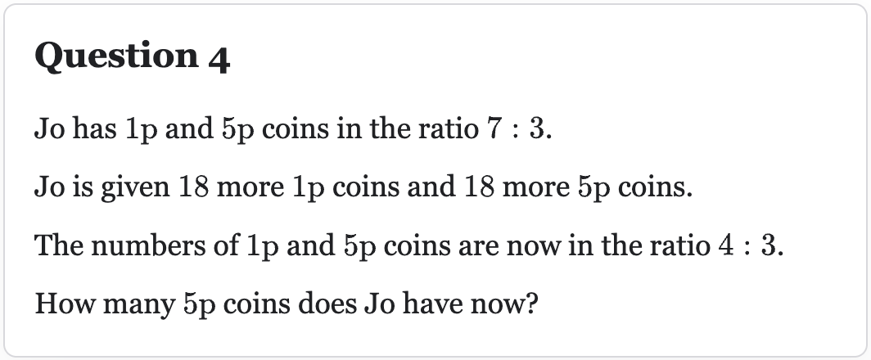
Changing Ratios - Invariance

Slide 10
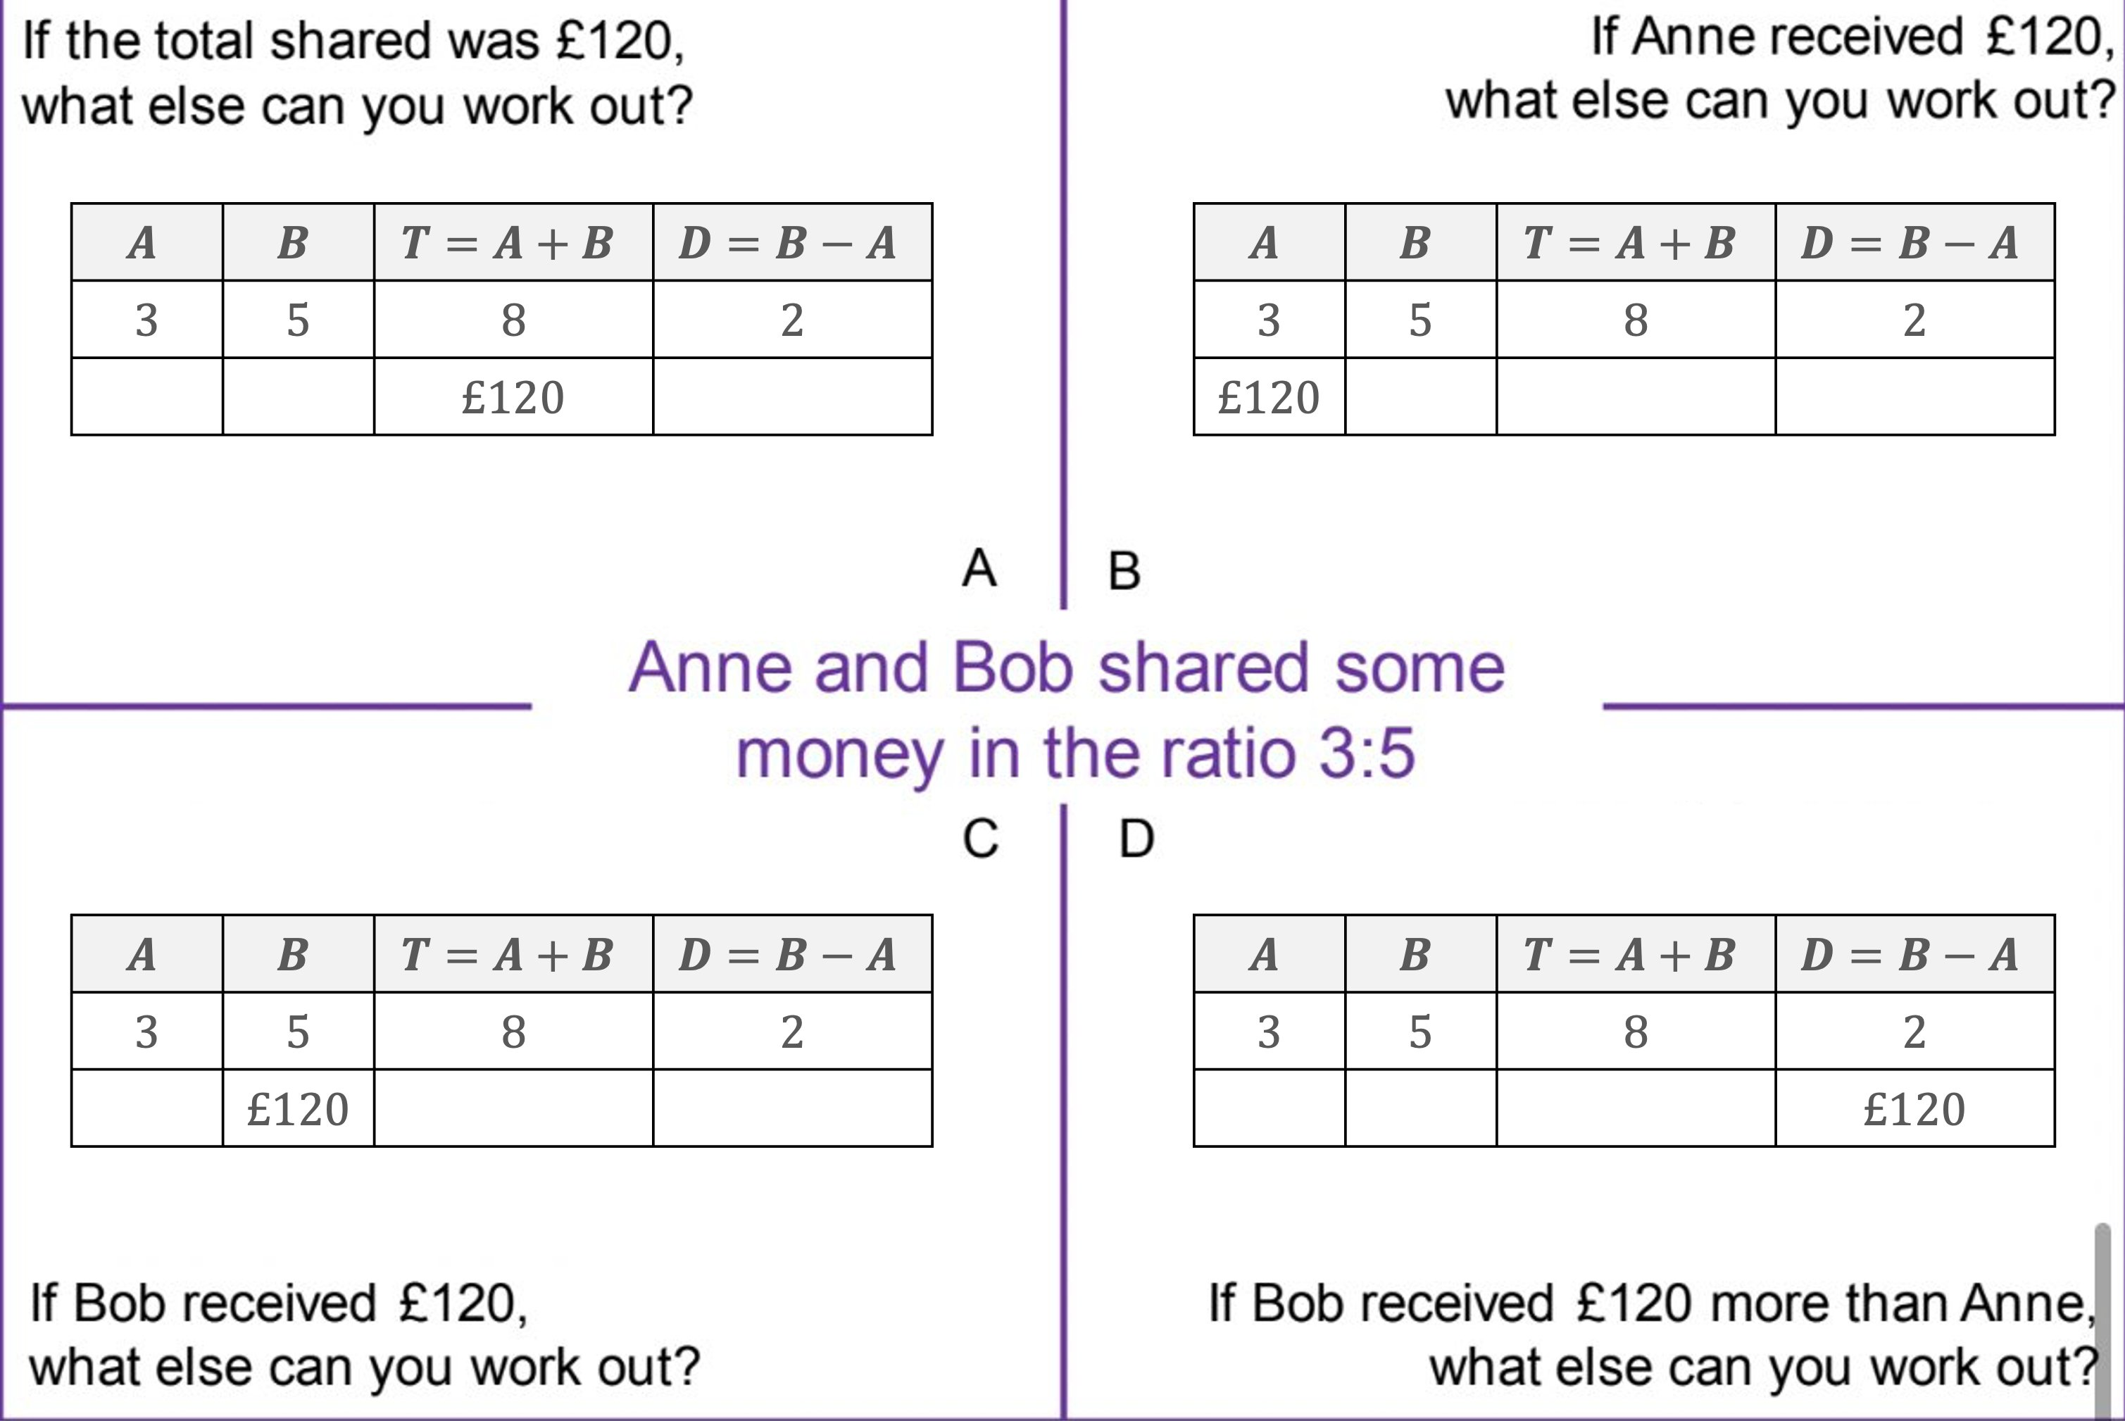
Simple Scaling

Slide 11
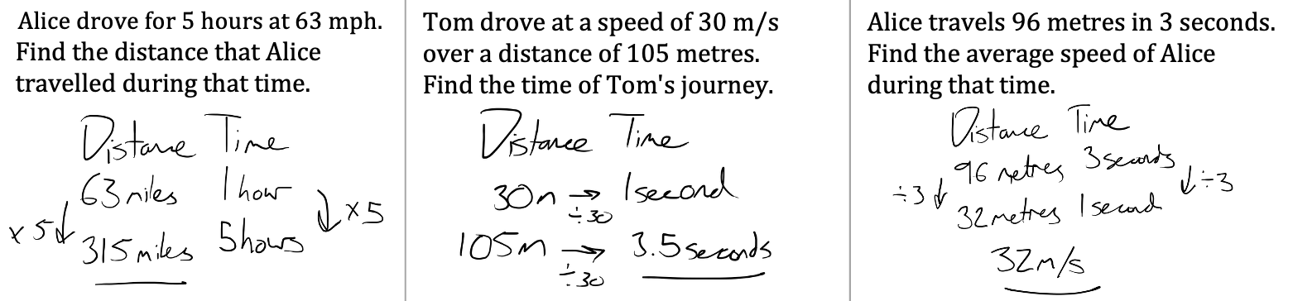
Ratio Scaling in other contexts
Speed, Distance, Time

Slide 12
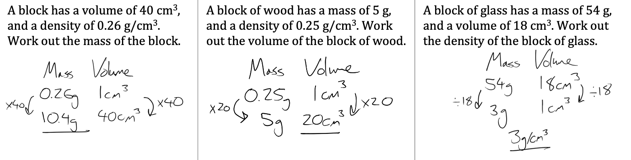
Ratio Scaling in other contexts
Density, Mass, Volume

Slide 13
Ratio Scaling in other contexts
Pressure? Gradient? Probability?

Slide 14
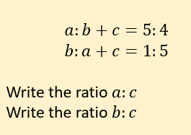
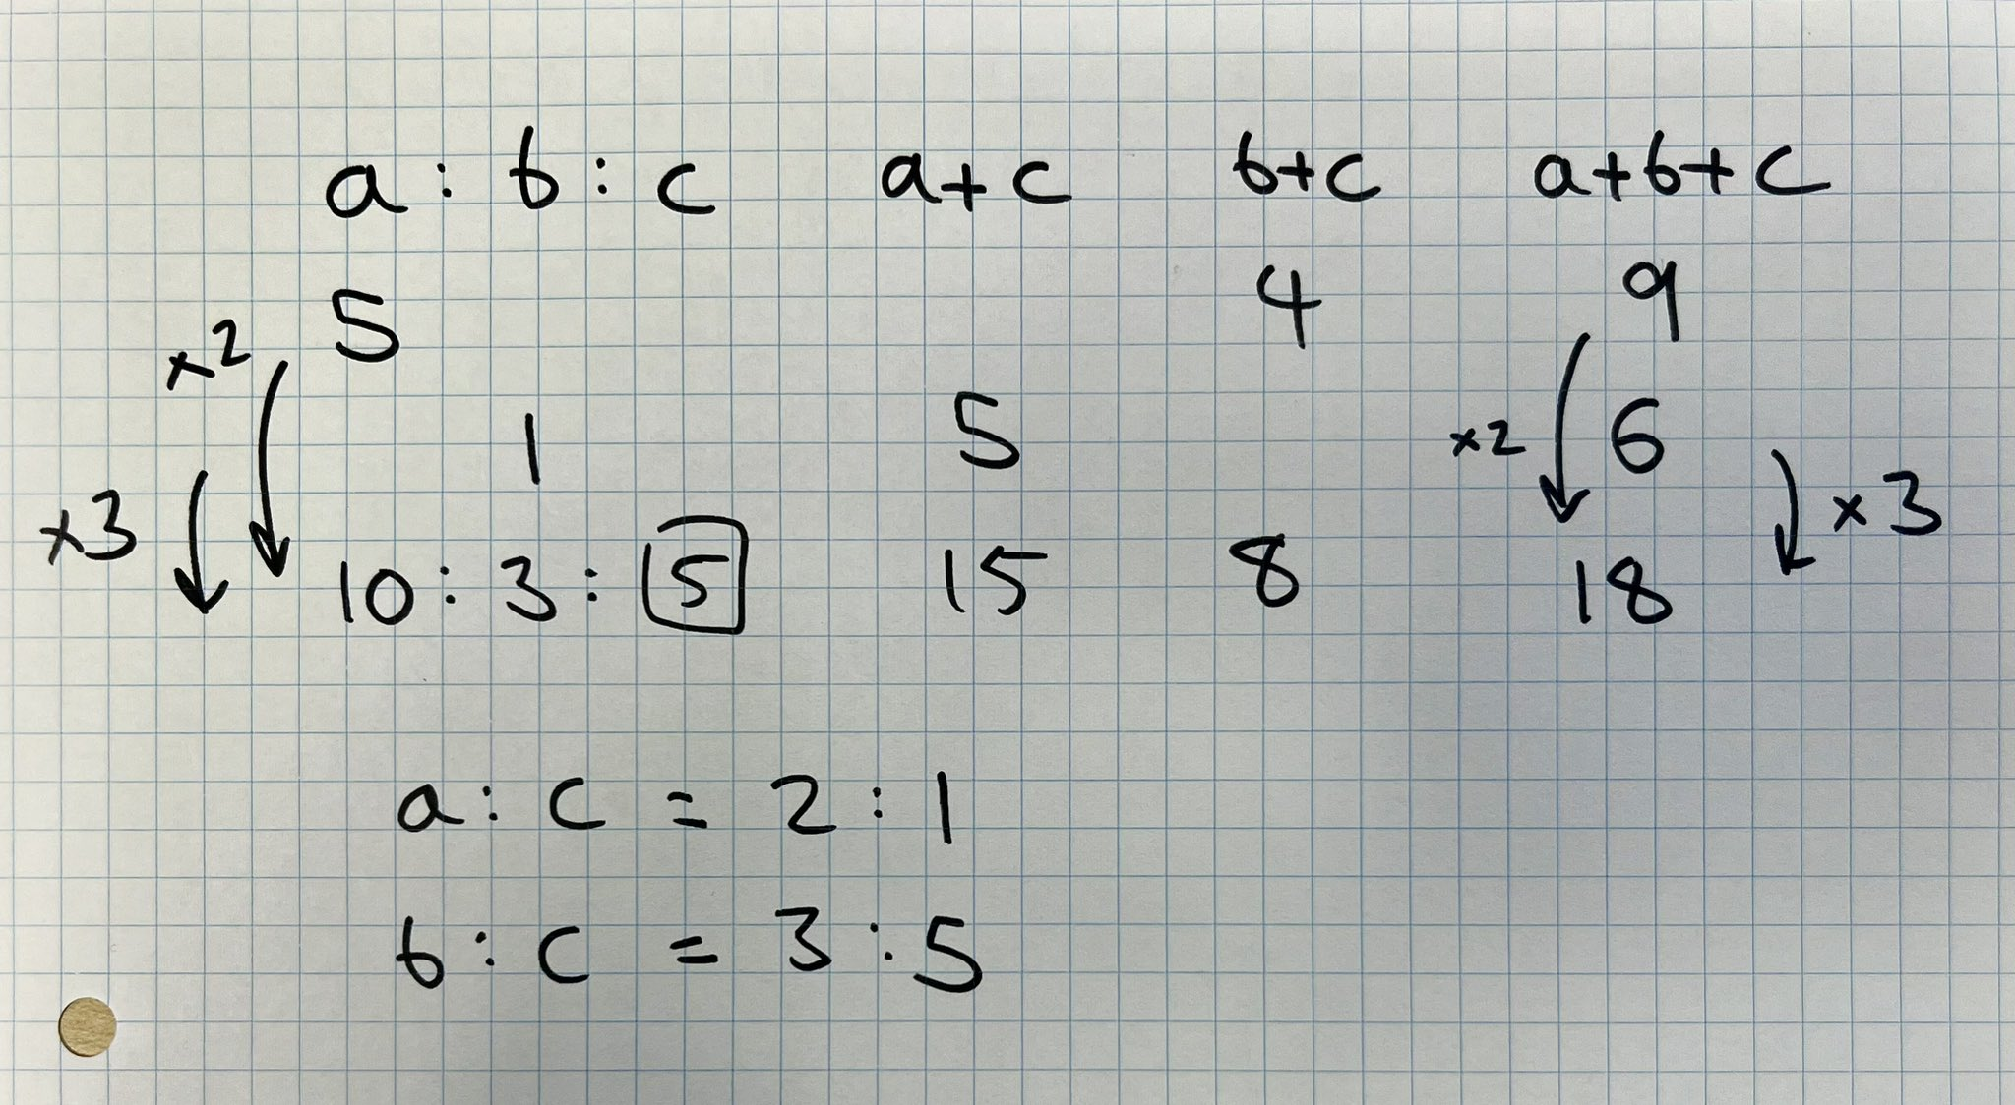
Other Questions

Slide 15
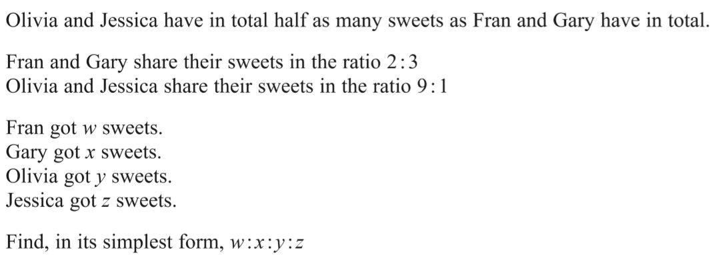
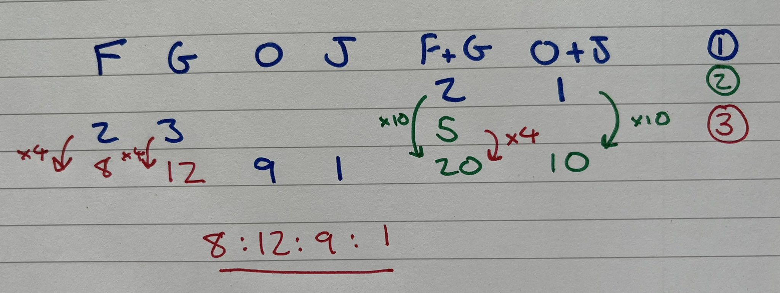
Other Questions

Slide 16
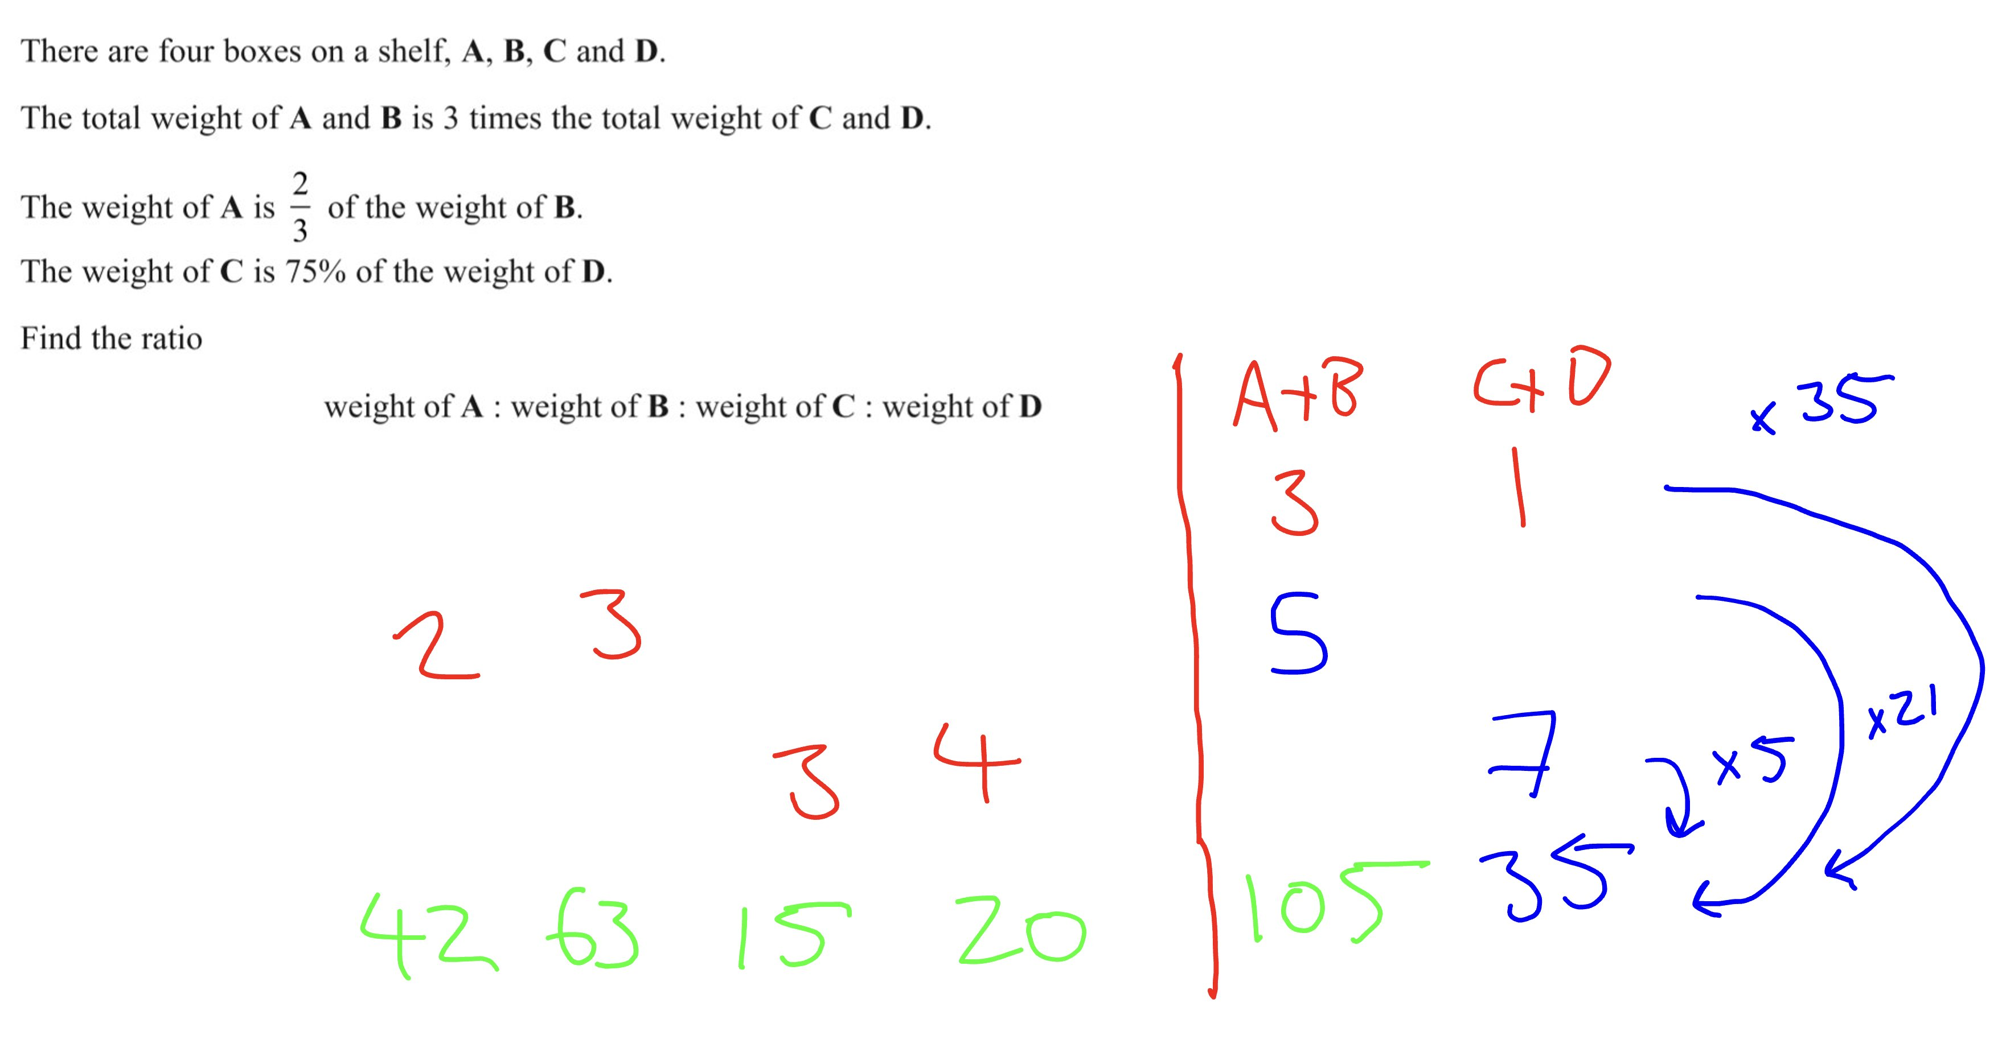
Other Questions

Slide 17
Other Questions

Slide 18
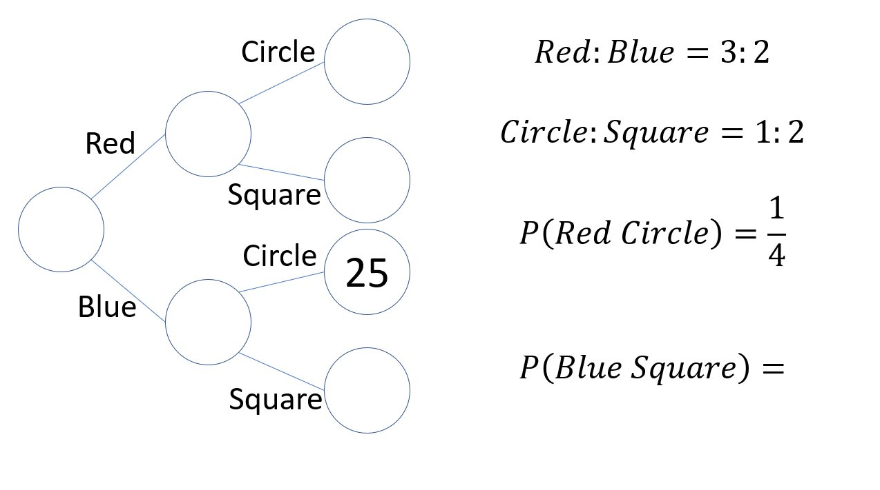
Other Questions

Slide 19
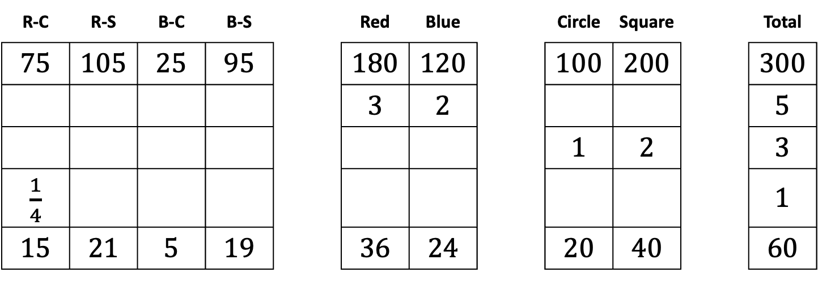
Other Questions
75
180
105
300
120
95
R-C | R-S | B-C | B-S |  | Red | Blue |  | Circle | Square |  | Total
75 | 105 | 25 | 95 |  | 180 | 120 |  | 100 | 200 |  | 300
 |  |  |  |  | 3 | 2 |  |  |  |  | 5
 |  |  |  |  |  |  |  | 1 | 2 |  | 3
$\frac{1}{4}$ |  |  |  |  |  |  |  |  |  |  | 1
15 | 21 | 5 | 19 |  | 36 | 24 |  | 20 | 40 |  | 60

Slide 20
Other Questions
R-C | R-S | B-C | B-S |  | Red | Blue |  | Circle | Square |  | Total

Slide 21
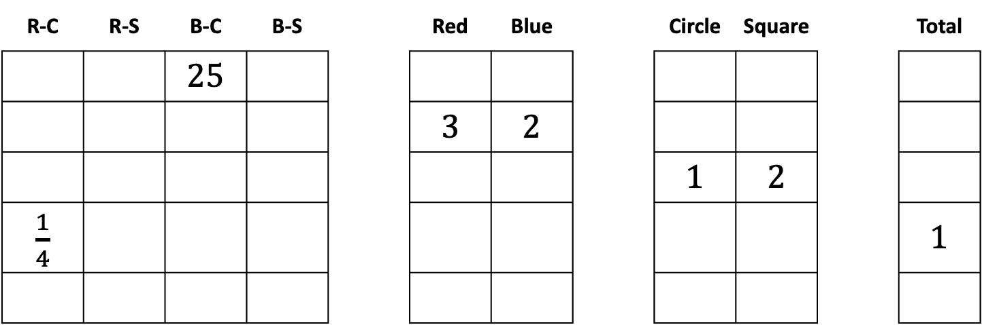
Other Questions
R-C | R-S | B-C | B-S |  | Red | Blue |  | Circle | Square |  | Total
 |  | 25
 |  |  |  |  | 3 | 2
 |  |  |  |  |  |  |  | 1 | 2
$\frac{1}{4}$ |  |  |  |  |  |  |  |  |  |  | 1

Slide 22
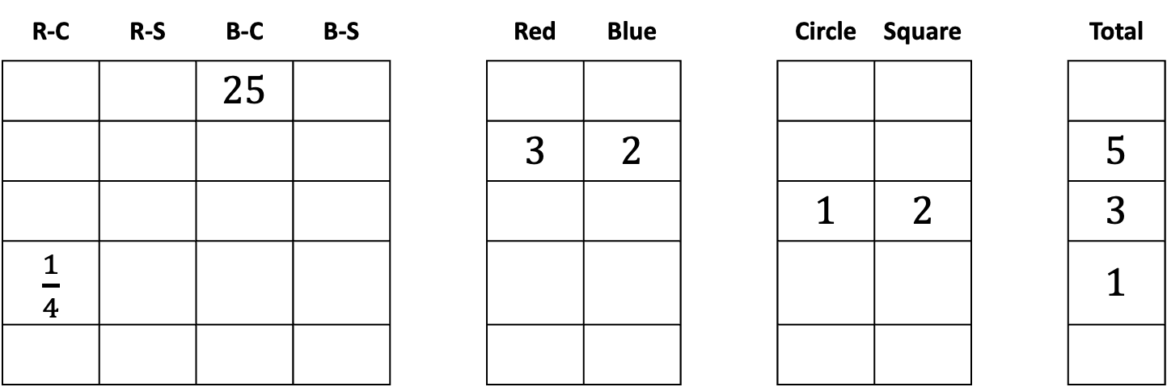
Other Questions
R-C | R-S | B-C | B-S |  | Red | Blue |  | Circle | Square |  | Total
 |  | 25
 |  |  |  |  | 3 | 2 |  |  |  |  | 5
 |  |  |  |  |  |  |  | 1 | 2 |  | 3
$\frac{1}{4}$ |  |  |  |  |  |  |  |  |  |  | 1

Slide 23
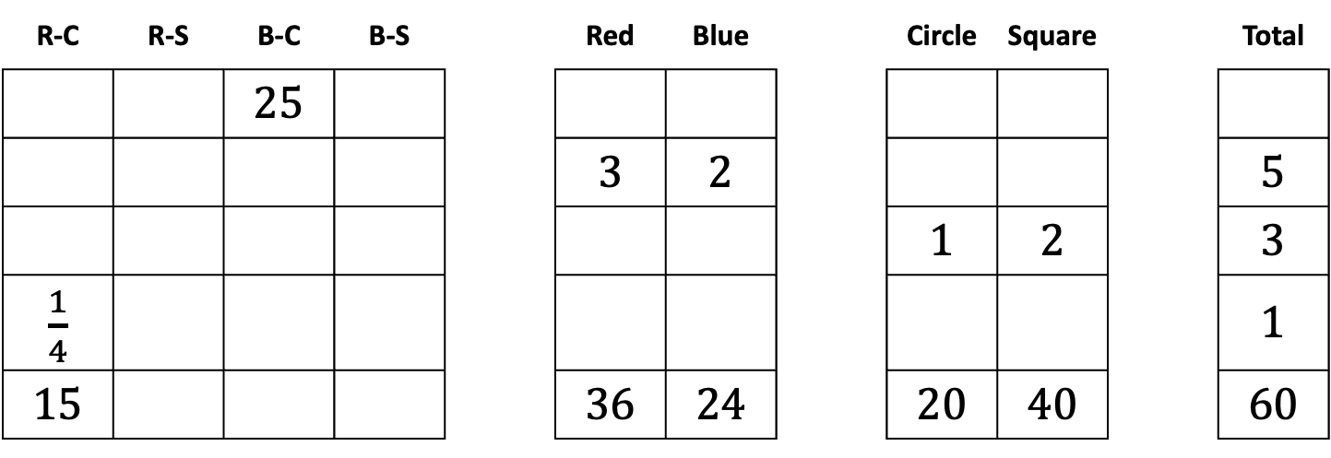
Other Questions
R-C | R-S | B-C | B-S |  | Red | Blue |  | Circle | Square |  | Total
 |  | 25
 |  |  |  |  | 3 | 2 |  |  |  |  | 5
 |  |  |  |  |  |  |  | 1 | 2 |  | 3
$\frac{1}{4}$ |  |  |  |  |  |  |  |  |  |  | 1
15 |  |  |  |  | 36 | 24 |  | 20 | 40 |  | 60

Slide 24
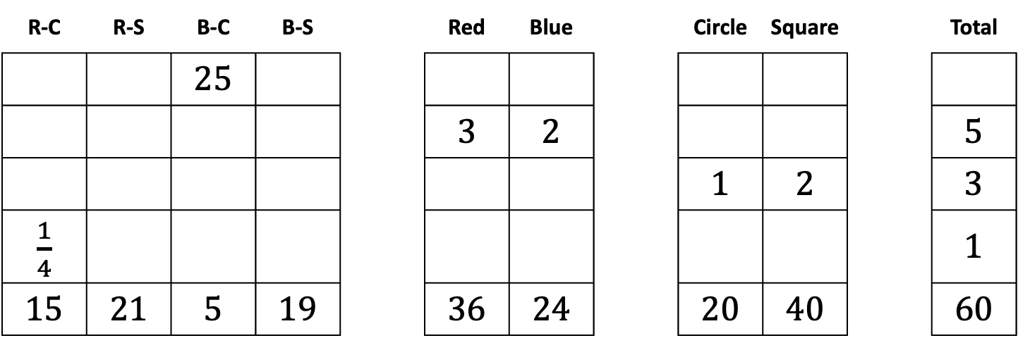
Other Questions
R-C | R-S | B-C | B-S |  | Red | Blue |  | Circle | Square |  | Total
 |  | 25
 |  |  |  |  | 3 | 2 |  |  |  |  | 5
 |  |  |  |  |  |  |  | 1 | 2 |  | 3
$\frac{1}{4}$ |  |  |  |  |  |  |  |  |  |  | 1
15 | 21 | 5 | 19 |  | 36 | 24 |  | 20 | 40 |  | 60

Slide 25
Other Questions
R-C | R-S | B-C | B-S |  | Red | Blue |  | Circle | Square |  | Total
75 | 105 | 25 | 95 |  | 180 | 120 |  | 100 | 200 |  | 300
 |  |  |  |  | 3 | 2 |  |  |  |  | 5
 |  |  |  |  |  |  |  | 1 | 2 |  | 3
$\frac{1}{4}$ |  |  |  |  |  |  |  |  |  |  | 1
15 | 21 | 5 | 19 |  | 36 | 24 |  | 20 | 40 |  | 60

Slide 26
Introductions
Ratio Scaling
interwovenmaths.com/gdst2
Nathan Day
@nathanday.bsky.social | n.day@not.gdst.net | interwovenmaths.com

