Slide 1
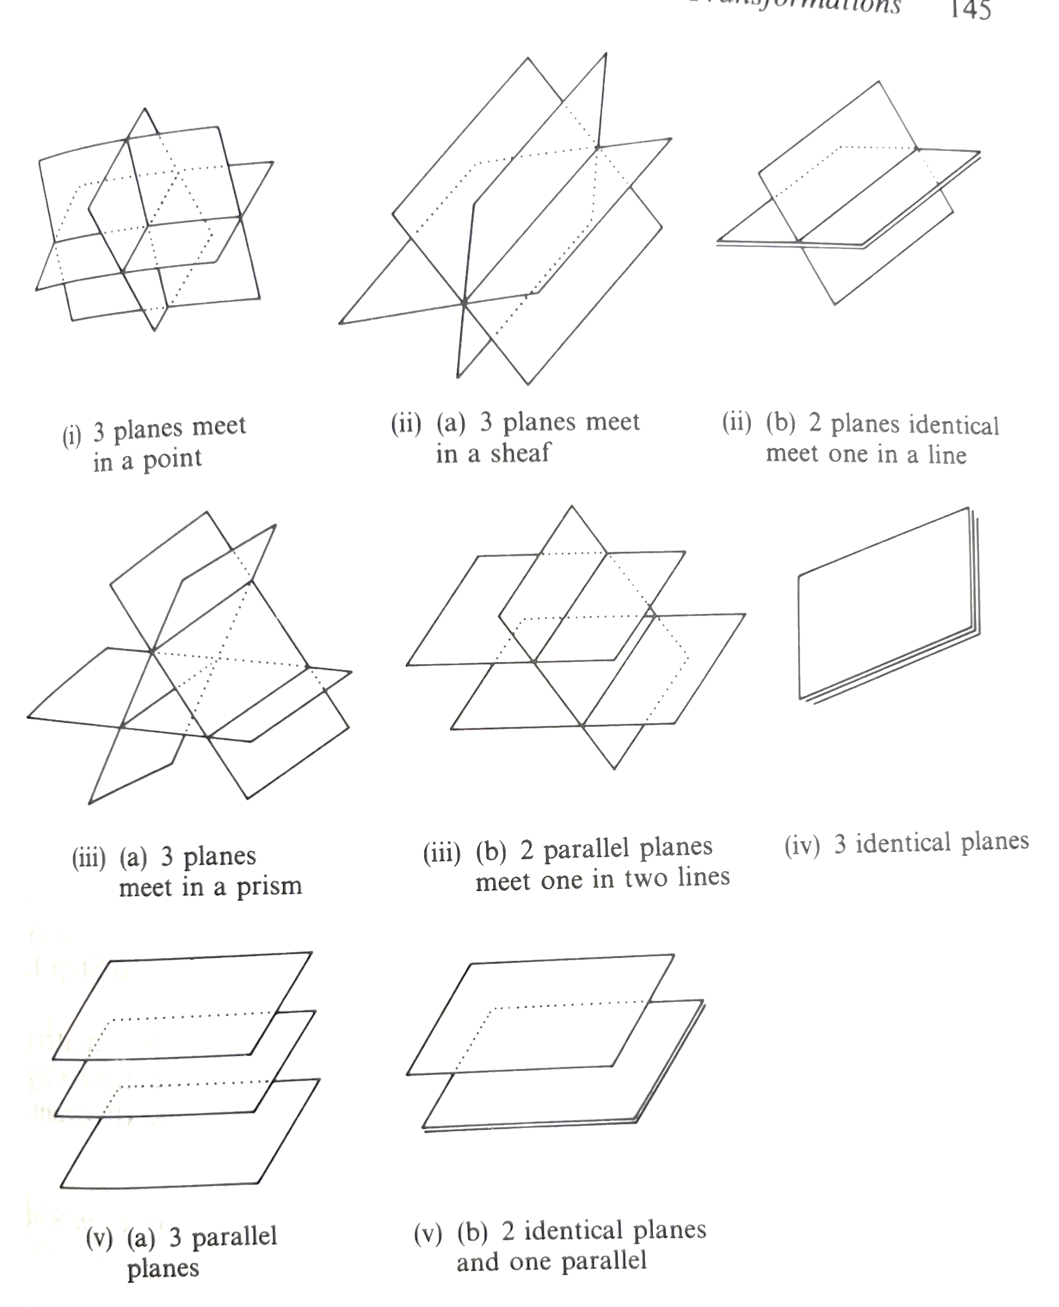
Geometric Configurations of Simultaneous Equations
Match the systems of linear equations to their geometric configuration.
A: Three planes meet in a point | B: Three planes meet in a sheaf |  | C: Three planes meet in a prism
D: Two parallel planes meet one in two lines | E: Two identical planes and one parallel |  | F: Two identical planes meet one in a line
G: Three parallel planes |  | H: Three identical planes
Consistent |  |  |  |  | Inconsistent

Slide 2
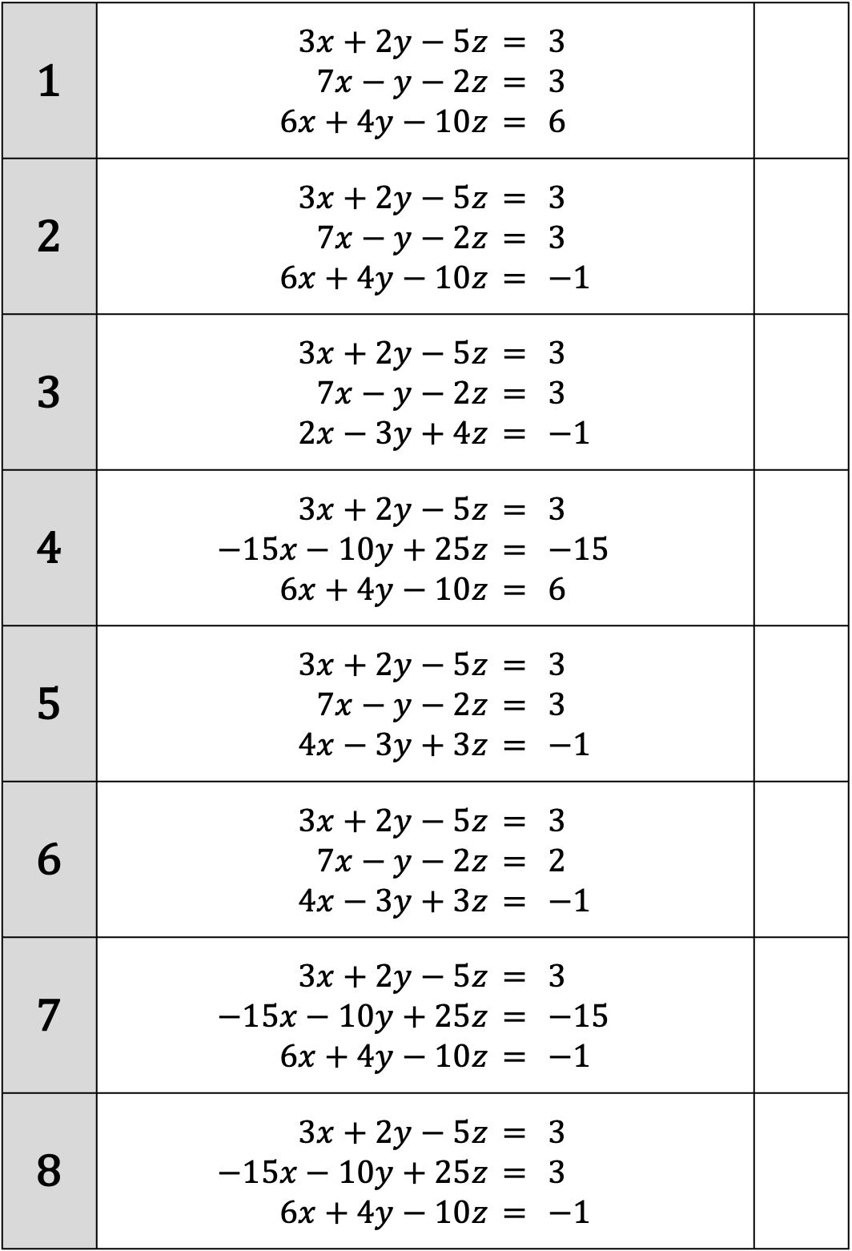
1 | $3x+2y−5z$ $7x−y−2z$ $6x+4y−10z$ | $$= \\ =$$ $=$ | $$3 \\ 3 \\ 6$$
2 | $3x+2y−5z$ $7x−y−2z$ $6x+4y−10z$ | $$= \\ =$$ $=$ | $$3 \\ 3 \\ −1$$
3 | $3x+2y−5z$ $7x−y−2z$ $2x−3y+4z$ | $$= \\ =$$ $=$ | $$3 \\ 3 \\ −1$$
4 | $3x+2y−5z$ $−15x−10y+25z$ $6x+4y−10z$ | $$= \\ =$$ $=$ | $$3 \\ −15 \\ 6$$
5 | $3x+2y−5z$ $7x−y−2z$ $4x−3y+3z$ | $$= \\ =$$ $=$ | $$3 \\ 3 \\ −1$$
6 | $3x+2y−5z$ $7x−y−2z$ $4x−3y+3z$ | $$= \\ =$$ $=$ | $$3 \\ 2 \\ −1$$
7 | $3x+2y−5z$ $−15x−10y+25z$ $6x+4y−10z$ | $$= \\ =$$ $=$ | $$3 \\ −15 \\ −1$$
8 | $3x+2y−5z$ $−15x−10y+25z$ $6x+4y−10z$ | $$= \\ =$$ $=$ | $$3 \\ 3 \\ −1$$

Slide 3
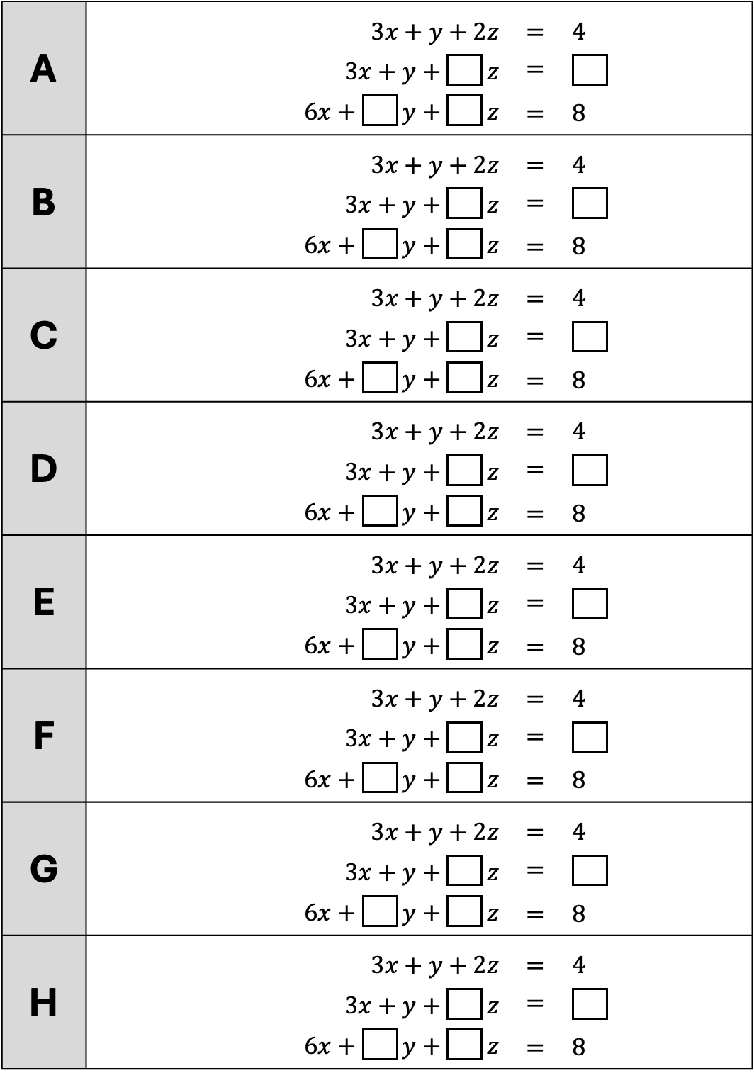
1. Fill in the gaps using only the numbers $2$ or $4$ to make each configuration.
(One of them is impossible!)
A | $3x+y+2z$ | $=$ | $4$
 | $3x+y+\boxed{} z$ | $=$
 | $6x+\boxed{} y+\boxed{} z$ | $=$ | $8$
B | $3x+y+2z$ | $=$ | $4$
 | $3x+y+\boxed{} z$ | $=$
 | $6x+\boxed{} y+\boxed{} z$ | $=$ | $8$
C | $3x+y+2z$ | $=$ | $4$
 | $3x+y+\boxed{} z$ | $=$
 | $6x+\boxed{} y+\boxed{} z$ | $=$ | $8$
D | $3x+y+2z$ | $=$ | $4$
 | $3x+y+\boxed{} z$ | $=$
 | $6x+\boxed{} y+\boxed{} z$ | $=$ | $8$
E | $3x+y+2z$ | $=$ | $4$
 | $3x+y+\boxed{} z$ | $=$
 | $6x+\boxed{} y+\boxed{} z$ | $=$ | $8$
F | $3x+y+2z$ | $=$ | $4$
 | $3x+y+\boxed{} z$ | $=$
 | $6x+\boxed{} y+\boxed{} z$ | $=$ | $8$
G | $3x+y+2z$ | $=$ | $4$
 | $3x+y+\boxed{} z$ | $=$
 | $6x+\boxed{} y+\boxed{} z$ | $=$ | $8$
H | $3x+y+2z$ | $=$ | $4$
 | $3x+y+\boxed{} z$ | $=$
 | $6x+\boxed{} y+\boxed{} z$ | $=$ | $8$

Slide 4

2. Fill in the gaps using only the numbers $3$ or $6$ to make each configuration.
(One of them is impossible!)
A | $2x−y+3z$ | $=$ | $3$
 | $2x−y+\boxed{} z$ | $=$
 | $4x−2y+\boxed{} z$ | $=$
B | $2x−y+3z$ | $=$ | $3$
 | $2x−y+\boxed{} z$ | $=$
 | $4x−2y+\boxed{} z$ | $=$
C | $2x−y+3z$ | $=$ | $3$
 | $2x−y+\boxed{} z$ | $=$
 | $4x−2y+\boxed{} z$ | $=$
D | $2x−y+3z$ | $=$ | $3$
 | $2x−y+\boxed{} z$ | $=$
 | $4x−2y+\boxed{} z$ | $=$
E | $2x−y+3z$ | $=$ | $3$
 | $2x−y+\boxed{} z$ | $=$
 | $4x−2y+\boxed{} z$ | $=$
F | $2x−y+3z$ | $=$ | $3$
 | $2x−y+\boxed{} z$ | $=$
 | $4x−2y+\boxed{} z$ | $=$
G | $2x−y+3z$ | $=$ | $3$
 | $2x−y+\boxed{} z$ | $=$
 | $4x−2y+\boxed{} z$ | $=$
H | $2x−y+3z$ | $=$ | $3$
 | $2x−y+\boxed{} z$ | $=$
 | $4x−2y+\boxed{} z$ | $=$

Slide 5
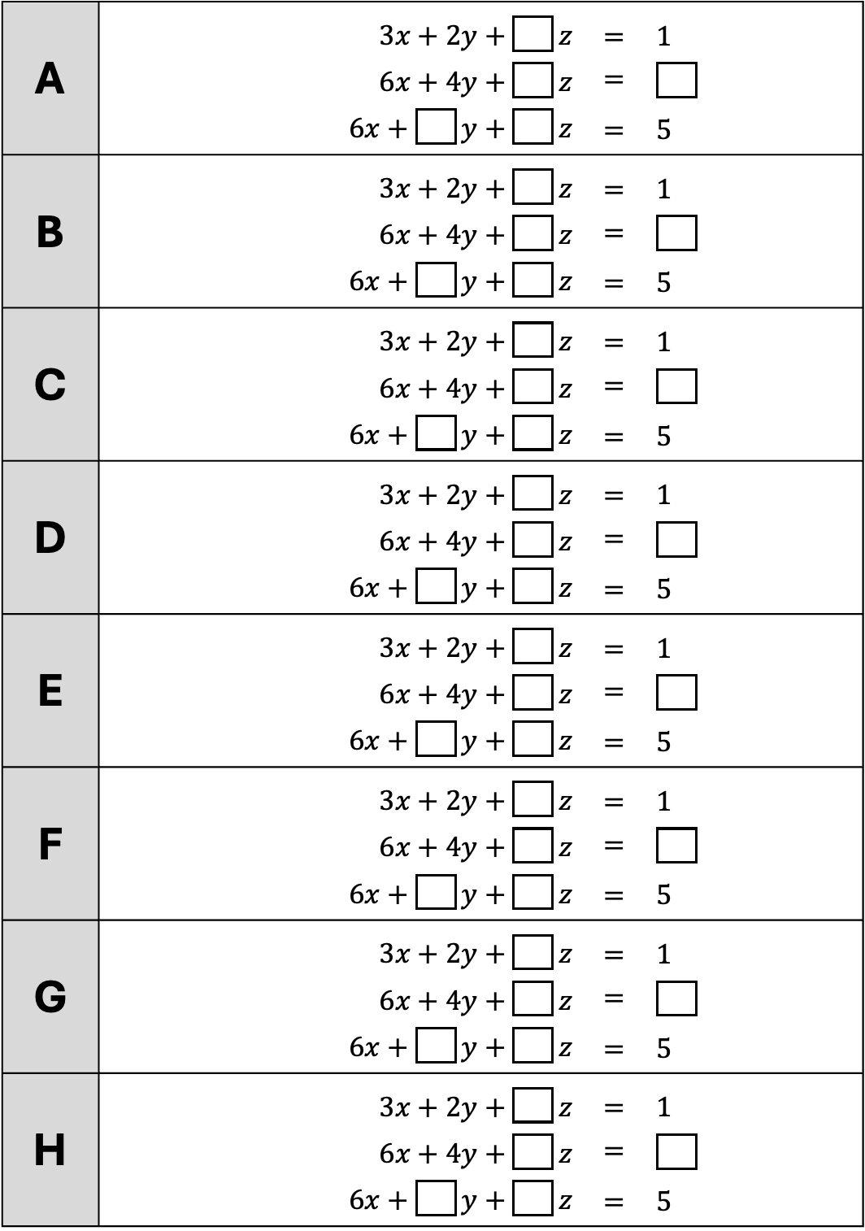
3. Fill in the gaps using only the numbers $2$ or $4$ to make each configuration.
(One of them is impossible!)
A | $3x+2y+\boxed{} z$ | $=$ | $1$
 | $6x+4y+\boxed{} z$ | $=$
 | $6x+\boxed{} y+\boxed{} z$ | $=$ | $5$
B | $3x+2y+\boxed{} z$ | $=$ | $1$
 | $6x+4y+\boxed{} z$ | $=$
 | $6x+\boxed{} y+\boxed{} z$ | $=$ | $5$
C | $3x+2y+\boxed{} z$ | $=$ | $1$
 | $6x+4y+\boxed{} z$ | $=$
 | $6x+\boxed{} y+\boxed{} z$ | $=$ | $5$
D | $3x+2y+\boxed{} z$ | $=$ | $1$
 | $6x+4y+\boxed{} z$ | $=$
 | $6x+\boxed{} y+\boxed{} z$ | $=$ | $5$
E | $3x+2y+\boxed{} z$ | $=$ | $1$
 | $6x+4y+\boxed{} z$ | $=$
 | $6x+\boxed{} y+\boxed{} z$ | $=$ | $5$
F | $3x+2y+\boxed{} z$ | $=$ | $1$
 | $6x+4y+\boxed{} z$ | $=$
 | $6x+\boxed{} y+\boxed{} z$ | $=$ | $5$
G | $3x+2y+\boxed{} z$ | $=$ | $1$
 | $6x+4y+\boxed{} z$ | $=$
 | $6x+\boxed{} y+\boxed{} z$ | $=$ | $5$
H | $3x+2y+\boxed{} z$ | $=$ | $1$
 | $6x+4y+\boxed{} z$ | $=$
 | $6x+\boxed{} y+\boxed{} z$ | $=$ | $5$

Slide 6
Geometric Configurations of Simultaneous Equations
Match the systems of linear equations to their geometric configuration.
A: Three planes meet in a point | B: Three planes meet in a sheaf |  | C: Three planes meet in a prism
D: Two parallel planes meet one in two lines | E: Two identical planes and one parallel |  | F: Two identical planes meet one in a line
G: Three parallel planes |  | H: Three identical planes
Consistent |  |  |  |  | Inconsistent
A | B | F | H |  | C | D | E | G

Slide 7
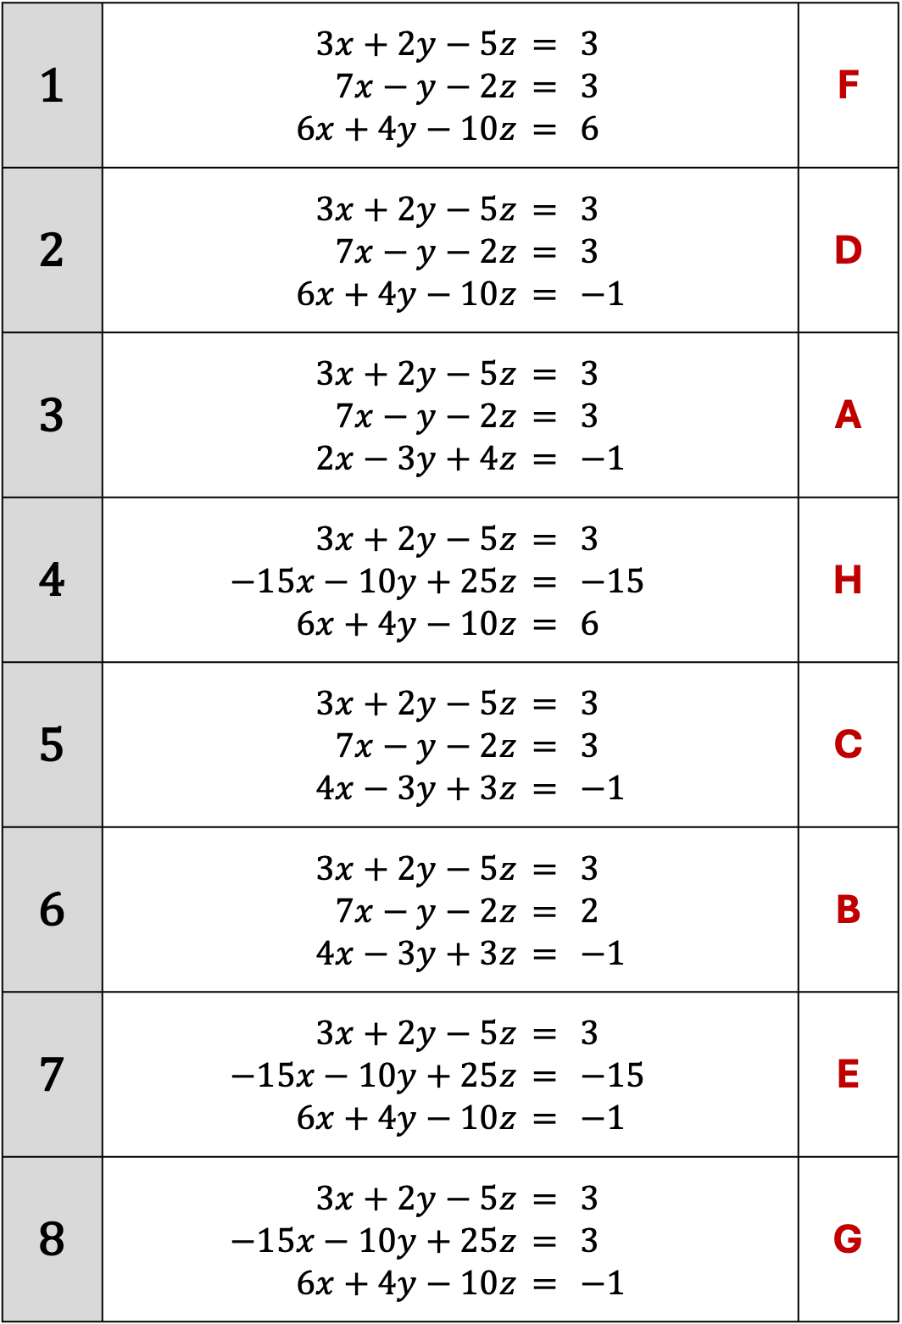
1 | $3x+2y−5z$ $7x−y−2z$ $6x+4y−10z$ | $$= \\ =$$ $=$ | $$3 \\ 3 \\ 6$$ | F
2 | $3x+2y−5z$ $7x−y−2z$ $6x+4y−10z$ | $$= \\ =$$ $=$ | $$3 \\ 3 \\ −1$$ | D
3 | $3x+2y−5z$ $7x−y−2z$ $2x−3y+4z$ | $$= \\ =$$ $=$ | $$3 \\ 3 \\ −1$$ | A
4 | $3x+2y−5z$ $−15x−10y+25z$ $6x+4y−10z$ | $$= \\ =$$ $=$ | $$3 \\ −15 \\ 6$$ | H
5 | $3x+2y−5z$ $7x−y−2z$ $4x−3y+3z$ | $$= \\ =$$ $=$ | $$3 \\ 3 \\ −1$$ | C
6 | $3x+2y−5z$ $7x−y−2z$ $4x−3y+3z$ | $$= \\ =$$ $=$ | $$3 \\ 2 \\ −1$$ | B
7 | $3x+2y−5z$ $−15x−10y+25z$ $6x+4y−10z$ | $$= \\ =$$ $=$ | $$3 \\ −15 \\ −1$$ | E
8 | $3x+2y−5z$ $−15x−10y+25z$ $6x+4y−10z$ | $$= \\ =$$ $=$ | $$3 \\ 3 \\ −1$$ | G

Slide 8
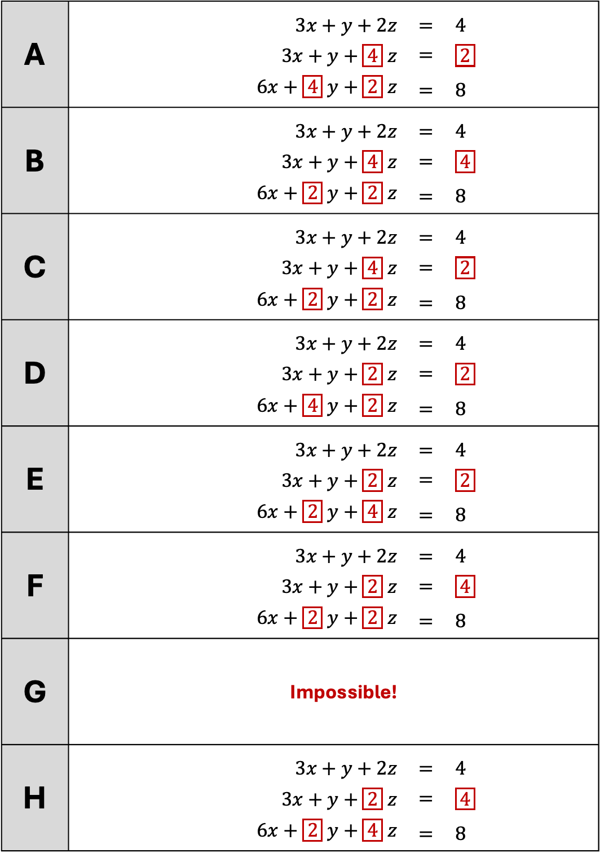
1. Fill in the gaps using only the numbers $2$ or $4$ to make each configuration.
[Some have multiple possible solutions. One example solution is given]
A | $3x+y+2z$ | $=$ | $4$
 | $3x+y+\boxed{4} z$ | $=$ | $\boxed{2}$
 | $6x+\boxed{4} y+\boxed{2} z$ | $=$ | $8$
B | $3x+y+2z$ | $=$ | $4$
 | $3x+y+\boxed{4} z$ | $=$ | $\boxed{4}$
 | $6x+\boxed{2} y+\boxed{2} z$ | $=$ | $8$
C | $3x+y+2z$ | $=$ | $4$
 | $3x+y+\boxed{4} z$ | $=$ | $\boxed{2}$
 | $6x+\boxed{2} y+\boxed{2} z$ | $=$ | $8$
D | $3x+y+2z$ | $=$ | $4$
 | $3x+y+\boxed{2} z$ | $=$ | $\boxed{2}$
 | $6x+\boxed{4} y+\boxed{2} z$ | $=$ | $8$
E | $3x+y+2z$ | $=$ | $4$
 | $3x+y+\boxed{2} z$ | $=$ | $\boxed{2}$
 | $6x+\boxed{2} y+\boxed{4} z$ | $=$ | $8$
F | $3x+y+2z$ | $=$ | $4$
 | $3x+y+\boxed{2} z$ | $=$ | $\boxed{4}$
 | $6x+\boxed{2} y+\boxed{2} z$ | $=$ | $8$
G
 | Impossible!
H | $3x+y+2z$ | $=$ | $4$
 | $3x+y+\boxed{2} z$ | $=$ | $\boxed{4}$
 | $6x+\boxed{2} y+\boxed{4} z$ | $=$ | $8$

Slide 9
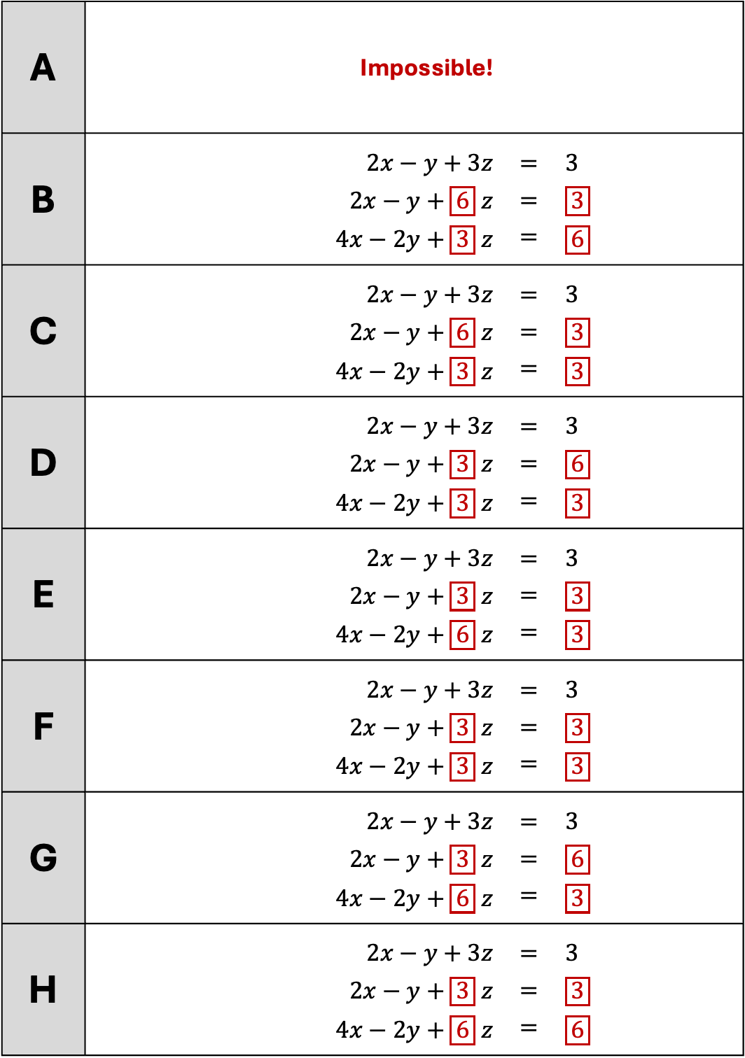
2. Fill in the gaps using only the numbers $3$ or $6$ to make each configuration.
[Some have multiple possible solutions. One example solution is given]
A
 | Impossible!
B | $2x−y+3z$ | $=$ | $3$
 | $2x−y+\boxed{6} z$ | $=$ | $\boxed{3}$
 | $4x−2y+\boxed{3} z$ | $=$ | $\boxed{6}$
C | $2x−y+3z$ | $=$ | $3$
 | $2x−y+\boxed{6} z$ | $=$ | $\boxed{3}$
 | $4x−2y+\boxed{3} z$ | $=$ | $\boxed{3}$
D | $2x−y+3z$ | $=$ | $3$
 | $2x−y+\boxed{3} z$ | $=$ | $\boxed{6}$
 | $4x−2y+\boxed{3} z$ | $=$ | $\boxed{3}$
E | $2x−y+3z$ | $=$ | $3$
 | $2x−y+\boxed{3} z$ | $=$ | $\boxed{3}$
 | $4x−2y+\boxed{6} z$ | $=$ | $\boxed{3}$
F | $2x−y+3z$ | $=$ | $3$
 | $2x−y+\boxed{3} z$ | $=$ | $\boxed{3}$
 | $4x−2y+\boxed{3} z$ | $=$ | $\boxed{3}$
G | $2x−y+3z$ | $=$ | $3$
 | $2x−y+\boxed{3} z$ | $=$ | $\boxed{6}$
 | $4x−2y+\boxed{6} z$ | $=$ | $\boxed{3}$
H | $2x−y+3z$ | $=$ | $3$
 | $2x−y+\boxed{3} z$ | $=$ | $\boxed{3}$
 | $4x−2y+\boxed{6} z$ | $=$ | $\boxed{6}$

Slide 10
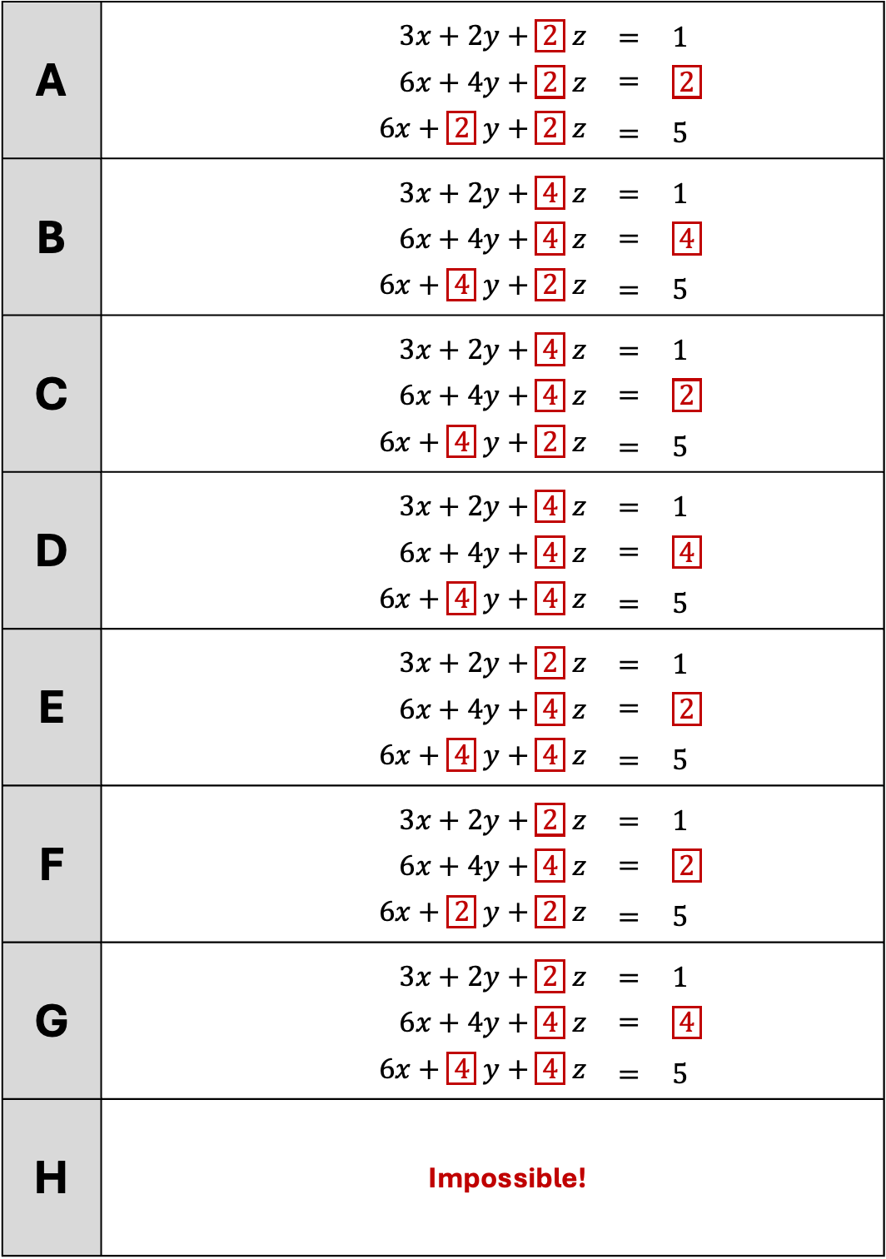
3. Fill in the gaps using only the numbers $2$ or $4$ to make each configuration.
[Some have multiple possible solutions. One example solution is given]
A | $3x+2y+\boxed{2} z$ | $=$ | $1$
 | $6x+4y+\boxed{2} z$ | $=$ | $\boxed{2}$
 | $6x+\boxed{2} y+\boxed{2} z$ | $=$ | $5$
B | $3x+2y+\boxed{4} z$ | $=$ | $1$
 | $6x+4y+\boxed{4} z$ | $=$ | $\boxed{4}$
 | $6x+\boxed{4} y+\boxed{2} z$ | $=$ | $5$
C | $3x+2y+\boxed{4} z$ | $=$ | $1$
 | $6x+4y+\boxed{4} z$ | $=$ | $\boxed{2}$
 | $6x+\boxed{4} y+\boxed{2} z$ | $=$ | $5$
D | $3x+2y+\boxed{4} z$ | $=$ | $1$
 | $6x+4y+\boxed{4} z$ | $=$ | $\boxed{4}$
 | $6x+\boxed{4} y+\boxed{4} z$ | $=$ | $5$
E | $3x+2y+\boxed{2} z$ | $=$ | $1$
 | $6x+4y+\boxed{4} z$ | $=$ | $\boxed{2}$
 | $6x+\boxed{4} y+\boxed{4} z$ | $=$ | $5$
F | $3x+2y+\boxed{2} z$ | $=$ | $1$
 | $6x+4y+\boxed{4} z$ | $=$ | $\boxed{2}$
 | $6x+\boxed{2} y+\boxed{2} z$ | $=$ | $5$
G | $3x+2y+\boxed{2} z$ | $=$ | $1$
 | $6x+4y+\boxed{4} z$ | $=$ | $\boxed{4}$
 | $6x+\boxed{4} y+\boxed{4} z$ | $=$ | $5$
H
 | Impossible!

