Slide 1
Introducing Sequences And Series
an interwoven approach

Slide 2


Calculate:
$$\int_{0}^{\frac{1}{10}}{1+x+x^{2}+x^{3}ⅆx}$$
Do Now
    Solve:
$$e^{2x}−e^{x}=\frac{10}{81}$$

Slide 3
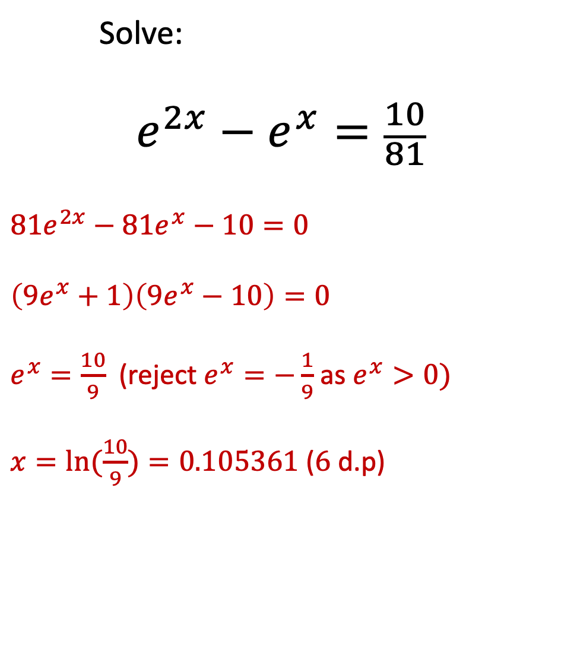

Calculate:
$$\int_{0}^{\frac{1}{10}}{1+x+x^{2}+x^{3}ⅆx}$$
$$={\left[x+\frac{1}{2}x^{2}+\frac{1}{3}x^{3}+\frac{1}{4}x^{4}\right]}_{0}^{\frac{1}{10}}$$
$$=\frac{1}{10}+\frac{1}{200}+\frac{1}{3000}+\frac{1}{40000}$$
$=0.105358$ ($6$ d.p)
Do Now
    Solve:
$$e^{2x}−e^{x}=\frac{10}{81}$$
$81e^{2x}−81e^{x}−10=0$
$\left(9e^{x}+1\right)\left(9e^{x}−10\right)=0$
$e^{x}=\frac{10}{9}$ (reject $e^{x}=−\frac{1}{9}$ as $e^{x}>0)$
$x=\ln{(\frac{10}{9})}=0.105361$ ($6$ d.p)

Slide 4
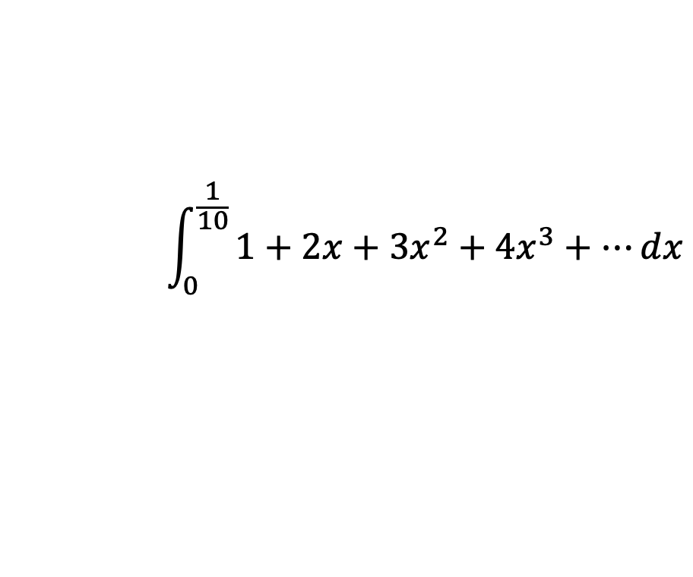

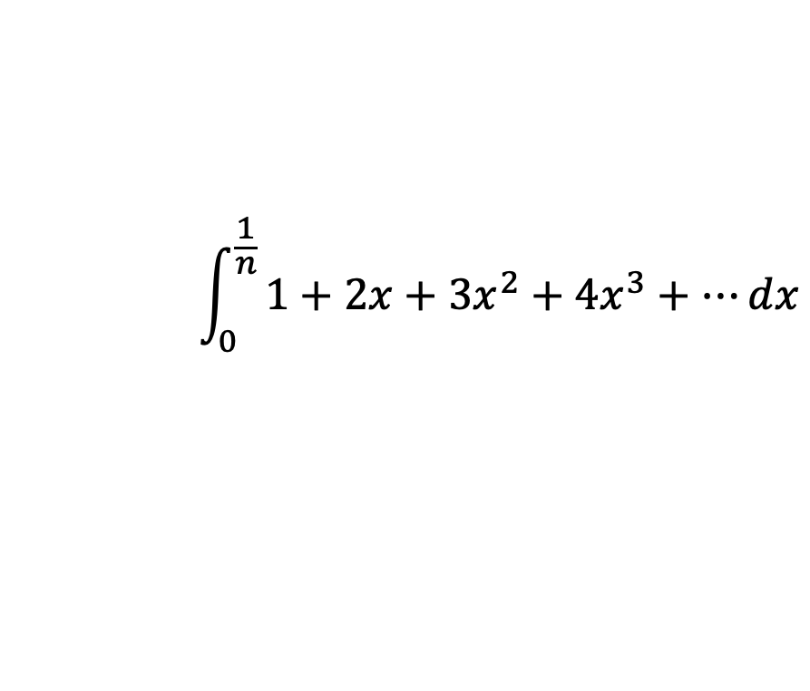
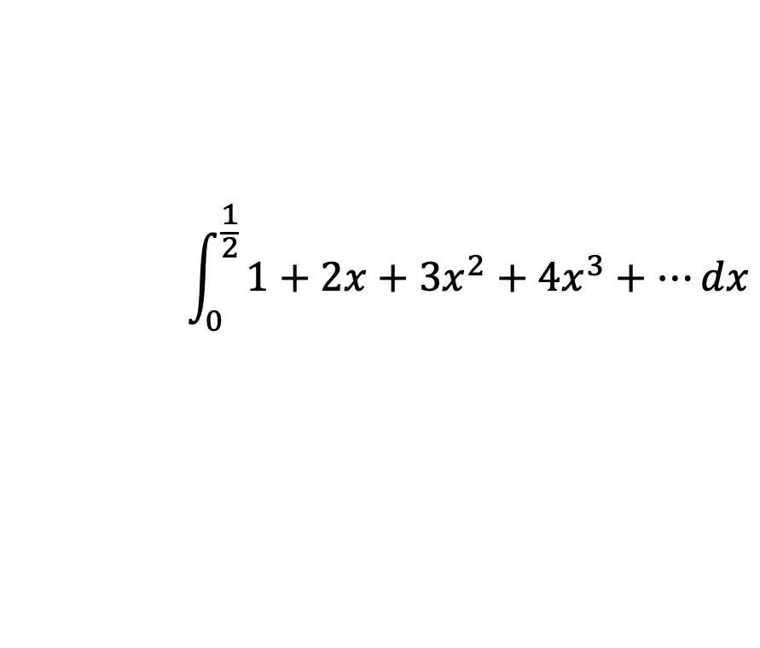
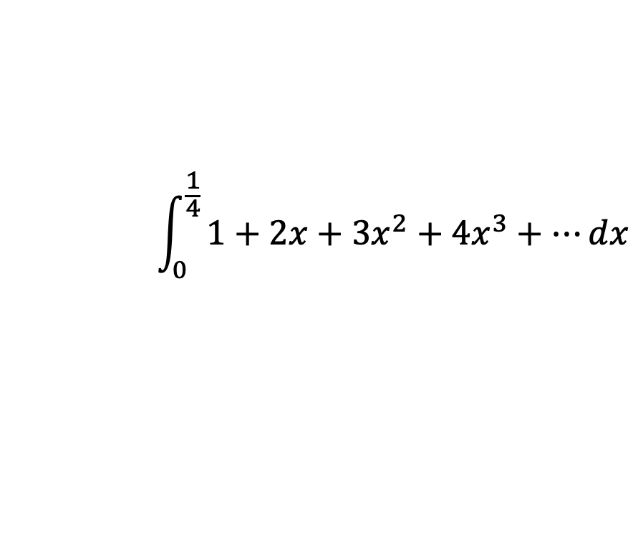
Calculate:
a.
b.
c.
d.
Task 1
Expand and simplify:
a. $(1−x)(1+x+x^{2}+x^{3}+…)$
b. $\left(1+x+x^{2}+…\right)\left(1+x+x^{2}+…\right)$
$$\int_{0}^{\frac{1}{10}}{1+2x+3x^{2}+4x^{3}+…ⅆx}$$
$$\int_{0}^{\frac{1}{4}}{1+2x+3x^{2}+4x^{3}+…ⅆx}$$
$$\int_{0}^{\frac{1}{2}}{1+2x+3x^{2}+4x^{3}+…ⅆx}$$
$$\int_{0}^{\frac{1}{n}}{1+2x+3x^{2}+4x^{3}+…ⅆx}$$

Slide 5
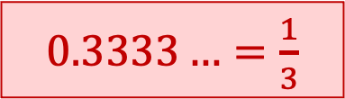
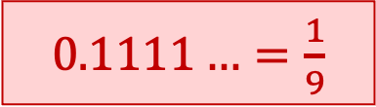
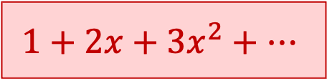



Calculate:
a.
b.
c.
d.
Task 1
Expand and simplify:
a. $(1−x)(1+x+x^{2}+x^{3}+…)$
b. $\left(1+x+x^{2}+…\right)\left(1+x+x^{2}+…\right)$
$$\int_{0}^{\frac{1}{10}}{1+2x+3x^{2}+4x^{3}+…ⅆx}$$
$0.1111…=\frac{1}{9}$
$$\int_{0}^{\frac{1}{4}}{1+2x+3x^{2}+4x^{3}+…ⅆx}$$
$$1$$
$0.3333…=\frac{1}{3}$
$$\int_{0}^{\frac{1}{2}}{1+2x+3x^{2}+4x^{3}+…ⅆx}$$
$1$
$$\int_{0}^{\frac{1}{n}}{1+2x+3x^{2}+4x^{3}+…ⅆx}$$
$\frac{1}{n−1}$
$$1+2x+3x^{2}+…$$

Slide 6
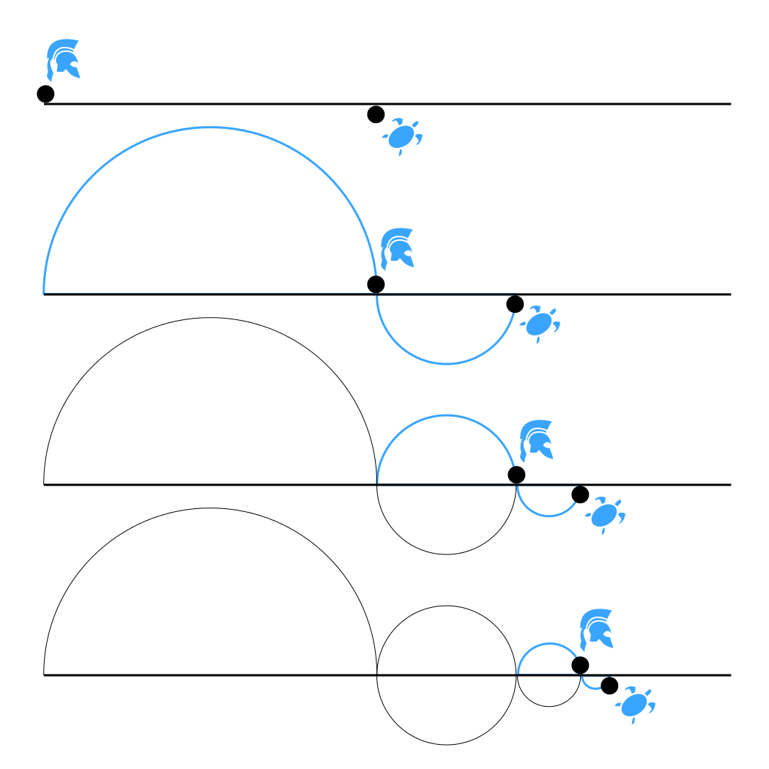
Achilles and a tortoise are in a race.
Both start from rest.
Achilles runs at 10 metres per second.
The tortoise walks at 10 metres per minute.
However, the tortoise started the race 600 m ahead of Achilles.
The tortoise gloats to Achilles:
‘You can never overtake me, since every time you reach where I was, I’ll have moved a bit further.’
Task 2
Find the time when:
Achilles reaches the tortoise’s starting point.
Achilles reaches where the tortoise was when Achilles reached the tortoise’s starting point.
Achilles reaches where the tortoise was when Achilles reached the point where the tortoise was when Achilles reached the tortoise’s starting point.
Achilles overtakes the tortoise.

Slide 7


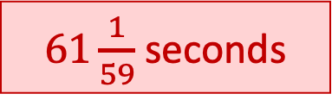
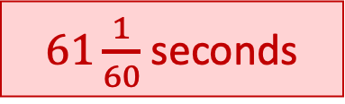
Achilles and a tortoise are in a race.
Both start from rest.
Achilles runs at 10 metres per second.
The tortoise walks at 10 metres per minute.
However, the tortoise started the race 600 m ahead of Achilles.
The tortoise gloats to Achilles:
‘You can never overtake me, since every time you reach where I was, I’ll have moved a bit further.’
Task 2
Find the time when:
Achilles reaches the tortoise’s starting point.
Achilles reaches where the tortoise was when Achilles reached the tortoise’s starting point.
Achilles reaches where the tortoise was when Achilles reached the point where the tortoise was when Achilles reached the tortoise’s starting point.
Achilles overtakes the tortoise.
$60$ seconds
$61$ seconds
$61\frac{1}{60}$ seconds
$61\frac{1}{59}$ seconds

Slide 8
Achilles and a tortoise are in a race.
Both start from rest.
Achilles accelerates at 10 ms⁻².
The tortoise accelerates at 1 ms⁻².
However, the tortoise started the race 600 m ahead of Achilles.
The tortoise gloats to Achilles:
‘You can never overtake me, since every time you reach where I was, I’ll have moved a bit further.’
Task 2
Find the time when:
Achilles reaches the tortoise’s starting point.
Achilles reaches where the tortoise was when Achilles reached the tortoise’s starting point.
Achilles reaches where the tortoise was when Achilles reached the point where the tortoise was when Achilles reached the tortoise’s starting point.
Achilles overtakes the tortoise.

Slide 9




Achilles and a tortoise are in a race.
Both start from rest.
Achilles accelerates at 10 ms⁻².
The tortoise accelerates at 1 ms⁻².
However, the tortoise started the race 600 m ahead of Achilles.
The tortoise gloats to Achilles:
‘You can never overtake me, since every time you reach where I was, I’ll have moved a bit further.’
Task 2
Find the time when:
Achilles reaches the tortoise’s starting point.
Achilles reaches where the tortoise was when Achilles reached the tortoise’s starting point.
Achilles reaches where the tortoise was when Achilles reached the point where the tortoise was when Achilles reached the tortoise’s starting point.
Achilles overtakes the tortoise.
$10.95$ seconds
$11.49$ seconds
$11.54$ seconds
$11.55$ seconds

Slide 10
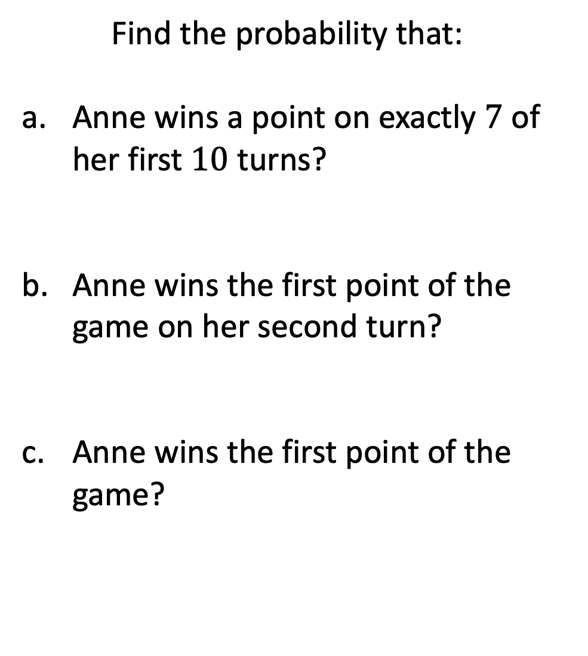
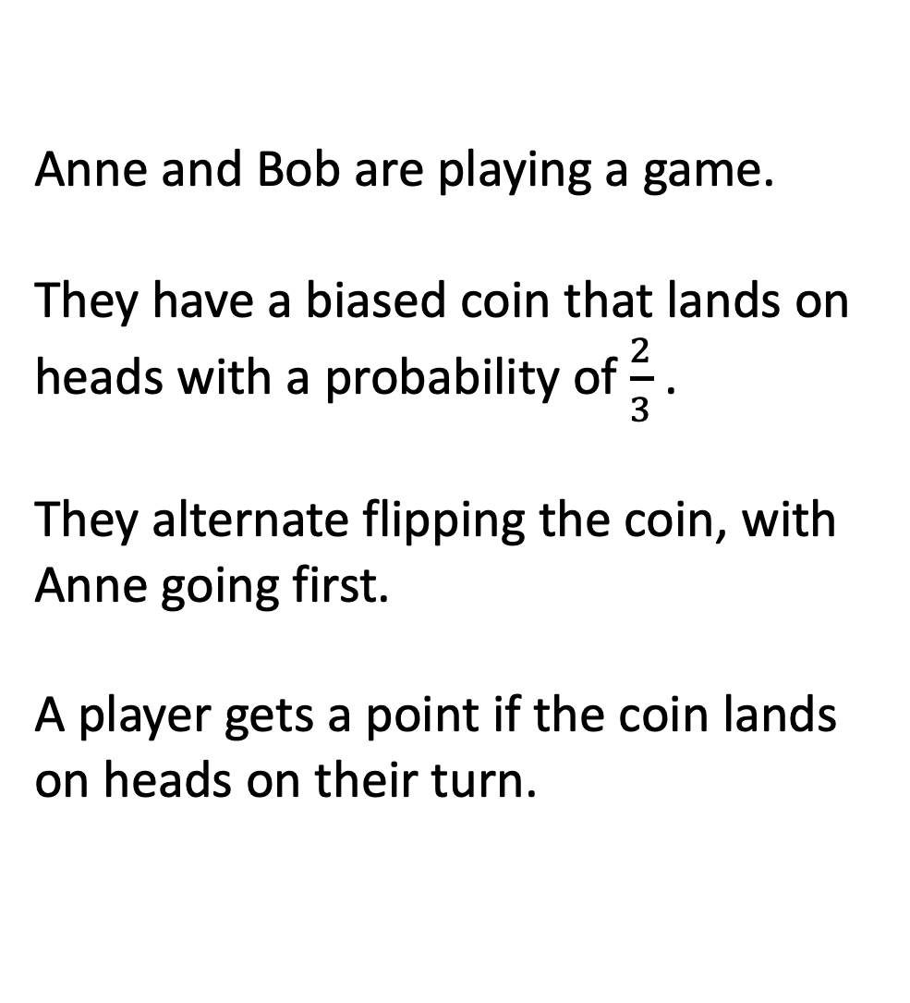
Anne and Bob are playing a game.
They have a biased coin that lands on heads with a probability of $\frac{2}{3}$ .
They alternate flipping the coin, with Anne going first.
A player gets a point if the coin lands on heads on their turn.
Task 3
Find the probability that:
Anne wins a point on exactly $7$ of her first $10$ turns?
Anne wins the first point of the game on her second turn?
Anne wins the first point of the game?

Slide 11



Anne and Bob are playing a game.
They have a biased coin that lands on heads with a probability of $\frac{2}{3}$ .
They alternate flipping the coin, with Anne going first.
A player gets a point if the coin lands on heads on their turn.
Task 3
Find the probability that:
Anne wins a point on exactly $7$ of her first $10$ turns?
Anne wins the first point of the game on her second turn?
Anne wins the first point of the game?
$$0.26012$$
$\frac{2}{27}$
$\frac{3}{4}$

Slide 12
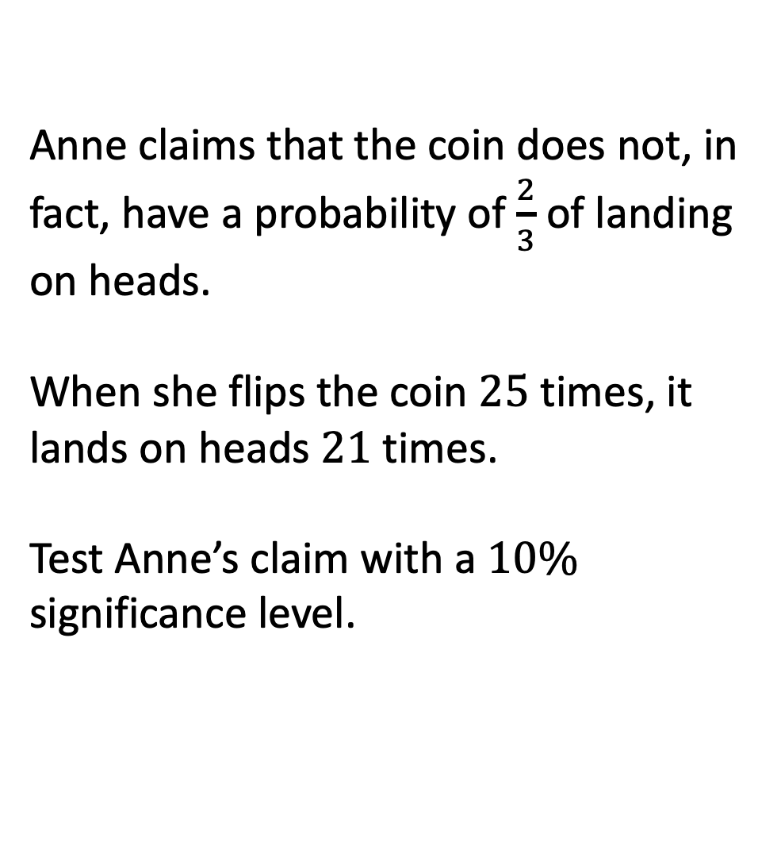
Anne claims that the coin does not, in fact, have a probability of $\frac{2}{3}$ of landing on heads.
When she flips the coin $25$ times, it lands on heads $21$ times.
Test Anne’s claim with a $10\%$ significance level.
Task 3

Slide 13
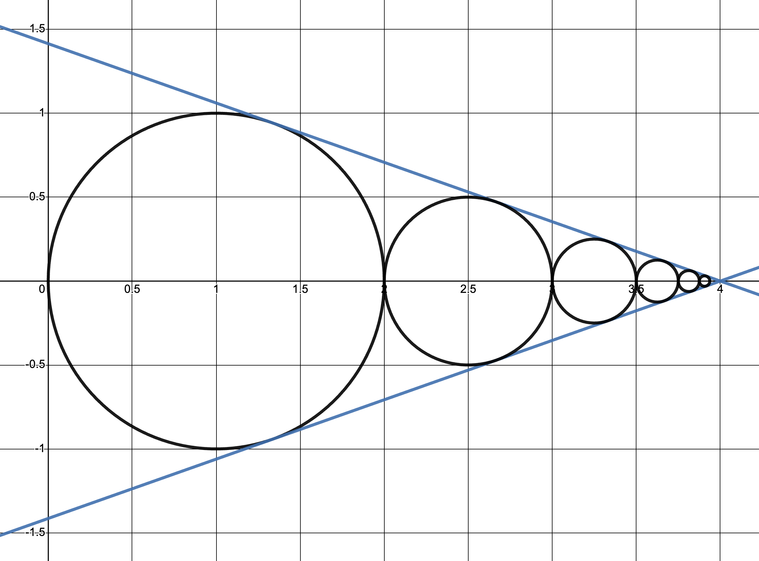
Task 4
Find the length of the radius of each circle.
Find the equation of each circle.
Find the equations of the blue lines.

Slide 14
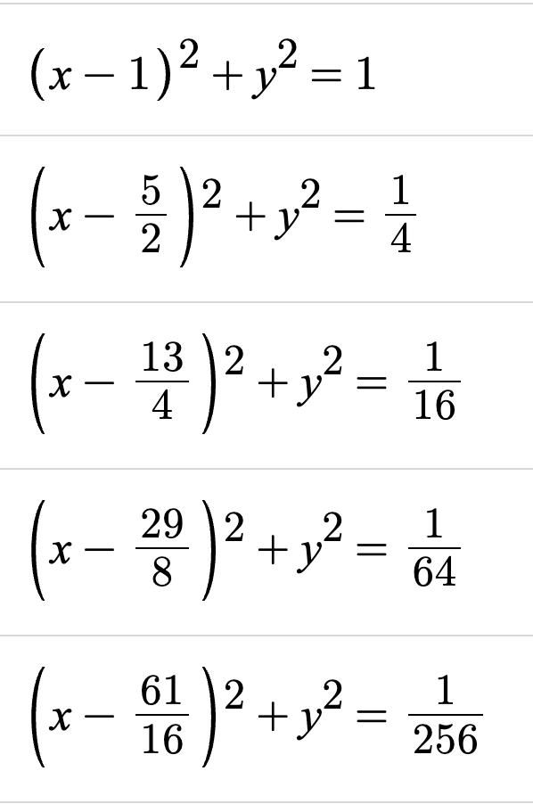
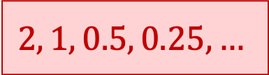
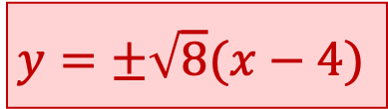
Task 4
Find the length of the radius of each circle.
Find the equation of each circle.
Find the equations of the blue lines.
$$2, 1, 0.5, 0.25,…$$
$$y=±\sqrt{8}(x−4)$$

