Slide 1
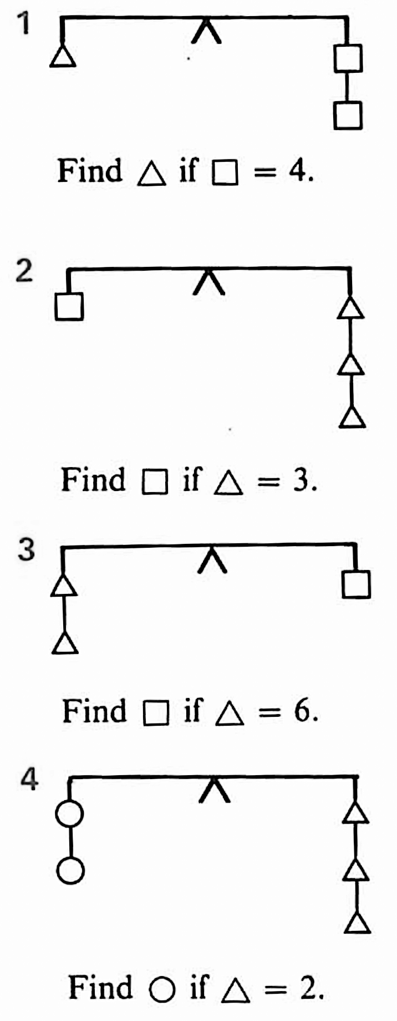
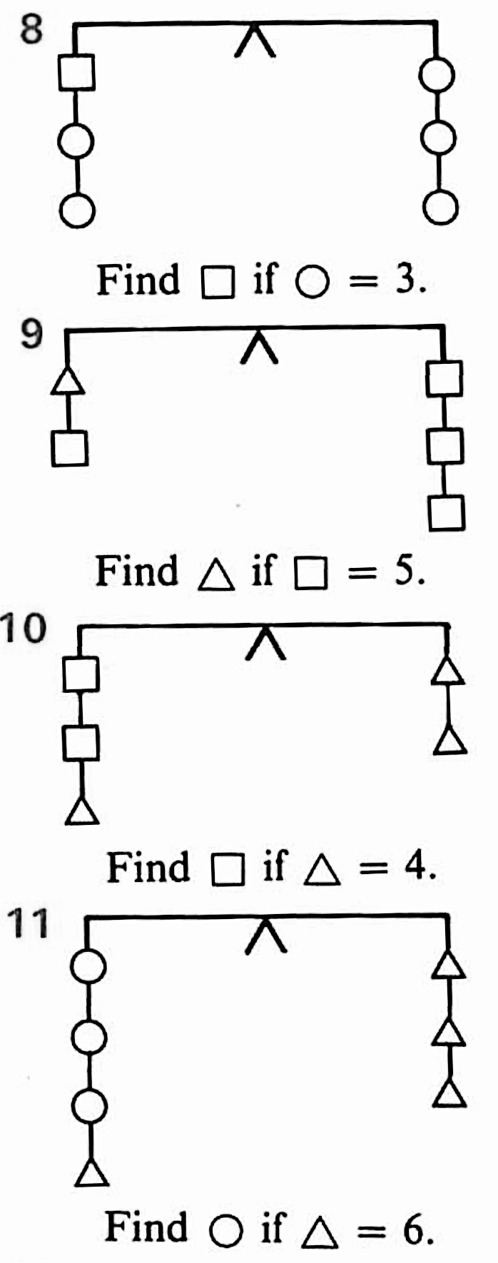
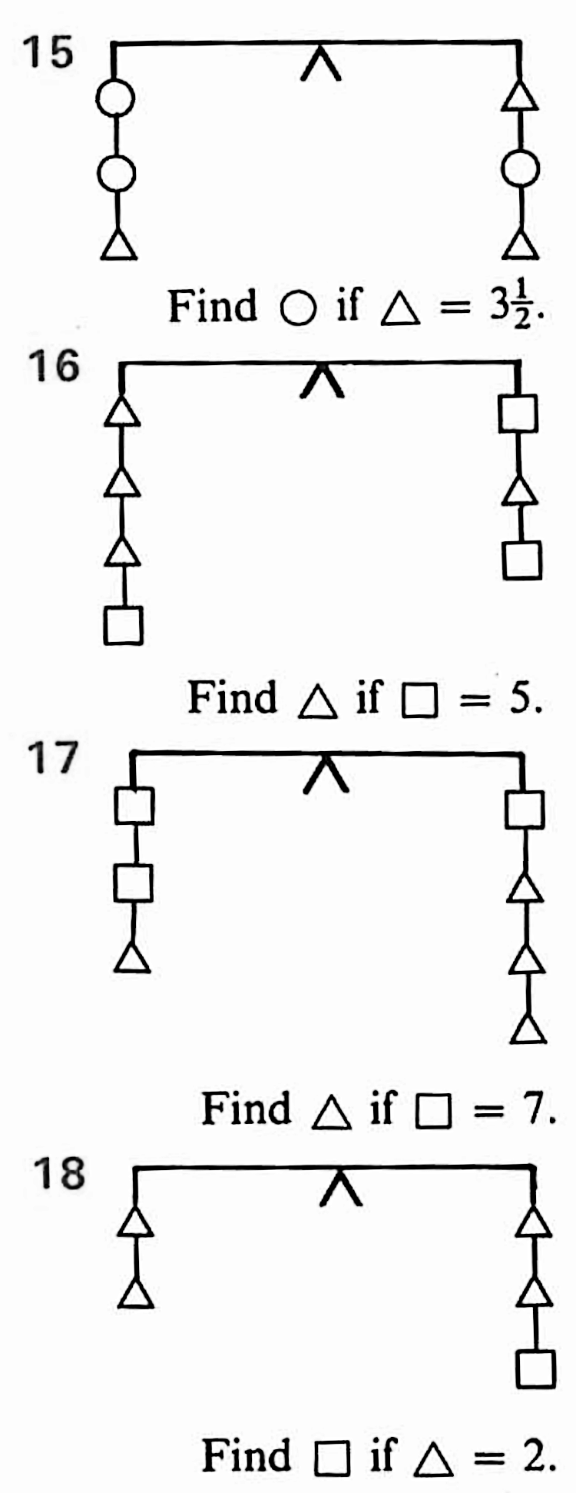
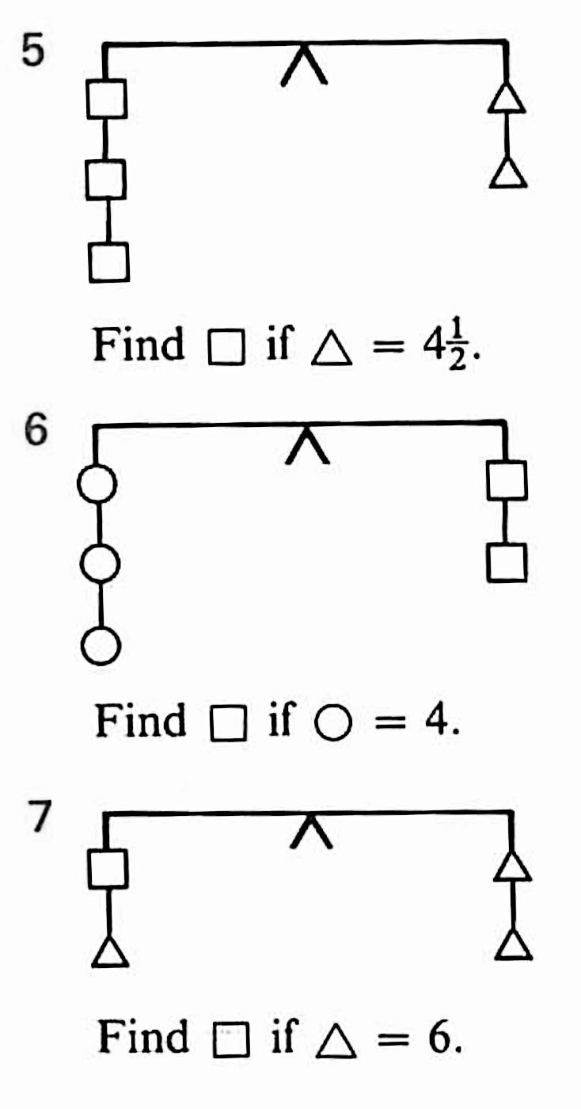
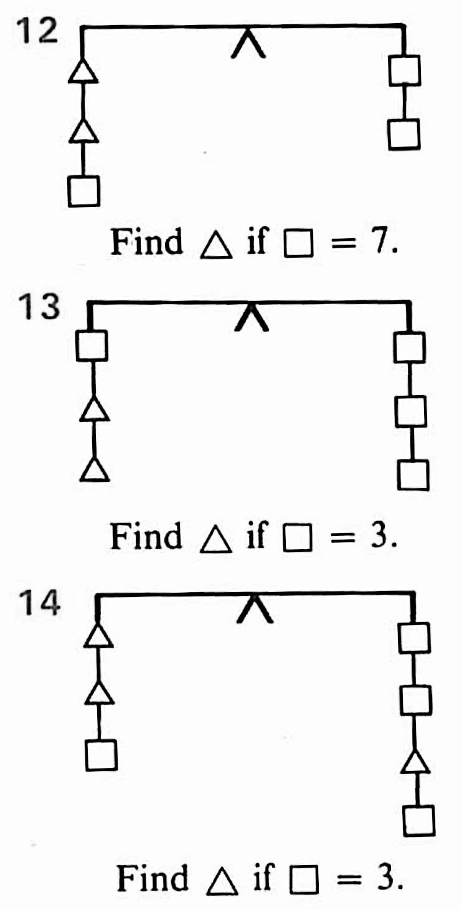
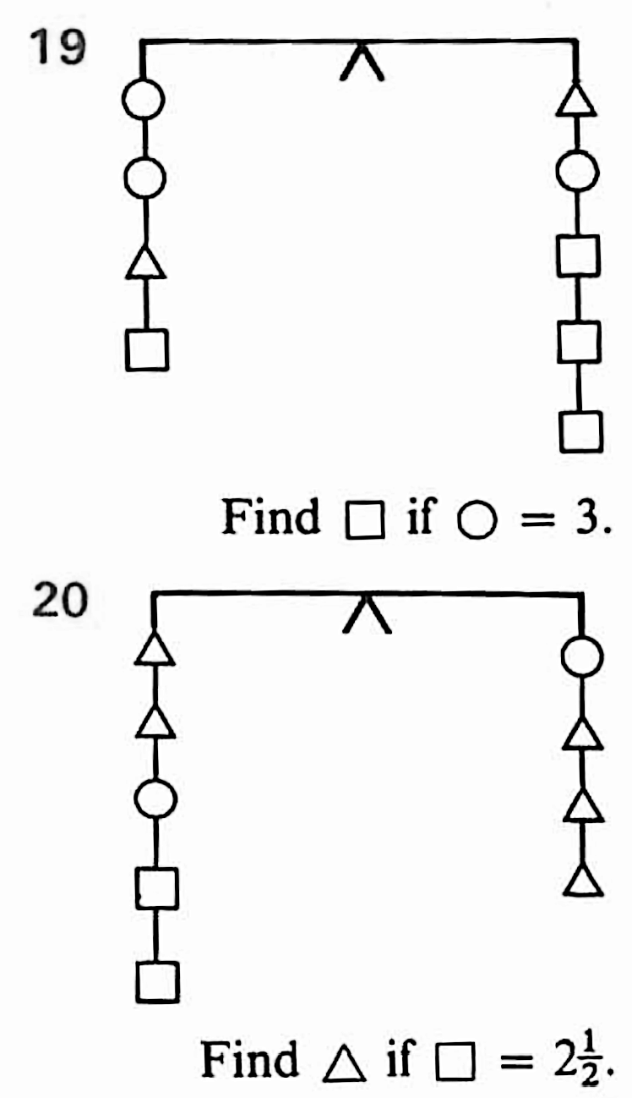

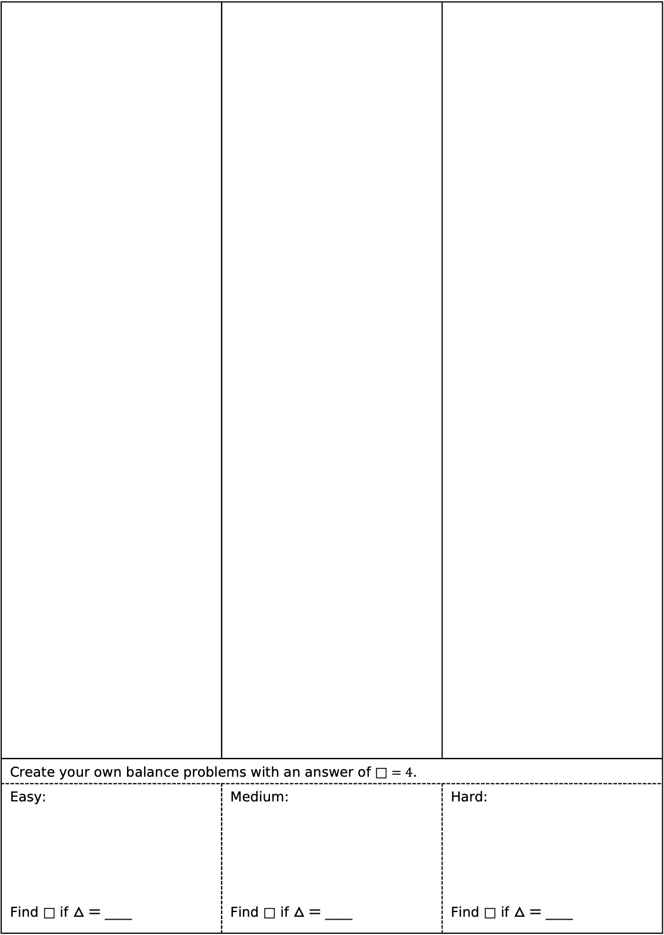
Task 1: Balancing
Create your own balance problems with an answer of $\text{□}=4$.
Easy: Find $\text{□}$ if $△ =$ ____ | Medium: Find $\text{□}$ if $△ =$ ____ | Hard: Find $\text{□}$ if $△ =$ ____

Slide 2
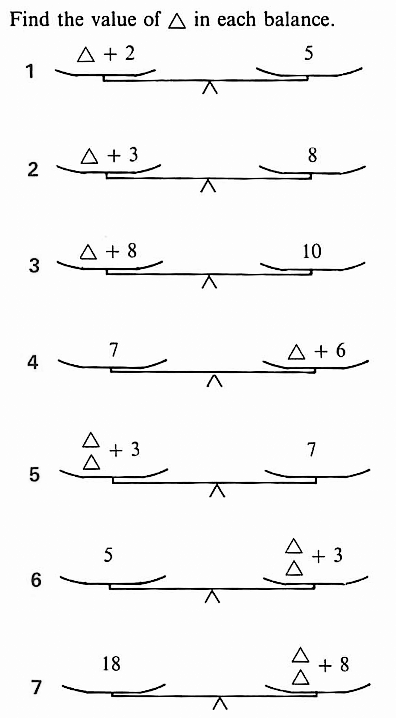
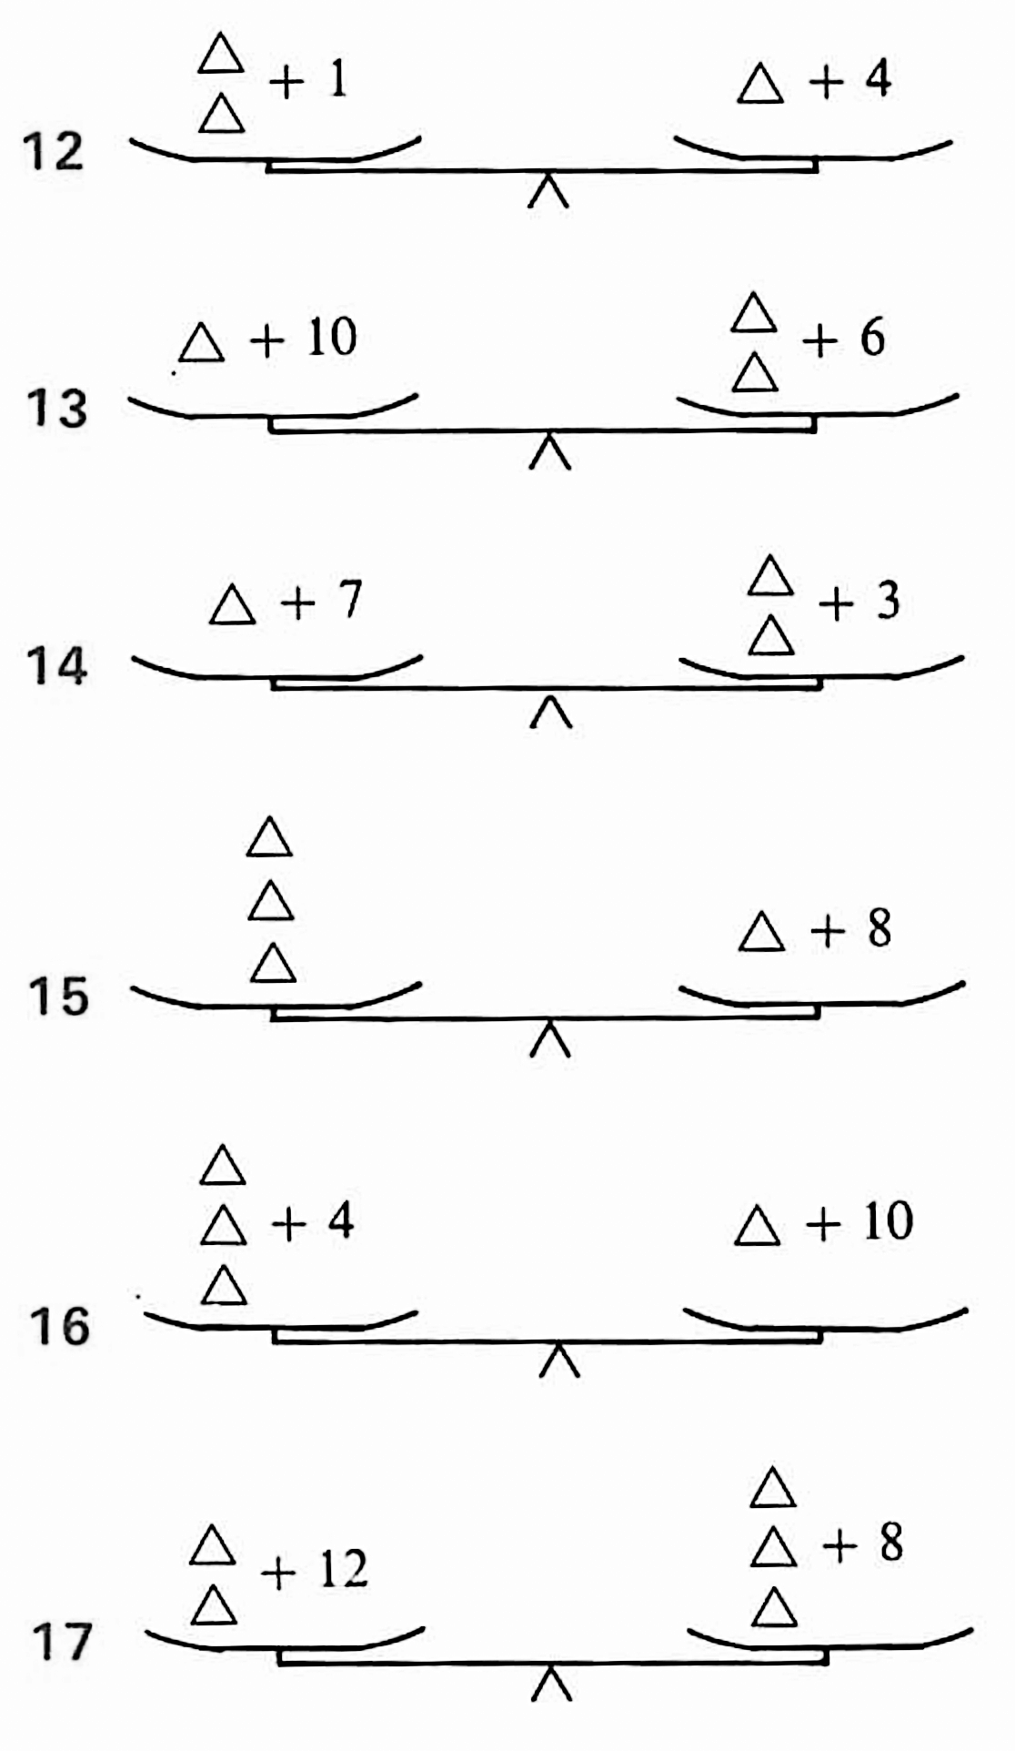
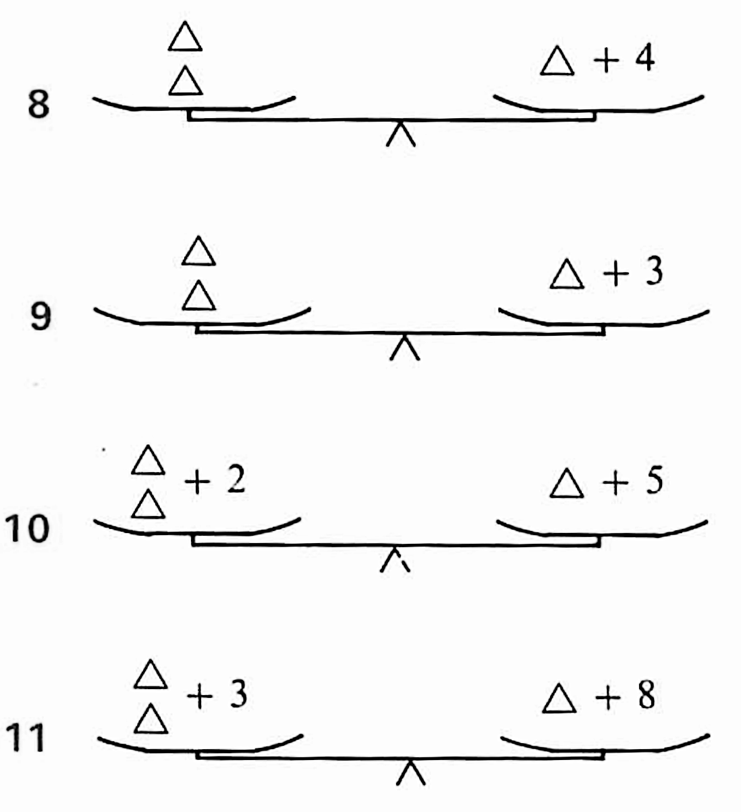
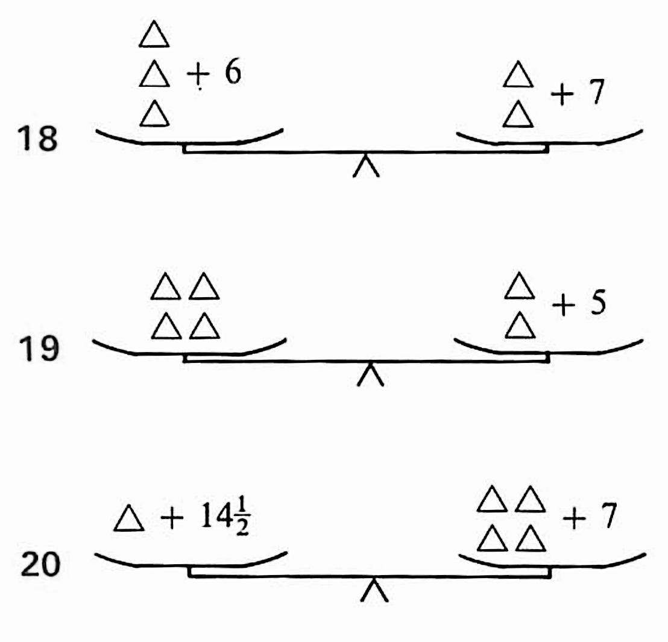
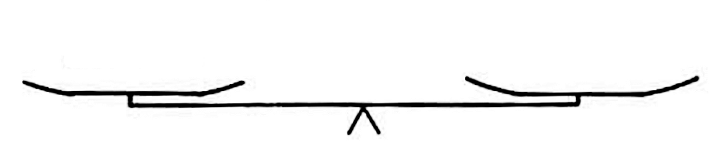
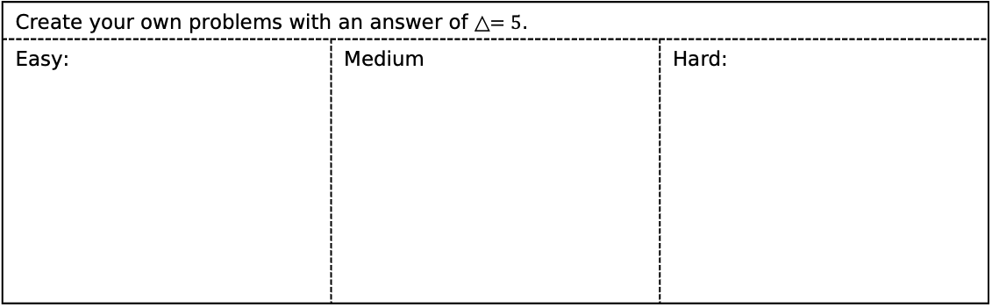
Task 2: Find the value of △ in each balance.
Create your own problems with an answer of $\text{△}=5$.
Easy: | Medium | Hard:

Slide 3
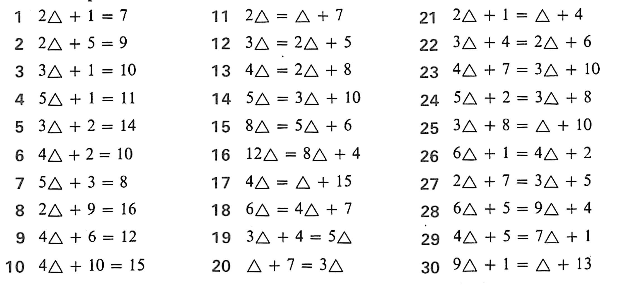
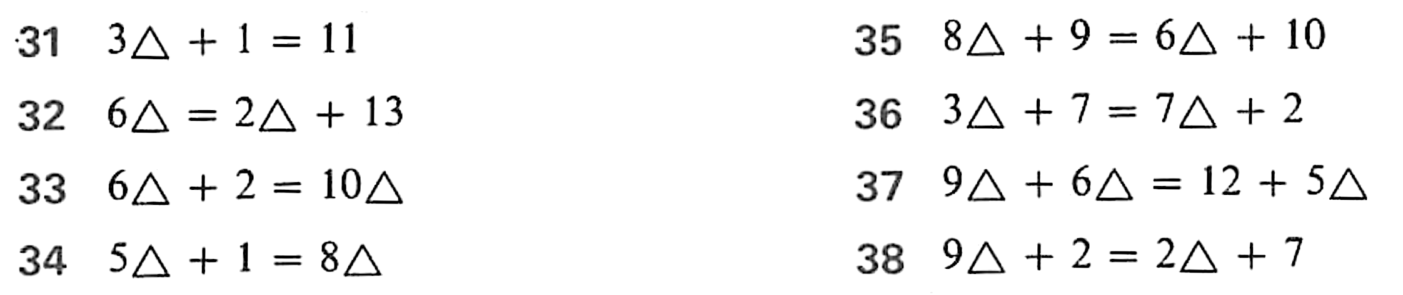
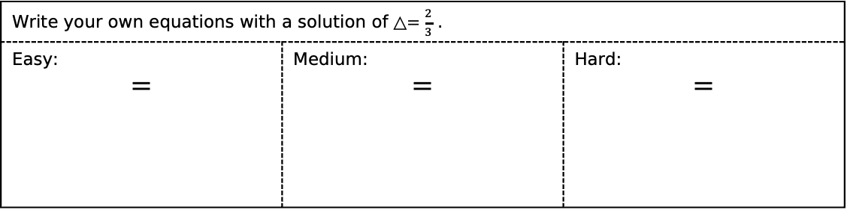
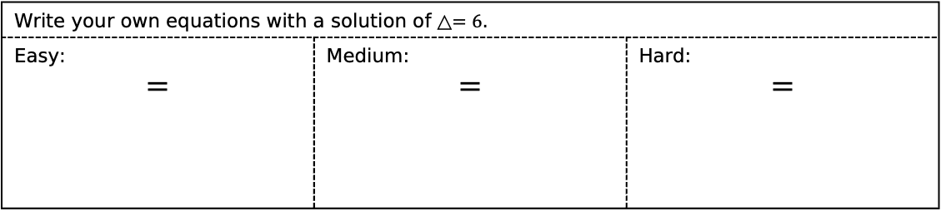
Task 3: Find the value of △ in each equation.
Write your own equations with a solution of $\text{△}=6$.
Easy: $=$ | Medium: $=$ | Hard: $=$
Find the value of △ in each equation, leaving each answer as a fraction.
Write your own equations with a solution of $\text{△}=\frac{2}{3}$ .
Easy: $=$ | Medium: $=$ | Hard: $=$

Slide 4





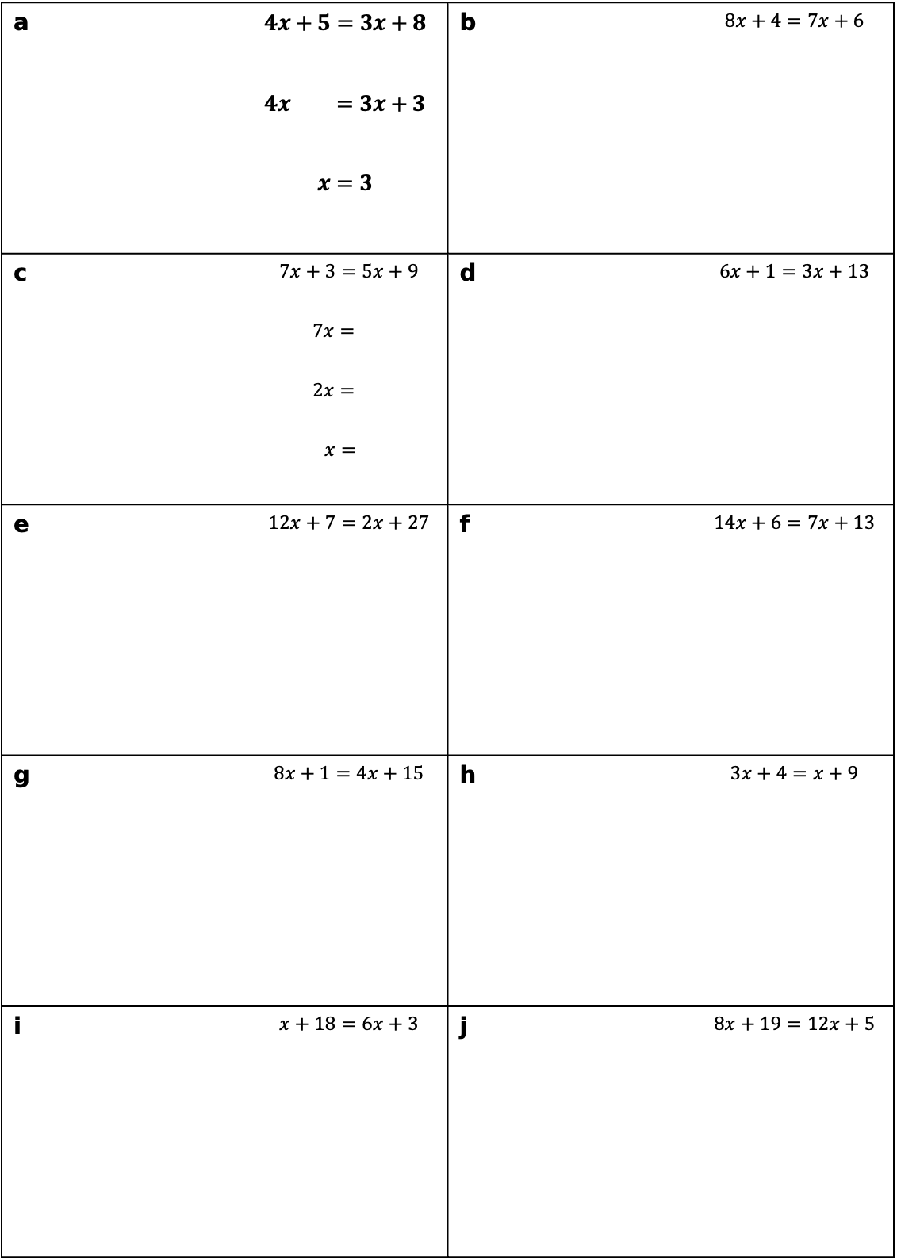









Task 4: Solve each equation both visually and algebraically.
a | $4x+5=3x+8$ $$4x =3x+3$$ $$x=3$$ | b | $8x+4=7x+6$
c | $7x+3=5x+9$ $$7x=$$ $$2x=$$ $$x=$$ | d | $6x+1=3x+13$
e | $12x+7=2x+27$ | f | $14x+6=7x+13$
g | $8x+1=4x+15$ | h | $3x+4=x+9$
i | $x+18=6x+3$ | j | $8x+19=12x+5$
 | $4\text{△}+5$ |  |  |  |  | $3\text{△}+8$
 | $8\text{△}+4$ |  |  |  |  | $7\text{△}+6$
 | $4\text{△}$ |  |  |  |  | $3\text{△}+3$
 | $\text{△}$ |  |  |  |  | $3$
 | $\text{△}$
 | $7\text{△}+3$ |  |  |  |  | $5\text{△}+9$
 | $7\text{△}$
 | $2\text{△}$
 | $\text{△}$
 | $\text{△}$
 | $\text{△}+18$ |  |  |  |  | $6\text{△}+3$
 |  |  |  |  |  | $$6\text{△}$$
 |  |  |  |  |  | $$5\text{△}$$
 |  |  |  |  |  | $\text{△}$

Slide 5
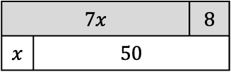
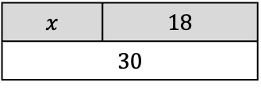
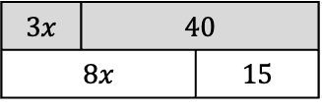
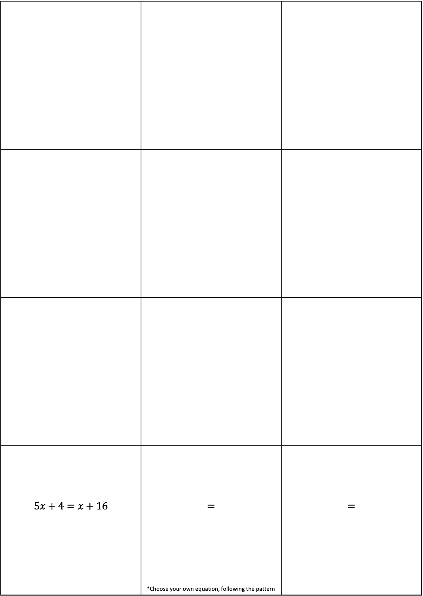
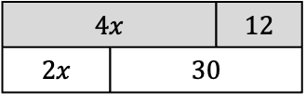
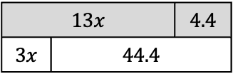
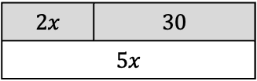
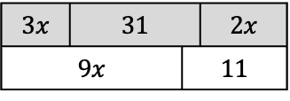
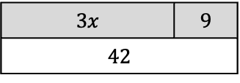
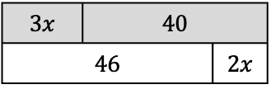
Task 5: Write down and solve the equation shown in each bar model.
$$5x+4=x+16$$ | $$=$$ *Choose your own equation, following the pattern | $$=$$
$x$ | 18
30
$3x$ | 9
42
$2x$ | 30
$5x$
$4x$ |  | 12
$2x$ | 30
$3x$ | 40
$8x$ |  | 15
$7x$ |  | 8
$x$ | 50
$3x$ | 40
46 |  | $2x$
$3x$ | 31 |  | $2x$
$9x$ |  | 11
$13x$ |  | $4.4$
$3x$ | $44.4$

Slide 6
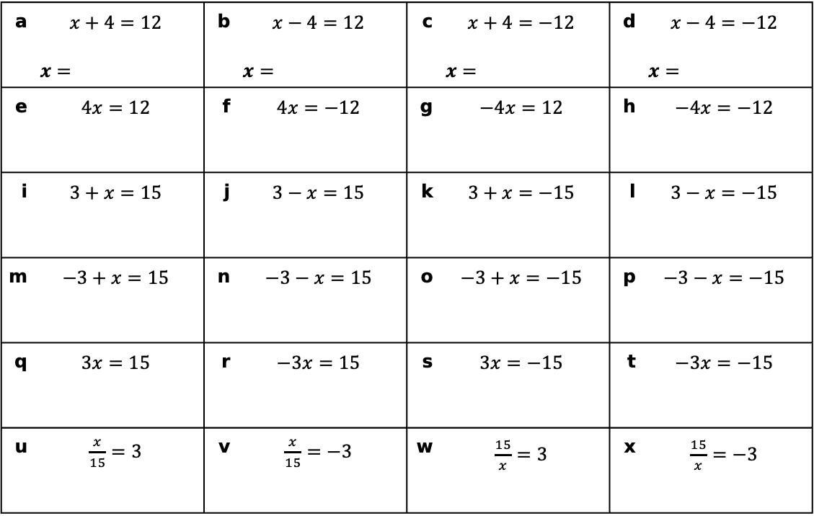
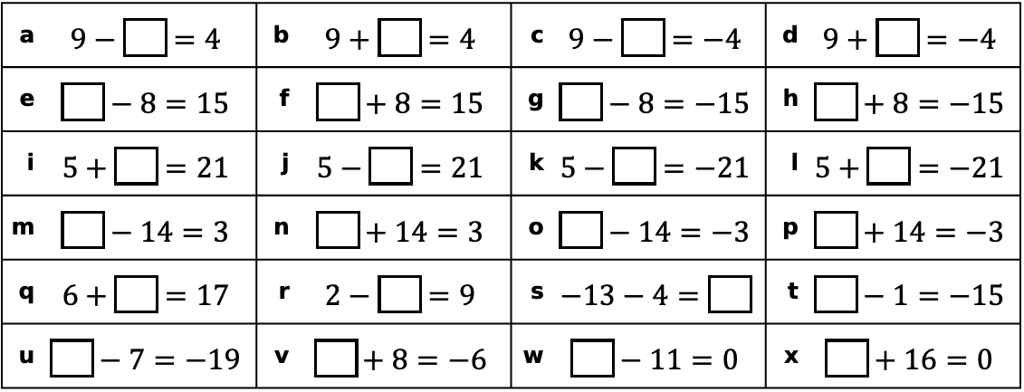
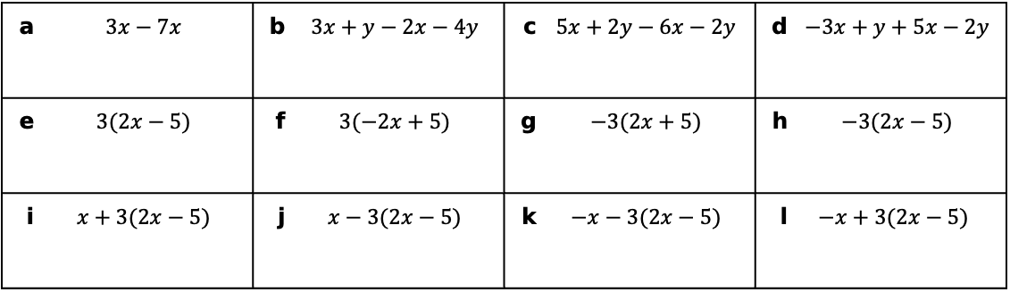
Task 6: Negative numbers recap
a | $9−\boxed{}=4$ | b | $9+\boxed{}=4$ | c | $9−\boxed{}=−4$ | d | $9+\boxed{}=−4$
e | $\boxed{}−8=15$ | f | $\boxed{}+8=15$ | g | $\boxed{}−8=−15$ | h | $\boxed{}+8=−15$
i | $5+\boxed{}=21$ | j | $5−\boxed{}=21$ | k | $5−\boxed{}=−21$ | l | $5+\boxed{}=−21$
m | $\boxed{}−14=3$ | n | $\boxed{}+14=3$ | o | $\boxed{}−14=−3$ | p | $\boxed{}+14=−3$
q | $6+\boxed{}=17$ | r | $2−\boxed{}=9$ | s | $−13−4=\boxed{}$ | t | $\boxed{}−1=−15$
u | $\boxed{}−7=−19$ | v | $\boxed{}+8=−6$ | w | $\boxed{}−11=0$ | x | $\boxed{}+16=0$
Task 7: Solve each of the following:
a | $x+4=12$ $x=$ | b | $$x−4=12$$ $x=$ | c | $$x+4=−12$$ $x=$ | d | $$x−4=−12$$ $x=$
e | $4x=12$ | f | $4x=−12$ | g | $−4x=12$ | h | $−4x=−12$
i | $3+x=15$ | j | $3−x=15$ | k | $3+x=−15$ | l | $3−x=−15$
m | $−3+x=15$ | n | $−3−x=15$ | o | $−3+x=−15$ | p | $−3−x=−15$
q | $3x=15$ | r | $−3x=15$ | s | $3x=−15$ | t | $−3x=−15$
u | $\frac{x}{15}=3$ | v | $\frac{x}{15}=−3$ | w | $\frac{15}{x}=3$ | x | $\frac{15}{x}=−3$
Task 8: Simplify each of the following:
a | $3x−7x$ | b | $3x+y−2x−4y$ | c | $5x+2y−6x−2y$ | d | $−3x+y+5x−2y$
e | $3(2x−5)$ | f | $3(−2x+5)$ | g | $−3(2x+5)$ | h | $−3(2x−5)$
i | $x+3(2x−5)$ | j | $x−3(2x−5)$ | k | $−x−3(2x−5)$ | l | $$−x+3(2x−5)$$

Slide 7
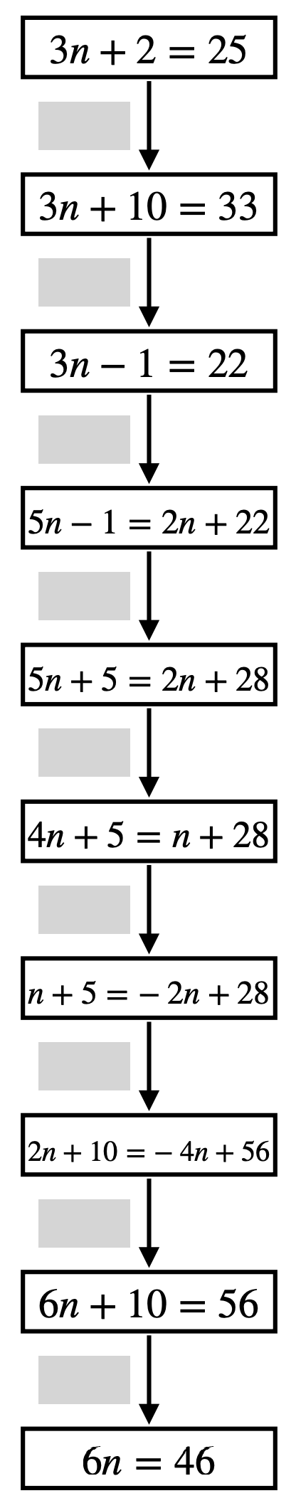
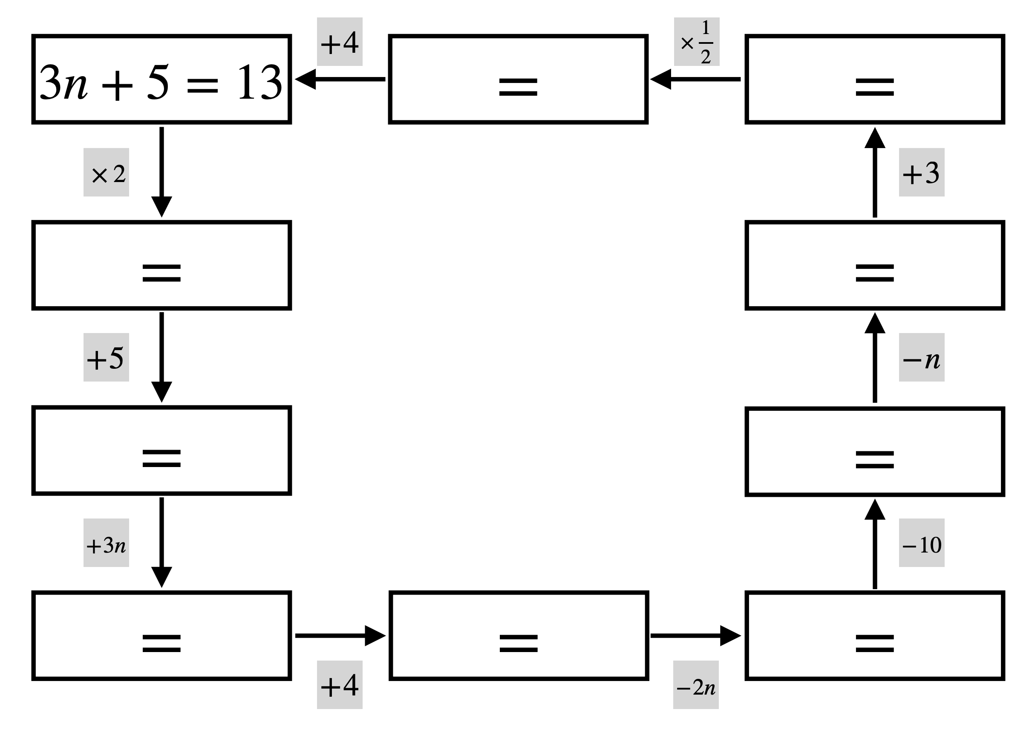
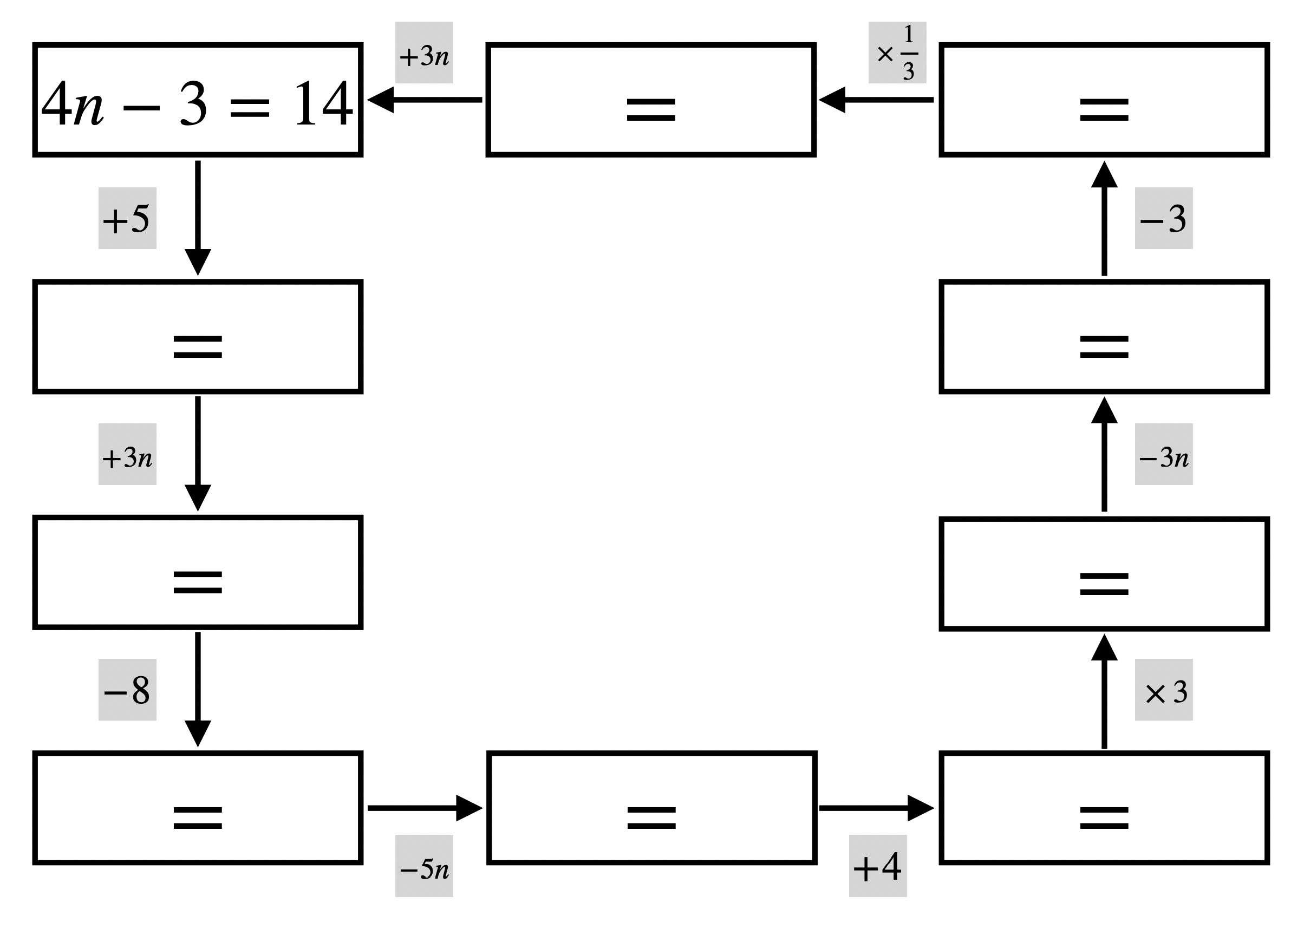
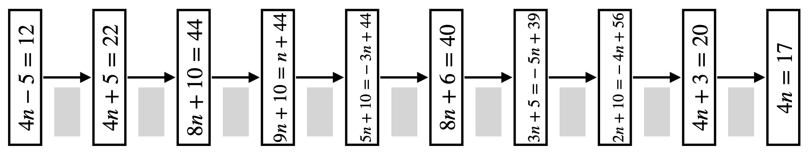






















Task 9: Equivalent Equations
$3n+5=13$
$=$
$=$
$3n+5=26$
$=$
$3n+5=31$
$=$
$=3n+31$
$=3n+35$
$=$
$$3n+5=13$$
$4n−3=14$
$=$
$=$
$$3n+5=13$$
$=$
$=$
$=$
$=$
$=$
$=$
$$3n+5=13$$

Slide 8
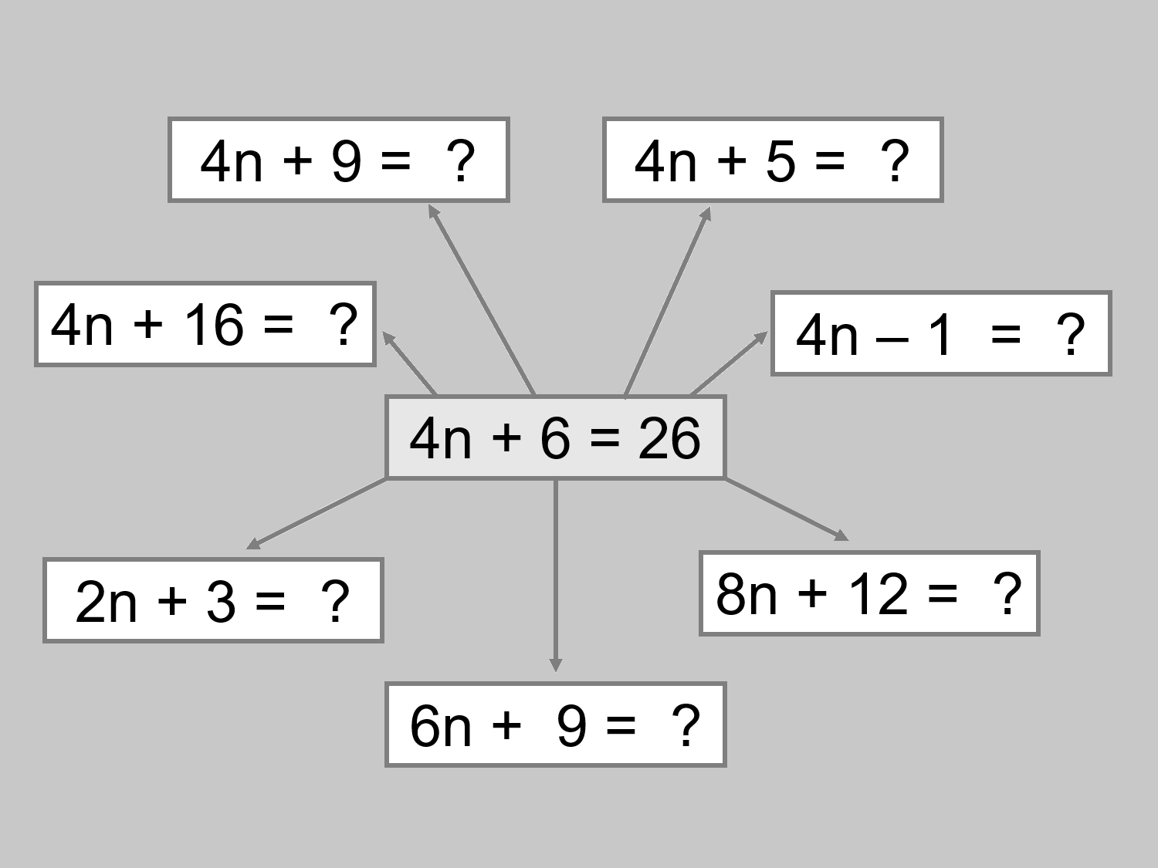
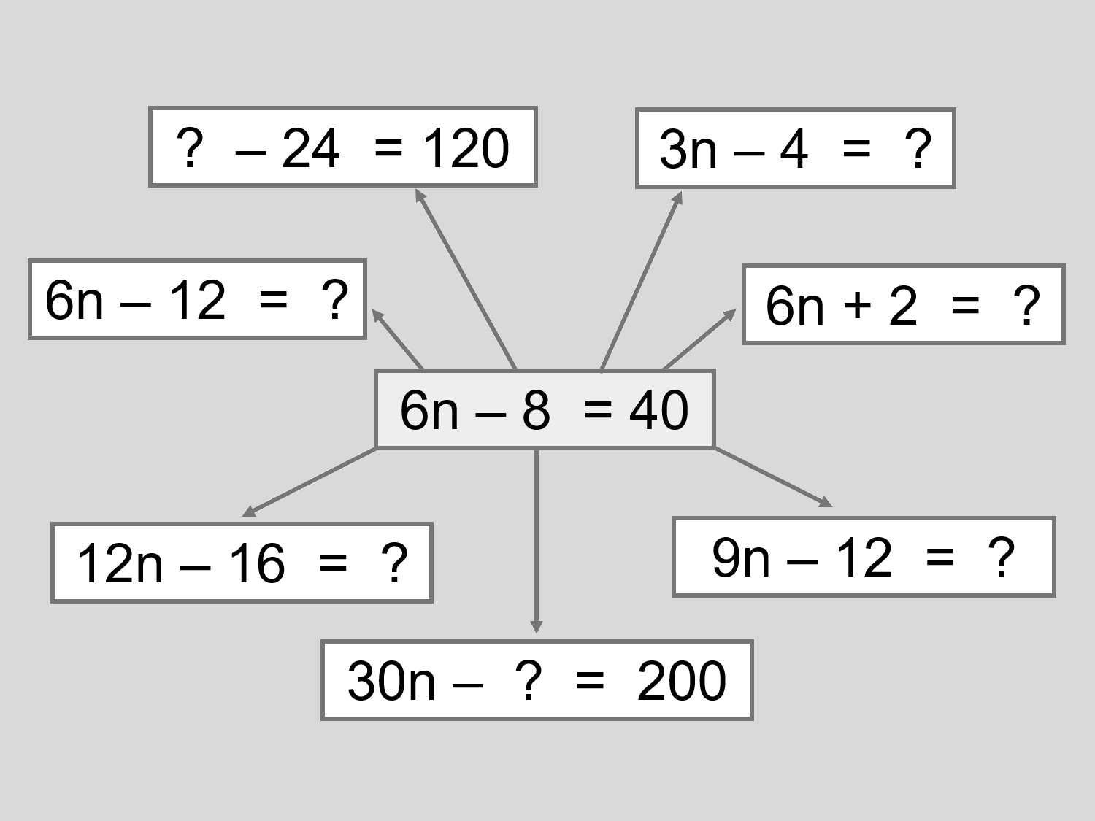
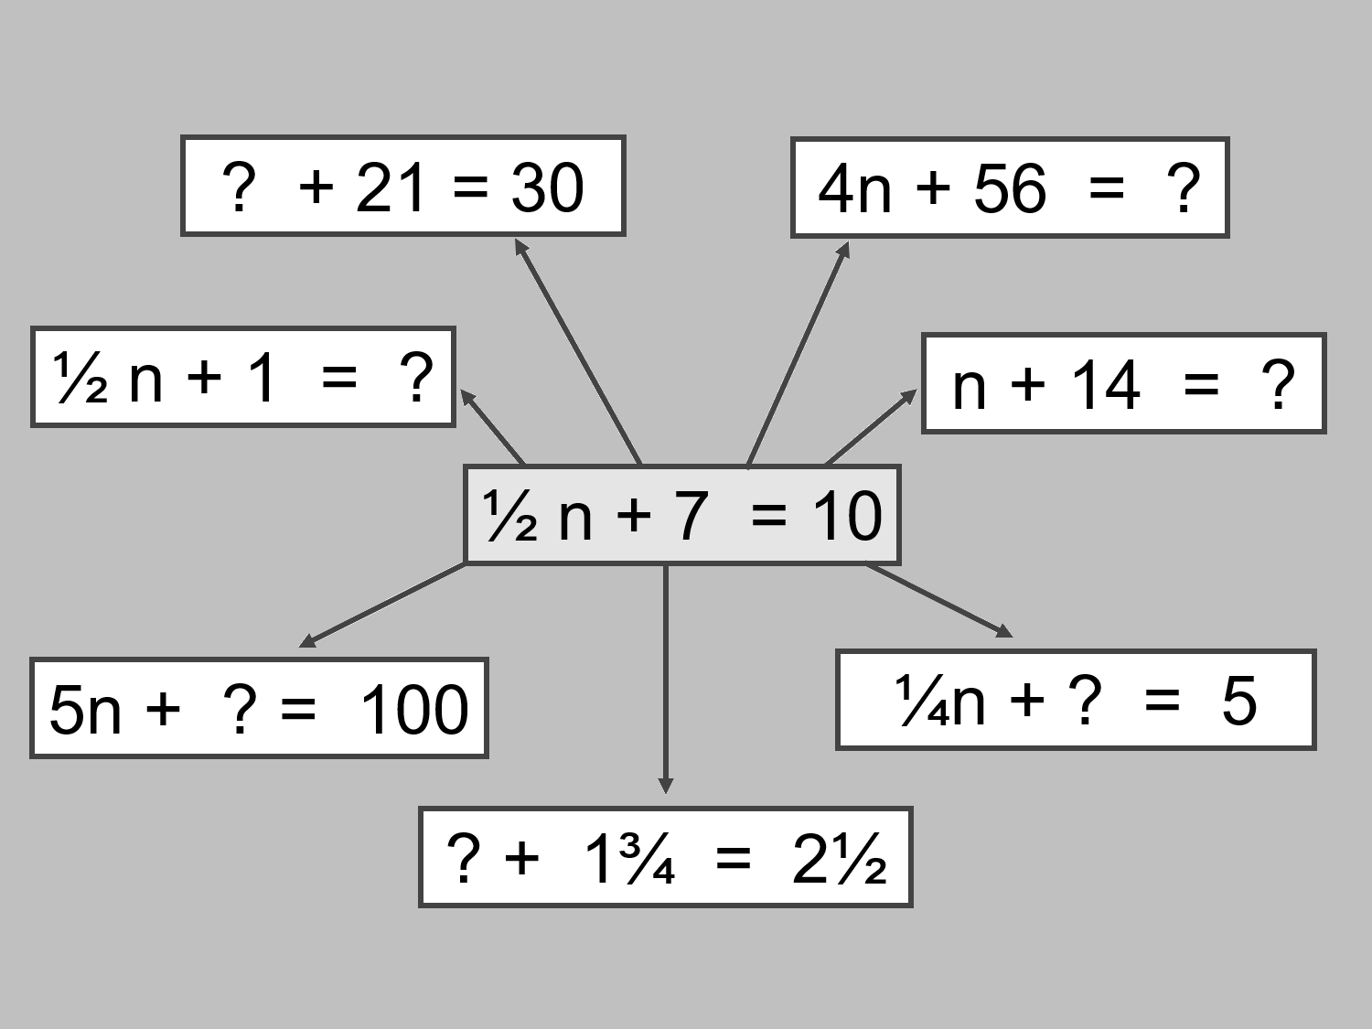
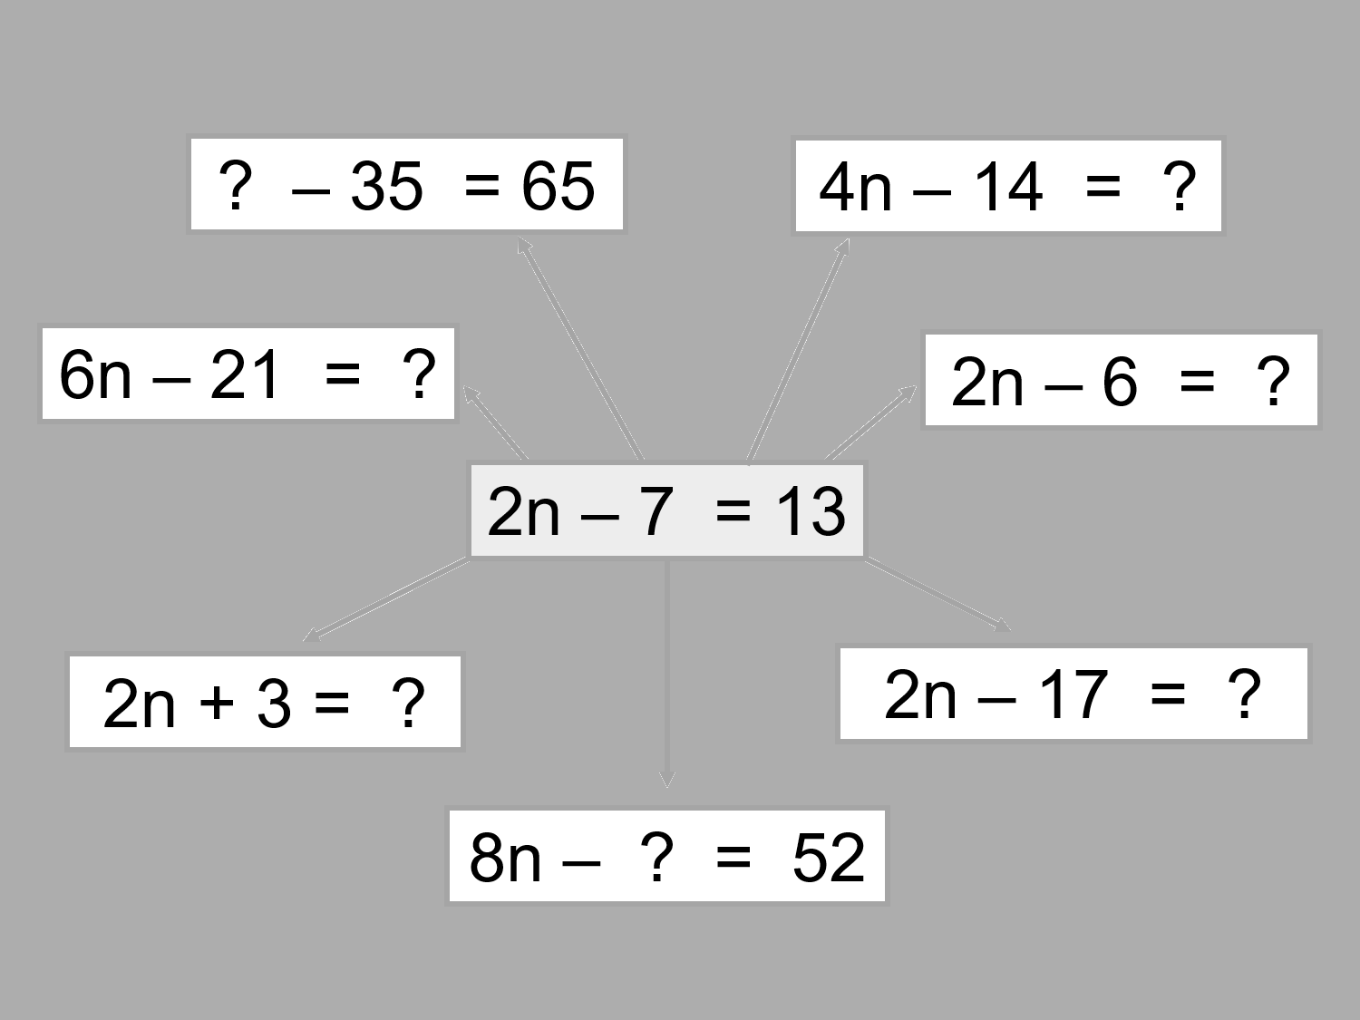
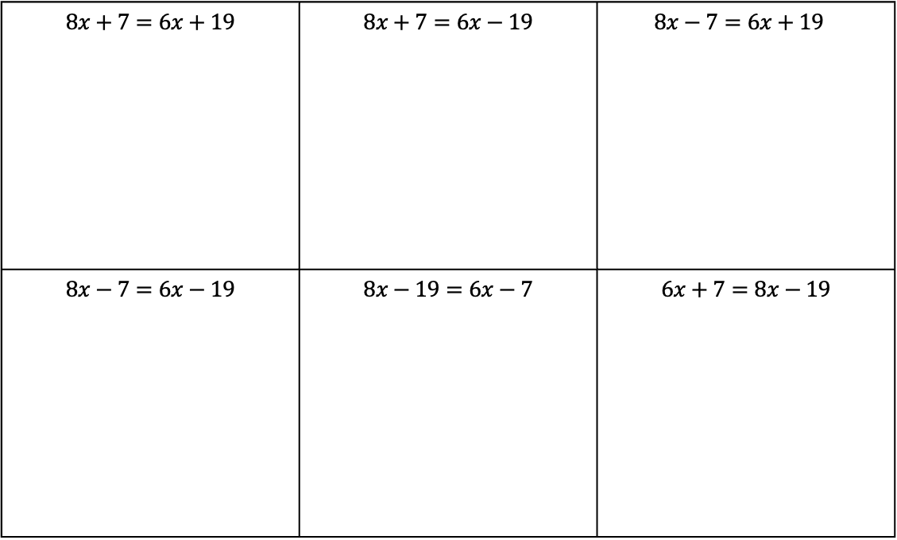
Task 10: Fill in the shaded boxes
Task 11: Solving equations with negatives
$8x+7=6x+19$ | $8x+7=6x−19$ | $$8x−7=6x+19$$
$8x−7=6x−19$ | $8x−19=6x−7$ | $6x+7=8x−19$

Slide 9
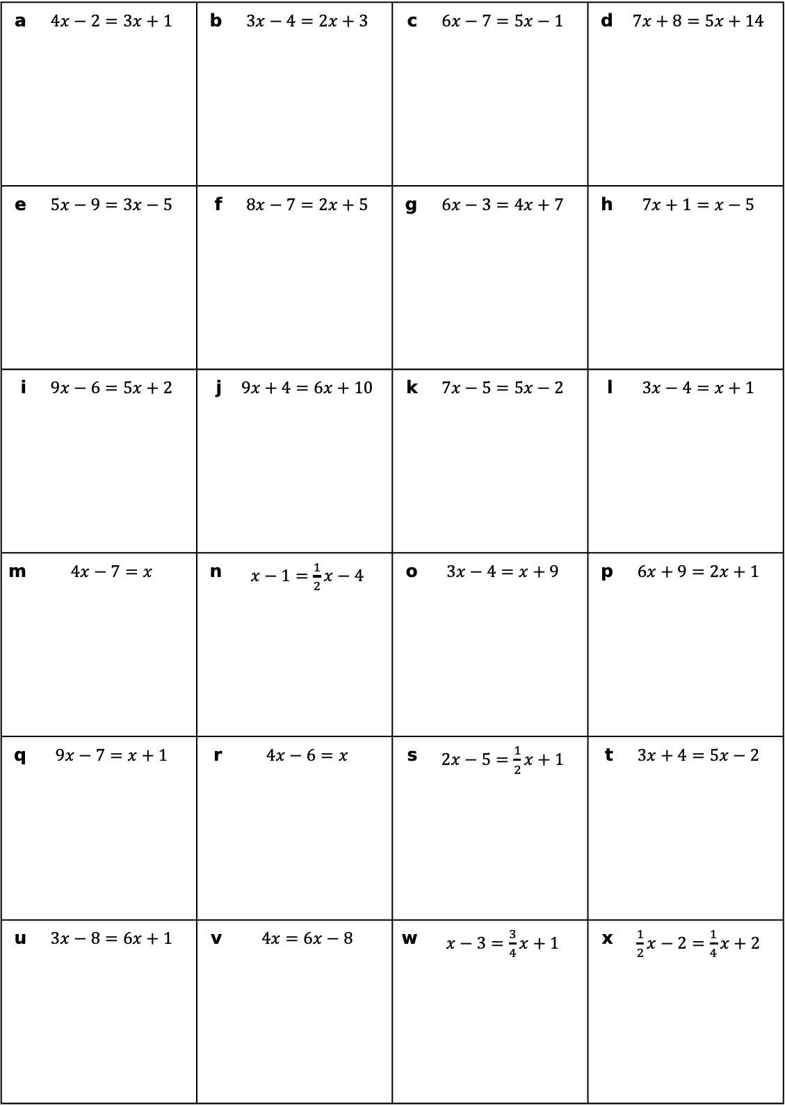
Task 12: Solve each of the equations
a | $4x−2=3x+1$ | b | $3x−4=2x+3$ | c | $6x−7=5x−1$ | d | $7x+8=5x+14$
e | $5x−9=3x−5$ | f | $8x−7=2x+5$ | g | $6x−3=4x+7$ | h | $7x+1=x−5$
i | $9x−6=5x+2$ | j | $9x+4=6x+10$ | k | $7x−5=5x−2$ | l | $3x−4=x+1$
m | $4x−7=x$ | n | $x−1=\frac{1}{2}x−4$ | o | $3x−4=x+9$ | p | $6x+9=2x+1$
q | $9x−7=x+1$ | r | $4x−6=x$ | s | $2x−5=\frac{1}{2}x+1$ | t | $3x+4=5x−2$
u | $3x−8=6x+1$ | v | $4x=6x−8$ | w | $x−3=\frac{3}{4}x+1$ | x | $\frac{1}{2}x−2=\frac{1}{4}x+2$

Slide 10
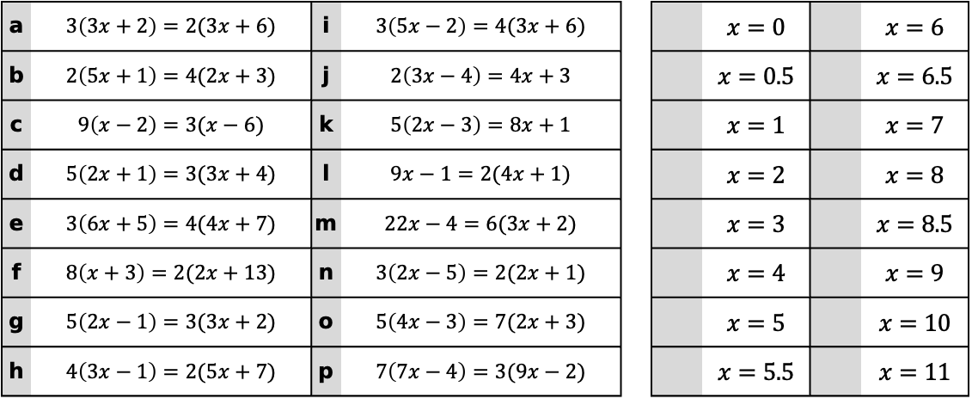
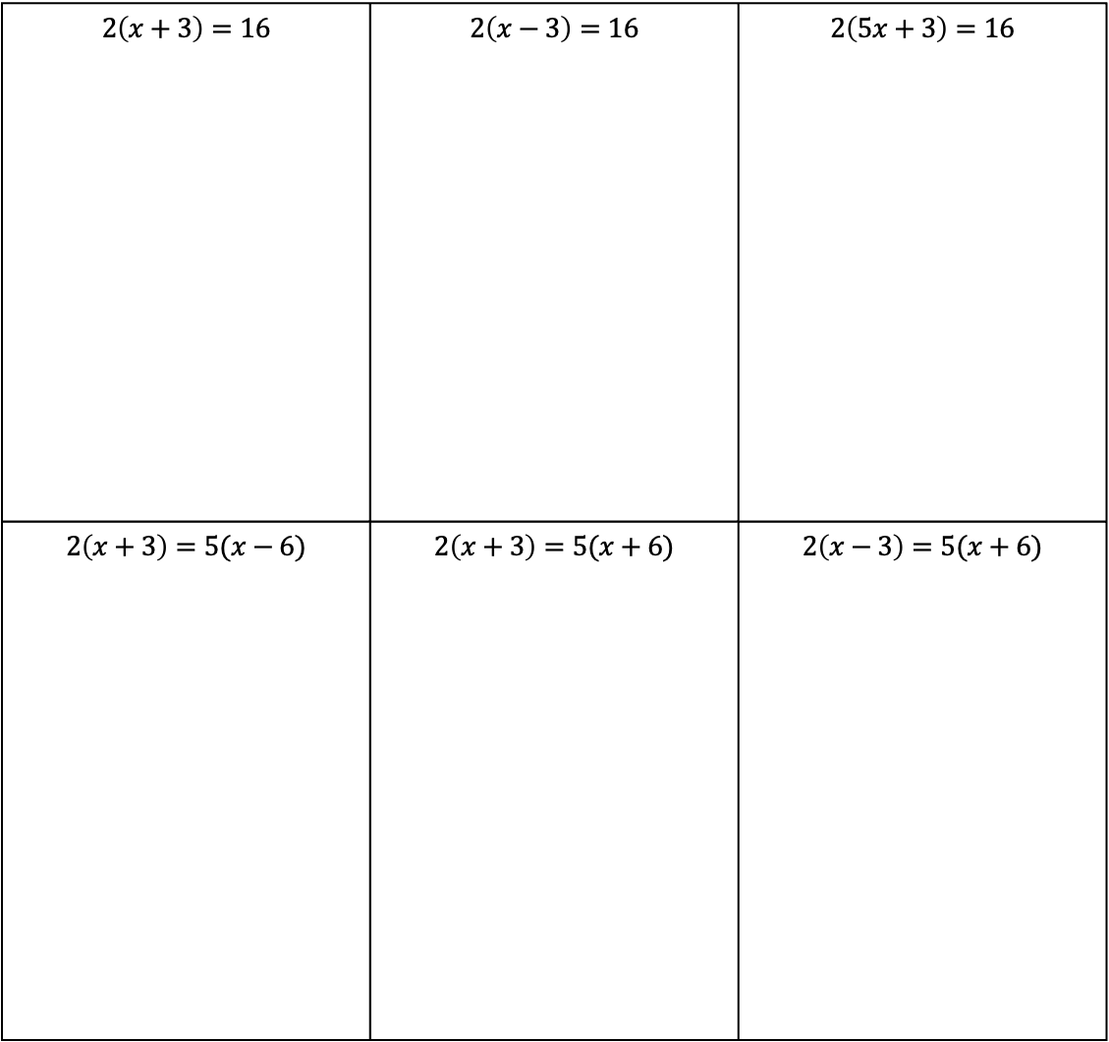
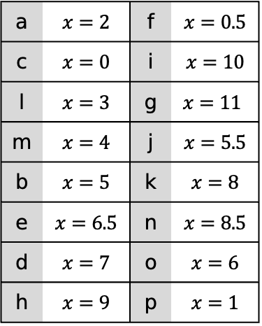
Task 13: Solving Equations with Brackets
$2\left(x+3\right)=16$ | $2\left(x−3\right)=16$ | $2\left(5x+3\right)=16$
$2\left(x+3\right)=5(x−6)$ | $2\left(x+3\right)=5(x+6)$ | $2\left(x−3\right)=5(x+6)$
a | $x=2$ | f | $x=0.5$
c | $x=0$ | i | $x=10$
l | $x=3$ | g | $$x=11$$
m | $x=4$ | j | $x=5.5$
b | $x=5$ | k | $x=8$
e | $x=6.5$ | n | $x=8.5$
d | $x=7$ | o | $x=6$
h | $x=9$ | p | $x=1$
Task 14: Match the equations to their solutions
a | $3\left(3x+2\right)=2(3x+6)$ | i | $3\left(5x−2\right)=4(3x+6)$ |  |  | $x=0$ |  | $x=6$
b | $2\left(5x+1\right)=4(2x+3)$ | j | $2\left(3x−4\right)=4x+3$ |  |  | $x=0.5$ |  | $x=6.5$
c | $9\left(x−2\right)=3(x−6)$ | k | $5\left(2x−3\right)=8x+1$ |  |  | $x=1$ |  | $x=7$
d | $5\left(2x+1\right)=3(3x+4)$ | l | $9x−1=2(4x+1)$ |  |  | $x=2$ |  | $x=8$
e | $3\left(6x+5\right)=4(4x+7)$ | m | $22x−4=6(3x+2)$ |  |  | $x=3$ |  | $x=8.5$
f | $8\left(x+3\right)=2(2x+13)$ | n | $3\left(2x−5\right)=2(2x+1)$ |  |  | $x=4$ |  | $x=9$
g | $5\left(2x−1\right)=3(3x+2)$ | o | $5\left(4x−3\right)=7(2x+3)$ |  |  | $x=5$ |  | $x=10$
h | $4\left(3x−1\right)=2(5x+7)$ | p | $7\left(7x−4\right)=3(9x−2)$ |  |  | $x=5.5$ |  | $x=11$

