Slide 1
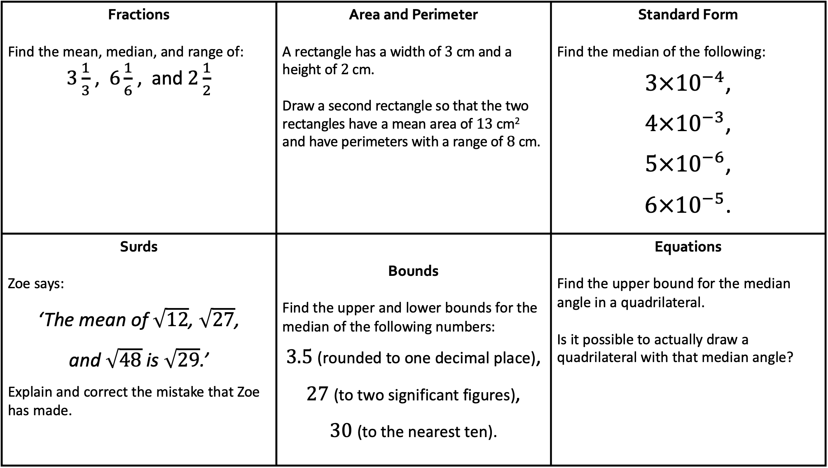
Fractions Find the mean, median, and range of: $3\frac{1}{3}$ , $6\frac{1}{6}$ , and $2\frac{1}{2}$ | Area and Perimeter A rectangle has a width of $3$ cm and a height of $2$ cm. Draw a second rectangle so that the two rectangles have a mean area of 13 cm² and have perimeters with a range of 8 cm. | Standard Form Find the median of the following: $3×{10}^{−4}$, $4×{10}^{−3}$, $5×{10}^{−6}$, $6×{10}^{−5}$.
Surds Zoe says: ‘The mean of $\sqrt{12}$, $\sqrt{27}$, and $\sqrt{48}$ is $\sqrt{29}$.’ Explain and correct the mistake that Zoe has made. | Bounds Find the upper and lower bounds for the median of the following numbers: $3.5$ (rounded to one decimal place), $27$ (to two significant figures), $30$ (to the nearest ten). | Equations Find the upper bound for the median angle in a quadrilateral. Is it possible to actually draw a quadrilateral with that median angle?
Averages with…

Slide 2
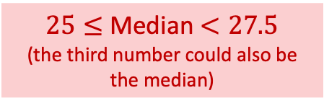

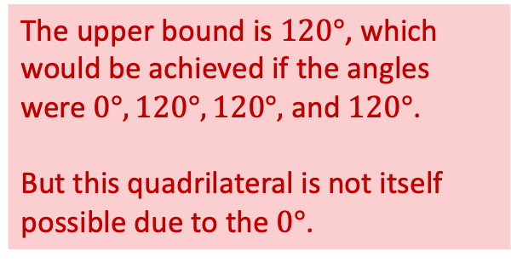
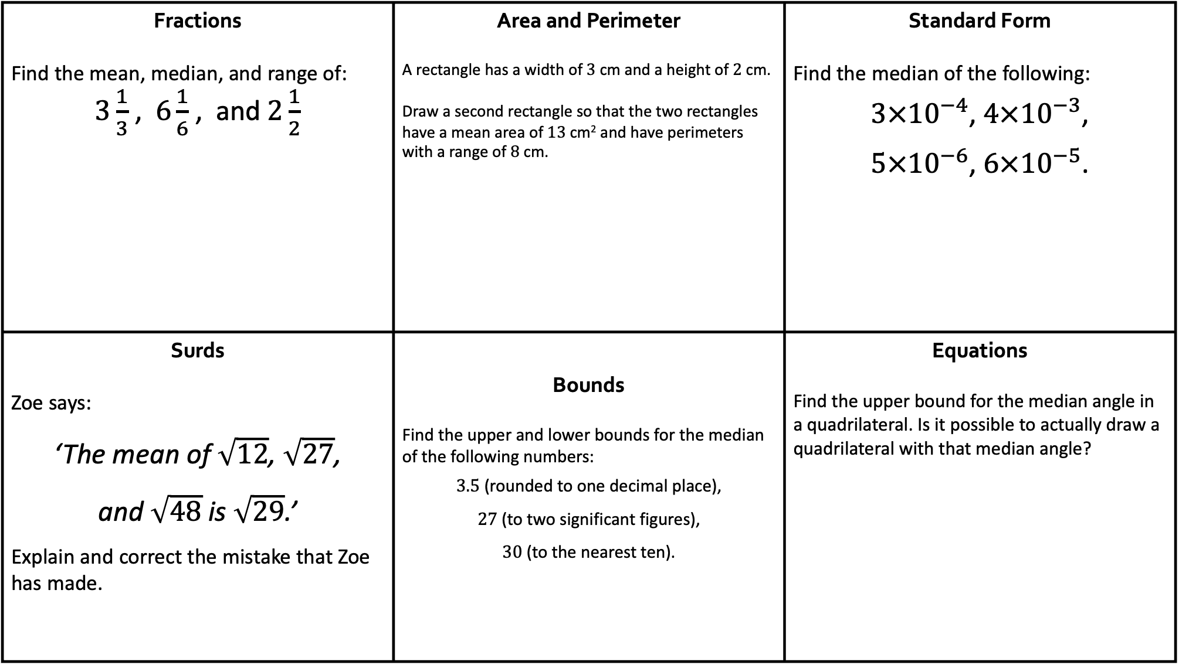


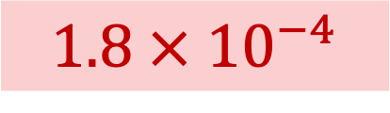
Fractions Find the mean, median, and range of: $3\frac{1}{3}$ , $6\frac{1}{6}$ , and $2\frac{1}{2}$ | Area and Perimeter A rectangle has a width of $3$ cm and a height of $2$ cm. Draw a second rectangle so that the two rectangles have a mean area of 13 cm² and have perimeters with a range of 8 cm. | Standard Form Find the median of the following: $3×{10}^{−4}$, $4×{10}^{−3}$, $5×{10}^{−6}$, $6×{10}^{−5}$.
Surds Zoe says: ‘The mean of $\sqrt{12}$, $\sqrt{27}$, and $\sqrt{48}$ is $\sqrt{29}$.’ Explain and correct the mistake that Zoe has made. | Bounds Find the upper and lower bounds for the median of the following numbers: $3.5$ (rounded to one decimal place), $27$ (to two significant figures), $30$ (to the nearest ten). | Equations Find the upper bound for the median angle in a quadrilateral. Is it possible to actually draw a quadrilateral with that median angle?
Mean = $4$
Median = $3\frac{1}{3}$
Range = $3\frac{2}{3}$
 | $4$ cm
$5$ cm
$1.8 × {10}^{−4}$
Answers!
Zoe found the square root of the mean of $12$, $27$ and $48$.
She should have done:
Mean $=\frac{\sqrt{12}+\sqrt{27}+\sqrt{48}}{3}$
$=\frac{2\sqrt{3}+3\sqrt{3}+4\sqrt{3}}{3}$
$=\frac{9\sqrt{3}}{3}=3\sqrt{3} \left(=\sqrt{27}\right)$
The upper bound is $120°$, which would be achieved if the angles were $0°, 120°, 120°,$ and $120°$.
But this quadrilateral is not itself possible due to the $0°$.
$25≤$ Median $<27.5$
(the third number could also be the median)

Slide 3
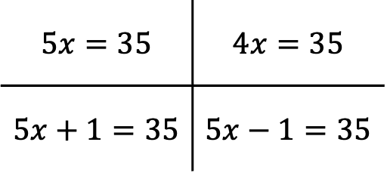
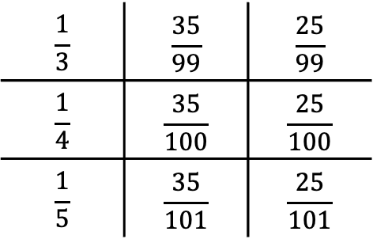
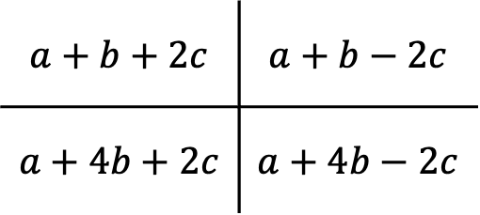
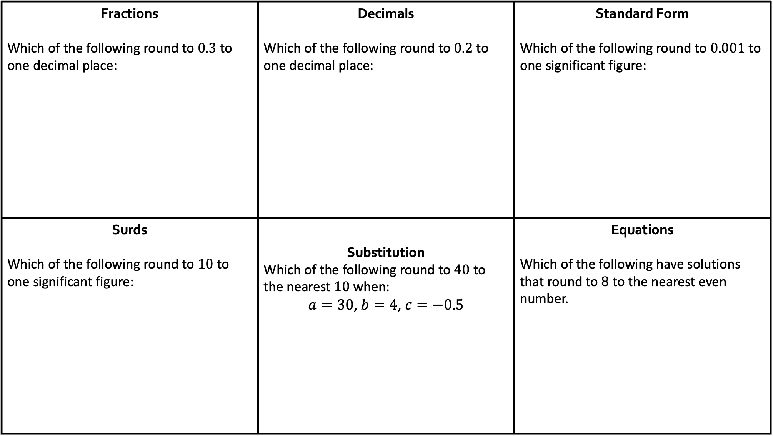
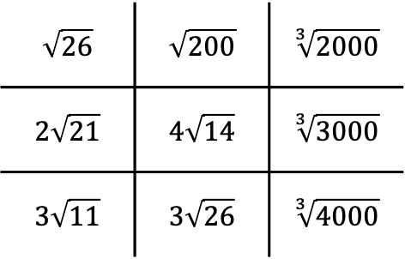
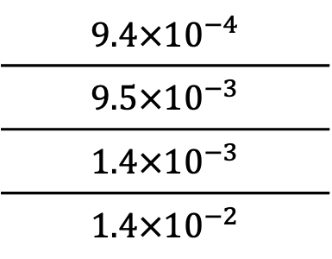
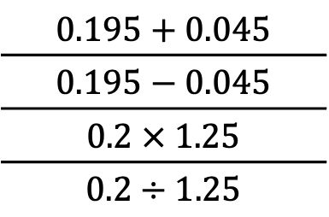
Fractions Which of the following round to $0.3$ to one decimal place: | Decimals Which of the following round to $0.2$ to one decimal place: | Standard Form Which of the following round to $0.001$ to one significant figure:
Surds Which of the following round to $10$ to one significant figure: | Substitution Which of the following round to $40$ to the nearest $10$ when: $a=30$, $b=4$, $c=−0.5$ | Equations Which of the following have solutions that round to $8$ to the nearest even number.
$$\frac{1}{3}$$ | $$\frac{35}{99}$$ | $$\frac{25}{99}$$
$$\frac{1}{4}$$ | $$\frac{35}{100}$$ | $$\frac{25}{100}$$
$$\frac{1}{5}$$ | $$\frac{35}{101}$$ | $$\frac{25}{101}$$
$$0.195+0.045$$
$$0.195−0.045$$
$$0.2 × 1.25$$
$$0.2÷1.25$$
$$9.4×{10}^{−4}$$
$$9.5×{10}^{−3}$$
$$1.4×{10}^{−3}$$
$$1.4×{10}^{−2}$$
Rounding with…
$$\sqrt{26}$$ | $$\sqrt{200}$$ | $$\sqrt[3]{2000}$$
$$2\sqrt{21}$$ | $$4\sqrt{14}$$ | $$\sqrt[3]{3000}$$
$$3\sqrt{11}$$ | $$3\sqrt{26}$$ | $$\sqrt[3]{4000}$$
$$a+b+2c$$ | $$a+b−2c$$
$$a+4b+2c$$ | $$a+4b−2c$$
$$5x=35$$ | $$4x=35$$
$$5x+1=35$$ | $$5x−1=35$$

Slide 4
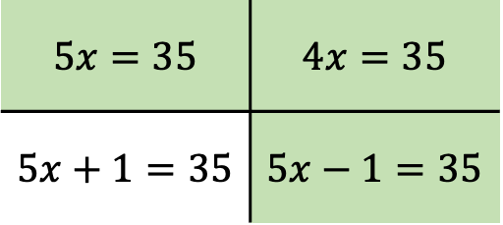
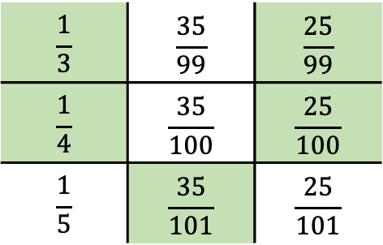
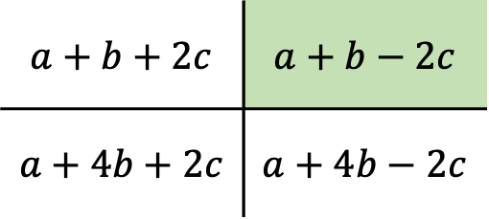
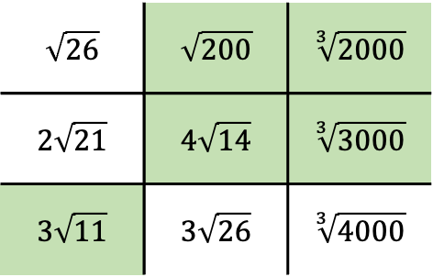
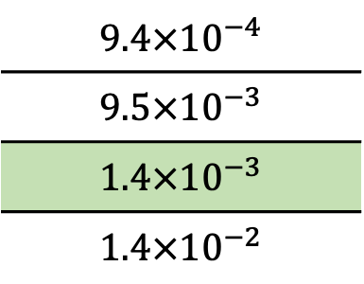
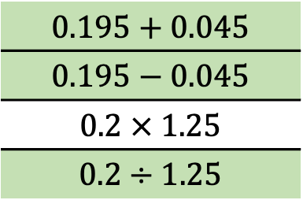
Fractions Which of the following round to $0.3$ to one decimal place: | Decimals Which of the following round to $0.2$ to one decimal place: | Standard Form Which of the following round to $0.001$ to one significant figure:
Surds Which of the following round to $10$ to one significant figure: | Substitution Which of the following round to $40$ to the nearest $10$ when: $a=30$, $b=4$, $c=−0.5$ | Equations Which of the following have solutions that round to $8$ to the nearest even number.
$$\frac{1}{3}$$ | $$\frac{35}{99}$$ | $$\frac{25}{99}$$
$$\frac{1}{4}$$ | $$\frac{35}{100}$$ | $$\frac{25}{100}$$
$$\frac{1}{5}$$ | $$\frac{35}{101}$$ | $$\frac{25}{101}$$
$$0.195+0.045$$
$$0.195−0.045$$
$$0.2 × 1.25$$
$$0.2÷1.25$$
$$9.4×{10}^{−4}$$
$$9.5×{10}^{−3}$$
$$1.4×{10}^{−3}$$
$$1.4×{10}^{−2}$$
Answers!
$$\sqrt{26}$$ | $$\sqrt{200}$$ | $$\sqrt[3]{2000}$$
$$2\sqrt{21}$$ | $$4\sqrt{14}$$ | $$\sqrt[3]{3000}$$
$$3\sqrt{11}$$ | $$3\sqrt{26}$$ | $$\sqrt[3]{4000}$$
$$a+b+2c$$ | $$a+b−2c$$
$$a+4b+2c$$ | $$a+4b−2c$$
$$5x=35$$ | $$4x=35$$
$$5x+1=35$$ | $$5x−1=35$$

Slide 5
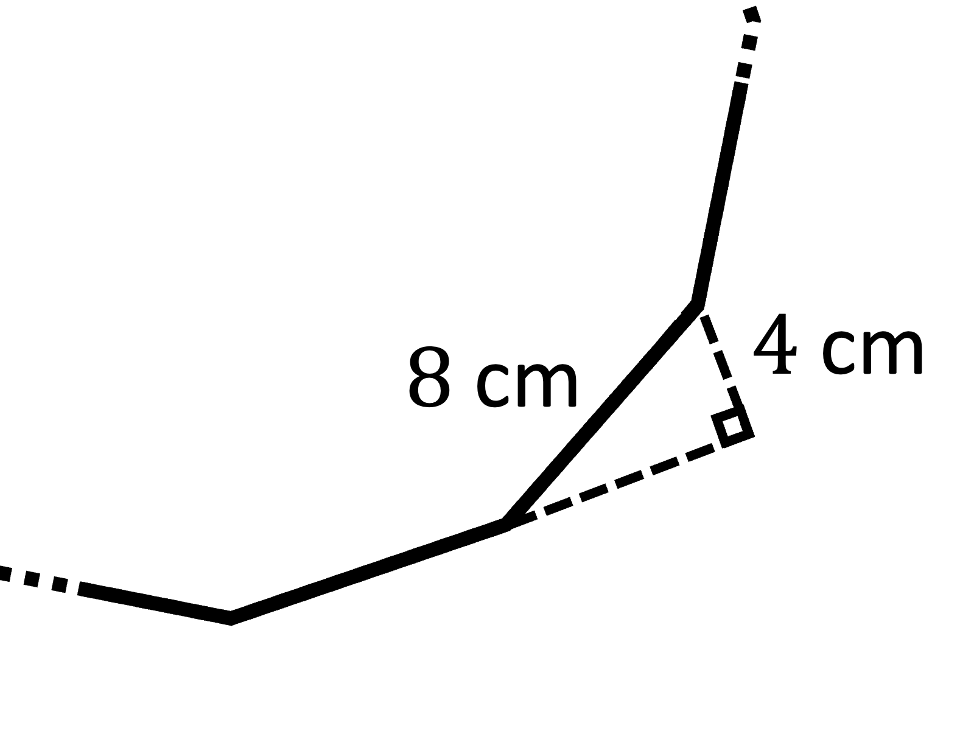
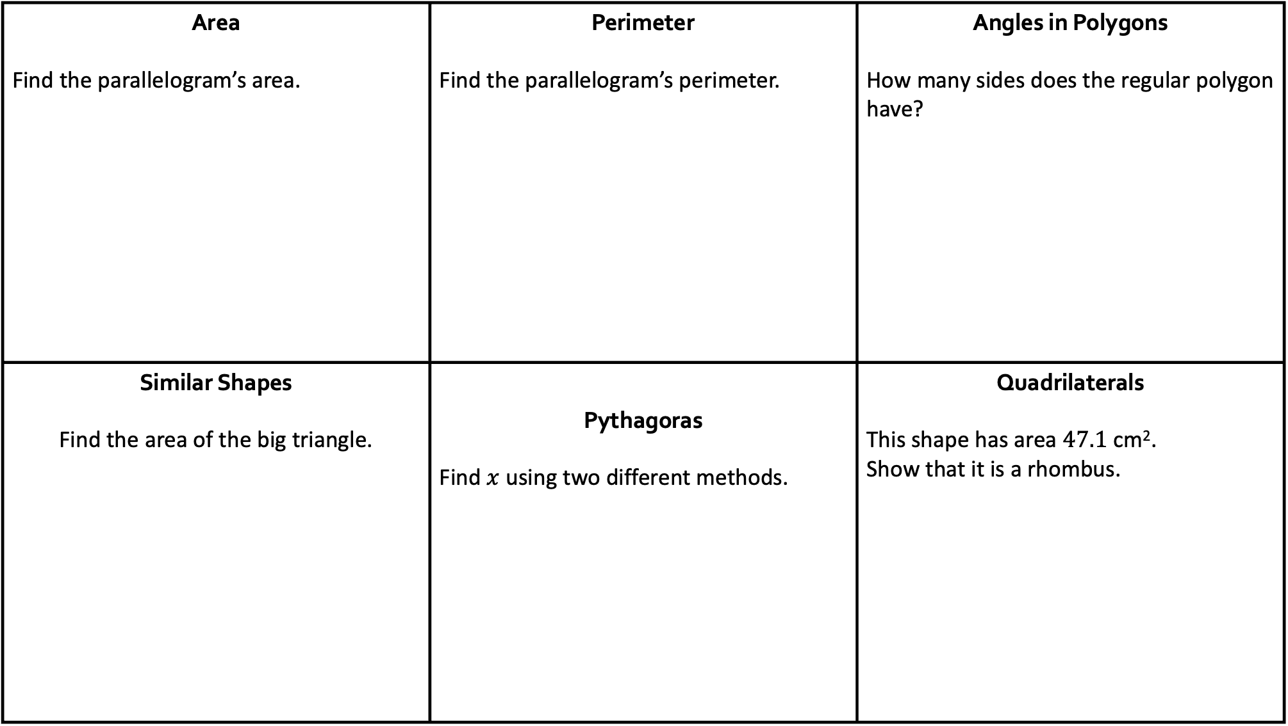
Area Find the parallelogram’s area. | Perimeter Find the parallelogram’s perimeter. | Angles in Polygons How many sides does the regular polygon have?
Similar Shapes Find the area of the big triangle. | Pythagoras Find $x$ using two different methods. | Quadrilaterals This shape has area $47.1$ cm². Show that it is a rhombus.
Trigonometry with…

Slide 6

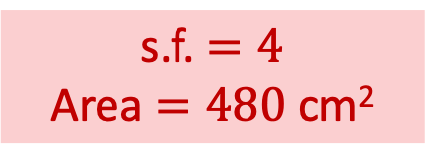
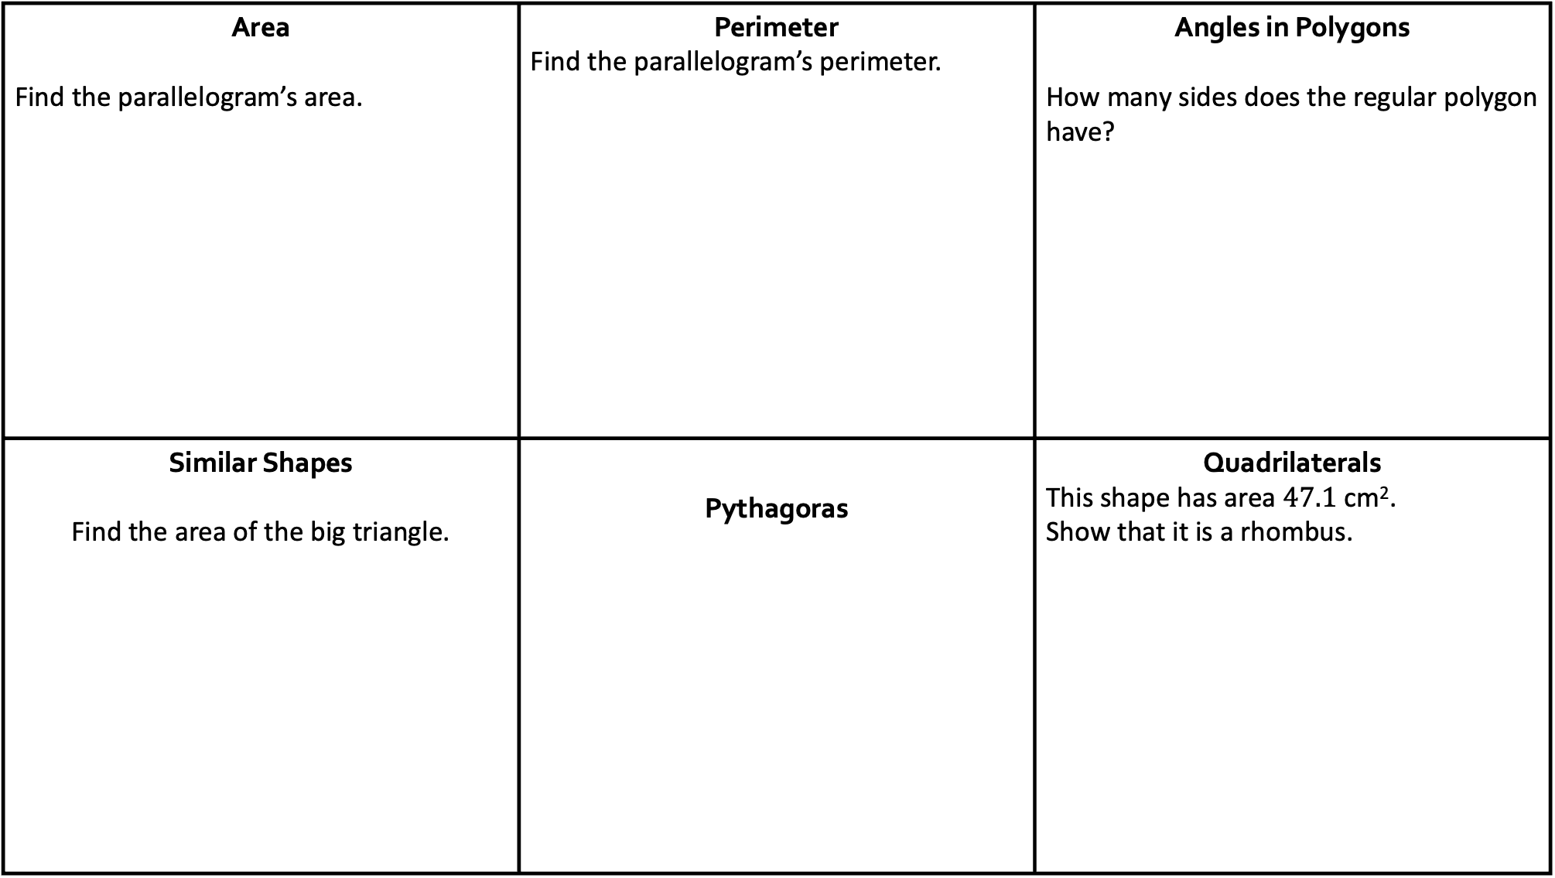



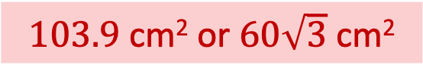
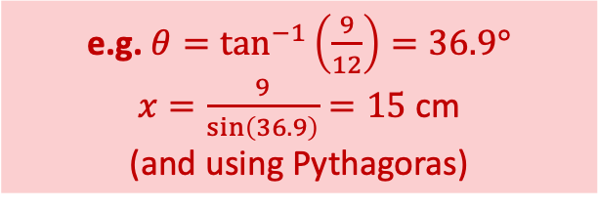
Area Find the parallelogram’s area. | Perimeter Find the parallelogram’s perimeter. | Angles in Polygons How many sides does the regular polygon have?
Similar Shapes Find the area of the big triangle. | Pythagoras | Quadrilaterals This shape has area $47.1$ cm². Show that it is a rhombus.
$48.5$ cm
$103.9$ cm² or $60\sqrt{3}$ cm²
$12$ sides
Answers!
$$θ$$
$h=\frac{47.1}{7}=6.73$ cm.
Left side $=\frac{6.73}{\sin\left(74\right)}=7$ cm.
All four sides the same length, so it is a rhombus.
e.g. $θ=\tan^{−1}\left(\frac{9}{12}\right)=36.9°$
$x=\frac{9}{\sin\left(36.9\right)}=15$ cm
(and using Pythagoras)
s.f. $=4$
Area $=480$ cm²

Slide 7
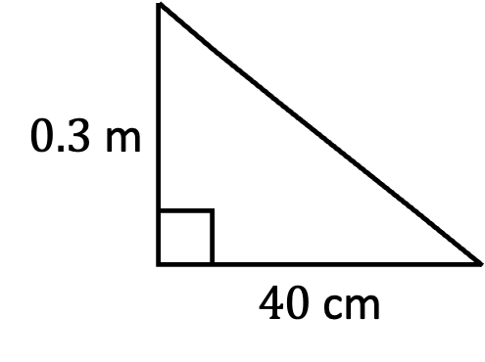
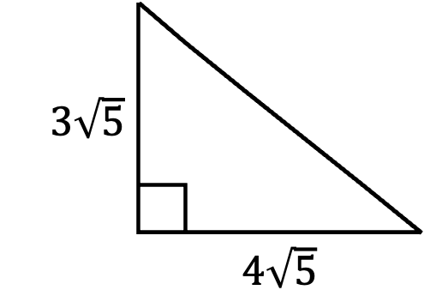
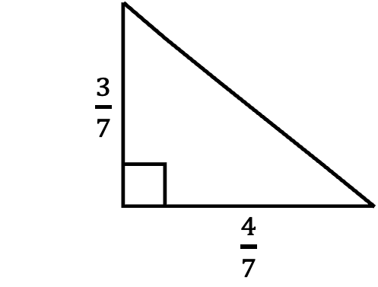
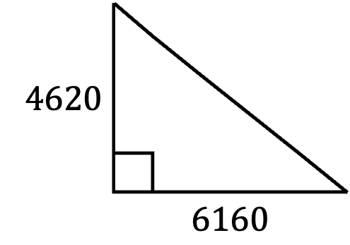
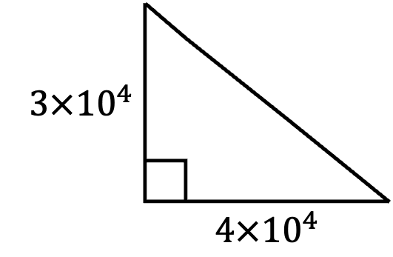
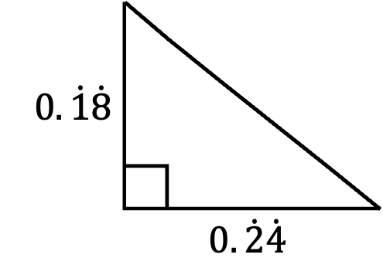
Unit Conversions Find the hypotenuse. | Fractions Find the hypotenuse. | Recurring Decimals Find the hypotenuse.
Standard Form Find the hypotenuse. | Surds Find the hypotenuse. | Prime Factorisation Find the hypotenuse.
$\frac{3}{7}$
 | $\frac{4}{7}$
$0.3$ m
 | $40$ cm
$0.\dot{1}\dot{8}$
 | $$0.\dot{2}\dot{4}$$
Pythagoras with…
$3×{10}^{4}$
 | $4×{10}^{4}$
$3\sqrt{5}$
 | $4\sqrt{5}$
$4620$
 | $6160$

Slide 8
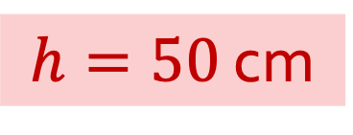

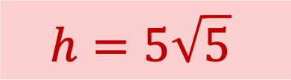

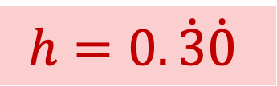

Unit Conversions Find the hypotenuse. | Fractions Find the hypotenuse. | Recurring Decimals Find the hypotenuse.
Standard Form Find the hypotenuse. | Surds Find the hypotenuse. | Prime Factorisation Find the hypotenuse.
$\frac{3}{7}$
 | $\frac{4}{7}$
$0.3$ m
 | $40$ cm
$$h=\frac{5}{7}$$
$0.\dot{1}\dot{8}$
 | $$0.\dot{2}\dot{4}$$
$h=50$ cm
$$h=0.\dot{3}\dot{0}$$
Answers!
$3×{10}^{4}$
 | $4×{10}^{4}$
$3\sqrt{5}$
 | $4\sqrt{5}$
$4620$
 | $6160$
$$h=7700$$
$$h=5×{10}^{4}$$
$$h=5\sqrt{5}$$

Slide 9
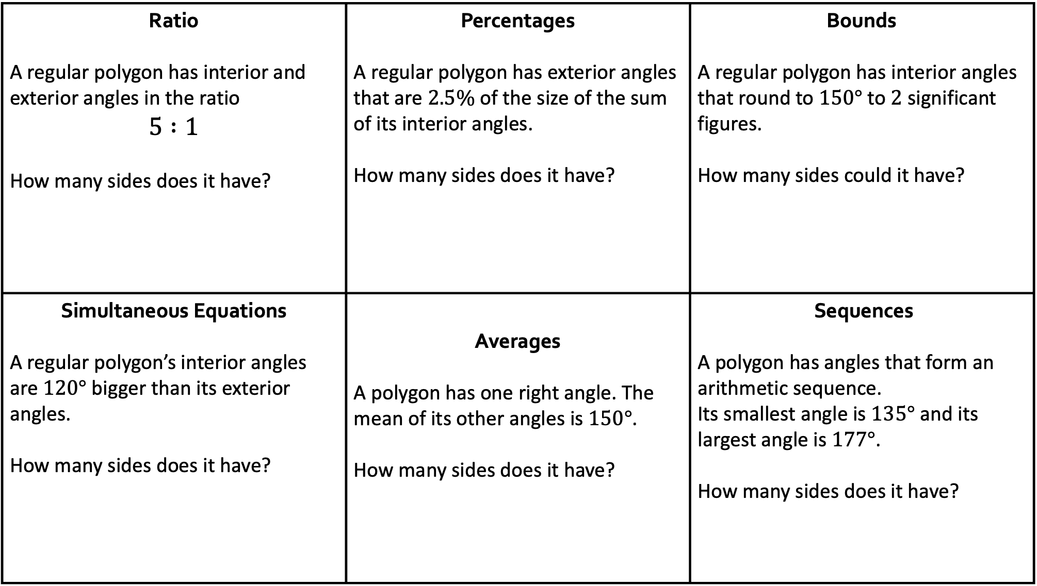
Ratio A regular polygon has interior and exterior angles in the ratio $$5 :1$$ How many sides does it have? | Percentages A regular polygon has exterior angles that are $2.5\%$ of the size of the sum of its interior angles. How many sides does it have? | Bounds A regular polygon has interior angles that round to $150°$ to $2$ significant figures. How many sides could it have?
Simultaneous Equations A regular polygon’s interior angles are $120°$ bigger than its exterior angles. How many sides does it have? | Averages A polygon has one right angle. The mean of its other angles is $150°$. How many sides does it have? | Sequences A polygon has angles that form an arithmetic sequence. Its smallest angle is $135°$ and its largest angle is $177°$. How many sides does it have?
Angles in polygons with…

Slide 10
Ratio A regular polygon has interior and exterior angles in the ratio $$5 :1$$ How many sides does it have? | Percentages A regular polygon has exterior angles that are $2.5\%$ of the size of the sum of its interior angles. How many sides does it have? | Bounds A regular polygon has interior angles that round to $150°$ to $2$ significant figures. How many sides could it have?
Simultaneous Equations A regular polygon’s interior angles are $120°$ bigger than its exterior angles. How many sides does it have? | Averages A polygon has one right angle. The mean of its other angles is $150°$. How many sides does it have? | Sequences A polygon has angles that form an arithmetic sequence. Its smallest angle is $135°$ and its largest angle is $177°$. How many sides does it have?
10 sides
11, 12, 13 or 14 sides
12 sides
Answers!
12 sides
10 sides
15 sides

Slide 11
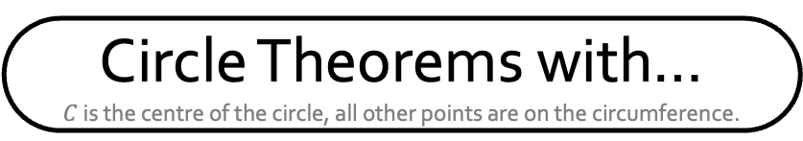
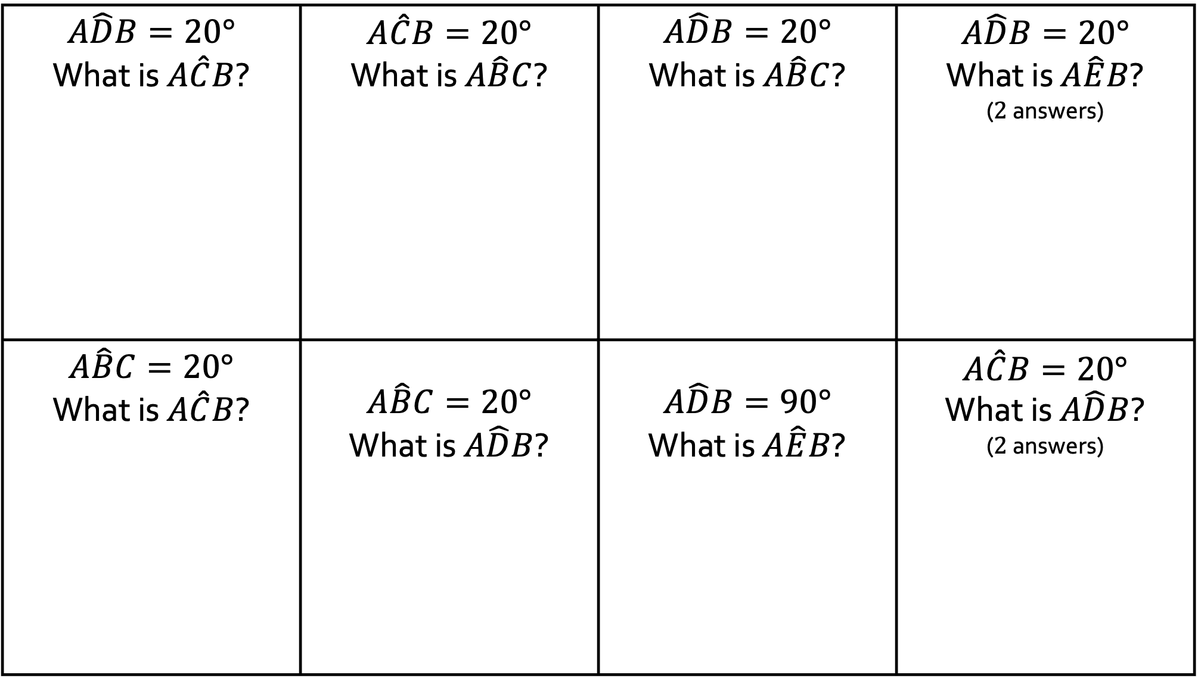
$$A\hat{D}B=20°$$ What is $A\hat{C}B$? | $$A\hat{C}B=20°$$ What is $A\hat{B}C$? | $$A\hat{D}B=20°$$ What is $A\hat{B}C$? | $A\hat{D}B=20°$ What is $A\hat{E}B$? ($2$ answers)
$$A\hat{B}C=20°$$ What is $A\hat{C}B$? | $$A\hat{B}C=20°$$ What is $A\hat{D}B$? | $$A\hat{D}B=90°$$ What is $A\hat{E}B$? | $A\hat{C}B=20°$ What is $A\hat{D}B$? ($2$ answers)
Circle Theorems with…
$C$ is the centre of the circle, all other points are on the circumference.

Slide 12
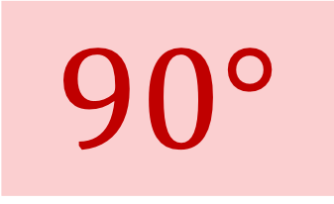
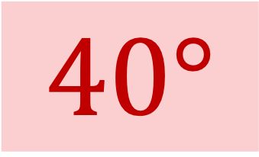
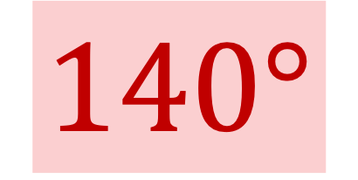
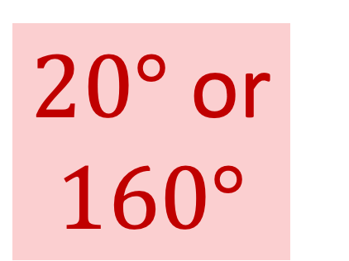
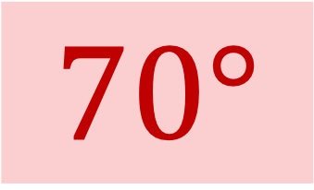
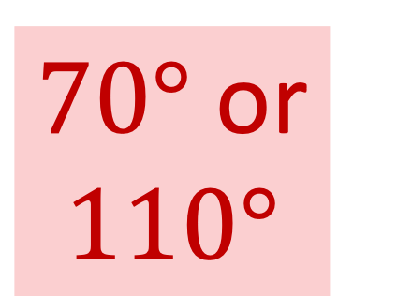
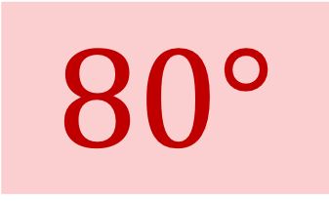
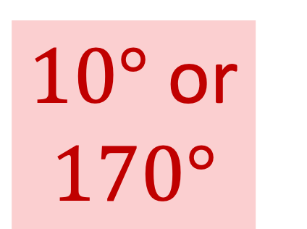
$$A\hat{D}B=20°$$ What is $A\hat{C}B$? | $$A\hat{C}B=20°$$ What is $A\hat{B}C$? | $$A\hat{D}B=20°$$ What is $A\hat{B}C$? | $A\hat{D}B=20°$ What is $A\hat{E}B$? ($2$ answers)
$$A\hat{B}C=20°$$ What is $A\hat{C}B$? | $$A\hat{B}C=20°$$ What is $A\hat{D}B$? | $$A\hat{D}B=90°$$ What is $A\hat{E}B$? | $A\hat{C}B=20°$ What is $A\hat{D}B$? ($2$ answers)
$20°$ or $160°$
$40°$
$80°$
$70°$
Answers!
$70°$ or $110°$
$10°$ or $170°$
$140°$
$90°$

Slide 13
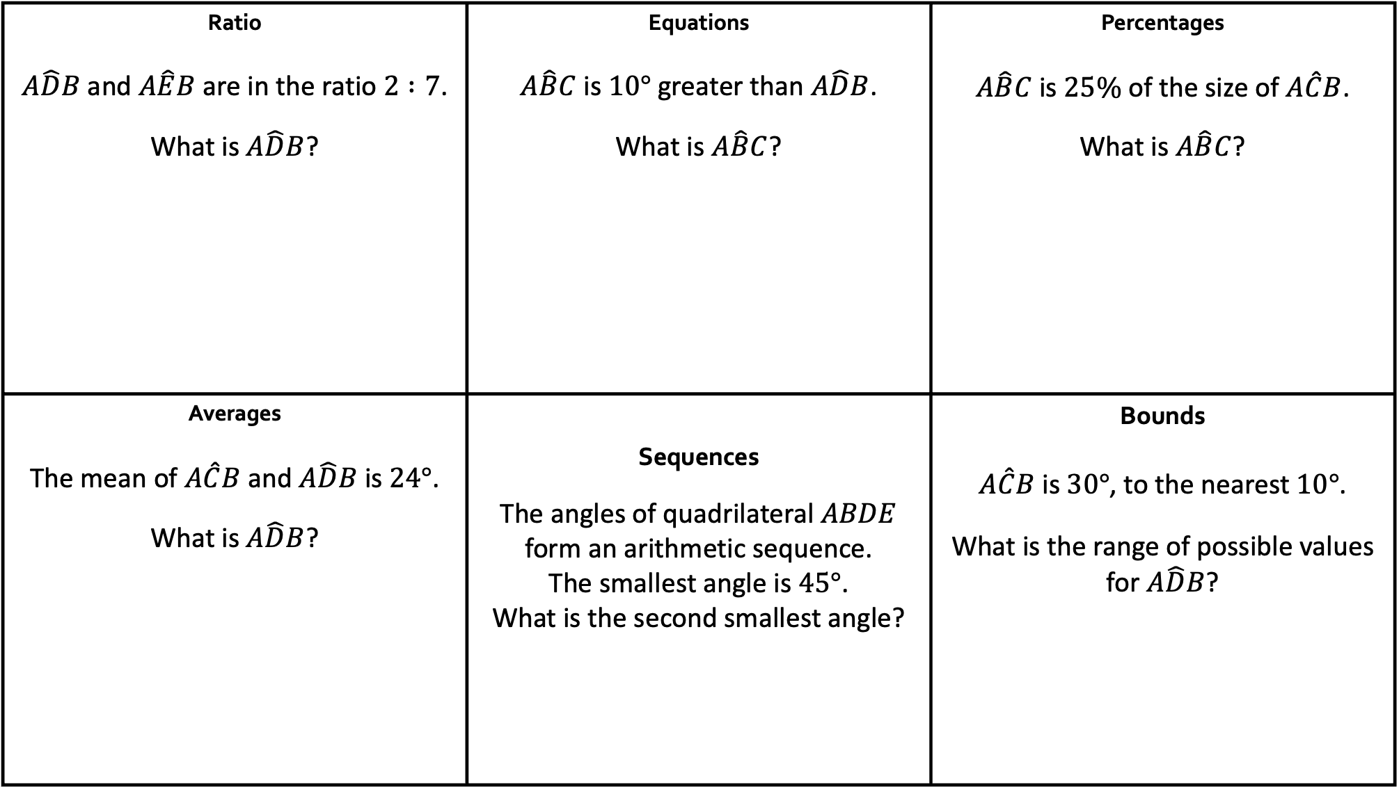
Ratio $A\hat{D}B$ and $A\hat{E}B$ are in the ratio $2 :7$. What is $A\hat{D}B$? | Equations $A\hat{B}C$ is $10°$ greater than $A\hat{D}B$. What is $A\hat{B}C$? | Percentages $A\hat{B}C$ is $25\%$ of the size of $A\hat{C}B$. What is $A\hat{B}C$?
Averages The mean of $A\hat{C}B$ and $A\hat{D}B$ is $24°$. What is $A\hat{D}B$? | Sequences The angles of quadrilateral $ABDE$ form an arithmetic sequence. The smallest angle is $45°$. What is the second smallest angle? | Bounds $A\hat{C}B$ is $30°$, to the nearest $10°$. What is the range of possible values for $A\hat{D}B$?
Circle Theorems with…
$C$ is the centre of the circle, all other points are on the circumference.

Slide 14







Ratio $A\hat{D}B$ and $A\hat{E}B$ are in the ratio $2 :7$. What is $A\hat{D}B$? | Equations $A\hat{B}C$ is $10°$ greater than $A\hat{D}B$. What is $A\hat{B}C$? | Percentages $A\hat{B}C$ is $25\%$ of the size of $A\hat{C}B$. What is $A\hat{B}C$?
Averages The mean of $A\hat{C}B$ and $A\hat{D}B$ is $24°$. What is $A\hat{D}B$? | Sequences The angles of quadrilateral $ABDE$ form an arithmetic sequence. The smallest angle is $45°$. What is the second smallest angle? | Bounds $A\hat{C}B$ is $30°$, to the nearest $10°$. What is the range of possible values for $A\hat{D}B$?
$40°$
$50°$
$30°$
Answers!
$$12.5°≤θ<17.5°$$
or
$$172.5<θ≤177.5$$
$16°$
$105°$

