Slide 1


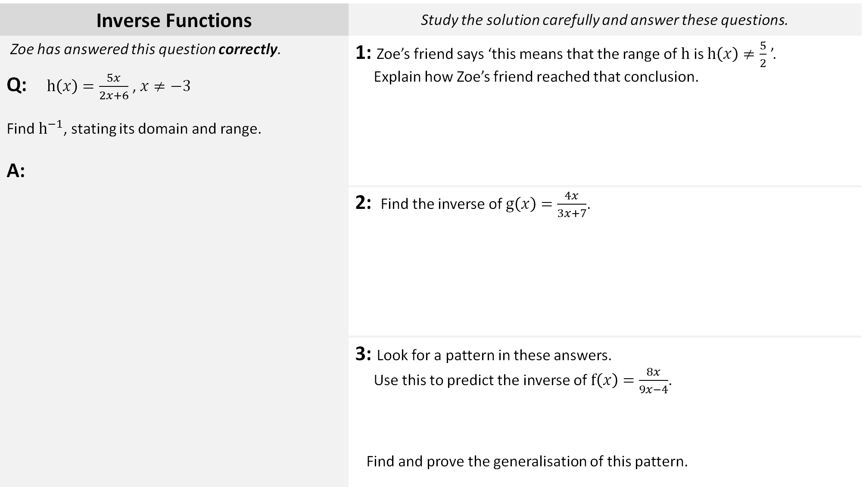

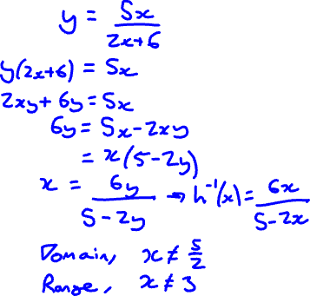
Inverse Functions | Study the solution carefully and answer these questions.
Zoe has answered this question correctly. Q: $h\left(x\right)=\frac{5x}{2x+6}$ , $x≠−3$ Find $h^{−1}$, stating its domain and range. A: | 1: Zoe’s friend says ‘this means that the range of $h$ is $h\left(x\right)≠\frac{5}{2}$ ’. Explain how Zoe’s friend reached that conclusion.
A: | 2: Find the inverse of $g\left(x\right)=\frac{4x}{3x+7}$.
 | 3: Look for a pattern in these answers. Use this to predict the inverse of $f\left(x\right)=\frac{8x}{9x−4}$. Find and prove the generalisation of this pattern.

