Slide 1
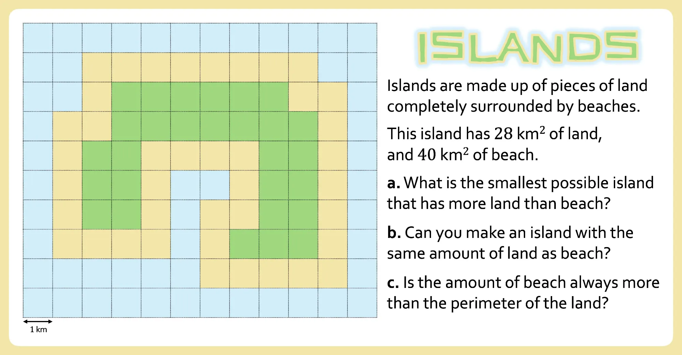

Slide 2

Islands
ISLANDS
Islands are made up of pieces of land completely surrounded by beaches.
What questions could you ask about islands?
$1$ km

Slide 3
0 – Drawing Islands
Draw:
An example of an island.
Something that is almost an Island.
Something that is definitely not an island.

Slide 4
1 – Small Island
Draw the smallest possible island that has more land than beach.

Slide 5
2 – Large Island
Draw the largest possible island that has more beach than land.

Slide 6
3 – Balanced Island
Draw an island with the same amount of land as beach.

Slide 7
3 – Balanced Island
Draw an island with the same amount of land as beach.

Slide 8
4 – Perimeter?
Draw an island where the amount of beach is less than the perimeter of the land.

Slide 9
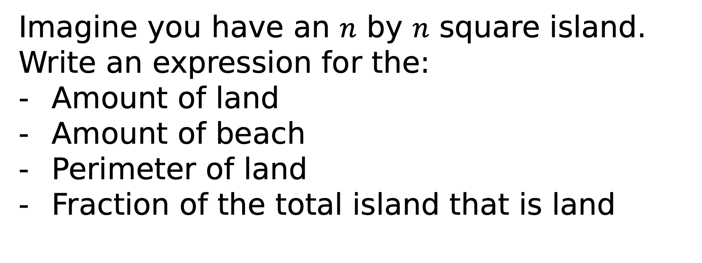
5 – Square Islands
Imagine you have an $n$ by $n$ square island.
Write an expression for the:
Amount of land
Amount of beach
Perimeter of land
Fraction of the total island that is land

Slide 10
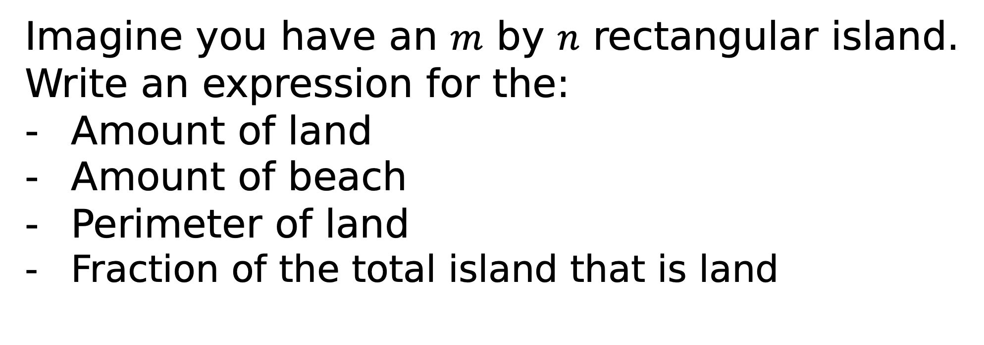
6 – Rectangular Islands
Imagine you have an $m$ by $n$ rectangular island.
Write an expression for the:
Amount of land
Amount of beach
Perimeter of land
Fraction of the total island that is land

Slide 11
7 – Rectangular Proof
Find two different rectangular islands that have the same amount of land as beach.
Prove that these are the only two possible islands.

Slide 12
8 – ?
Ask a mathematical question about islands.
Answer it.

