Slide 1
A

Slide 2
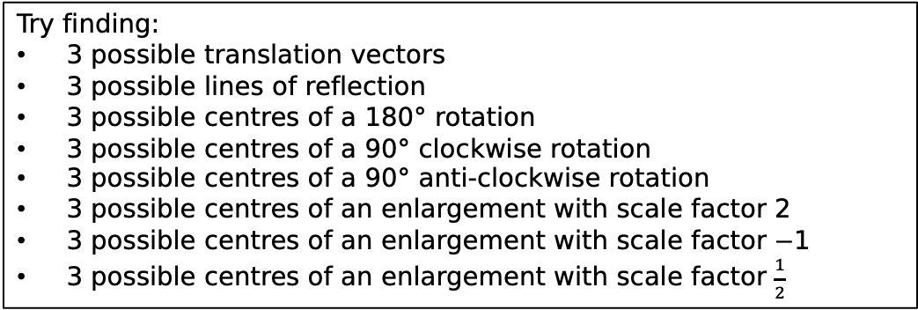
Try finding:
3 possible translation vectors
3 possible lines of reflection
3 possible centres of a $180°$ rotation
3 possible centres of a $90°$ clockwise rotation
3 possible centres of a $90°$ anti-clockwise rotation
3 possible centres of an enlargement with scale factor 2
3 possible centres of an enlargement with scale factor $−$1
3 possible centres of an enlargement with scale factor $\frac{1}{2}$
A

Slide 3
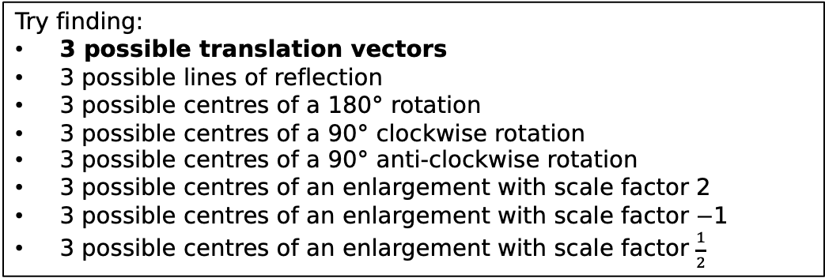
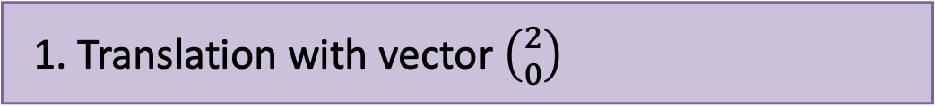
Try finding:
3 possible translation vectors
3 possible lines of reflection
3 possible centres of a $180°$ rotation
3 possible centres of a $90°$ clockwise rotation
3 possible centres of a $90°$ anti-clockwise rotation
3 possible centres of an enlargement with scale factor 2
3 possible centres of an enlargement with scale factor $−$1
3 possible centres of an enlargement with scale factor $\frac{1}{2}$
A’
1. Translation with vector $\left({2 \atop 0}\right)$
2.
3.

Slide 4
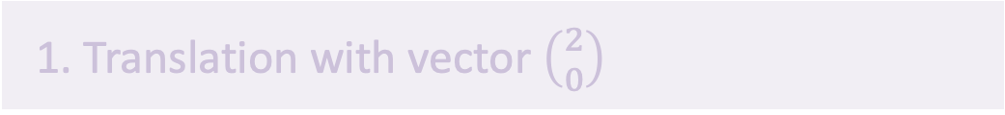
Try finding:
3 possible translation vectors
3 possible lines of reflection
3 possible centres of a $180°$ rotation
3 possible centres of a $90°$ clockwise rotation
3 possible centres of a $90°$ anti-clockwise rotation
3 possible centres of an enlargement with scale factor 2
3 possible centres of an enlargement with scale factor $−$1
3 possible centres of an enlargement with scale factor $\frac{1}{2}$
A
1. Translation with vector $\left({2 \atop 0}\right)$
2.
3.
4.

Slide 5

Try finding:
3 possible translation vectors
3 possible lines of reflection
3 possible centres of a $180°$ rotation
3 possible centres of a $90°$ clockwise rotation
3 possible centres of a $90°$ anti-clockwise rotation
3 possible centres of an enlargement with scale factor 2
3 possible centres of an enlargement with scale factor $−$1
3 possible centres of an enlargement with scale factor $\frac{1}{2}$
A’
1. Translation with vector $\left({2 \atop 0}\right)$
2. Translation with vector $\left({5 \atop 0}\right)$
3.
4.

Slide 6

Try finding:
3 possible translation vectors
3 possible lines of reflection
3 possible centres of a $180°$ rotation
3 possible centres of a $90°$ clockwise rotation
3 possible centres of a $90°$ anti-clockwise rotation
3 possible centres of an enlargement with scale factor 2
3 possible centres of an enlargement with scale factor $−$1
3 possible centres of an enlargement with scale factor $\frac{1}{2}$
A
2. Translation with vector $\left({5 \atop 0}\right)$
3.
4.
5.

Slide 7
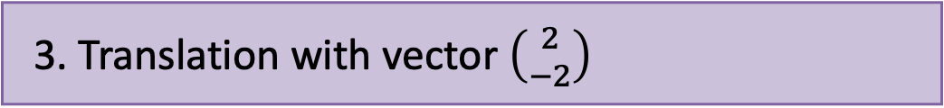
Try finding:
3 possible translation vectors
3 possible lines of reflection
3 possible centres of a $180°$ rotation
3 possible centres of a $90°$ clockwise rotation
3 possible centres of a $90°$ anti-clockwise rotation
3 possible centres of an enlargement with scale factor 2
3 possible centres of an enlargement with scale factor $−$1
3 possible centres of an enlargement with scale factor $\frac{1}{2}$
2. Translation with vector $\left({5 \atop 0}\right)$
A’
3. Translation with vector $\left({2 \atop −2}\right)$
4.
5.

Slide 8
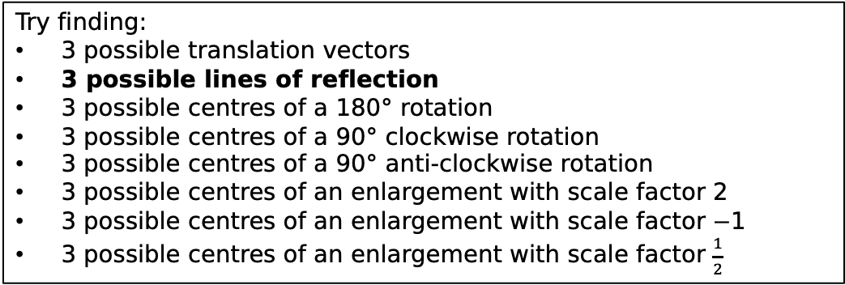

Try finding:
3 possible translation vectors
3 possible lines of reflection
3 possible centres of a $180°$ rotation
3 possible centres of a $90°$ clockwise rotation
3 possible centres of a $90°$ anti-clockwise rotation
3 possible centres of an enlargement with scale factor 2
3 possible centres of an enlargement with scale factor $−$1
3 possible centres of an enlargement with scale factor $\frac{1}{2}$
A
3. Translation with vector $\left({2 \atop −2}\right)$
4.
5.
6.

Slide 9
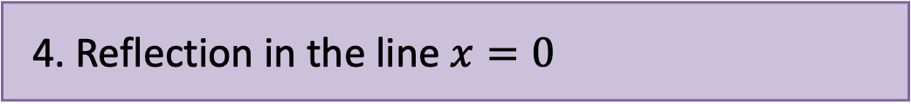
Try finding:
3 possible translation vectors
3 possible lines of reflection
3 possible centres of a $180°$ rotation
3 possible centres of a $90°$ clockwise rotation
3 possible centres of a $90°$ anti-clockwise rotation
3 possible centres of an enlargement with scale factor 2
3 possible centres of an enlargement with scale factor $−$1
3 possible centres of an enlargement with scale factor $\frac{1}{2}$
A’
3. Translation with vector $\left({2 \atop −2}\right)$
4. Reflection in the line $x=0$
5.
6.

Slide 10
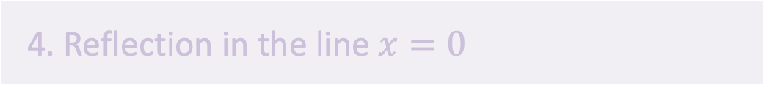
Try finding:
3 possible translation vectors
3 possible lines of reflection
3 possible centres of a $180°$ rotation
3 possible centres of a $90°$ clockwise rotation
3 possible centres of a $90°$ anti-clockwise rotation
3 possible centres of an enlargement with scale factor 2
3 possible centres of an enlargement with scale factor $−$1
3 possible centres of an enlargement with scale factor $\frac{1}{2}$
A
4. Reflection in the line $x=0$
5.
6.
7.

Slide 11
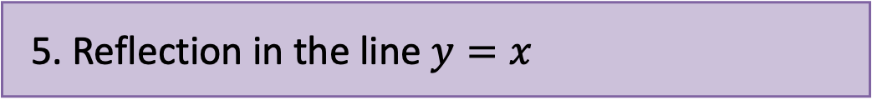
Try finding:
3 possible translation vectors
3 possible lines of reflection
3 possible centres of a $180°$ rotation
3 possible centres of a $90°$ clockwise rotation
3 possible centres of a $90°$ anti-clockwise rotation
3 possible centres of an enlargement with scale factor 2
3 possible centres of an enlargement with scale factor $−$1
3 possible centres of an enlargement with scale factor $\frac{1}{2}$
4. Reflection in the line $x=0$
A’
5. Reflection in the line $y=x$
6.
7.

Slide 12
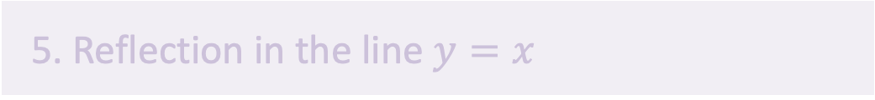
Try finding:
3 possible translation vectors
3 possible lines of reflection
3 possible centres of a $180°$ rotation
3 possible centres of a $90°$ clockwise rotation
3 possible centres of a $90°$ anti-clockwise rotation
3 possible centres of an enlargement with scale factor 2
3 possible centres of an enlargement with scale factor $−$1
3 possible centres of an enlargement with scale factor $\frac{1}{2}$
A
5. Reflection in the line $y=x$
6.
7.
8.

Slide 13
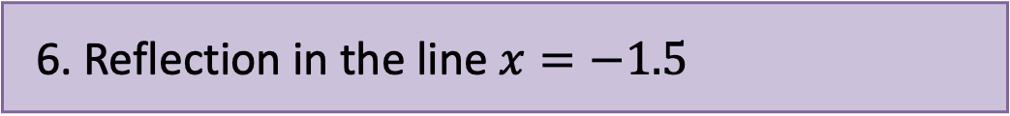
Try finding:
3 possible translation vectors
3 possible lines of reflection
3 possible centres of a $180°$ rotation
3 possible centres of a $90°$ clockwise rotation
3 possible centres of a $90°$ anti-clockwise rotation
3 possible centres of an enlargement with scale factor 2
3 possible centres of an enlargement with scale factor $−$1
3 possible centres of an enlargement with scale factor $\frac{1}{2}$
A’
5. Reflection in the line $y=x$
6. Reflection in the line $x=−1.5$
7.
8.

Slide 14
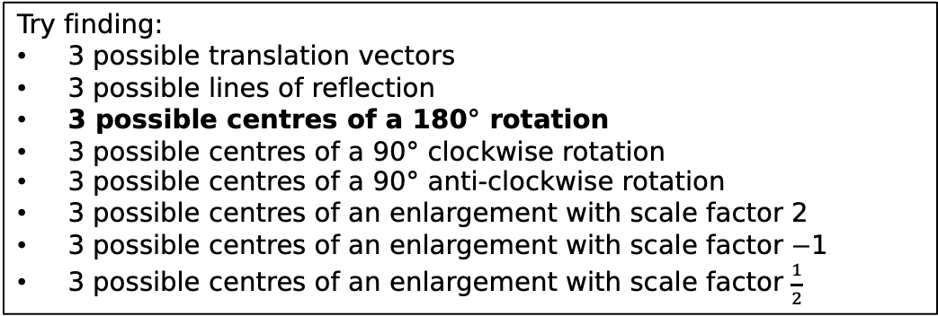
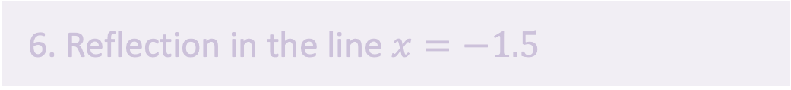
Try finding:
3 possible translation vectors
3 possible lines of reflection
3 possible centres of a 180$°$ rotation
3 possible centres of a 90$°$ clockwise rotation
3 possible centres of a 90$°$ anti-clockwise rotation
3 possible centres of an enlargement with scale factor 2
3 possible centres of an enlargement with scale factor $−$1
3 possible centres of an enlargement with scale factor $\frac{1}{2}$
A
6. Reflection in the line $x=−1.5$
7.
8.
9.

Slide 15
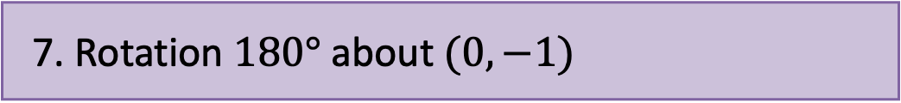
Try finding:
3 possible translation vectors
3 possible lines of reflection
3 possible centres of a 180$°$ rotation
3 possible centres of a 90$°$ clockwise rotation
3 possible centres of a 90$°$ anti-clockwise rotation
3 possible centres of an enlargement with scale factor 2
3 possible centres of an enlargement with scale factor $−$1
3 possible centres of an enlargement with scale factor $\frac{1}{2}$
6. Reflection in the line $x=−1.5$
A’
7. Rotation $180°$ about $(0,−1)$
8.
9.

Slide 16

Try finding:
3 possible translation vectors
3 possible lines of reflection
3 possible centres of a 180$°$ rotation
3 possible centres of a 90$°$ clockwise rotation
3 possible centres of a 90$°$ anti-clockwise rotation
3 possible centres of an enlargement with scale factor 2
3 possible centres of an enlargement with scale factor $−$1
3 possible centres of an enlargement with scale factor $\frac{1}{2}$
A
7. Rotation $180°$ about $(0,−1)$
8.
9.
10.

Slide 17
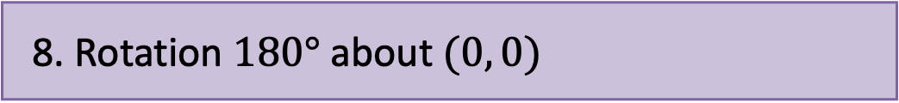
Try finding:
3 possible translation vectors
3 possible lines of reflection
3 possible centres of a 180$°$ rotation
3 possible centres of a 90$°$ clockwise rotation
3 possible centres of a 90$°$ anti-clockwise rotation
3 possible centres of an enlargement with scale factor 2
3 possible centres of an enlargement with scale factor $−$1
3 possible centres of an enlargement with scale factor $\frac{1}{2}$
A’
7. Rotation $180°$ about $(0,−1)$
8. Rotation $180°$ about $(0, 0)$
9.
10.

Slide 18
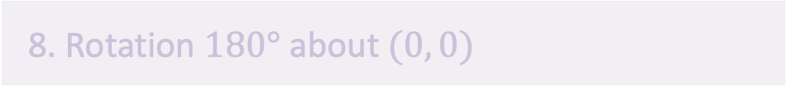
Try finding:
3 possible translation vectors
3 possible lines of reflection
3 possible centres of a 180$°$ rotation
3 possible centres of a 90$°$ clockwise rotation
3 possible centres of a 90$°$ anti-clockwise rotation
3 possible centres of an enlargement with scale factor 2
3 possible centres of an enlargement with scale factor $−$1
3 possible centres of an enlargement with scale factor $\frac{1}{2}$
A
8. Rotation $180°$ about $(0, 0)$
9.
10.
11.

Slide 19
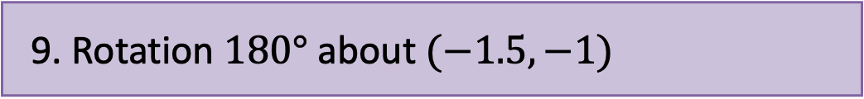
Try finding:
3 possible translation vectors
3 possible lines of reflection
3 possible centres of a 180$°$ rotation
3 possible centres of a 90$°$ clockwise rotation
3 possible centres of a 90$°$ anti-clockwise rotation
3 possible centres of an enlargement with scale factor 2
3 possible centres of an enlargement with scale factor $−$1
3 possible centres of an enlargement with scale factor $\frac{1}{2}$
8. Rotation $180°$ about $(0, 0)$
A’
9. Rotation $180°$ about $(−1.5, −1)$
10.
11.

Slide 20
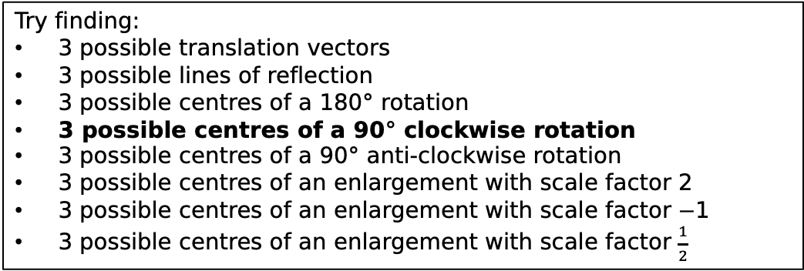

Try finding:
3 possible translation vectors
3 possible lines of reflection
3 possible centres of a 180$°$ rotation
3 possible centres of a 90$°$ clockwise rotation
3 possible centres of a 90$°$ anti-clockwise rotation
3 possible centres of an enlargement with scale factor 2
3 possible centres of an enlargement with scale factor $−$1
3 possible centres of an enlargement with scale factor $\frac{1}{2}$
A
9. Rotation $180°$ about $(−1.5, −1)$
10.
11.
12.

Slide 21
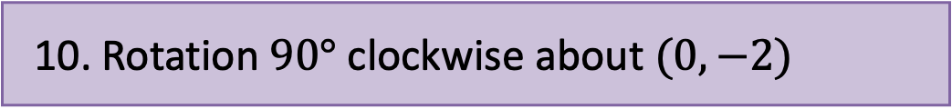
Try finding:
3 possible translation vectors
3 possible lines of reflection
3 possible centres of a 180$°$ rotation
3 possible centres of a 90$°$ clockwise rotation
3 possible centres of a 90$°$ anti-clockwise rotation
3 possible centres of an enlargement with scale factor 2
3 possible centres of an enlargement with scale factor $−$1
3 possible centres of an enlargement with scale factor $\frac{1}{2}$
A’
9. Rotation $180°$ about $(−1.5, −1)$
10. Rotation $90°$ clockwise about $(0, −2)$
11.
12.

Slide 22

Try finding:
3 possible translation vectors
3 possible lines of reflection
3 possible centres of a 180$°$ rotation
3 possible centres of a 90$°$ clockwise rotation
3 possible centres of a 90$°$ anti-clockwise rotation
3 possible centres of an enlargement with scale factor 2
3 possible centres of an enlargement with scale factor $−$1
3 possible centres of an enlargement with scale factor $\frac{1}{2}$
A
10. Rotation $90°$ clockwise about $(0, −2)$
11.
12.
13.

Slide 23
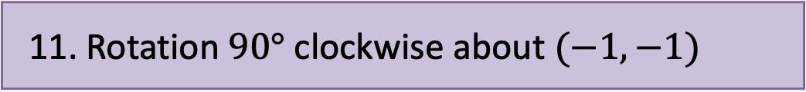
Try finding:
3 possible translation vectors
3 possible lines of reflection
3 possible centres of a 180$°$ rotation
3 possible centres of a 90$°$ clockwise rotation
3 possible centres of a 90$°$ anti-clockwise rotation
3 possible centres of an enlargement with scale factor 2
3 possible centres of an enlargement with scale factor $−$1
3 possible centres of an enlargement with scale factor $\frac{1}{2}$
A’
10. Rotation $90°$ clockwise about $(0, −2)$
11. Rotation $90°$ clockwise about $(−1, −1)$
12.
13.

Slide 24
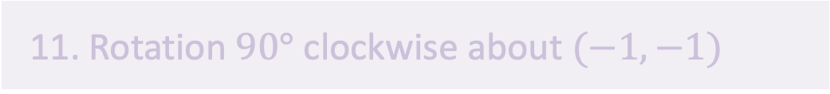
Try finding:
3 possible translation vectors
3 possible lines of reflection
3 possible centres of a 180$°$ rotation
3 possible centres of a 90$°$ clockwise rotation
3 possible centres of a 90$°$ anti-clockwise rotation
3 possible centres of an enlargement with scale factor 2
3 possible centres of an enlargement with scale factor $−$1
3 possible centres of an enlargement with scale factor $\frac{1}{2}$
A
11. Rotation $90°$ clockwise about $(−1, −1)$
12.
13.
14.

Slide 25
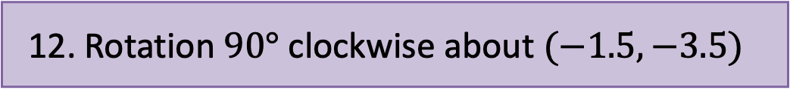
Try finding:
3 possible translation vectors
3 possible lines of reflection
3 possible centres of a 180$°$ rotation
3 possible centres of a 90$°$ clockwise rotation
3 possible centres of a 90$°$ anti-clockwise rotation
3 possible centres of an enlargement with scale factor 2
3 possible centres of an enlargement with scale factor $−$1
3 possible centres of an enlargement with scale factor $\frac{1}{2}$
11. Rotation $90°$ clockwise about $(−1, −1)$
A’
12. Rotation $90°$ clockwise about $(−1.5, −3.5)$
13.
14.

Slide 26
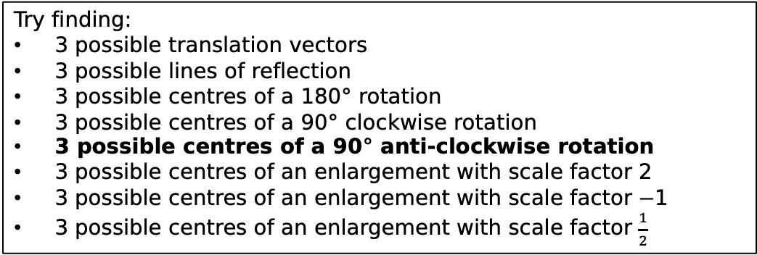
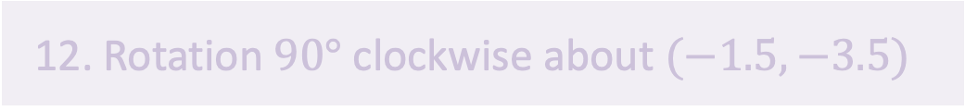
Try finding:
3 possible translation vectors
3 possible lines of reflection
3 possible centres of a 180$°$ rotation
3 possible centres of a 90$°$ clockwise rotation
3 possible centres of a 90$°$ anti-clockwise rotation
3 possible centres of an enlargement with scale factor 2
3 possible centres of an enlargement with scale factor $−$1
3 possible centres of an enlargement with scale factor $\frac{1}{2}$
A
12. Rotation $90°$ clockwise about $(−1.5, −3.5)$
13.
14.
15.

Slide 27
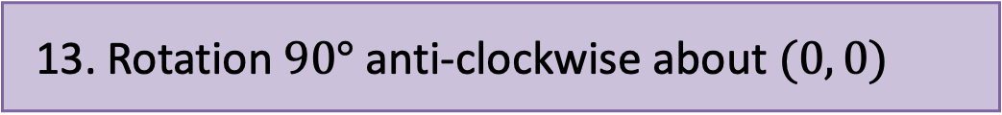
Try finding:
3 possible translation vectors
3 possible lines of reflection
3 possible centres of a 180$°$ rotation
3 possible centres of a 90$°$ clockwise rotation
3 possible centres of a 90$°$ anti-clockwise rotation
3 possible centres of an enlargement with scale factor 2
3 possible centres of an enlargement with scale factor $−$1
3 possible centres of an enlargement with scale factor $\frac{1}{2}$
12. Rotation $90°$ clockwise about $(−1.5, −3.5)$
A’
13. Rotation $90°$ anti-clockwise about $(0, 0)$
14.
15.

Slide 28
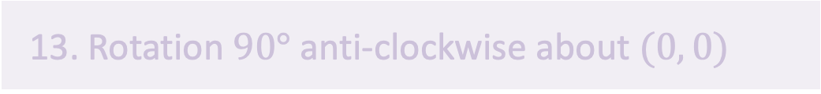
Try finding:
3 possible translation vectors
3 possible lines of reflection
3 possible centres of a 180$°$ rotation
3 possible centres of a 90$°$ clockwise rotation
3 possible centres of a 90$°$ anti-clockwise rotation
3 possible centres of an enlargement with scale factor 2
3 possible centres of an enlargement with scale factor $−$1
3 possible centres of an enlargement with scale factor $\frac{1}{2}$
A
13. Rotation $90°$ anti-clockwise about $(0, 0)$
14.
15.
16.

Slide 29
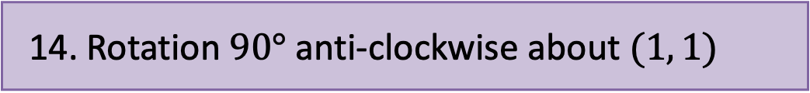
Try finding:
3 possible translation vectors
3 possible lines of reflection
3 possible centres of a 180$°$ rotation
3 possible centres of a 90$°$ clockwise rotation
3 possible centres of a 90$°$ anti-clockwise rotation
3 possible centres of an enlargement with scale factor 2
3 possible centres of an enlargement with scale factor $−$1
3 possible centres of an enlargement with scale factor $\frac{1}{2}$
13. Rotation $90°$ anti-clockwise about $(0, 0)$
A’
14. Rotation $90°$ anti-clockwise about $(1, 1)$
15.
16.

Slide 30
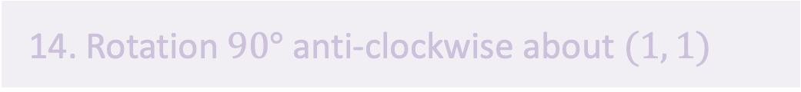
Try finding:
3 possible translation vectors
3 possible lines of reflection
3 possible centres of a 180$°$ rotation
3 possible centres of a 90$°$ clockwise rotation
3 possible centres of a 90$°$ anti-clockwise rotation
3 possible centres of an enlargement with scale factor 2
3 possible centres of an enlargement with scale factor $−$1
3 possible centres of an enlargement with scale factor $\frac{1}{2}$
A
14. Rotation $90°$ anti-clockwise about $(1, 1)$
15.
16.
17.

Slide 31
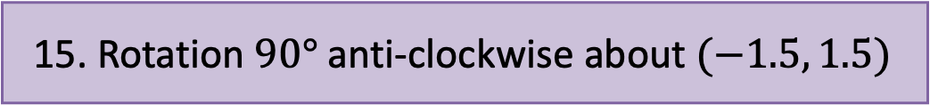
Try finding:
3 possible translation vectors
3 possible lines of reflection
3 possible centres of a 180$°$ rotation
3 possible centres of a 90$°$ clockwise rotation
3 possible centres of a 90$°$ anti-clockwise rotation
3 possible centres of an enlargement with scale factor 2
3 possible centres of an enlargement with scale factor $−$1
3 possible centres of an enlargement with scale factor $\frac{1}{2}$
A’
14. Rotation $90°$ anti-clockwise about $(1, 1)$
15. Rotation $90°$ anti-clockwise about $(−1.5, 1.5)$
16.
17.

Slide 32
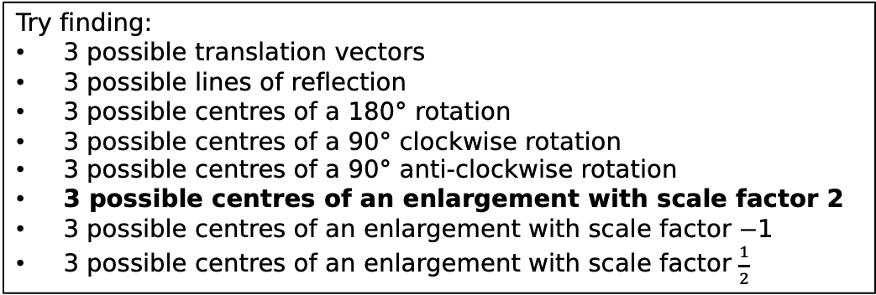
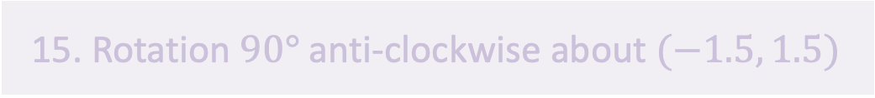
Try finding:
3 possible translation vectors
3 possible lines of reflection
3 possible centres of a 180$°$ rotation
3 possible centres of a 90$°$ clockwise rotation
3 possible centres of a 90$°$ anti-clockwise rotation
3 possible centres of an enlargement with scale factor 2
3 possible centres of an enlargement with scale factor $−$1
3 possible centres of an enlargement with scale factor $\frac{1}{2}$
A
15. Rotation $90°$ anti-clockwise about $(−1.5, 1.5)$
16.
17.
18.

Slide 33
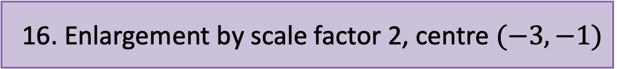
Try finding:
3 possible translation vectors
3 possible lines of reflection
3 possible centres of a 180$°$ rotation
3 possible centres of a 90$°$ clockwise rotation
3 possible centres of a 90$°$ anti-clockwise rotation
3 possible centres of an enlargement with scale factor 2
3 possible centres of an enlargement with scale factor $−$1
3 possible centres of an enlargement with scale factor $\frac{1}{2}$
A’
15. Rotation $90°$ anti-clockwise about $(−1.5, 1.5)$
16. Enlargement by scale factor 2, centre $(−3,−1)$
17.
18.

Slide 34
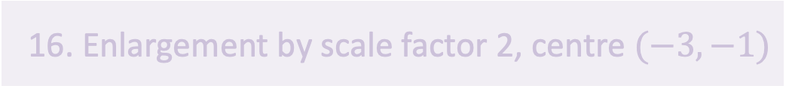
Try finding:
3 possible translation vectors
3 possible lines of reflection
3 possible centres of a 180$°$ rotation
3 possible centres of a 90$°$ clockwise rotation
3 possible centres of a 90$°$ anti-clockwise rotation
3 possible centres of an enlargement with scale factor 2
3 possible centres of an enlargement with scale factor $−$1
3 possible centres of an enlargement with scale factor $\frac{1}{2}$
A
16. Enlargement by scale factor 2, centre $(−3,−1)$
17.
18.
19.

Slide 35
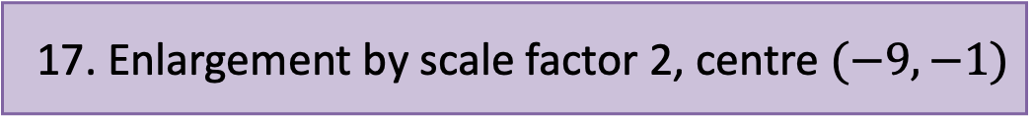
Try finding:
3 possible translation vectors
3 possible lines of reflection
3 possible centres of a 180$°$ rotation
3 possible centres of a 90$°$ clockwise rotation
3 possible centres of a 90$°$ anti-clockwise rotation
3 possible centres of an enlargement with scale factor 2
3 possible centres of an enlargement with scale factor $−$1
3 possible centres of an enlargement with scale factor $\frac{1}{2}$
A’
16. Enlargement by scale factor 2, centre $(−3,−1)$
17. Enlargement by scale factor 2, centre $(−9,−1)$
18.
19.

Slide 36
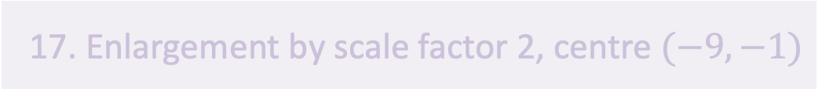
Try finding:
3 possible translation vectors
3 possible lines of reflection
3 possible centres of a 180$°$ rotation
3 possible centres of a 90$°$ clockwise rotation
3 possible centres of a 90$°$ anti-clockwise rotation
3 possible centres of an enlargement with scale factor 2
3 possible centres of an enlargement with scale factor $−$1
3 possible centres of an enlargement with scale factor $\frac{1}{2}$
A
17. Enlargement by scale factor 2, centre $(−9,−1)$
18.
19.
20.

Slide 37
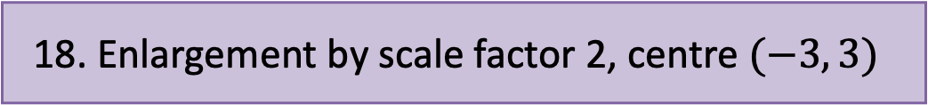
Try finding:
3 possible translation vectors
3 possible lines of reflection
3 possible centres of a 180$°$ rotation
3 possible centres of a 90$°$ clockwise rotation
3 possible centres of a 90$°$ anti-clockwise rotation
3 possible centres of an enlargement with scale factor 2
3 possible centres of an enlargement with scale factor $−$1
3 possible centres of an enlargement with scale factor $\frac{1}{2}$
A’
17. Enlargement by scale factor 2, centre $(−9,−1)$
18. Enlargement by scale factor 2, centre $(−3, 3)$
19.
20.

Slide 38
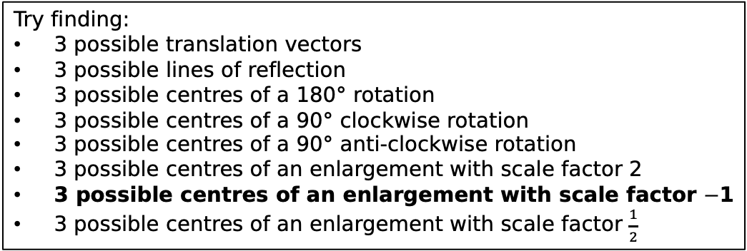
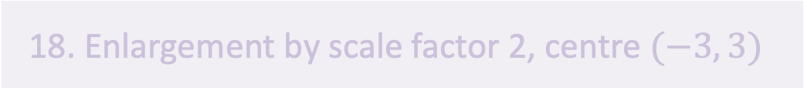
Try finding:
3 possible translation vectors
3 possible lines of reflection
3 possible centres of a 180$°$ rotation
3 possible centres of a 90$°$ clockwise rotation
3 possible centres of a 90$°$ anti-clockwise rotation
3 possible centres of an enlargement with scale factor 2
3 possible centres of an enlargement with scale factor $−$1
3 possible centres of an enlargement with scale factor $\frac{1}{2}$
A
18. Enlargement by scale factor 2, centre $(−3, 3)$
19.
20.
21.

Slide 39
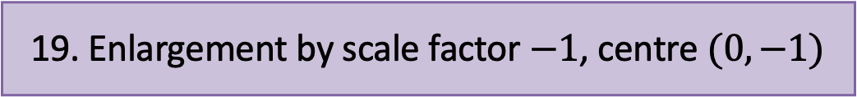
Try finding:
3 possible translation vectors
3 possible lines of reflection
3 possible centres of a 180$°$ rotation
3 possible centres of a 90$°$ clockwise rotation
3 possible centres of a 90$°$ anti-clockwise rotation
3 possible centres of an enlargement with scale factor 2
3 possible centres of an enlargement with scale factor $−$1
3 possible centres of an enlargement with scale factor $\frac{1}{2}$
18. Enlargement by scale factor 2, centre $(−3, 3)$
A’
19. Enlargement by scale factor $−1$, centre $(0, −1)$
20.
21.

Slide 40
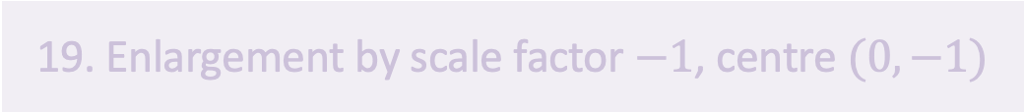
Try finding:
3 possible translation vectors
3 possible lines of reflection
3 possible centres of a 180$°$ rotation
3 possible centres of a 90$°$ clockwise rotation
3 possible centres of a 90$°$ anti-clockwise rotation
3 possible centres of an enlargement with scale factor 2
3 possible centres of an enlargement with scale factor $−$1
3 possible centres of an enlargement with scale factor $\frac{1}{2}$
A
19. Enlargement by scale factor $−1$, centre $(0, −1)$
20.
21.
22.

Slide 41
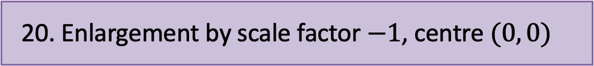
Try finding:
3 possible translation vectors
3 possible lines of reflection
3 possible centres of a 180$°$ rotation
3 possible centres of a 90$°$ clockwise rotation
3 possible centres of a 90$°$ anti-clockwise rotation
3 possible centres of an enlargement with scale factor 2
3 possible centres of an enlargement with scale factor $−$1
3 possible centres of an enlargement with scale factor $\frac{1}{2}$
A’
19. Enlargement by scale factor $−1$, centre $(0, −1)$
20. Enlargement by scale factor $−1$, centre $(0, 0)$
21.
22.

Slide 42
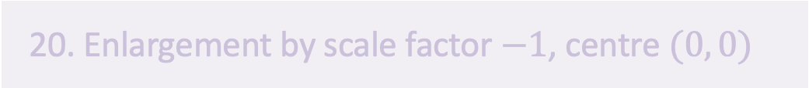
Try finding:
3 possible translation vectors
3 possible lines of reflection
3 possible centres of a 180$°$ rotation
3 possible centres of a 90$°$ clockwise rotation
3 possible centres of a 90$°$ anti-clockwise rotation
3 possible centres of an enlargement with scale factor 2
3 possible centres of an enlargement with scale factor $−$1
3 possible centres of an enlargement with scale factor $\frac{1}{2}$
A
20. Enlargement by scale factor $−1$, centre $(0, 0)$
21.
22.
23.

Slide 43
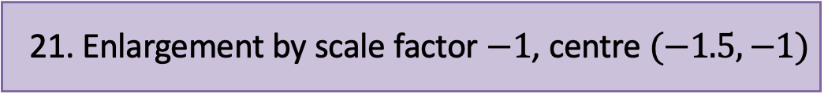
Try finding:
3 possible translation vectors
3 possible lines of reflection
3 possible centres of a 180$°$ rotation
3 possible centres of a 90$°$ clockwise rotation
3 possible centres of a 90$°$ anti-clockwise rotation
3 possible centres of an enlargement with scale factor 2
3 possible centres of an enlargement with scale factor $−$1
3 possible centres of an enlargement with scale factor $\frac{1}{2}$
20. Enlargement by scale factor $−1$, centre $(0, 0)$
A’
21. Enlargement by scale factor $−1$, centre $(−1.5, −1)$
22.
23.

Slide 44
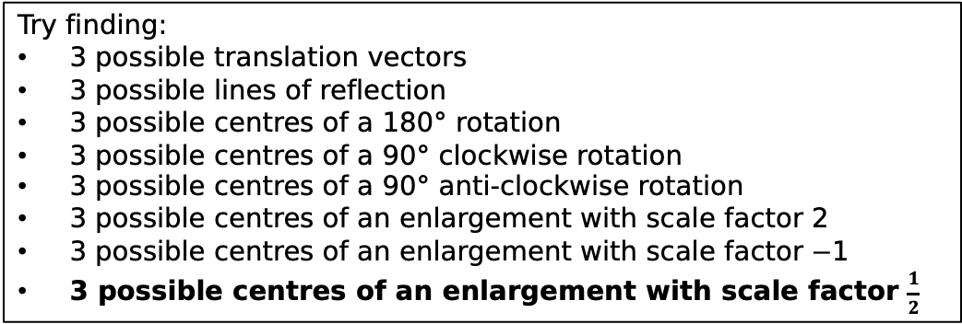
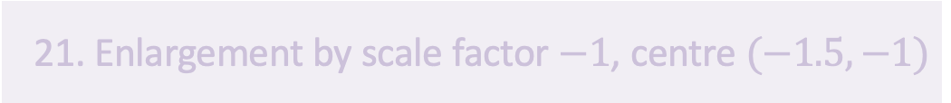
Try finding:
3 possible translation vectors
3 possible lines of reflection
3 possible centres of a 180$°$ rotation
3 possible centres of a 90$°$ clockwise rotation
3 possible centres of a 90$°$ anti-clockwise rotation
3 possible centres of an enlargement with scale factor 2
3 possible centres of an enlargement with scale factor $−$1
3 possible centres of an enlargement with scale factor $\frac{1}{2}$
A
21. Enlargement by scale factor $−1$, centre $(−1.5, −1)$
22.
23.
24.

Slide 45
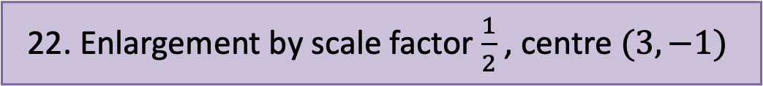
Try finding:
3 possible translation vectors
3 possible lines of reflection
3 possible centres of a 180$°$ rotation
3 possible centres of a 90$°$ clockwise rotation
3 possible centres of a 90$°$ anti-clockwise rotation
3 possible centres of an enlargement with scale factor 2
3 possible centres of an enlargement with scale factor $−$1
3 possible centres of an enlargement with scale factor $\frac{1}{2}$
A’
21. Enlargement by scale factor $−1$, centre $(−1.5, −1)$
22. Enlargement by scale factor $\frac{1}{2}$ , centre $(3,−1)$
23.
24.

Slide 46
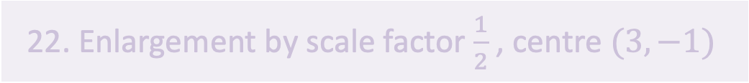
Try finding:
3 possible translation vectors
3 possible lines of reflection
3 possible centres of a 180$°$ rotation
3 possible centres of a 90$°$ clockwise rotation
3 possible centres of a 90$°$ anti-clockwise rotation
3 possible centres of an enlargement with scale factor 2
3 possible centres of an enlargement with scale factor $−$1
3 possible centres of an enlargement with scale factor $\frac{1}{2}$
A
22. Enlargement by scale factor $\frac{1}{2}$ , centre $(3, −1)$
23.
24.

Slide 47
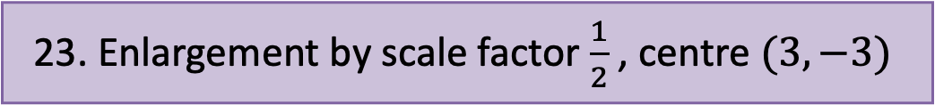
Try finding:
3 possible translation vectors
3 possible lines of reflection
3 possible centres of a 180$°$ rotation
3 possible centres of a 90$°$ clockwise rotation
3 possible centres of a 90$°$ anti-clockwise rotation
3 possible centres of an enlargement with scale factor 2
3 possible centres of an enlargement with scale factor $−$1
3 possible centres of an enlargement with scale factor $\frac{1}{2}$
22. Enlargement by scale factor $\frac{1}{2}$ , centre $(3, −1)$
A’
23. Enlargement by scale factor $\frac{1}{2}$ , centre $(3, −3)$
24.

Slide 48

Try finding:
3 possible translation vectors
3 possible lines of reflection
3 possible centres of a 180$°$ rotation
3 possible centres of a 90$°$ clockwise rotation
3 possible centres of a 90$°$ anti-clockwise rotation
3 possible centres of an enlargement with scale factor 2
3 possible centres of an enlargement with scale factor $−$1
3 possible centres of an enlargement with scale factor $\frac{1}{2}$
A
23. Enlargement by scale factor $\frac{1}{2}$ , centre $(3, −3)$
24.
2.

Slide 49
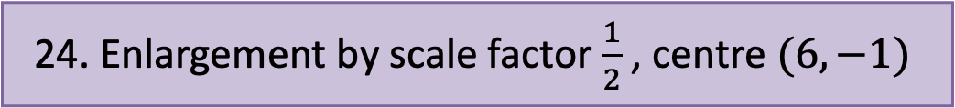
Try finding:
3 possible translation vectors
3 possible lines of reflection
3 possible centres of a 180$°$ rotation
3 possible centres of a 90$°$ clockwise rotation
3 possible centres of a 90$°$ anti-clockwise rotation
3 possible centres of an enlargement with scale factor 2
3 possible centres of an enlargement with scale factor $−$1
3 possible centres of an enlargement with scale factor $\frac{1}{2}$
A’
23. Enlargement by scale factor $\frac{1}{2}$ , centre $(3, −3)$
24. Enlargement by scale factor $\frac{1}{2}$ , centre $(6, −1)$

Slide 50
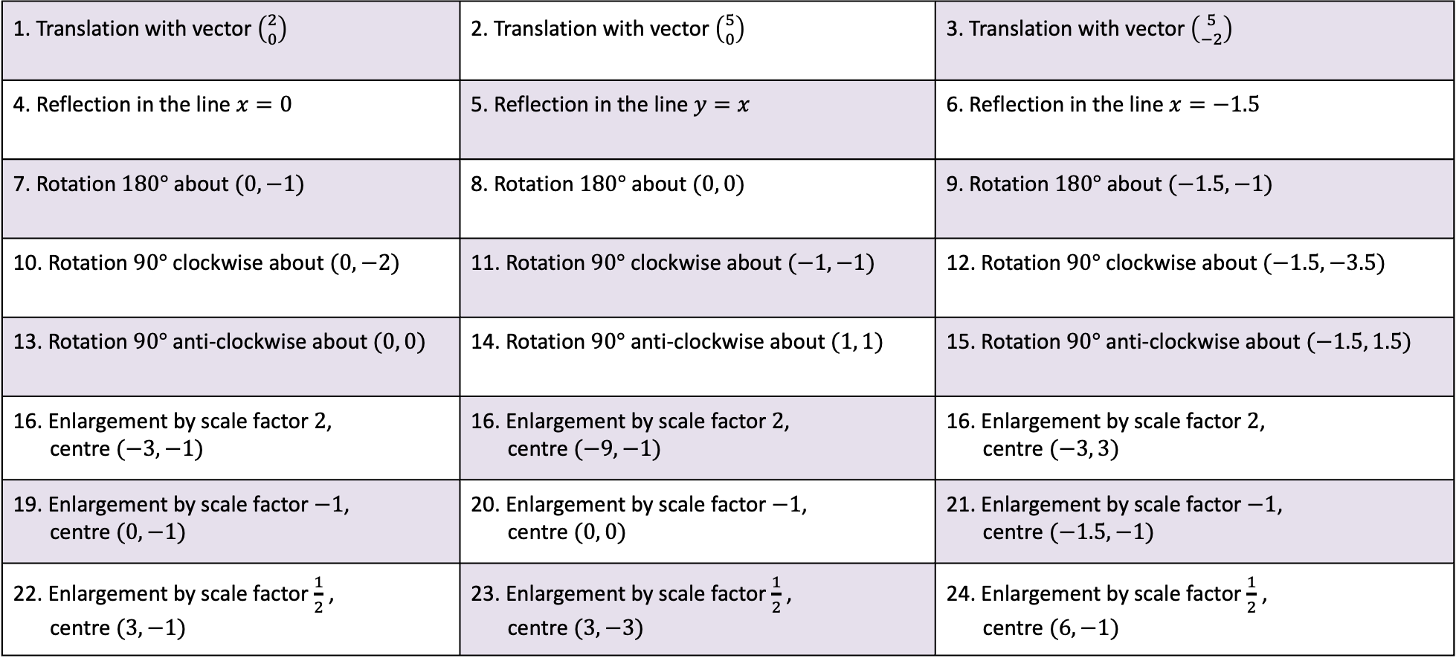
1. Translation with vector $\left({2 \atop 0}\right)$ | 2. Translation with vector $\left({5 \atop 0}\right)$ | 3. Translation with vector $\left({5 \atop −2}\right)$
4. Reflection in the line $x=0$ | 5. Reflection in the line $y=x$ | 6. Reflection in the line $x=−1.5$
7. Rotation $180°$ about $(0,−1)$ | 8. Rotation $180°$ about $(0, 0)$ | 9. Rotation $180°$ about $(−1.5,−1)$
10. Rotation $90°$ clockwise about $(0, −2)$ | 11. Rotation $90°$ clockwise about $(−1, −1)$ | 12. Rotation $90°$ clockwise about $(−1.5, −3.5)$
13. Rotation $90°$ anti-clockwise about $(0, 0)$ | 14. Rotation $90°$ anti-clockwise about $(1, 1)$ | 15. Rotation $90°$ anti-clockwise about $(−1.5, 1.5)$
16. Enlargement by scale factor $2$, centre $(−3,−1)$ | 16. Enlargement by scale factor $2$, centre $(−9,−1)$ | 16. Enlargement by scale factor $2$, centre $(−3, 3)$
19. Enlargement by scale factor $−1$, centre $(0, −1)$ | 20. Enlargement by scale factor $−1$, centre $(0, 0)$ | 21. Enlargement by scale factor $−1$, centre $(−1.5, −1)$
22. Enlargement by scale factor $\frac{1}{2}$ , centre $(3, −1)$ | 23. Enlargement by scale factor $\frac{1}{2}$ , centre $(3, −3)$ | 24. Enlargement by scale factor $\frac{1}{2}$ , centre $(6, −1)$

