Slide 1
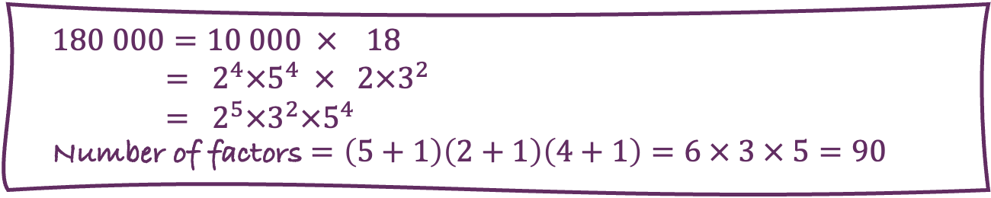
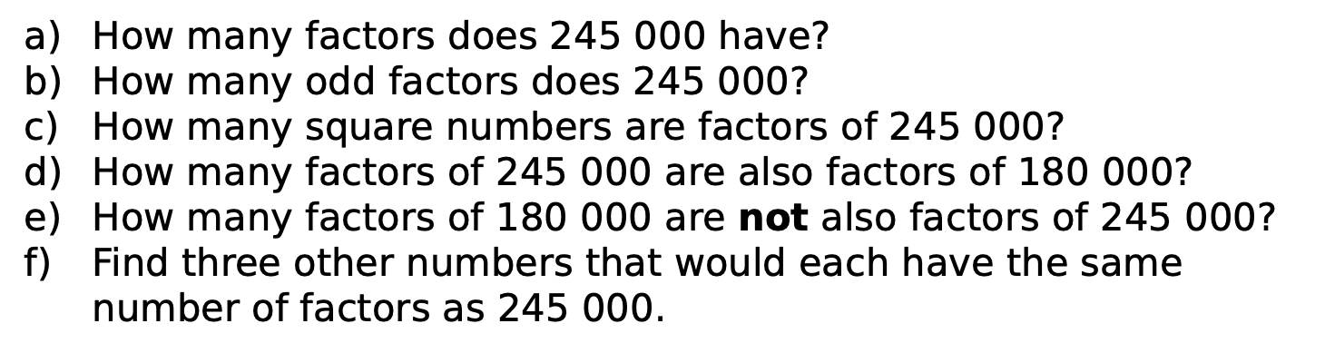
Product Rule for Counting | Counting Factors
e.g. How many factors does $180 000$ have?
$$180 000=10 000 × 18$$
$= 2^{4}×5^{4} × 2×3^{2}$
$= 2^{5}×3^{2}×5^{4}$
Number of factors $=\left(5+1\right)\left(2+1\right)\left(4+1\right)=6 × 3 × 5=90$
How many factors does $245 000$ have?
How many odd factors does $245 000$?
How many square numbers are factors of $245 000$?
How many factors of $245 000$ are also factors of $180 000$?
How many factors of $180 000$ are not also factors of $245 000$?
Find three other numbers that would each have the same number of factors as $245 000$.

Slide 2
Always? Sometimes? Never?
The number of factors of the product of two numbers is the product of the number of factors of each number. | The number of square factors of a square number is equal to the number of factors of its square root.
The number of common factors of two numbers is equal to the number of factors of their highest common factor. | A number with two distinct prime factors has a prime number of factors.

Slide 3
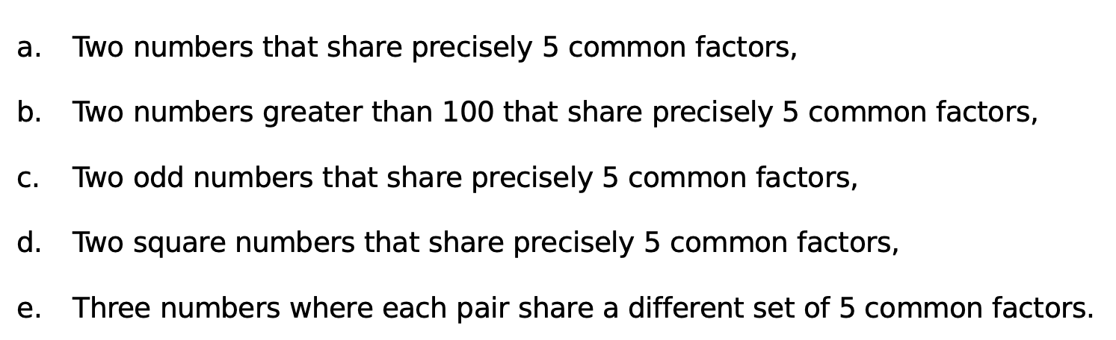
Can you find…
Two numbers that share precisely $5$ common factors,
Two numbers greater than $100$ that share precisely $5$ common factors,
Two odd numbers that share precisely $5$ common factors,
Two square numbers that share precisely $5$ common factors,
Three numbers where each pair share a different set of $5$ common factors.

Slide 4
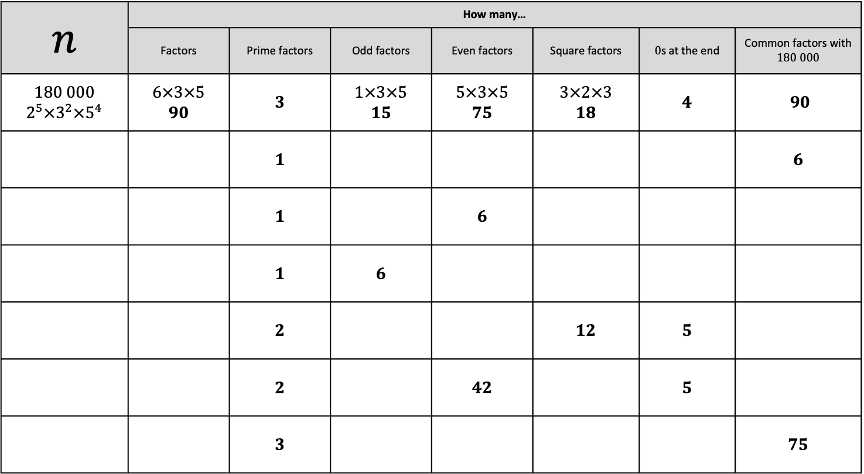
$n$ | How many…
 | Factors | Prime factors | Odd factors | Even factors | Square factors | $0$s at the end | Common factors with $180 000$
$180 000$ $$2^{5}×3^{2}×5^{4}$$ | $6×3×5$ $$90$$ | $3$ | $1×3×5$ $15$ | $5×3×5$ $75$ | $3×2×3$ $18$ | $4$ | $90$
 |  | $1$ |  |  |  |  | $6$
 |  | $1$ |  | $6$
 |  | $1$ | $6$
 |  | $2$ |  |  | $12$ | $5$
 |  | $2$ |  | $42$ |  | $5$
 |  | $3$ |  |  |  |  | $75$

Slide 5
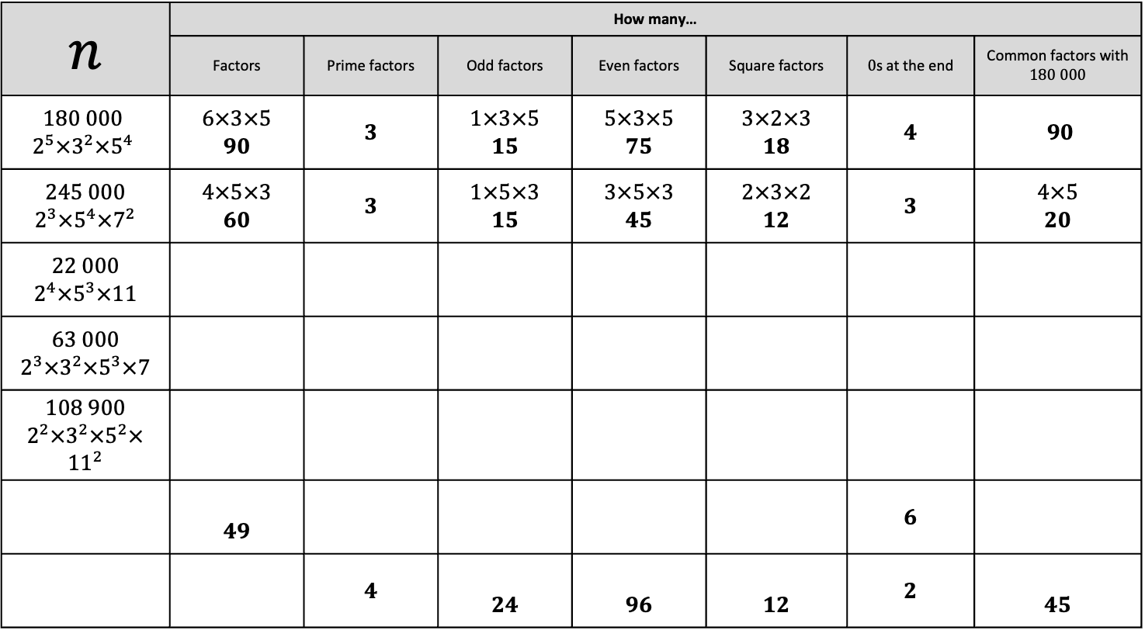
$n$ | How many…
 | Factors | Prime factors | Odd factors | Even factors | Square factors | $0$s at the end | Common factors with $180 000$
$180 000$ $$2^{5}×3^{2}×5^{4}$$ | $6×3×5$ $$90$$ | $3$ | $1×3×5$ $15$ | $5×3×5$ $75$ | $3×2×3$ $18$ | $4$ | $90$
$245 000$ $$2^{3}×5^{4}×7^{2}$$ | $4×5×3$ $$60$$ | $3$ | $1×5×3$ $15$ | $3×5×3$ $45$ | $2×3×2$ $12$ | $3$ | $4×5$ $20$
$22 000$ $2^{4}×5^{3}×11$
$63 000$ $2^{3}×3^{2}×5^{3}×7$
$108 900$ $2^{2}×3^{2}×5^{2}×{11}^{2}$
 | $49$ |  |  |  |  | $6$
 |  | $4$ | $24$ | $96$ | $12$ | $2$ | $45$

Slide 6
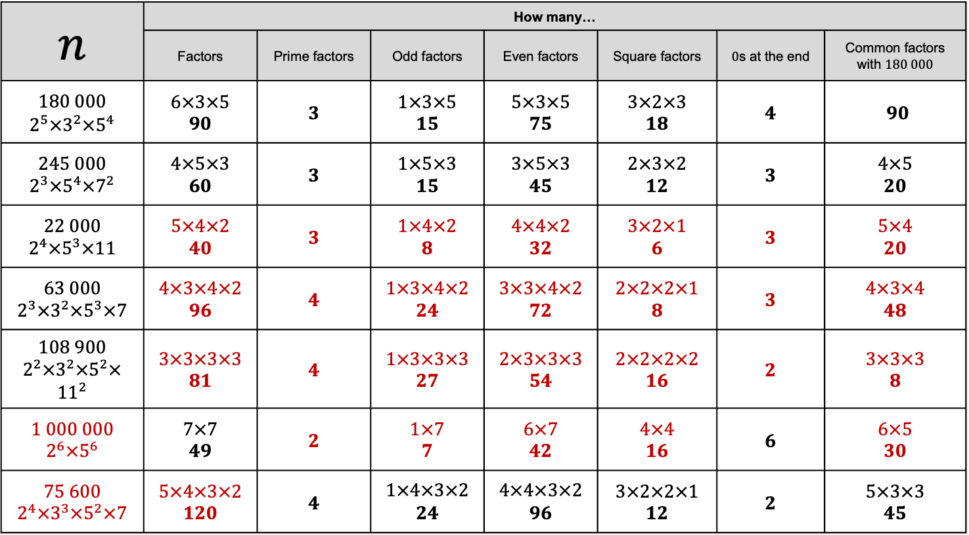
$n$ | How many…
 | Factors | Prime factors | Odd factors | Even factors | Square factors | $0$s at the end | Common factors with $180 000$
$180 000$ $$2^{5}×3^{2}×5^{4}$$ | $6×3×5$ $$90$$ | $3$ | $1×3×5$ $15$ | $5×3×5$ $75$ | $3×2×3$ $18$ | $4$ | $90$
$245 000$ $$2^{3}×5^{4}×7^{2}$$ | $4×5×3$ $$60$$ | $3$ | $1×5×3$ $15$ | $3×5×3$ $45$ | $2×3×2$ $12$ | $3$ | $4×5$ $20$
$22 000$ $2^{4}×5^{3}×11$ | $5×4×2$ $40$ | $3$ | $1×4×2$ $8$ | $4×4×2$ $32$ | $3×2×1$ $$6$$ | $3$ | $5×4$ $20$
$63 000$ $2^{3}×3^{2}×5^{3}×7$ | $4×3×4×2$ $96$ | $4$ | $1×3×4×2$ $24$ | $3×3×4×2$ $72$ | $2×2×2×1$ $8$ | $3$ | $4×3×4$ $48$
$108 900$ $2^{2}×3^{2}×5^{2}×{11}^{2}$ | $3×3×3×3$ $81$ | $4$ | $1×3×3×3$ $27$ | $2×3×3×3$ $54$ | $2×2×2×2$ $16$ | $2$ | $3×3×3$ $8$
$1 000 000$ $2^{6}×5^{6}$ | $7×7$ $49$ | $2$ | $1×7$ $7$ | $6×7$ $$42$$ | $4×4$ $16$ | $6$ | $6×5$ $30$
$75 600$ $$2^{4}×3^{3}×5^{2}×7$$ | $5×4×3×2$ $120$ | $4$ | $1×4×3×2$ $24$ | $4×4×3×2$ $96$ | $3×2×2×1$ $12$ | $2$ | $5×3×3$ $45$

