Slide 1
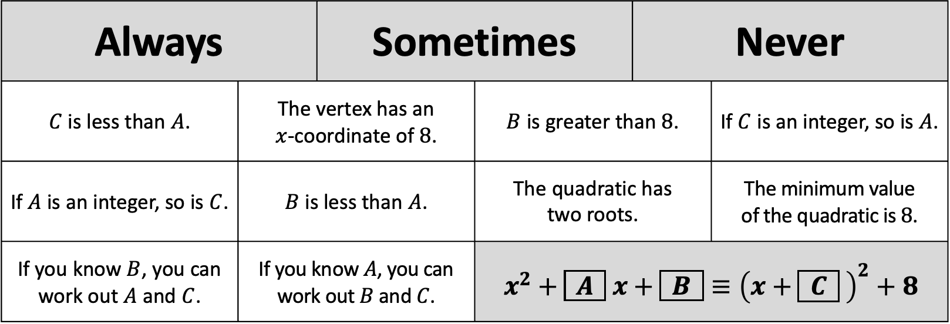

Always |  | Sometimes |  | Never
$C$ is less than $A$. | The vertex has an $x$-coordinate of $8$. |  | $B$ is greater than $8$. |  | If $C$ is an integer, so is $A$.
If $A$ is an integer, so is $C$. | $B$ is less than $A$. |  | The quadratic has two roots. |  | The minimum value of the quadratic is $8$.
If you know $B$, you can work out $A$ and $C$. | If you know $A$, you can work out $B$ and $C$. |  | $x^{2}+\boxed{ A } x+\boxed{ B }≡{\left(x+\boxed{ C } \right)}^{2}+8$
Always |  | Sometimes |  | Never
$C$ is less than $A$. | The vertex has an $x$-coordinate of $8$. |  | $B$ is greater than $8$. |  | If $C$ is an integer, so is $A$.
If $A$ is an integer, so is $C$. | $B$ is less than $A$. |  | The quadratic has two roots. |  | The minimum value of the quadratic is $8$.
If you know $B$, you can work out $A$ and $C$. | If you know $A$, you can work out $B$ and $C$. |  | $x^{2}+\boxed{ A } x+\boxed{ B }≡{\left(x+\boxed{ C } \right)}^{2}+8$

