Slide 1
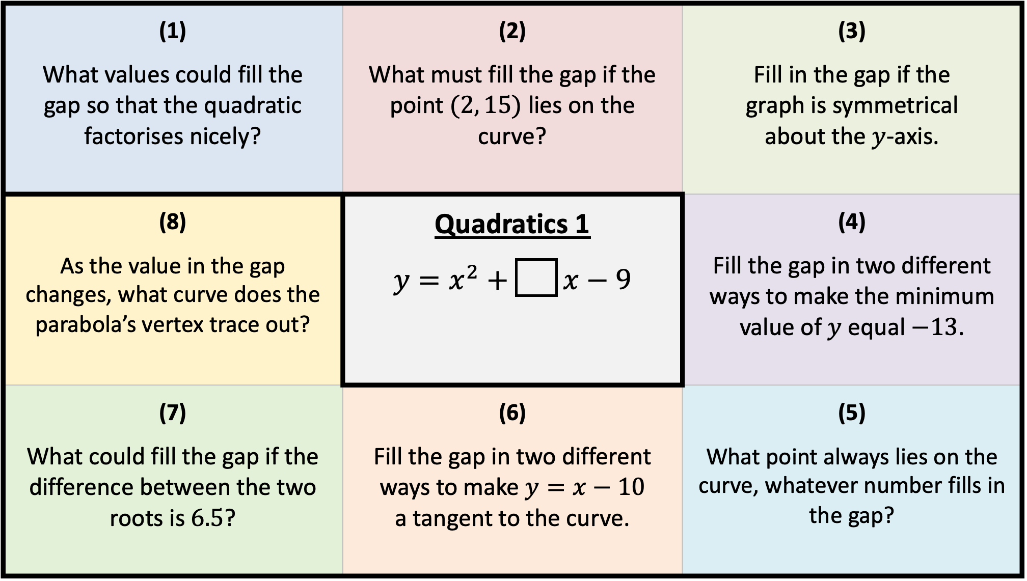
(1) What values could fill the gap so that the quadratic factorises nicely? | (2) What must fill the gap if the point $(2, 15)$ lies on the curve? | (3) Fill in the gap if the graph is symmetrical about the $y$-axis.
(8) As the value in the gap changes, what curve does the parabola’s vertex trace out? | Quadratics 1 $$y=x^{2}+\boxed{} x−9$$ | (4) Fill the gap in two different ways to make the minimum value of $y$ equal $−13$.
(7) What could fill the gap if the difference between the two roots is $6.5$? | (6) Fill the gap in two different ways to make $y=x−10$ a tangent to the curve. | (5) What point always lies on the curve, whatever number fills in the gap?

Slide 2
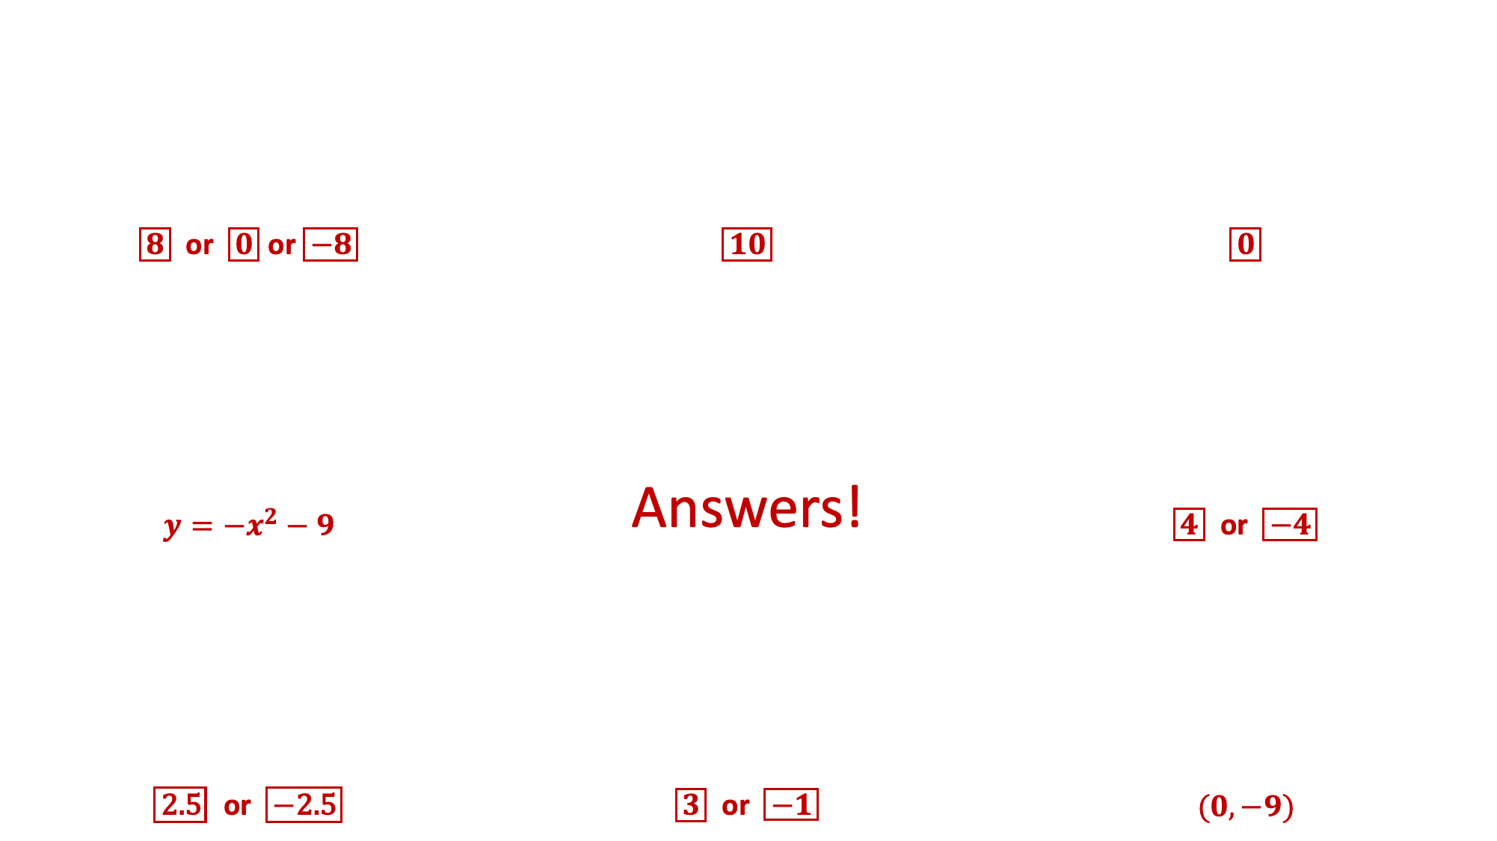
(1) What values could fill the gap so that the quadratic factorises nicely? | (2) What must fill the gap if the point $(2, 15)$ lies on the curve? | (3) Fill in the gap if the graph is symmetrical about the $y$-axis.
(8) As the value in the gap changes, what curve does the parabola’s vertex trace out? | Quadratics 1 $$y=x^{2}+\boxed{} x−9$$ | (4) Fill the gap in two different ways to make the minimum value of $y$ equal $−13$.
(7) What could fill the gap if the difference between the two roots is $6.5$? | (6) Fill the gap in two different ways to make $y=x−10$ a tangent to the curve. | (5) What point always lies on the curve, whatever number fills in the gap?
$\boxed{8}$ or $\boxed{0}$ or $\boxed{−8}$ | $\boxed{10}$ | $\boxed{0}$
$y=−x^{2}−9$ | Answers! | $\boxed{4} \text{or} \boxed{−4}$
$\boxed{\text{2.5}} \text{or} \boxed{−\text{2}\text{.5}}$ | $\boxed{3} \text{or} \boxed{−1}$ | $(0,−9)$

Slide 3
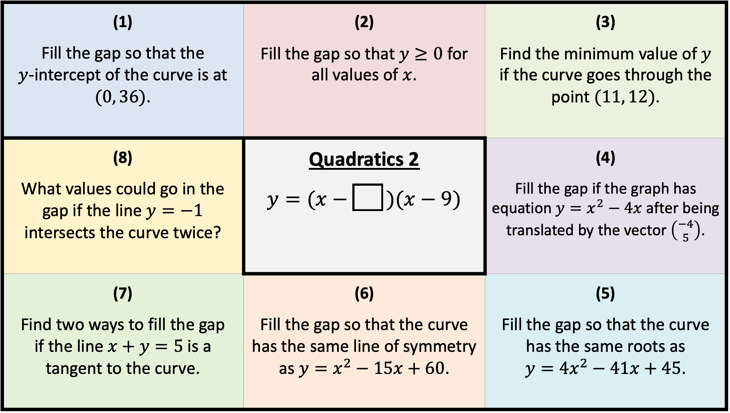
(1) Fill the gap so that the $y$-intercept of the curve is at $(0, 36)$. | (2) Fill the gap so that $y≥0$ for all values of $x$. | (3) Find the minimum value of $y$ if the curve goes through the point $(11, 12)$.
(8) What values could go in the gap if the line $y=−1$ intersects the curve twice? | Quadratics 2 $$y=(x−\boxed{} )(x−9)$$ | (4) Fill the gap if the graph has equation $y=x^{2}−4x$ after being translated by the vector $\left({−4 \atop 5}\right)$.
(7) Find two ways to fill the gap if the line $x+y=5$ is a tangent to the curve. | (6) Fill the gap so that the curve has the same line of symmetry as $y=x^{2}−15x+60$. | (5) Fill the gap so that the curve has the same roots as $y=4x^{2}−41x+45$.

Slide 4
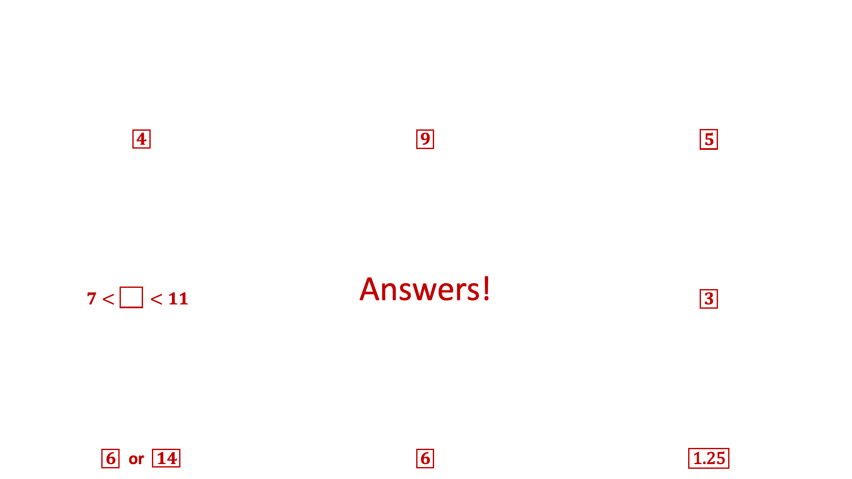

(1) Fill the gap so that the $y$-intercept of the curve is at $(0, 36)$. | (2) Fill the gap so that $y≥0$ for all values of $x$. | (3) Find the minimum value of $y$ if the curve goes through the point $(11, 12)$.
(8) What values could go in the gap if the line $y=−1$ does not intersect the curve? | Quadratics 2 $$y=(x−\boxed{} )(x−9)$$ | (4) Fill the gap if the graph has equation $y=x^{2}−4x$ after being translated by the vector $\left({−4 \atop 5}\right)$.
(7) Find two ways to fill the gap if the line $x+y=5$ is a tangent to the curve. | (6) Fill the gap so that the curve has the same line of symmetry as $y=x^{2}−15x+60$. | (5) Fill the gap so that the curve has the same roots as $y=4x^{2}−41x+45$.
$\boxed{4}$ | $\boxed{9}$ | $\boxed{5}$
$$7<\boxed{}<11$$ | Answers! | $\boxed{3}$
$\boxed{6} \text{or} \boxed{14}$ | $\boxed{6}$ | $\boxed{\text{1.25}}$

Slide 5
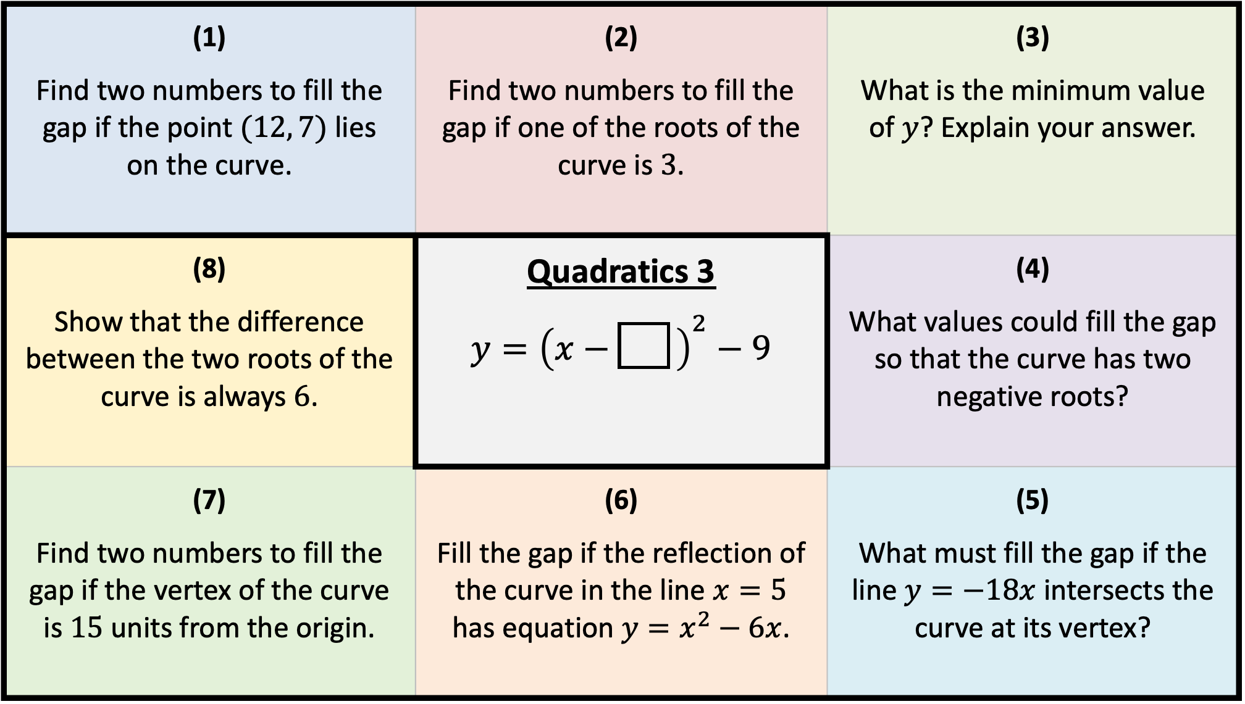
(1) Find two numbers to fill the gap if the point $(12, 7)$ lies on the curve. | (2) Find two numbers to fill the gap if one of the roots of the curve is $3$. | (3) What is the minimum value of $y$? Explain your answer.
(8) Show that the difference between the two roots of the curve is always $6$. | Quadratics 3 $$y={\left(x−\boxed{} \right)}^{2}−9$$ | (4) What values could fill the gap so that the curve has two negative roots?
(7) Find two numbers to fill the gap if the vertex of the curve is $15$ units from the origin. | (6) Fill the gap if the reflection of the curve in the line $x=5$ has equation $y=x^{2}−6x$. | (5) What must fill the gap if the line $y=−18x$ intersects the curve at its vertex?

Slide 6
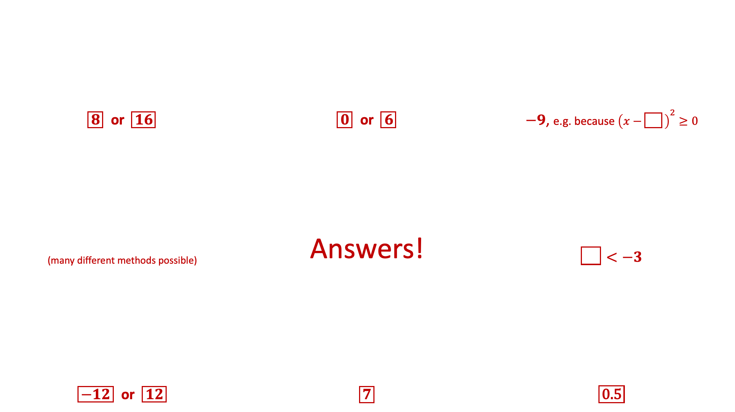
(1) Find two numbers to fill the gap if the point $(12, 7)$ lies on the curve. | (2) Find two numbers to fill the gap if one of the roots of the curve is $3$. | (3) What is the minimum value of $y$? Explain your answer.
(8) Show that the difference between the two roots of the curve is always $6$. | Quadratics 3 $$y={\left(x−\boxed{} \right)}^{2}−9$$ | (4) What values could fill the gap so that the curve has two negative roots?
(7) Find two numbers to fill the gap if the vertex of the curve is $15$ units from the origin. | (6) Fill the gap if the reflection of the curve in the line $x=5$ has equation $y=x^{2}−6x$. | (5) What must fill the gap if the line $y=−18x$ intersects the curve at its vertex?
$\boxed{8}$ or $\boxed{16}$ | $\boxed{0} \text{or} \boxed{6}$ | $−9$, e.g. because ${\left(x−\boxed{} \right)}^{2}≥0$
(many different methods possible) | Answers! | $\boxed{}<−3$
$\boxed{−12} \text{or} \boxed{12}$ | $\boxed{7}$ | $\boxed{\text{0.5}}$

