Slide 1
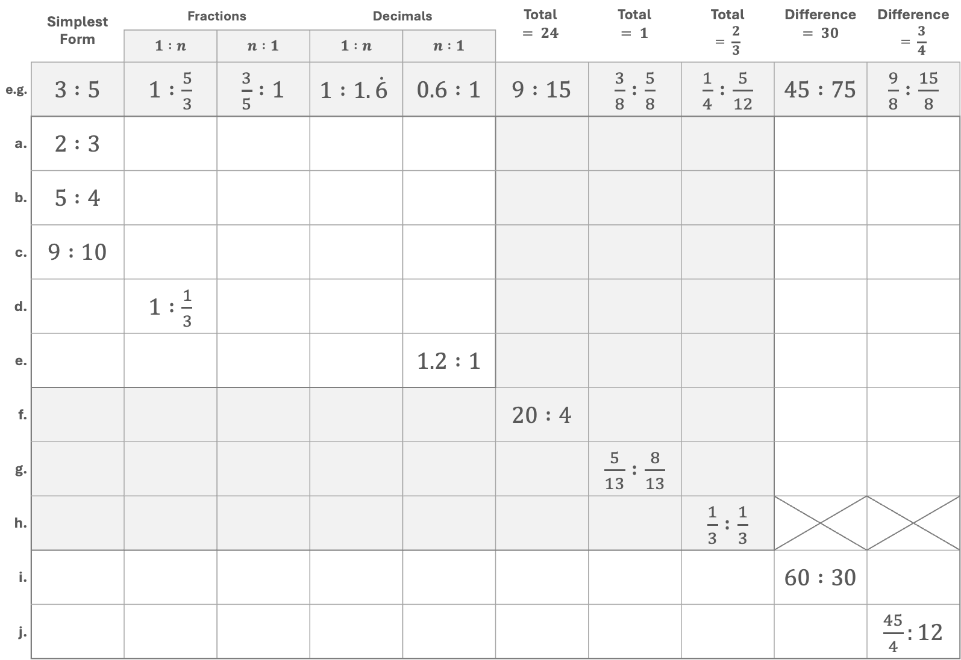
 | Simplest Form | Fractions |  | Decimals |  | Total $$= 24$$ | Total $$= 1$$ | Total $$= \frac{2}{3}$$ | Difference $$= 30$$ | Difference $$= \frac{3}{4}$$
 |  | $1 :n$ | $n :1$ | $1 :n$ | $n :1$
e.g. | $3 :5$ | $1 :\frac{5}{3}$ | $\frac{3}{5} :1$ | $$1 :1.\dot{6}$$ | $0.6 :1$ | $9 :15$ | $\frac{3}{8} :\frac{5}{8}$ | $\frac{1}{4} :\frac{5}{12}$ | $45 :75$ | $\frac{9}{8} :\frac{15}{8}$
a. | $2 :3$
b. | $5 :4$
c. | $9 :10$
d. |  | $1 :\frac{1}{3}$
e. |  |  |  |  | $1.2 :1$
f. |  |  |  |  |  | $20 :4$
g. |  |  |  |  |  |  | $\frac{5}{13} :\frac{8}{13}$
h. |  |  |  |  |  |  |  | $\frac{1}{3} :\frac{1}{3}$
i. |  |  |  |  |  |  |  |  | $60 :30$
j. |  |  |  |  |  |  |  |  |  | $\frac{45}{4}:12$

