Slide 1


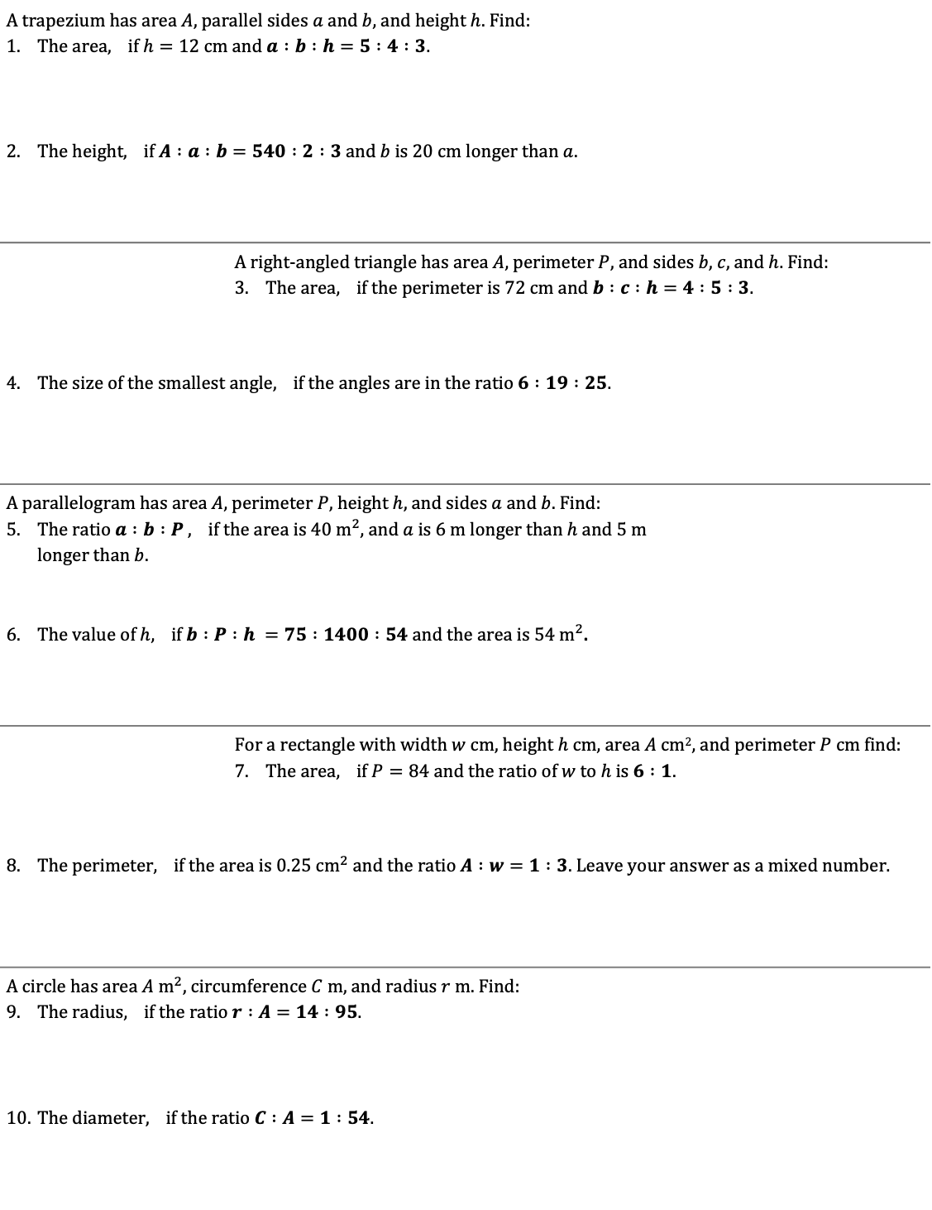










Sharing in a Ratio – Area and Perimeter
A trapezium has area $A$, parallel sides $a$ and $b$, and height $h$. Find: The area, if $h=12 \text{cm}$ and $a :b :h=5 :4 :3$. The height, if $A :a :b=540 :2 :3$ and $b$ is 20 cm longer than $a$.
 | A right-angled triangle has area $A$, perimeter $P$, and sides $b$, $c$, and $h$. Find: The area, if the perimeter is $72 \text{cm}$ and $b :c :h=4 :5 :3$.
The size of the smallest angle, if the angles are in the ratio $6 :19 :25$.
A parallelogram has area $A$, perimeter $P$, height $h$, and sides $a$ and $b$. Find: The ratio $a :b :P$ , if the area is $40 {\text{m}}^{2}$, and $a$ is $6 \text{m}$ longer than $h$ and $5 \text{m}$ longer than $b$. The value of $h$, if $b :P :h =75 :1400 :54$ and the area is $54 m^{2}$.
 | For a rectangle with width $w$ cm, height $h$ cm, area $A$ cm², and perimeter $P$ cm find: The area, if $P=84$ and the ratio of $w$ to $h$ is $6 :1$.
The perimeter, if the area is $0.25 {\text{cm}}^{2}$and the ratio $A :w=1 :3$. Leave your answer as a mixed number.
A circle has area $A$ ${\text{m}}^{2}$, circumference $C$ $\text{m}$, and radius $r \text{m}$. Find: The radius, if the ratio $r :A=14 :95$. The diameter, if the ratio $C :A=1 :54$.
$b$
$h$
$a$
$c$
$h$
$b$
$b$
$h$
$a$
$h$
$w$
$r$

