Slide 1
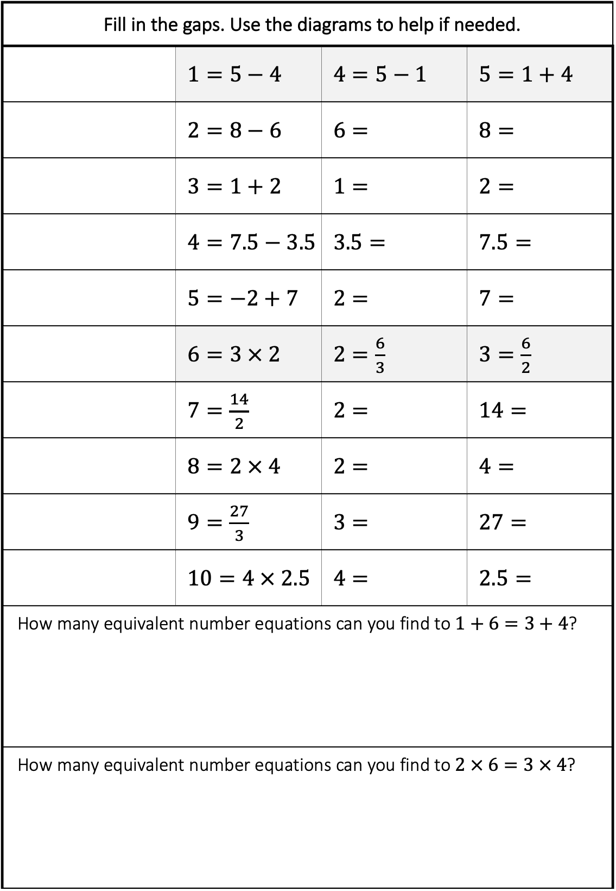
Fill in the gaps. Use the diagrams to help if needed. | Please fill in the gaps (between the train and the platform edge).
 | $1=5−4$ | $4=5−1$ | $5=1+4$
 | $2=8−6$ | $6=8−2$ | $8=2+6$
 | $3=1+2$ | $1=$ | $2=3−1$
 | $4=7.5−3.5$ | $3.5=7.5−4$ | $7.5=4+3.5$
 | $5=−2+7$ | $2=7−5$ | $7=2+5$
 | $6=3 × 2$ | $2=\frac{6}{3}$ | $3=\frac{6}{2}$
 | $7=\frac{14}{2}$ | $2=$ | $14=$
 | $8=2 × 4$ | $2=\frac{8}{4}$ | $4=\frac{8}{2}$
 | $9=\frac{27}{3}$ | $3=\frac{27}{9}$ | $27=3 × 9$
 | $10=4 × 2.5$ | $4=\frac{10}{2}$ | $2.5=\frac{10}{5}$
How many equivalent number equations can you find to $1+6=3+4$?
How many equivalent number equations can you find to $2 × 6=3 × 4$?
5
4 | 1
8
2
2 | 6
 | 3
 | 14

Slide 2
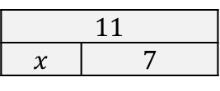
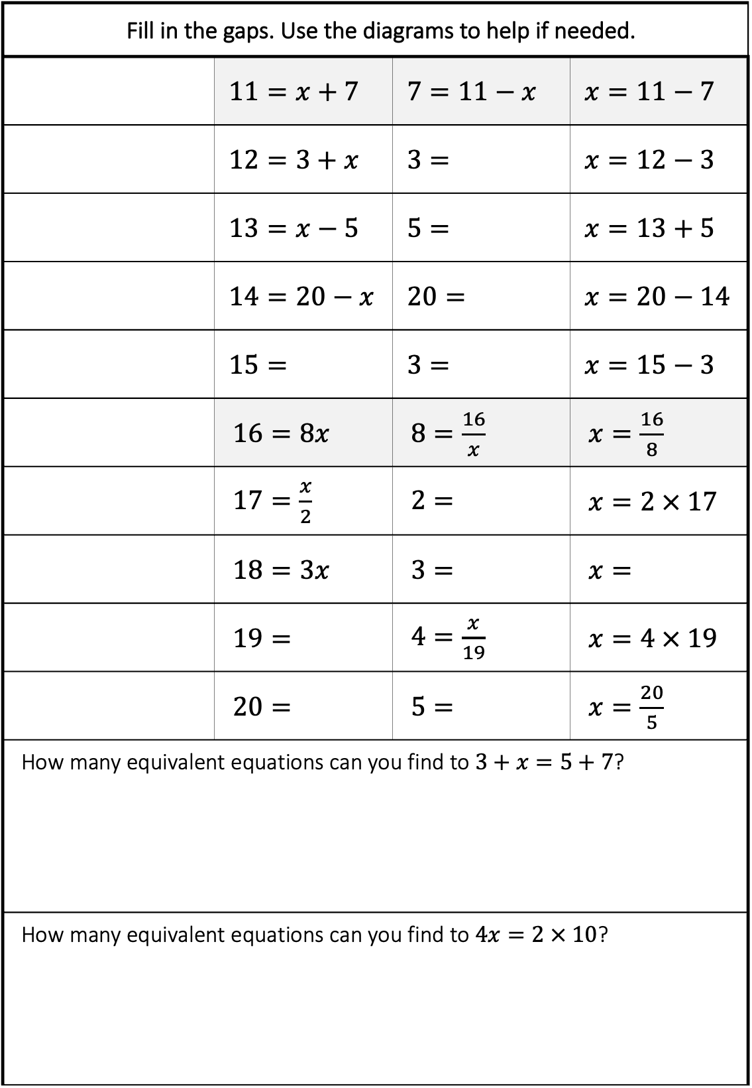

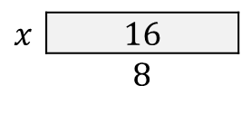
Fill in the gaps. Use the diagrams to help if needed. | Please fill in the gaps (between the train and the platform edge).
 | $11=x+7$ | $7=11−x$ | $x=11−7$
 | $12=3+x$ | $3=12−x$ | $x=12−3$
 | $13=x−5$ | $5=x−13$ | $x=13+5$
 | $14=20−x$ | $20=x+14$ | $x=20−14$
 | $15=x+3$ | $3=15−x$ | $x=15−3$
 | $16=8x$ | $8=\frac{16}{x}$ | $x=\frac{16}{8}$
 | $17=\frac{x}{2}$ | $2=\frac{x}{17}$ | $x=2 × 17$
 | $18=3x$ | $3=\frac{18}{x}$ | $x=\frac{18}{3}$
 | $19=$ | $4=\frac{x}{19}$ | $x=4 × 19$
 | $20=$ | $5=\frac{20}{x}$ | $x=\frac{20}{5}\frac{20}{5}$
How many equivalent equations can you find to $3+x=5+7$?
How many equivalent equations can you find to $4x=2 × 10$?
11
$x$ | 7
$x$ | 16
 | 8
 | $x$

Slide 3

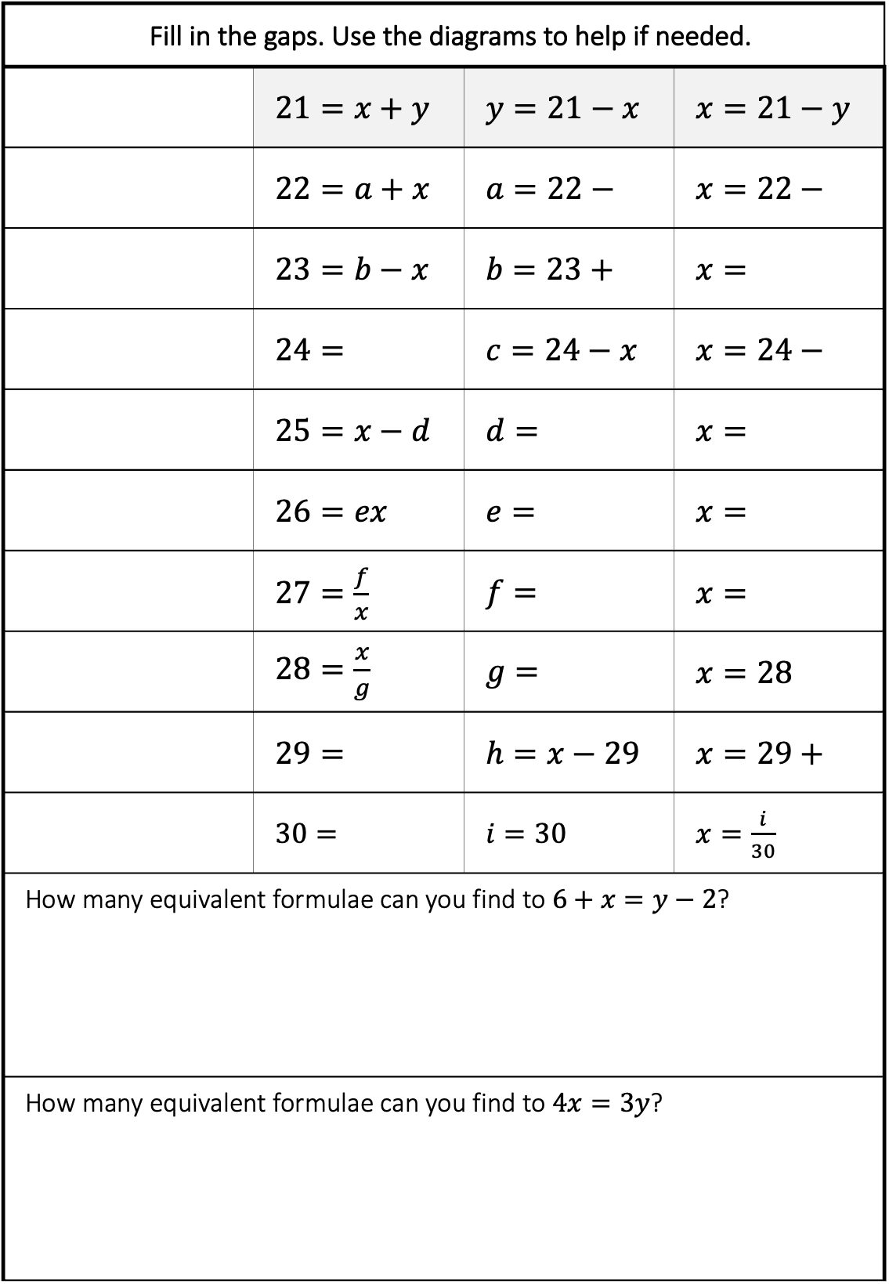
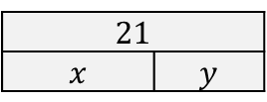
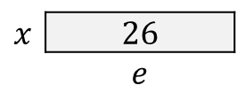
Fill in the gaps. Use the diagrams to help if needed. | Please fill in the gaps (between the train and the platform edge).
 | $21=x+y$ | $y=21−x$ | $x=21−y$
 | $22=a+x$ | $a=22−x$ | $x=22−a$
 | $23=b−x$ | $b=23+x$ | $x=b−23$
 | $24=$ | $c=24−x$ | $x=24−c$
 | $25=x−d$ | $d=x−25$ | $x=d+25$
 | $26=ex$ | $e=\frac{26}{x}$ | $x=\frac{26}{e}$
 | $27=\frac{f}{x}$ | $f=27x$ | $x=\frac{f}{27}$
 | $28=\frac{x}{g}$ | $g=\frac{x}{28}$ | $x=28g$
 | $29=x−h$ | $h=x−29$ | $x=29+h$
 | $30=\frac{i}{x}$ | $i=30x$ | $x=\frac{i}{30}$
How many equivalent formulae can you find to $6+x=y−2$?
How many equivalent formulae can you find to $4x=3y$?
21
$x$ | $y$
22
$a$ | $x$
$x$ | 26
 | $e$

Slide 4
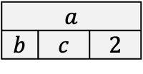

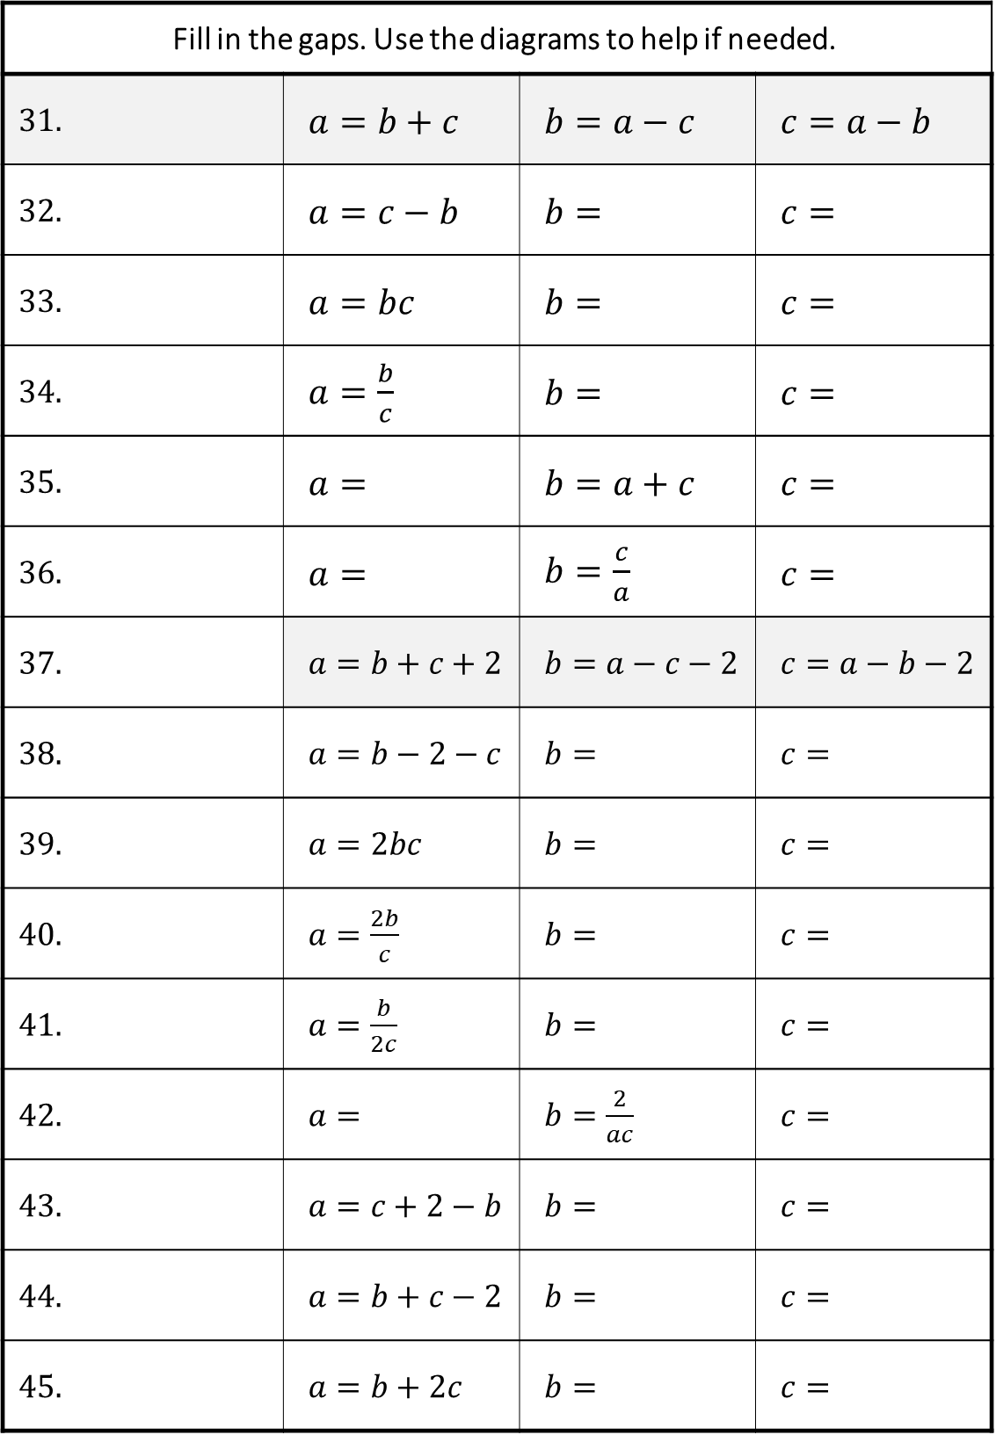



Fill in the gaps. Use the diagrams to help if needed. | Please fill in the gaps (between the train and the platform edge).
31. | $a=b+c$ | $b=a−c$ | $c=a−b$
32. | $a=c−b$ | $b=$ | $c=$
33. | $a=bc$ | $b=$ | $c=$
34. | $a=\frac{b}{c}$ | $b=$ | $c=$
35. | $a=$ | $b=a+c$ | $c=$
36. | $a=$ | $b=\frac{c}{a}$ | $c=$
37. | $a=b+c+2$ | $b=a−c−2$ | $c=a−b−2$
38. | $a=b−2−c$ | $b=$ | $c=$
39. | $a=2bc$ | $b=$ | $c=$
40. | $a=\frac{2b}{c}$ | $b=$ | $c=$
41. | $a=\frac{b}{2c}$ | $b=$ | $c=$
42. | $a=$ | $b=\frac{2}{ac}$ | $c=$
43. | $a=c+2−b$ | $b=$ | $c=$
44. | $a=b+c−2$ | $b=$ | $c=$
45. | $a=b+2c$ | $b=$ | $c=$
$a$
$b$ | $c$
$a$
$b$ | $c$ | 2
$c$ | a
 | $2b$
 | $2b$
$a$ |  | $b$
$c$ | $2$

Slide 5
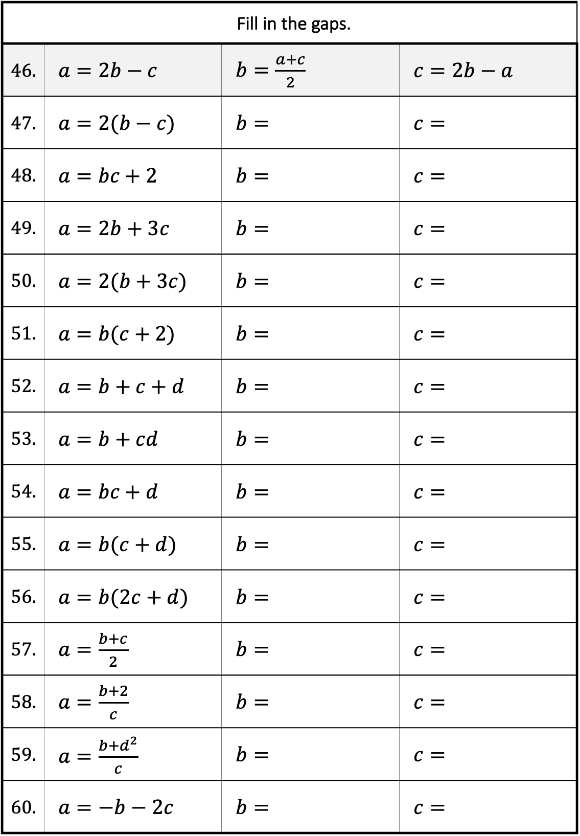
Fill in the gaps. | Please fill in the gaps (between the train and the platform edge).
46. | $a=2b−c$ | $b=\frac{a+c}{2}$ | $c=2b−a$
47. | $a=2(b−c)$ | $b=$ | $c=$
48. | $a=bc+2$ | $b=$ | $c=$
49. | $a=2b+3c$ | $b=$ | $c=$
50. | $a=2(b+3c)$ | $b=$ | $c=$
51. | $a=b(c+2)$ | $b=$ | $c=$
52. | $a=b+c+d$ | $b=$ | $c=$
53. | $a=b+cd$ | $b=$ | $c=$
54. | $a=bc+d$ | $b=$ | $c=$
55. | $a=b(c+d)$ | $b=$ | $c=$
56. | $a=b(2c+d)$ | $b=$ | $c=$
57. | $a=\frac{b+c}{2}$ | $b=$ | $c=$
58. | $a=\frac{b+2}{c}$ | $b=$ | $c=$
59. | $a=\frac{b+d^{2}}{c}$ | $b=$ | $c=$
60. | $a=−b−2c$ | $b=$ | $c=$

