Slide 1

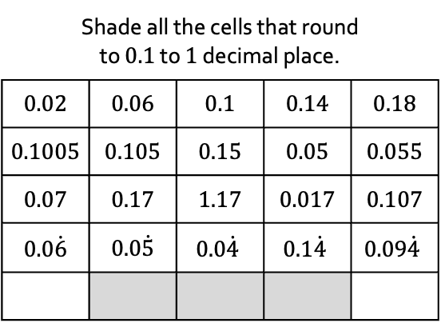
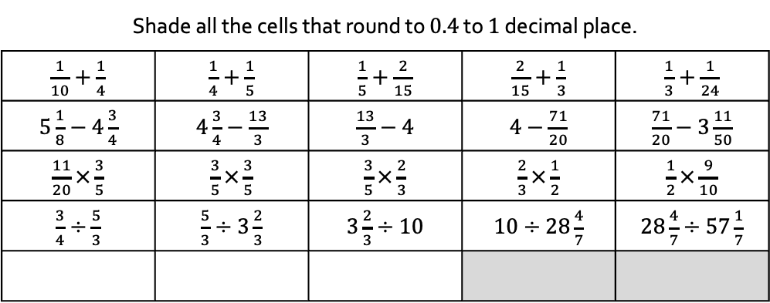
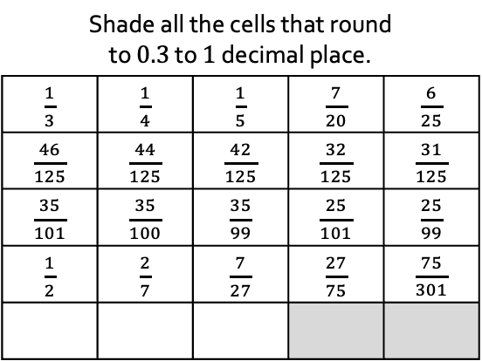
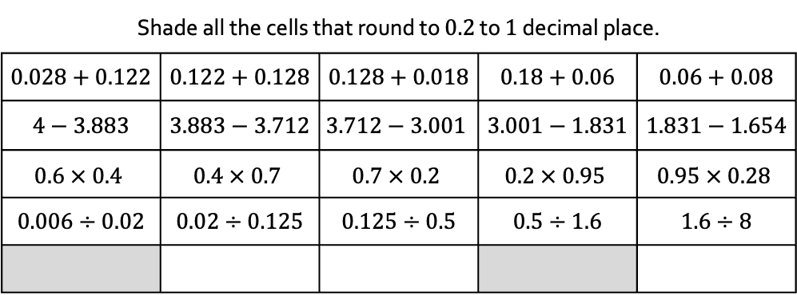
InterwovenMaths.com
Rounding with… Fractions
and… Decimals
Shade all the cells that round to $0.1$ to $1$ decimal place.
$0.02$ | $0.06$ | $0.1$ | $0.14$ | $0.18$
$0.1005$ | $0.105$ | $0.15$ | $0.05$ | $0.055$
$0.07$ | $0.17$ | $1.17$ | $0.017$ | $0.107$
$0.0\dot{6}$ | $0.0\dot{5}$ | $$0.0\dot{4}$$ | $$0.1\dot{4}$$ | $$0.09\dot{4}$$
Shade all the cells that round to $0.2$ to $1$ decimal place.
$0.028+0.122$ | $0.122+0.128$ | $0.128+0.018$ | $0.18+0.06$ | $0.06+0.08$
$4−3.883$ | $3.883−3.712$ | $$3.712−3.001$$ | $3.001−1.831$ | $1.831−1.654$
$$0.6 × 0.4$$ | $$0.4 × 0.7$$ | $$0.7 × 0.2$$ | $$0.2 × 0.95$$ | $$0.95 × 0.28$$
$0.006÷0.02$ | $0.02÷0.125$ | $0.125÷0.5$ | $0.5÷1.6$ | $1.6÷8$
Shade all the cells that round to $0.3$ to $1$ decimal place.
$\frac{1}{3}$ | $\frac{1}{4}$ | $\frac{1}{5}$ | $\frac{7}{20}$ | $\frac{6}{25}$
$\frac{46}{125}$ | $\frac{44}{125}$ | $\frac{42}{125}$ | $\frac{32}{125}$ | $\frac{31}{125}$
$\frac{35}{101}$ | $\frac{35}{100}$ | $\frac{35}{99}$ | $\frac{25}{101}$ | $\frac{25}{99}$
$\frac{1}{2}$ | $\frac{2}{7}$ | $\frac{7}{27}$ | $\frac{27}{75}$ | $\frac{75}{301}$
Shade all the cells that round to $0.4$ to $1$ decimal place.
$\frac{1}{10}+\frac{1}{4}$ | $\frac{1}{4}+\frac{1}{5}$ | $\frac{1}{5}+\frac{2}{15}$ | $\frac{2}{15}+\frac{1}{3}$ | $\frac{1}{3}+\frac{1}{24}$
$5\frac{1}{8}−4\frac{3}{4}$ | $4\frac{3}{4}−\frac{13}{3}$ | $\frac{13}{3}−4$ | $4−\frac{71}{20}$ | $\frac{71}{20}−3\frac{11}{50}$
$\frac{11}{20}×\frac{3}{5}$ | $\frac{3}{5}×\frac{3}{5}$ | $\frac{3}{5}×\frac{2}{3}$ | $\frac{2}{3}×\frac{1}{2}$ | $\frac{1}{2}×\frac{9}{10}$
$\frac{3}{4}÷\frac{5}{3}$ | $\frac{5}{3}÷3\frac{2}{3}$ | $3\frac{2}{3}÷10$ | $10÷28\frac{4}{7}$ | $28\frac{4}{7}÷57\frac{1}{7}$
1) Complete the bottom row of each table in a way that continues the pattern.
2) Which answers would change if, instead of rounding to $1$ decimal place, you rounded to $1$ significant figure?

Slide 2
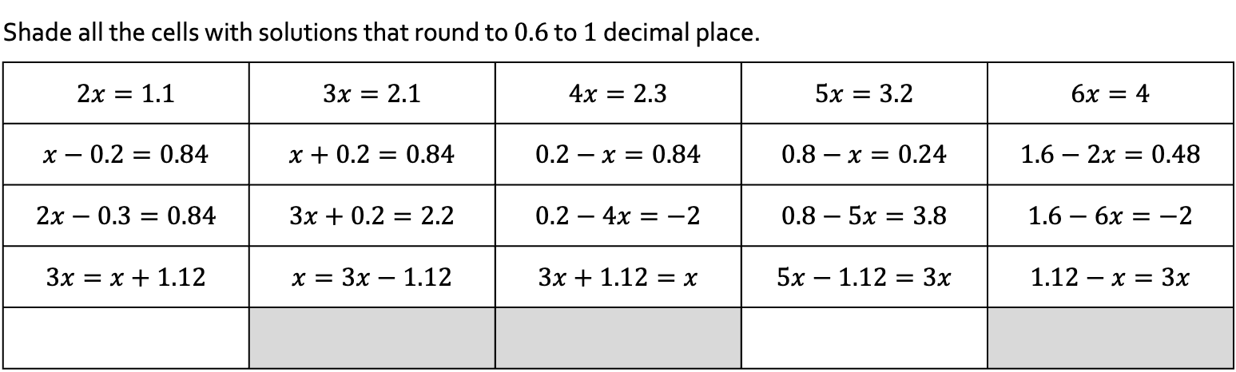
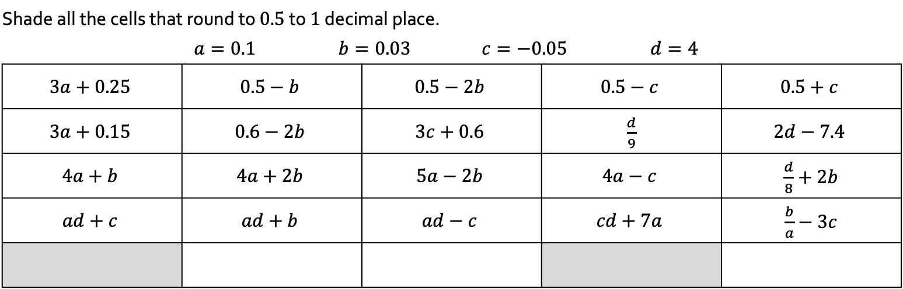
InterwovenMaths.com
Rounding with… Algebra
Shade all the cells that round to $0.5$ to $1$ decimal place.
 | $$a=0.1$$ |  | $$b=0.03$$ |  | $$c=−0.05$$ |  | $$d=4$$
$$3a+0.25$$ |  | $$0.5−b$$ |  | $$0.5−2b$$ |  | $$0.5−c$$ |  | $$0.5+c$$
$$3a+0.15$$ |  | $$0.6−2b$$ |  | $$3c+0.6$$ |  | $\frac{d}{9}$ |  | $$2d−7.4$$
$$4a+b$$ |  | $$4a+2b$$ |  | $$5a−2b$$ |  | $$4a−c$$ |  | $\frac{d}{8}+2b$
$$ad+c$$ |  | $$ad+b$$ |  | $$ad−c$$ |  | $$cd+7a$$ |  | $\frac{b}{a}−3c$
Shade all the cells with solutions that round to $0.6$ to $1$ decimal place.
$2x=1.1$ | $3x=2.1$ | $4x=2.3$ | $5x=3.2$ | $6x=4$
$x−0.2=0.84$ | $x+0.2=0.84$ | $0.2−x=0.84$ | $0.8−x=0.24$ | $1.6−2x=0.48$
$2x−0.3=0.84$ | $3x+0.2=2.2$ | $0.2−4x=−2$ | $0.8−5x=3.8$ | $1.6−6x=−2$
$3x=x+1.12$ | $x=3x−1.12$ | $3x+1.12=x$ | $5x−1.12=3x$ | $1.12−x=3x$
Complete the bottom row of each table in a way that continues the pattern.

