Slide 1
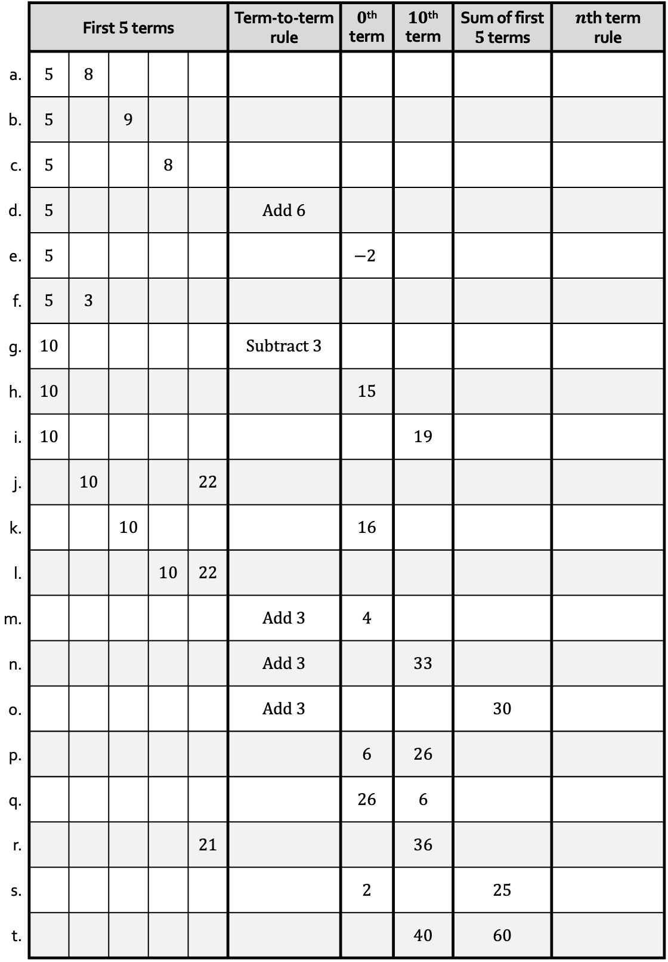
 | First $5$ terms |  |  |  |  | Term-to-term rule | $0$^{th} term | $10$^{th} term | Sum of first $5$ terms | $n$th term rule
a. | 5 | 8
b. | 5 |  | 9
c. | 5 |  |  | 8
d. | 5 |  |  |  |  | Add 6
e. | 5 |  |  |  |  |  | $$−2$$
f. | 5 | 3
g. | 10 |  |  |  |  | Subtract 3
h. | 10 |  |  |  |  |  | 15
i. | 10 |  |  |  |  |  |  | 19
j. |  | 10 |  |  | 22
k. |  |  | 10 |  |  |  | 16
l. |  |  |  | 10 | 22
m. |  |  |  |  |  | Add 3 | 4
n. |  |  |  |  |  | Add 3 |  | 33
o. |  |  |  |  |  | Add 3 |  |  | 30
p. |  |  |  |  |  |  | 6 | 26
q. |  |  |  |  |  |  | 26 | 6
r. |  |  |  |  | 21 |  |  | 36
s. |  |  |  |  |  |  | 2 |  | 25
t. |  |  |  |  |  |  |  | 40 | 60

Slide 2
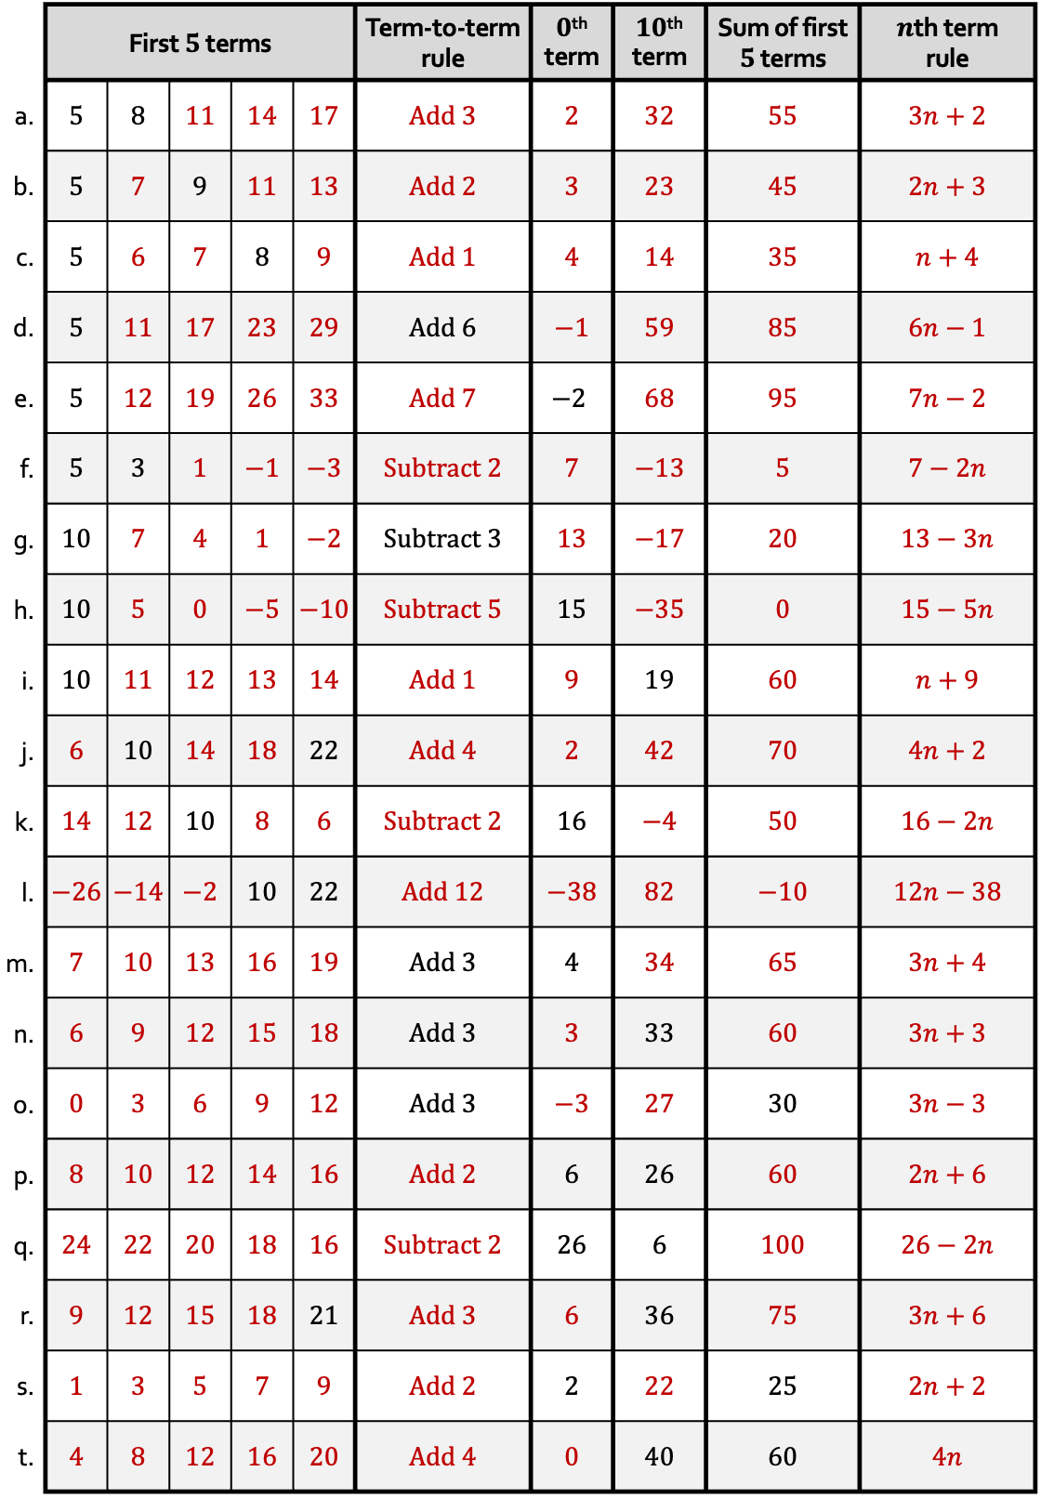
 | First $5$ terms |  |  |  |  | Term-to-term rule | $0$^{th} term | $10$^{th} term | Sum of first $5$ terms | $n$th term rule
a. | 5 | 8 | 11 | 14 | 17 | Add 3 | 2 | 32 | 55 | $3n+2$
b. | 5 | 7 | 9 | 11 | 13 | Add 2 | 3 | 23 | 45 | $2n+3$
c. | 5 | 6 | 7 | 8 | 9 | Add 1 | 4 | 14 | 35 | $n+4$
d. | 5 | 11 | 17 | 23 | 29 | Add 6 | $−1$ | 59 | 85 | $6n−1$
e. | 5 | 12 | 19 | 26 | 33 | Add 7 | $$−2$$ | 68 | 95 | $7n−2$
f. | 5 | 3 | 1 | $−1$ | $−3$ | Subtract 2 | 7 | $−13$ | 5 | $7−2n$
g. | 10 | 7 | 4 | 1 | $−2$ | Subtract 3 | 13 | $−17$ | 20 | $13−3n$
h. | 10 | 5 | 0 | $−5$ | $−10$ | Subtract 5 | 15 | $−35$ | 0 | $15−5n$
i. | 10 | 11 | 12 | 13 | 14 | Add 1 | 9 | 19 | 60 | $n+9$
j. | 6 | 10 | 14 | 18 | 22 | Add 4 | 2 | 42 | 70 | $4n+2$
k. | 14 | 12 | 10 | 8 | 6 | Subtract 2 | 16 | $−4$ | 50 | $16−2n$
l. | $−26$ | $−14$ | $−2$ | 10 | 22 | Add 12 | $−38$ | 82 | $−10$ | $12n−38$
m. | 7 | 10 | 13 | 16 | 19 | Add 3 | 4 | 34 | 65 | $3n+4$
n. | 6 | 9 | 12 | 15 | 18 | Add 3 | 3 | 33 | 60 | $3n+3$
o. | 0 | 3 | 6 | 9 | 12 | Add 3 | $−3$ | 27 | 30 | $3n−3$
p. | 8 | 10 | 12 | 14 | 16 | Add 2 | 6 | 26 | 60 | $2n+6$
q. | 24 | 22 | 20 | 18 | 16 | Subtract 2 | 26 | 6 | 100 | $26−2n$
r. | 9 | 12 | 15 | 18 | 21 | Add 3 | 6 | 36 | 75 | $3n+6$
s. | 1 | 3 | 5 | 7 | 9 | Add 2 | 2 | 22 | 25 | $2n+2$
t. | 4 | 8 | 12 | 16 | 20 | Add 4 | 0 | 40 | 60 | $4n$

