Slide 1
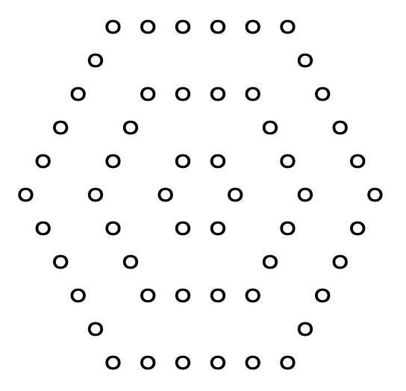
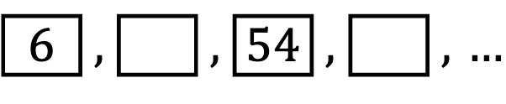
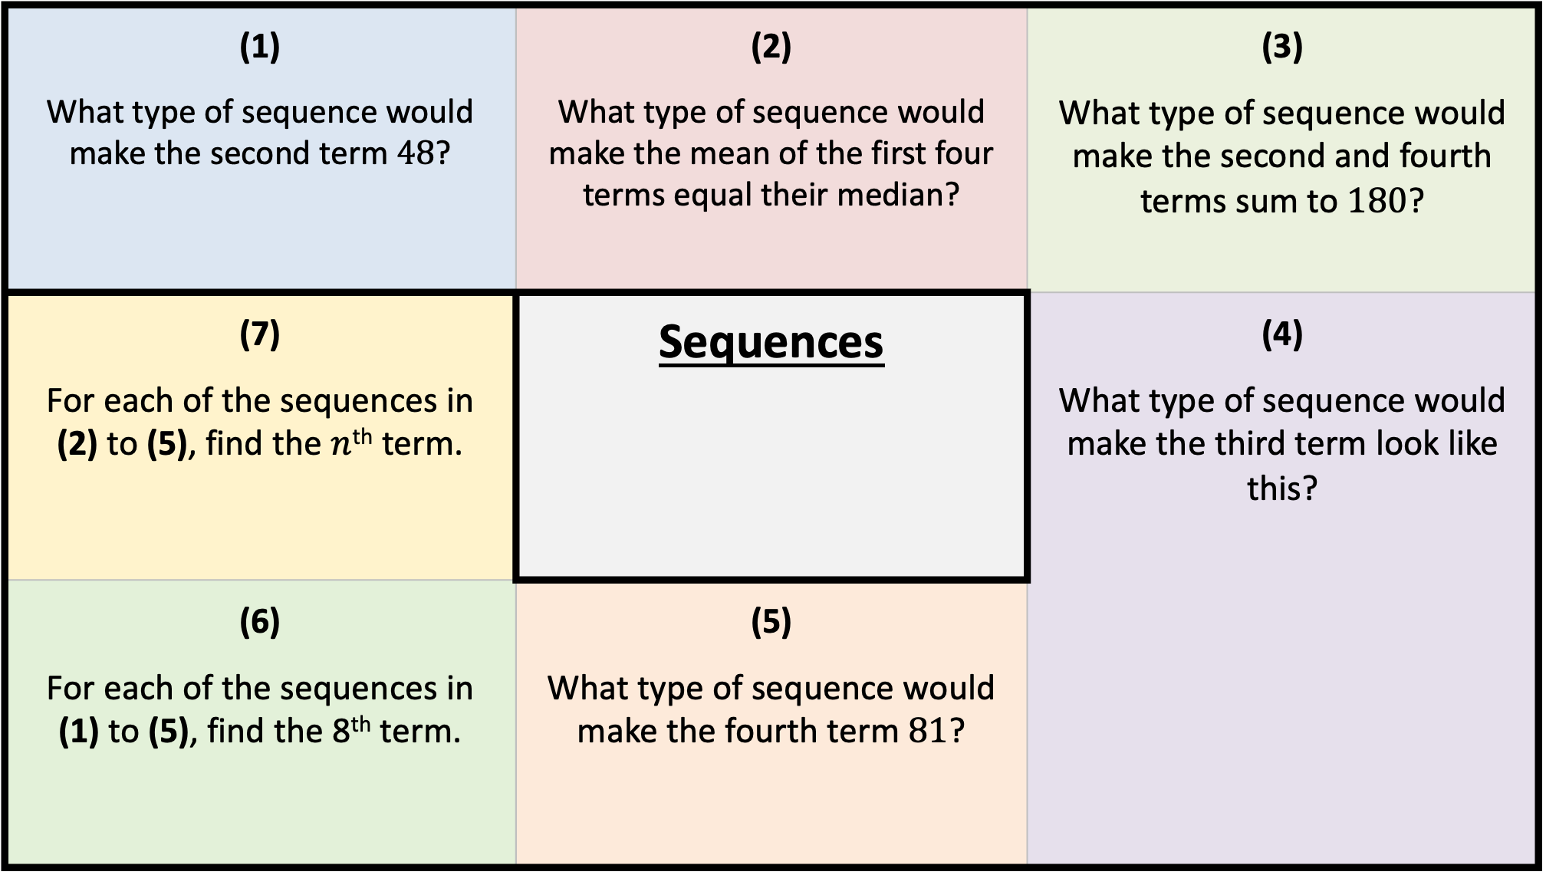
(1) What type of sequence would make the second term $48$? | (2) What type of sequence would make the mean of the first four terms equal their median? | (3) What type of sequence would make the second and fourth terms sum to $180$?
(7) For each of the sequences in (2) to (5), find the $n$^{th} term. | Sequences | (4) What type of sequence would make the third term look like this?
(6) For each of the sequences in (1) to (5), find the 8th term. | (5) What type of sequence would make the fourth term $81$? | (5) Find the area of the triangle when the perimeter is 24 cm.
6 | , |  | , | 54 | , |  | , | $…$

Slide 2
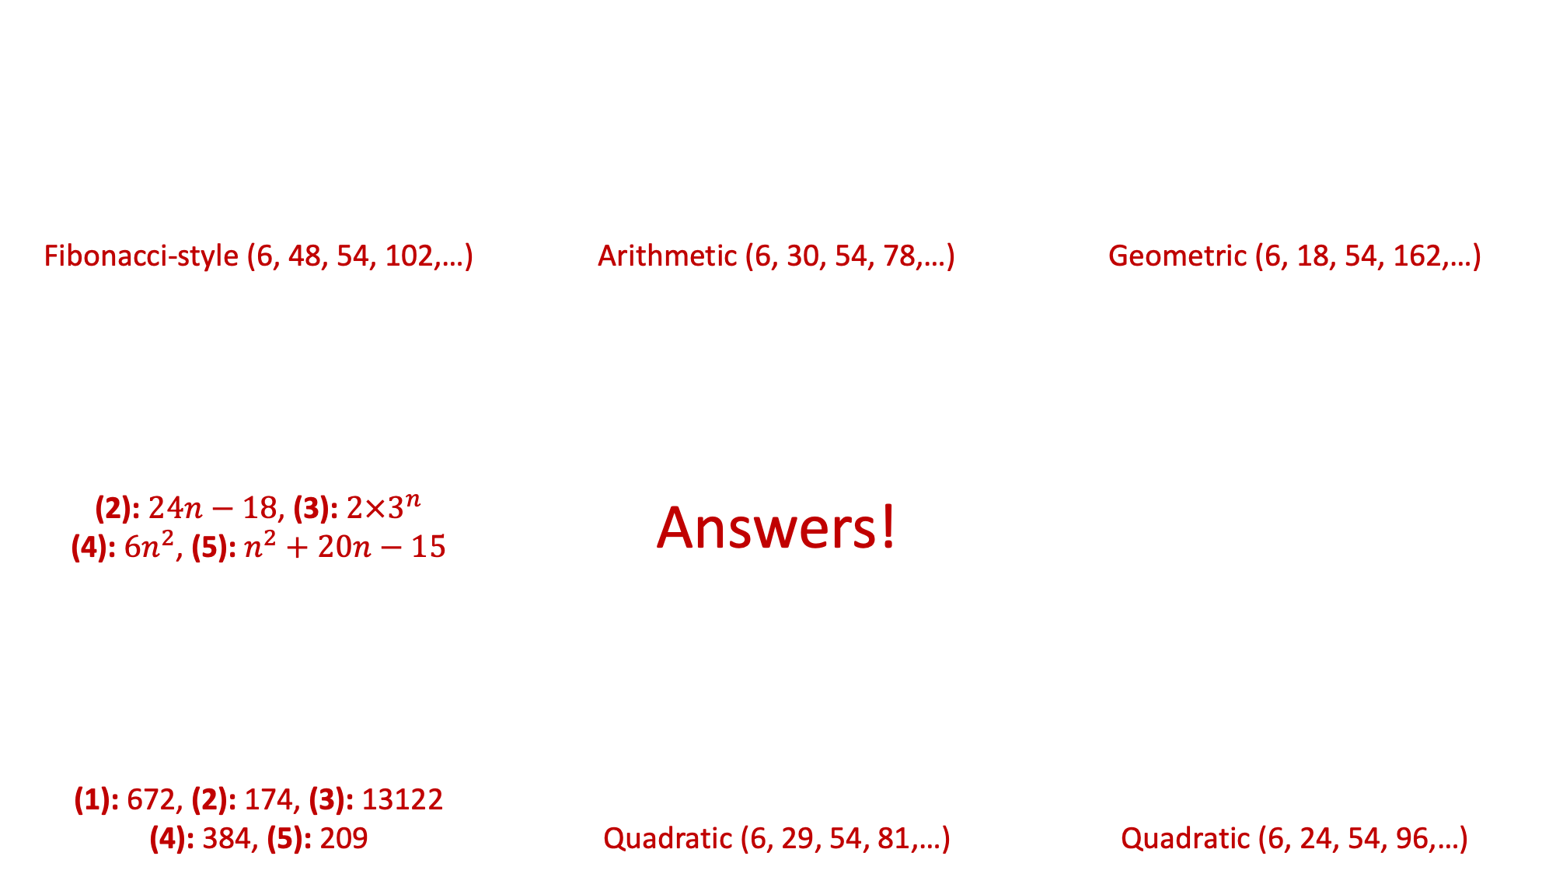
(1) What type of sequence would make the second term $48$? | (2) What type of sequence would make the mean of the first four terms equal their median? | (3) What type of sequence would make the second and fourth terms sum to $180$?
(7) For each of the sequences in (2) to (5), find the $n$^{th} term. | Sequences | (4) What type of sequence would make the third term look like this?
(6) For each of the sequences in (1) to (5), find the 8th term. | (5) What type of sequence would make the fourth term $81$? | (5) Find the area of the triangle when the perimeter is 24 cm.
Fibonacci-style (6, 48, 54, 102,…) | Arithmetic (6, 30, 54, 78,…) | Geometric (6, 18, 54, 162,…)
(2): $24n−18$, (3): $2×3^{n}$ (4): $6n^{2}$, (5): $n^{2}+20n−15$ | Answers!
(1): 672, (2): 174, (3): 13122 (4): 384, (5): 209 | Quadratic (6, 29, 54, 81,…) | Quadratic (6, 24, 54, 96,…)
6 | , |  | , | 54 | , |  | , | $…$

