Slide 1
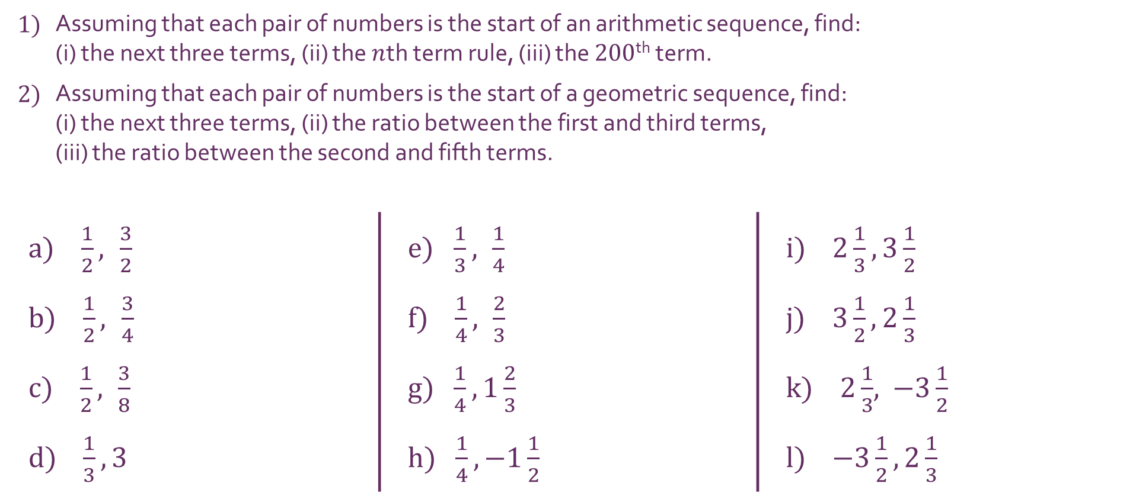
Fractions
1) | Assuming that each pair of numbers is the start of an arithmetic sequence, find: (i) the next three terms, (ii) the $n$th term rule, (iii) the $200$^{th} term.
2) | Assuming that each pair of numbers is the start of a geometric sequence, find: (i) the next three terms, (ii) the ratio between the first and third terms, (iii) the ratio between the second and fifth terms.
a) $\frac{1}{2}, \frac{3}{2}$ |  | e) $\frac{1}{3}, \frac{1}{4}$ | i) $2\frac{1}{3}, 3\frac{1}{2}$
b) $\frac{1}{2}, \frac{3}{4}$ |  | f) $\frac{1}{4}, \frac{2}{3}$ | j) $3\frac{1}{2},2\frac{1}{3}$
c) $\frac{1}{2}, \frac{3}{8}$ |  | g) $\frac{1}{4}, 1\frac{2}{3}$ | k) $2\frac{1}{3}$, $−3\frac{1}{2}$
d) $\frac{1}{3}, 3$ |  | h) $\frac{1}{4}, −1\frac{1}{2}$ | l) $−3\frac{1}{2}, 2\frac{1}{3}$

Slide 2
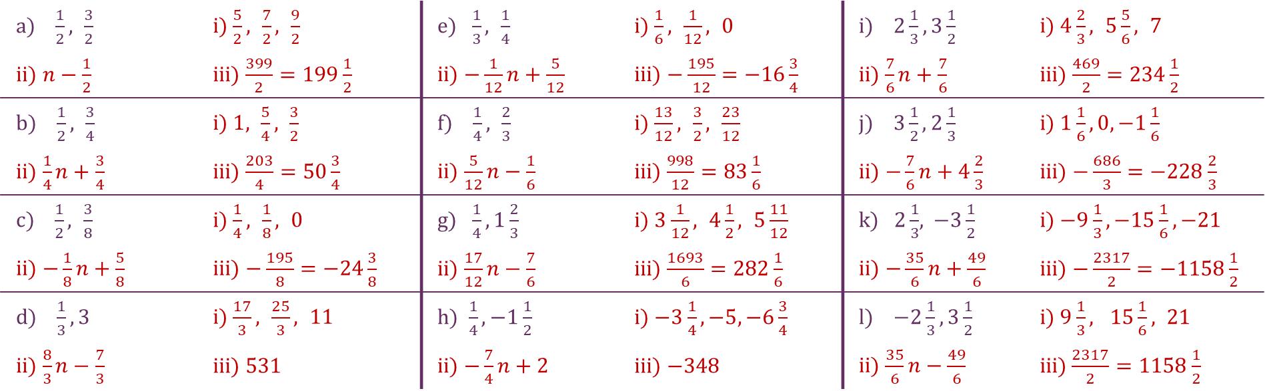
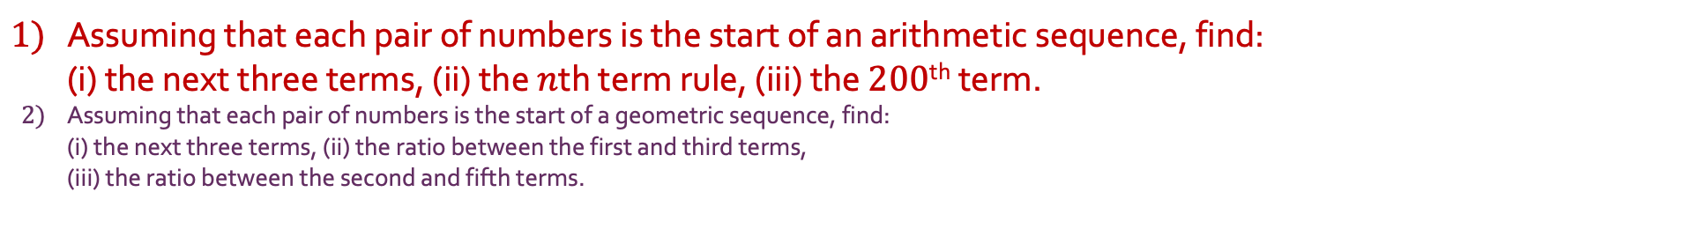
Fractions
1) | Assuming that each pair of numbers is the start of an arithmetic sequence, find: (i) the next three terms, (ii) the $n$th term rule, (iii) the $200$^{th} term.
2) | Assuming that each pair of numbers is the start of a geometric sequence, find: (i) the next three terms, (ii) the ratio between the first and third terms, (iii) the ratio between the second and fifth terms.
a) $\frac{1}{2}, \frac{3}{2}$ | i) $\frac{5}{2}, \frac{7}{2}, \frac{9}{2}$ | e) $\frac{1}{3}, \frac{1}{4}$ | i) $\frac{1}{6}, \frac{1}{12}, 0$ | i) $2\frac{1}{3}, 3\frac{1}{2}$ | i) $4\frac{2}{3}, 5\frac{5}{6}, 7$
ii) $n−\frac{1}{2}$ | iii) $\frac{399}{2}=199\frac{1}{2}$ | ii) $−\frac{1}{12}n+\frac{5}{12}$ | iii) $−\frac{195}{12}=−16\frac{3}{4}$ | ii) $\frac{7}{6}n+\frac{7}{6}$ | iii) $\frac{469}{2}=234\frac{1}{2}$
b) $\frac{1}{2}, \frac{3}{4}$ | i) $1, \frac{5}{4}, \frac{3}{2}$ | f) $\frac{1}{4}, \frac{2}{3}$ | i) $\frac{13}{12}, \frac{3}{2}, \frac{23}{12}$ | j) $3\frac{1}{2},2\frac{1}{3}$ | i) $1\frac{1}{6}, 0, −1\frac{1}{6}$
ii) $\frac{1}{4}n+\frac{3}{4}$ | iii) $\frac{203}{4}=50\frac{3}{4}$ | ii) $\frac{5}{12}n−\frac{1}{6}$ | iii) $\frac{998}{12}=83\frac{1}{6}$ | ii) $−\frac{7}{6}n+4\frac{2}{3}$ | iii) $−\frac{686}{3}=−228\frac{2}{3}$
c) $\frac{1}{2}, \frac{3}{8}$ | i) $\frac{1}{4}, \frac{1}{8}, 0$ | g) $\frac{1}{4}, 1\frac{2}{3}$ | i) $3\frac{1}{12}, 4\frac{1}{2}, 5\frac{11}{12}$ | k) $2\frac{1}{3}$, $−3\frac{1}{2}$ | i) $−9\frac{1}{3}, −15\frac{1}{6},−21$
ii) $−\frac{1}{8}n+\frac{5}{8}$ | iii) $−\frac{195}{8}=−24\frac{3}{8}$ | ii) $\frac{17}{12}n−\frac{7}{6}$ | iii) $\frac{1693}{6}=282\frac{1}{6}$ | ii) $−\frac{35}{6}n+\frac{49}{6}$ | iii) $−\frac{2317}{2}=−1158\frac{1}{2}$
d) $\frac{1}{3}, 3$ | i) $\frac{17}{3}, \frac{25}{3}, 11$ | h) $\frac{1}{4}, −1\frac{1}{2}$ | i) $−3\frac{1}{4}, −5, −6\frac{3}{4}$ | l) $−2\frac{1}{3}, 3\frac{1}{2}$ | i) $9\frac{1}{3}, 15\frac{1}{6}, 21$
ii) $\frac{8}{3}n−\frac{7}{3}$ | iii) $531$ | ii) $−\frac{7}{4}n+2$ | iii) $−348$ | ii) $\frac{35}{6}n−\frac{49}{6}$ | iii)$\frac{2317}{2}=1158\frac{1}{2}$

Slide 3
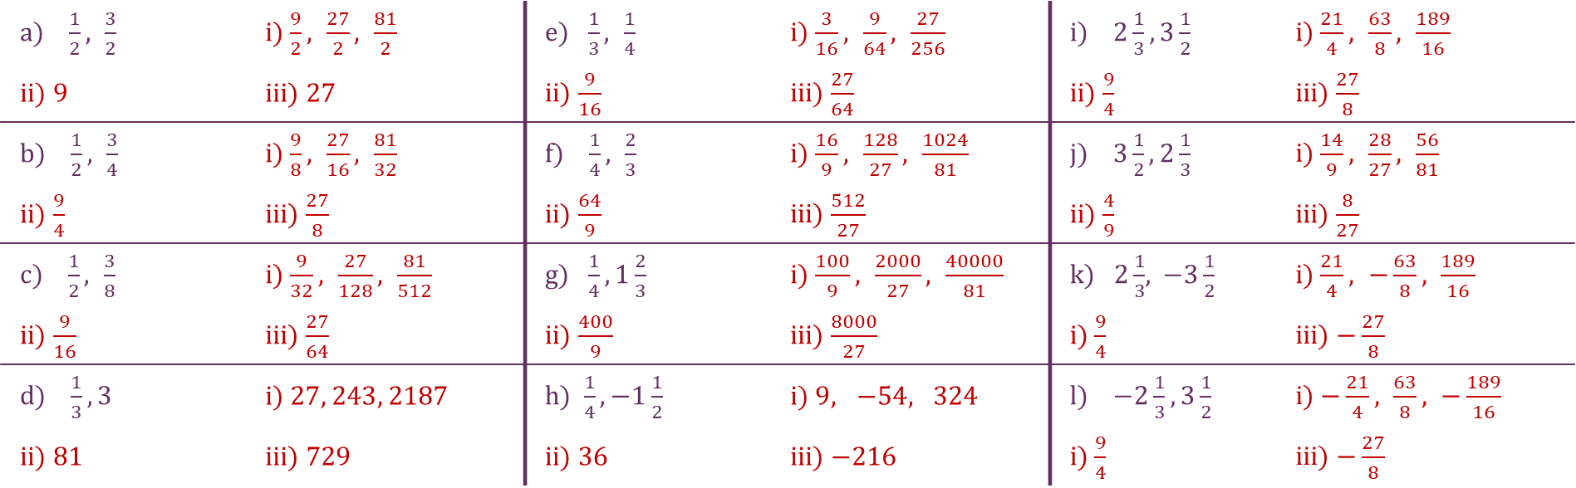
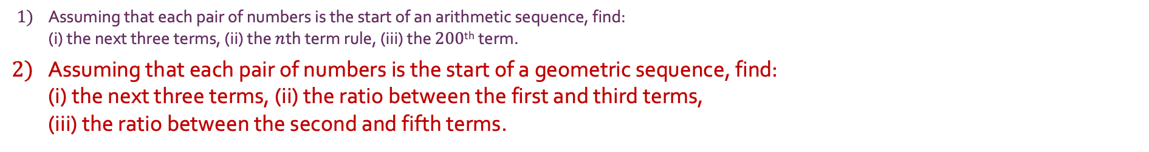
Fractions
1) | Assuming that each pair of numbers is the start of an arithmetic sequence, find: (i) the next three terms, (ii) the $n$th term rule, (iii) the $200$^{th} term.
2) | Assuming that each pair of numbers is the start of a geometric sequence, find: (i) the next three terms, (ii) the ratio between the first and third terms, (iii) the ratio between the second and fifth terms.
a) $\frac{1}{2}, \frac{3}{2}$ | i) $\frac{9}{2}, \frac{27}{2}, \frac{81}{2}$ | e) $\frac{1}{3}, \frac{1}{4}$ | i) $\frac{3}{16}, \frac{9}{64}, \frac{27}{256}$ | i) $2\frac{1}{3}, 3\frac{1}{2}$ | i) $\frac{21}{4}, \frac{63}{8}, \frac{189}{16}$
ii) $9$ | iii) $27$ | ii) $\frac{9}{16}$ | iii) $\frac{27}{64}$ | ii) $\frac{9}{4}$ | iii) $\frac{27}{8}$
b) $\frac{1}{2}, \frac{3}{4}$ | i) $\frac{9}{8}, \frac{27}{16}, \frac{81}{32}$ | f) $\frac{1}{4}, \frac{2}{3}$ | i) $\frac{16}{9}, \frac{128}{27}, \frac{1024}{81}$ | j) $3\frac{1}{2},2\frac{1}{3}$ | i) $\frac{14}{9}, \frac{28}{27}, \frac{56}{81}$
ii) $\frac{9}{4}$ | iii) $\frac{27}{8}$ | ii) $\frac{64}{9}$ | iii) $\frac{512}{27}$ | ii) $\frac{4}{9}$ | iii) $\frac{8}{27}$
c) $\frac{1}{2}, \frac{3}{8}$ | i) $\frac{9}{32}, \frac{27}{128}, \frac{81}{512}$ | g) $\frac{1}{4}, 1\frac{2}{3}$ | i) $\frac{100}{9}, \frac{2000}{27}, \frac{40000}{81}$ | k) $2\frac{1}{3}$, $−3\frac{1}{2}$ | i) $\frac{21}{4}, −\frac{63}{8}, \frac{189}{16}$
ii) $\frac{9}{16}$ | iii) $\frac{27}{64}$ | ii) $\frac{400}{9}$ | iii) $\frac{8000}{27}$ | i) $\frac{9}{4}$ | iii) $−\frac{27}{8}$
d) $\frac{1}{3}, 3$ | i) $27, 243, 2187$ | h) $\frac{1}{4}, −1\frac{1}{2}$ | i) $9, −54, 324$ | l) $−2\frac{1}{3}, 3\frac{1}{2}$ | i) $−\frac{21}{4}, \frac{63}{8}, −\frac{189}{16}$
ii) $81$ | iii) $729$ | ii) $36$ | iii) $−216$ | i) $\frac{9}{4}$ | iii) $−\frac{27}{8}$

