Slide 1
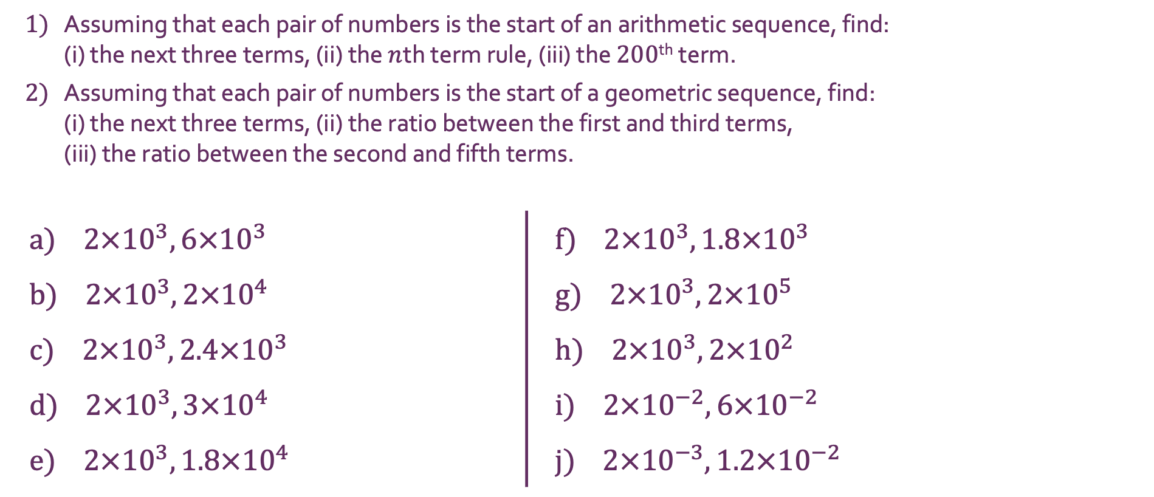
Standard Form
1) | Assuming that each pair of numbers is the start of an arithmetic sequence, find: (i) the next three terms, (ii) the $n$th term rule, (iii) the $200$^{th} term.
2) | Assuming that each pair of numbers is the start of a geometric sequence, find: (i) the next three terms, (ii) the ratio between the first and third terms, (iii) the ratio between the second and fifth terms.
a) $2×{10}^{3},6×{10}^{3}$ |  | f) $2×{10}^{3},1.8×{10}^{3}$
b) $2×{10}^{3},2×{10}^{4}$ |  | g) $2×{10}^{3},2×{10}^{5}$
c) $2×{10}^{3},2.4×{10}^{3}$ |  | h) $2×{10}^{3},2×{10}^{2}$
d) $2×{10}^{3},3×{10}^{4}$ |  | i) $2×{10}^{−2},6×{10}^{−2}$
e) $2×{10}^{3},1.8×{10}^{4}$ |  | j) $2×{10}^{−3},1.2×{10}^{−2}$

Slide 2
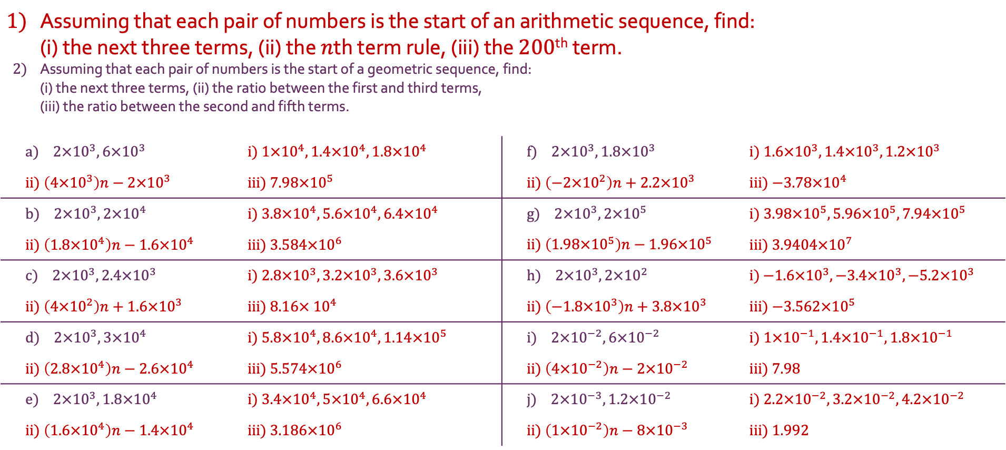
Standard Form
1) | Assuming that each pair of numbers is the start of an arithmetic sequence, find: (i) the next three terms, (ii) the $n$th term rule, (iii) the $200$^{th} term.
2) | Assuming that each pair of numbers is the start of a geometric sequence, find: (i) the next three terms, (ii) the ratio between the first and third terms, (iii) the ratio between the second and fifth terms.
a) $2×{10}^{3},6×{10}^{3}$ |  | i) $1×{10}^{4}, 1.4×{10}^{4}, 1.8×{10}^{4}$ | f) $2×{10}^{3},1.8×{10}^{3}$ | i) $1.6×{10}^{3}, 1.4×{10}^{3}, 1.2×{10}^{3}$
ii) $\left(4×{10}^{3}\right)n−2×{10}^{3}$ |  | iii) $7.98×{10}^{5}$ | ii) $\left(−2×{10}^{2}\right)n+2.2×{10}^{3}$ | iii) $−3.78×{10}^{4}$
b) $2×{10}^{3},2×{10}^{4}$ |  | i) $3.8×{10}^{4}, 5.6×{10}^{4}, 6.4×{10}^{4}$ | g) $2×{10}^{3},2×{10}^{5}$ | i) $3.98×{10}^{5}, 5.96×{10}^{5},7.94×{10}^{5}$
ii) $\left(1.8×{10}^{4}\right)n−1.6×{10}^{4}$ |  | iii) $3.584×{10}^{6}$ | ii) $\left(1.98×{10}^{5}\right)n−1.96×{10}^{5}$ | iii) $3.9404×{10}^{7}$
c) $2×{10}^{3},2.4×{10}^{3}$ |  | i) $2.8×{10}^{3}, 3.2×{10}^{3}, 3.6×{10}^{3}$ | h) $2×{10}^{3},2×{10}^{2}$ | i) $−1.6×{10}^{3}, −3.4×{10}^{3},−5.2×{10}^{3}$
ii) $\left(4×{10}^{2}\right)n+1.6×{10}^{3}$ |  | iii) $8.16× {10}^{4}$ | ii) $\left(−1.8×{10}^{3}\right)n+3.8×{10}^{3}$ | iii) $−3.562×{10}^{5}$
d) $2×{10}^{3},3×{10}^{4}$ |  | i) $5.8×{10}^{4}, 8.6×{10}^{4},1.14×{10}^{5}$ | i) $2×{10}^{−2},6×{10}^{−2}$ | i) $1×{10}^{−1}, 1.4×{10}^{−1}, 1.8×{10}^{−1}$
ii) $\left(2.8×{10}^{4}\right)n−2.6×{10}^{4}$ |  | iii) $5.574×{10}^{6}$ | ii) $\left(4×{10}^{−2}\right)n−2×{10}^{−2}$ | iii) $7.98$
e) $2×{10}^{3},1.8×{10}^{4}$ |  | i) $3.4×{10}^{4}, 5×{10}^{4},6.6×{10}^{4}$ | j) $2×{10}^{−3},1.2×{10}^{−2}$ | i) $2.2×{10}^{−2}, 3.2×{10}^{−2}, 4.2×{10}^{−2}$
ii) $\left(1.6×{10}^{4}\right)n−1.4×{10}^{4}$ |  | iii) $3.186×{10}^{6}$ | ii) $\left(1×{10}^{−2}\right)n−8×{10}^{−3}$ | iii) $1.992$

Slide 3
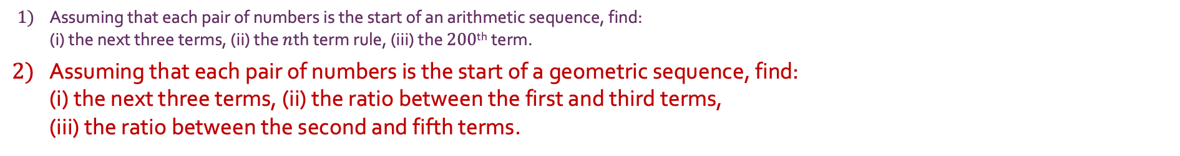
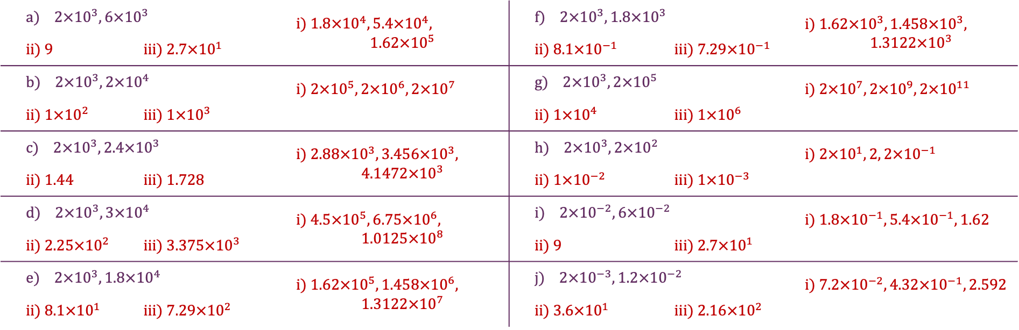
Standard Form
1) | Assuming that each pair of numbers is the start of an arithmetic sequence, find: (i) the next three terms, (ii) the $n$th term rule, (iii) the $200$^{th} term.
2) | Assuming that each pair of numbers is the start of a geometric sequence, find: (i) the next three terms, (ii) the ratio between the first and third terms, (iii) the ratio between the second and fifth terms.
a) $2×{10}^{3},6×{10}^{3}$ |  | i) $1.8×{10}^{4}, 5.4×{10}^{4},$ $$1.62×{10}^{5}$$ | f) $2×{10}^{3},1.8×{10}^{3}$ |  | i) $1.62×{10}^{3}, 1.458×{10}^{3},$ $$1.3122×{10}^{3}$$
ii) $9$ | iii) $2.7×{10}^{1}$ | iii) $27$ | ii) $8.1×{10}^{−1}$ | iii) $7.29×{10}^{−1}$ | iii) $27$
b) $2×{10}^{3},2×{10}^{4}$ |  | i) $2×{10}^{5},2×{10}^{6}, 2×{10}^{7}$ | g) $2×{10}^{3},2×{10}^{5}$ |  | i) $2×{10}^{7},2×{10}^{9}, 2×{10}^{11}$
ii) $1×{10}^{2}$ | iii) $1×{10}^{3}$ |  | ii) $1×{10}^{4}$ | iii) $1×{10}^{6}$
c) $2×{10}^{3},2.4×{10}^{3}$ |  | i) $2.88×{10}^{3}, 3.456×{10}^{3},$ $$4.1472×{10}^{3}$$ | h) $2×{10}^{3},2×{10}^{2}$ |  | i) $2×{10}^{1},2, 2×{10}^{−1}$
ii) 1.44 | iii) 1.728 |  | ii) $1×{10}^{−2}$ | iii) $1×{10}^{−3}$
d) $2×{10}^{3},3×{10}^{4}$ |  | i) $4.5×{10}^{5}, 6.75×{10}^{6},$ $$1.0125×{10}^{8}$$ | i) $2×{10}^{−2},6×{10}^{−2}$ |  | i) $1.8×{10}^{−1}, 5.4×{10}^{−1}, 1.62$
ii) $2.25×{10}^{2}$ | iii) $3.375×{10}^{3}$ |  | ii) 9 | iii) $2.7×{10}^{1}$
e) $2×{10}^{3},1.8×{10}^{4}$ |  | i) $1.62×{10}^{5}, 1.458×{10}^{6},$ $$1.3122×{10}^{7}$$ | j) $2×{10}^{−3},1.2×{10}^{−2}$ |  | i) $7.2×{10}^{−2}, 4.32×{10}^{−1},2.592$
ii) $8.1×{10}^{1}$ | iii) $7.29×{10}^{2}$ |  | ii) $3.6×{10}^{1}$ | iii) $2.16×{10}^{2}$

