Slide 1
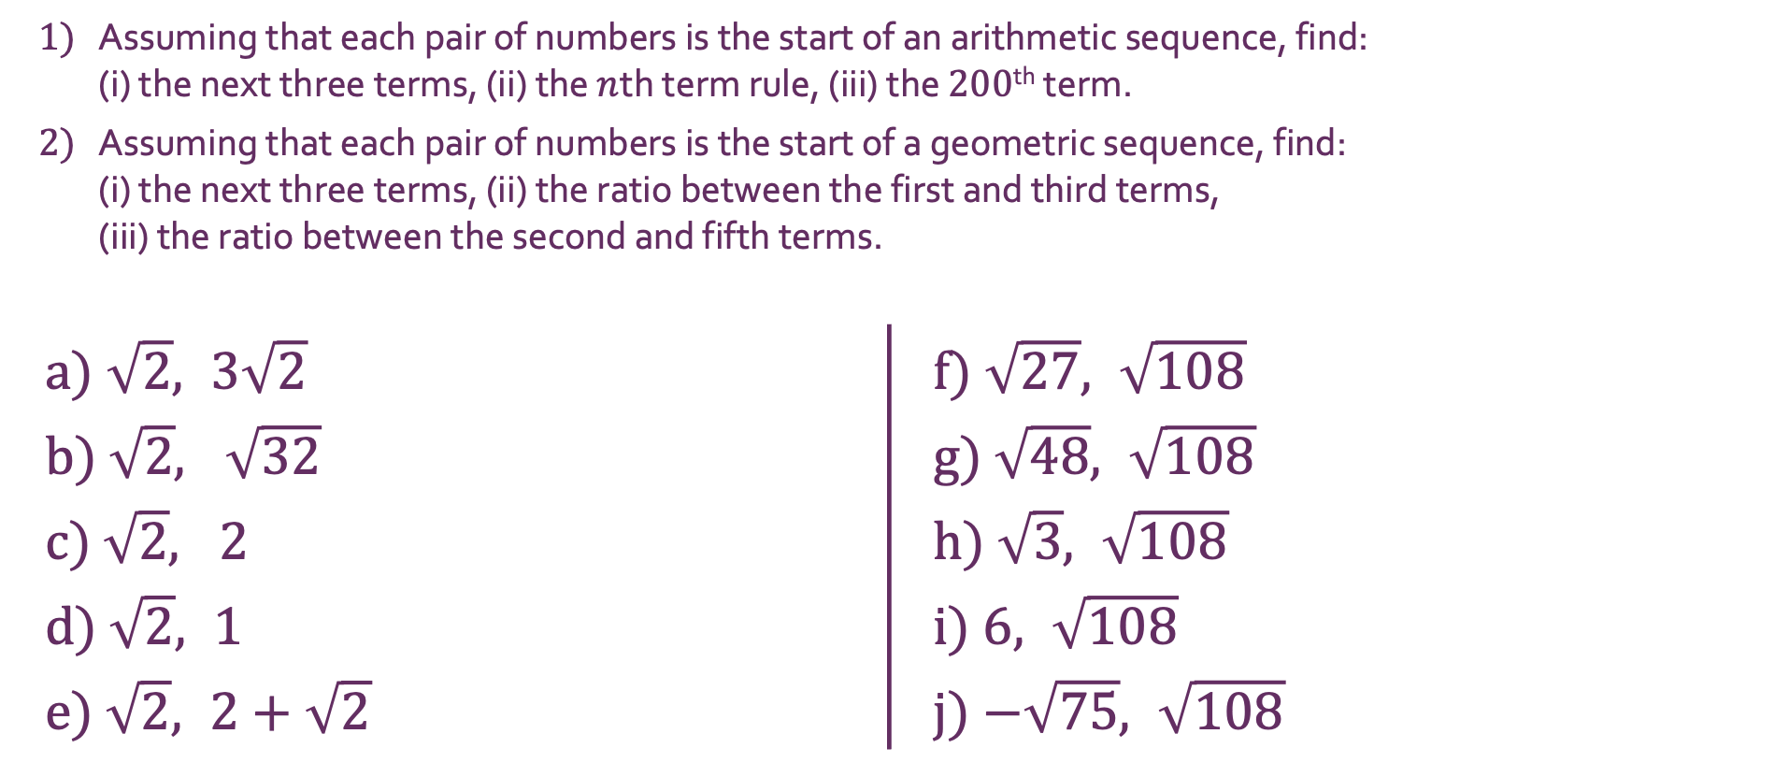
Surds
1) | Assuming that each pair of numbers is the start of an arithmetic sequence, find: (i) the next three terms, (ii) the $n$th term rule, (iii) the $200$^{th} term.
2) | Assuming that each pair of numbers is the start of a geometric sequence, find: (i) the next three terms, (ii) the ratio between the first and third terms, (iii) the ratio between the second and fifth terms.
a) $\sqrt{2}, 3\sqrt{2}$ |  | f) $\sqrt{27}, \sqrt{108}$
b) $\sqrt{2}, \sqrt{32}$ |  | g) $\sqrt{48}, \sqrt{108}$
c) $\sqrt{2}, 2$ |  | h) $\sqrt{3}, \sqrt{108}$
d) $\sqrt{2}, 1$ |  | i) $6, \sqrt{108}$
e) $\sqrt{2}, 2+\sqrt{2}$ |  | j) $−\sqrt{75}, \sqrt{108}$

Slide 2
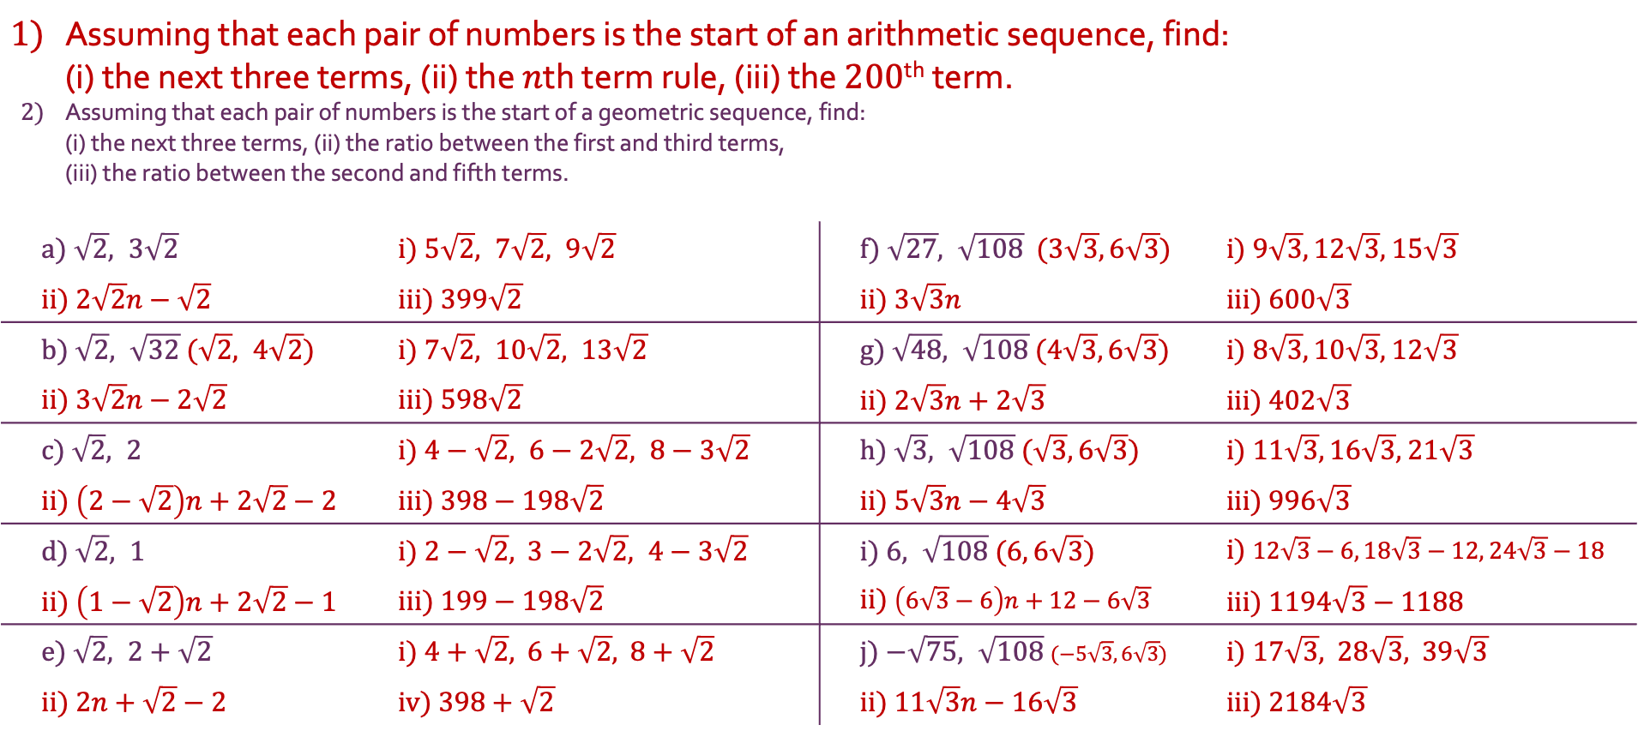
Surds
1) | Assuming that each pair of numbers is the start of an arithmetic sequence, find: (i) the next three terms, (ii) the $n$th term rule, (iii) the $200$^{th} term.
2) | Assuming that each pair of numbers is the start of a geometric sequence, find: (i) the next three terms, (ii) the ratio between the first and third terms, (iii) the ratio between the second and fifth terms.
a) $\sqrt{2}, 3\sqrt{2}$ |  | i) $5\sqrt{2}, 7\sqrt{2}, 9\sqrt{2}$ | f) $\sqrt{27}, \sqrt{108}$ ($3\sqrt{3}, 6\sqrt{3}$) | i) $9\sqrt{3}, 12\sqrt{3}$, $15\sqrt{3}$
ii) $2\sqrt{2}n−\sqrt{2}$ |  | iii) $399\sqrt{2}$ | ii) $3\sqrt{3}n$ | iii) $600\sqrt{3}$
b) $\sqrt{2}, \sqrt{32}$ ($\sqrt{2}, 4\sqrt{2}$) |  | i) $7\sqrt{2}, 10\sqrt{2}, 13\sqrt{2}$ | g) $\sqrt{48}, \sqrt{108}$ ($4\sqrt{3}, 6\sqrt{3}$) | i) $8\sqrt{3}, 10\sqrt{3}$, $12\sqrt{3}$
ii) $3\sqrt{2}n−2\sqrt{2}$ |  | iii) $598\sqrt{2}$ | ii) $2\sqrt{3}n+2\sqrt{3}$ | iii) $402\sqrt{3}$
c) $\sqrt{2}, 2$ |  | i) $4−\sqrt{2}, 6−2\sqrt{2}, 8−3\sqrt{2}$ | h) $\sqrt{3}, \sqrt{108}$ ($\sqrt{3}, 6\sqrt{3}$) | i) $11\sqrt{3}, 16\sqrt{3}$, $21\sqrt{3}$
ii) $\left(2−\sqrt{2}\right)n+2\sqrt{2}−2$ |  | iii) $398−198\sqrt{2}$ | ii) $5\sqrt{3}n−4\sqrt{3}$ | iii) $996\sqrt{3}$
d) $\sqrt{2}, 1$ |  | i) $2−\sqrt{2}$, $3−2\sqrt{2}, 4−3\sqrt{2}$ | i) $6, \sqrt{108}$ (6$, 6\sqrt{3}$) | i) $12\sqrt{3}−6, 18\sqrt{3}−12$, $24\sqrt{3}−18$
ii) $\left(1−\sqrt{2}\right)n+2\sqrt{2}−1$ |  | iii) $199−198\sqrt{2}$ | ii) $\left(6\sqrt{3}−6\right)n+12−6\sqrt{3}$ | iii) $1194\sqrt{3}−1188$
e) $\sqrt{2}, 2+\sqrt{2}$ |  | i) $4+\sqrt{2}$, $6+\sqrt{2}$, $8+\sqrt{2}$ | j) $−\sqrt{75}, \sqrt{108}$ ($−5\sqrt{3}, 6\sqrt{3}$) | i) $17\sqrt{3}$, $28\sqrt{3}$, $39\sqrt{3}$
ii) $2n+\sqrt{2}−2$ |  | iv) $398+\sqrt{2}$ | ii) $11\sqrt{3}n−16\sqrt{3}$ | iii) $2184\sqrt{3}$

Slide 3
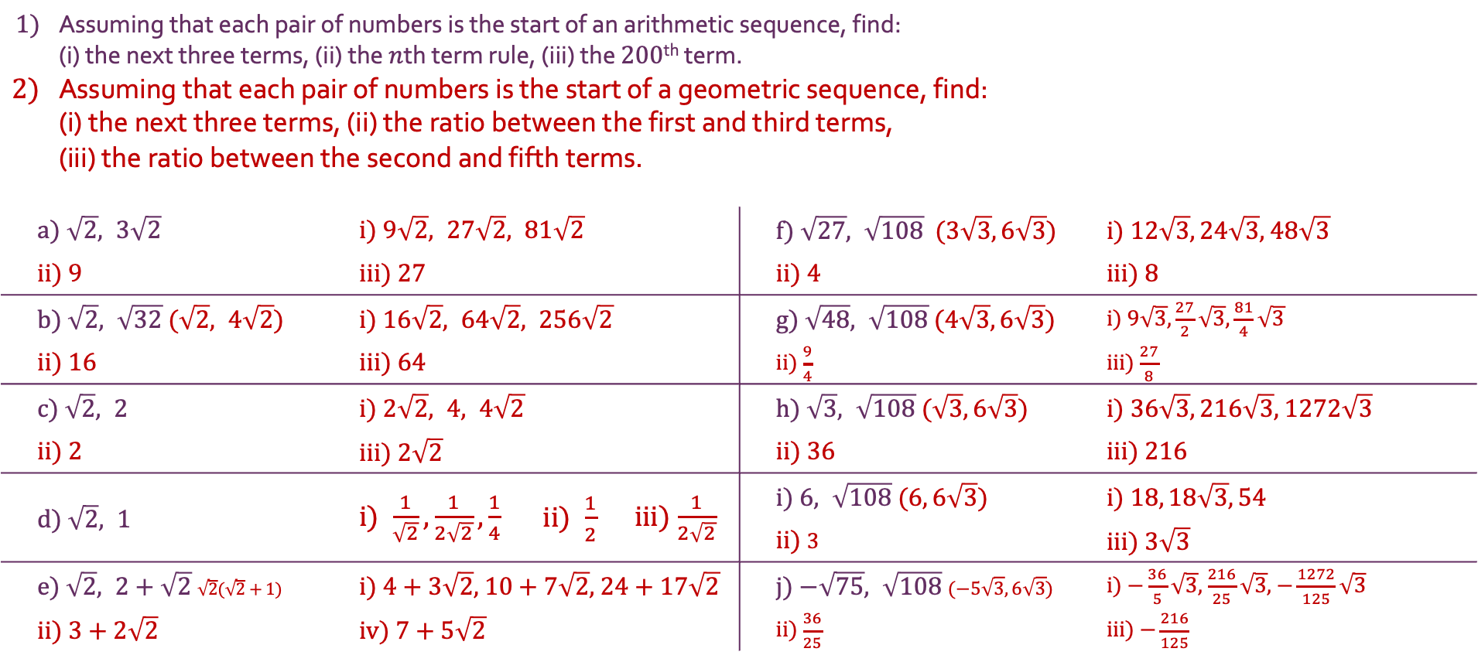
Surds
1) | Assuming that each pair of numbers is the start of an arithmetic sequence, find: (i) the next three terms, (ii) the $n$th term rule, (iii) the $200$^{th} term.
2) | Assuming that each pair of numbers is the start of a geometric sequence, find: (i) the next three terms, (ii) the ratio between the first and third terms, (iii) the ratio between the second and fifth terms.
a) $\sqrt{2}, 3\sqrt{2}$ |  | i) $9\sqrt{2}, 27\sqrt{2}, 81\sqrt{2}$ |  |  | f) $\sqrt{27}, \sqrt{108}$ ($3\sqrt{3}, 6\sqrt{3}$) | i) $12\sqrt{3}, 24\sqrt{3}$, $48\sqrt{3}$
ii) $9$ |  | iii) $27$ |  |  | ii) $4$ | iii) $8$
b) $\sqrt{2}, \sqrt{32}$ ($\sqrt{2}, 4\sqrt{2}$) |  | i) $16\sqrt{2}, 64\sqrt{2}, 256\sqrt{2}$ |  |  | g) $\sqrt{48}, \sqrt{108}$ ($4\sqrt{3}, 6\sqrt{3}$) | i) $9\sqrt{3},\frac{27}{2}\sqrt{3}$, $\frac{81}{4}\sqrt{3}$
ii) $16$ |  | iii) $64$ |  |  | ii) $\frac{9}{4}$ | iii) $\frac{27}{8}$
c) $\sqrt{2}, 2$ |  | i) $2\sqrt{2}, 4, 4\sqrt{2}$ |  |  | h) $\sqrt{3}, \sqrt{108}$ ($\sqrt{3}, 6\sqrt{3}$) | i) $36\sqrt{3}, 216\sqrt{3}$, $1272\sqrt{3}$
ii) $2$ |  | iii) $2\sqrt{2}$ |  |  | ii) $36$ | iii) $216$
d) $\sqrt{2}, 1$ |  | i) $\frac{1}{\sqrt{2}},\frac{1}{2\sqrt{2}},\frac{1}{4}$ | ii) $\frac{1}{2}$ | iii) $\frac{1}{2\sqrt{2}}$ | i) $6, \sqrt{108}$ (6$, 6\sqrt{3}$) | i) $18, 18\sqrt{3}, 54$
 |  |  |  |  | ii) $3$ | iii) $3\sqrt{3}$
e) $\sqrt{2}, 2+\sqrt{2}$ $\sqrt{2}(\sqrt{2}+1$) |  | i) $4+3\sqrt{2}$, $10+7\sqrt{2}$, $24+17\sqrt{2}$ |  |  | j) $−\sqrt{75}, \sqrt{108}$ ($−5\sqrt{3}, 6\sqrt{3}$) | i) $−\frac{36}{5}\sqrt{3}$, $\frac{216}{25}\sqrt{3}$, $−\frac{1272}{125}\sqrt{3}$
ii) $3+2\sqrt{2}$ |  | iv) $7+5\sqrt{2}$ |  |  | ii) $\frac{36}{25}$ | iii) $−\frac{216}{125}$

