Slide 1
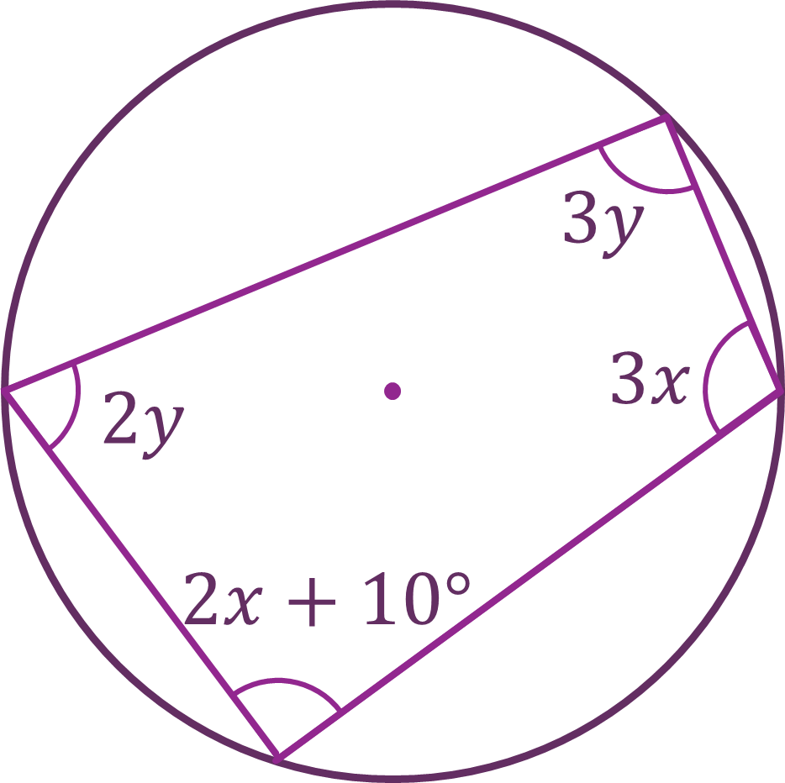
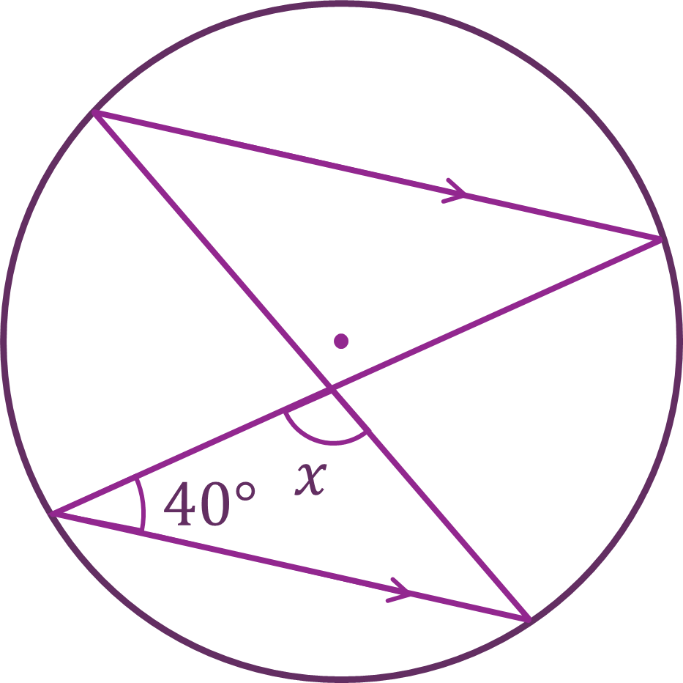
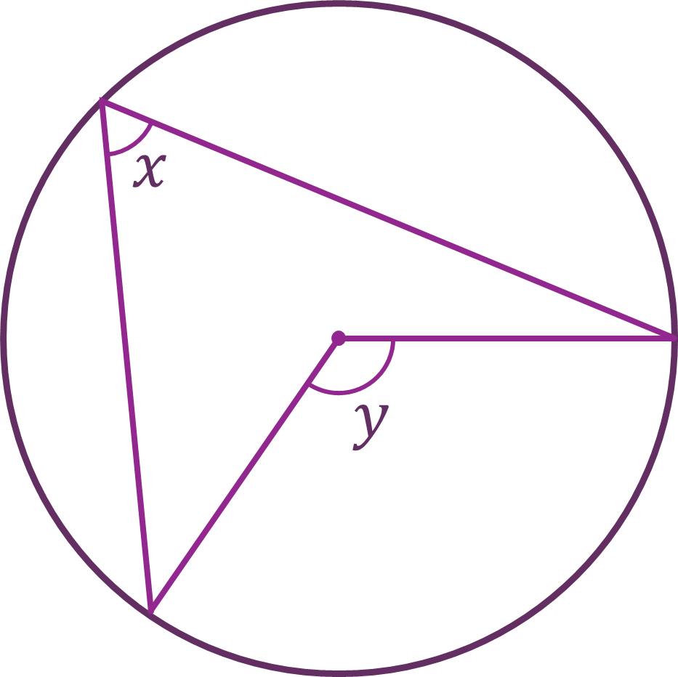
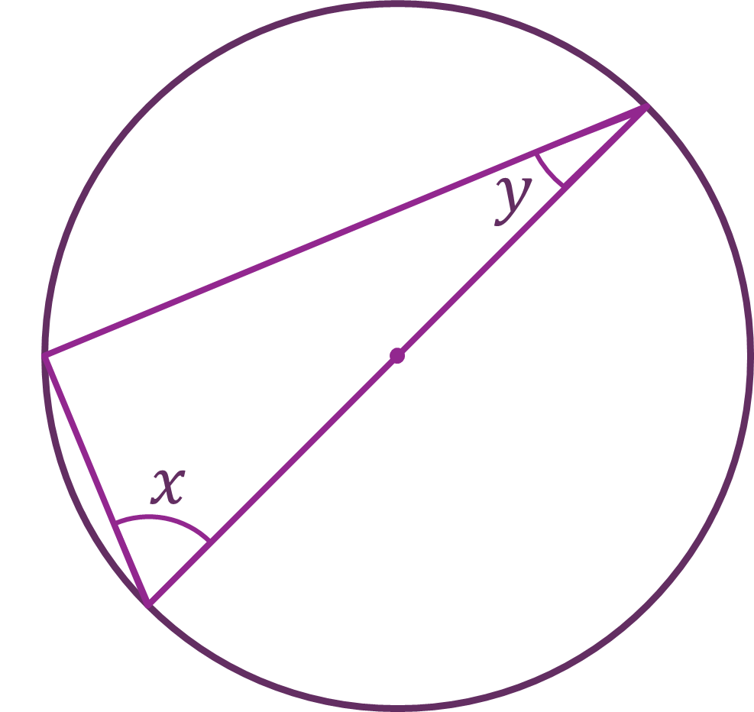
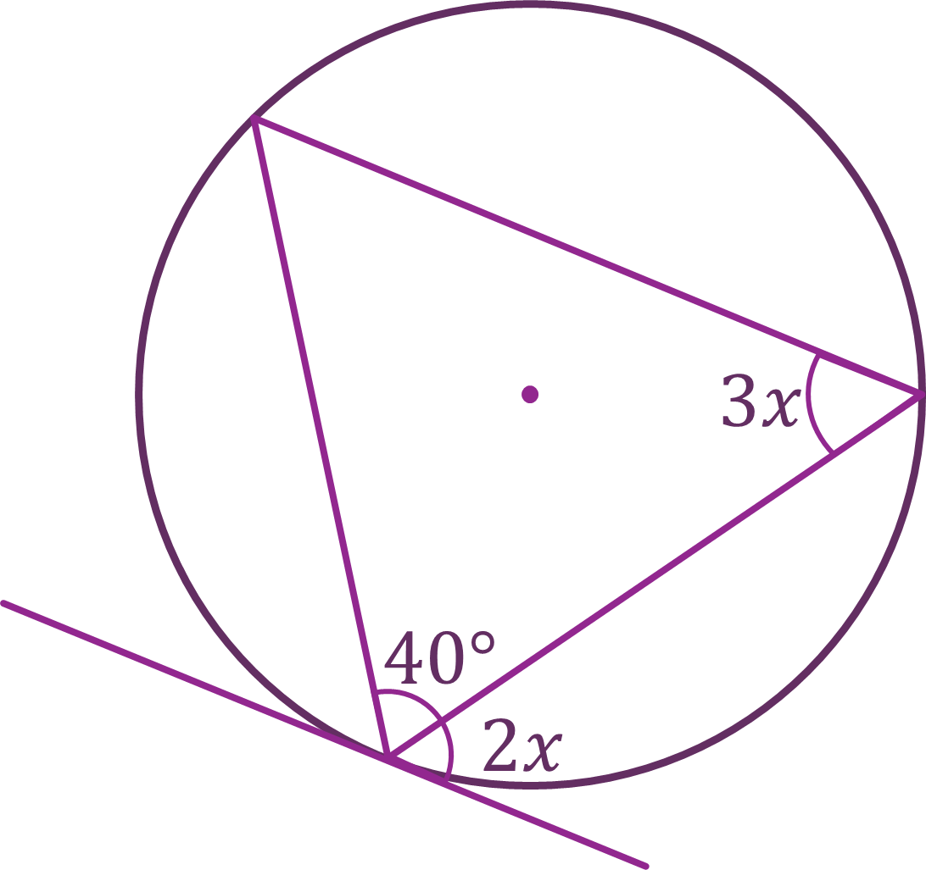
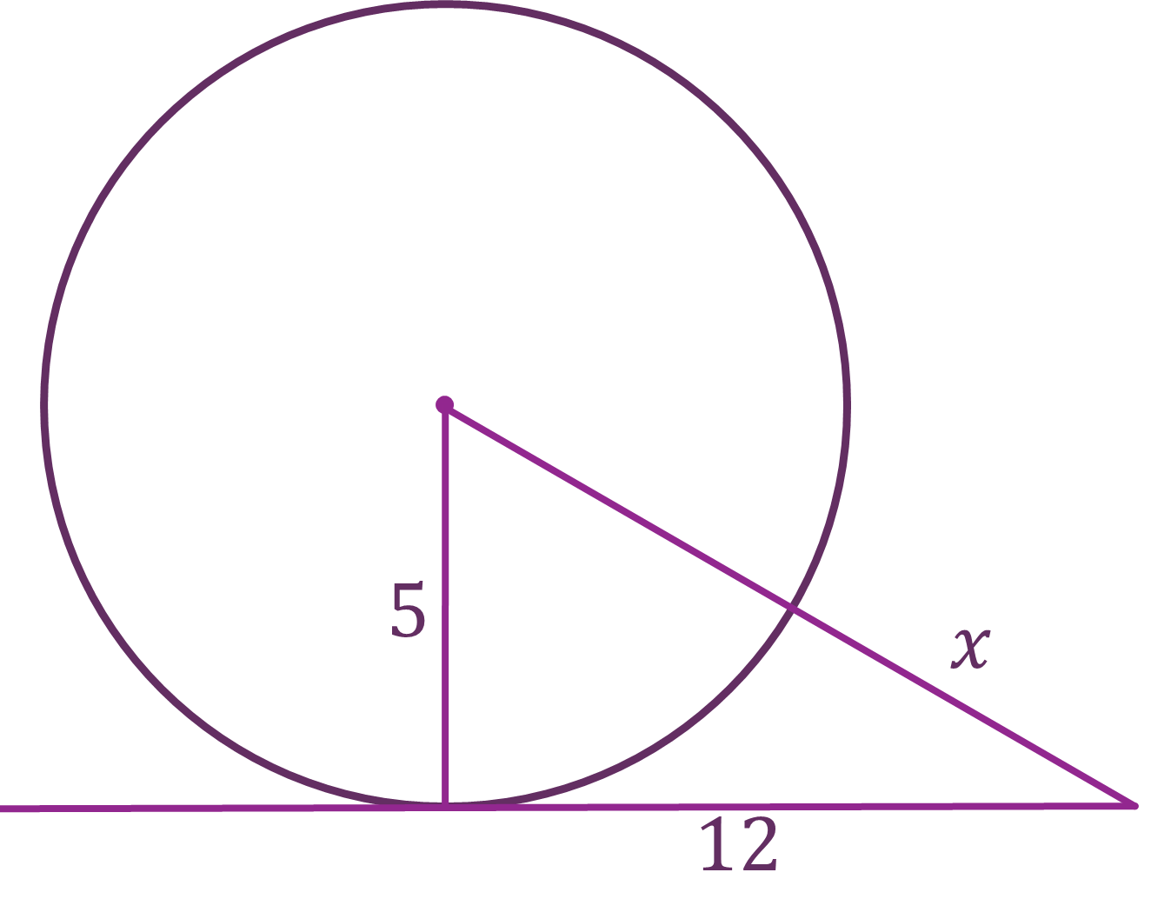
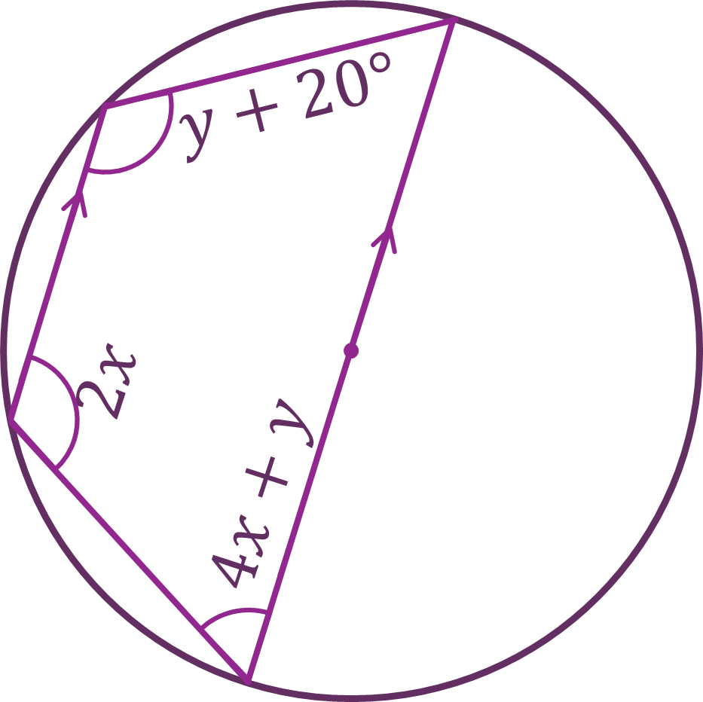
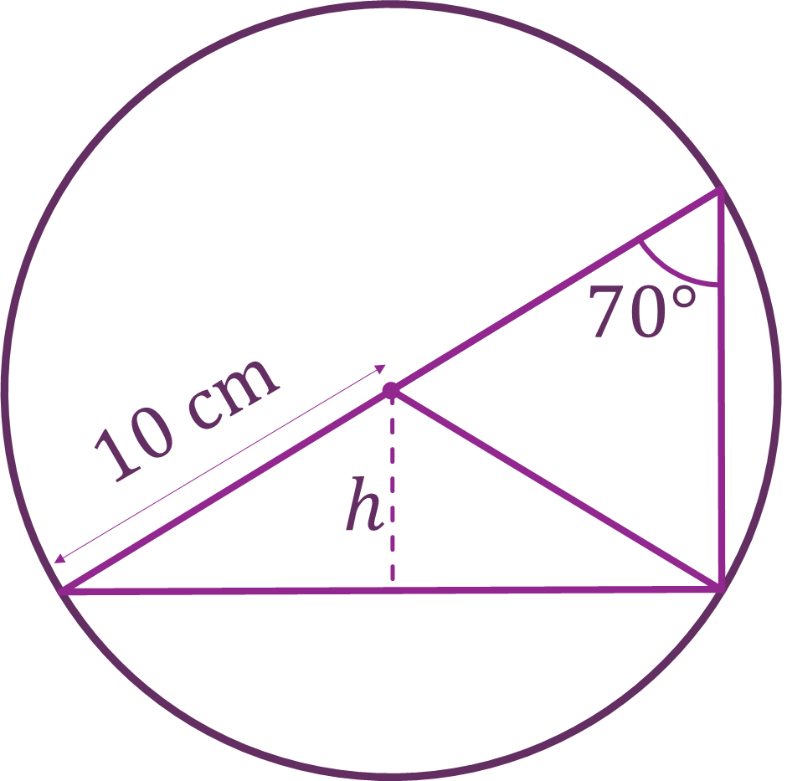
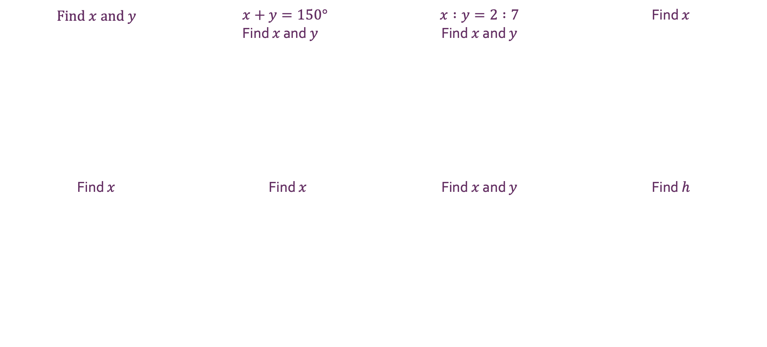
Circle Theorems
Solving further equations with…
a) | b) | c) | d)
e) | f) | g) | h)
Find $x$ and $y$ | $$x+y=150° \\ \text{Find} x \text{and} y$$ | $x :y=2 :7$ Find $x$ and $y$ | Find $x$
Find $x$ | Find $x$ | Find $x$ and $y$ | Find $h$
@karenshancock

Slide 2








Solving further equations with…
Circle Theorems
a) | b) | c) | d)
e) | f) | g) | h)
Find $x$ and $y$ | $$x+y=150° \\ \text{Find} x \text{and} y$$ | $x :y=2 :7$ Find $x$ and $y$ | Find $x$
Find $x$ | Find $x$ | Find $x$ and $y$ | Find $h$
$$x=40°, y=30°$$
$$x=50°, y=100°$$
$$x=70°, y=20°$$
$$x=100°$$
$$x=28°$$
$$x=8$$
$$x=25°, y=30°$$
$$h=3.42 \text{cm}$$
@karenshancock

