Slide 1
Circle Theorems
Find the value of each letter. All angles are given in degrees.

Slide 2
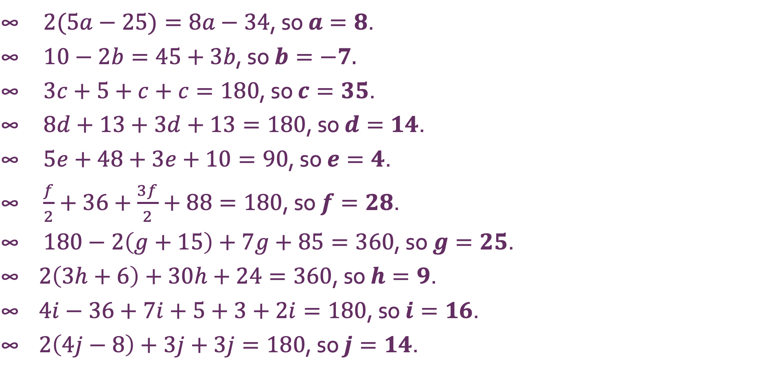
Circle Theorems
$2(5a−25)=8a−34$, so $a=8$. $10−2b=45+3b$, so $b=−7$. $3c+5+c+c=180$, so $c=35$. $8d+13+3d+13=180$, so $d=14$. $5e+48+3e+10=90$, so $e=4$. $\frac{f}{2}+36+\frac{3f}{2}+88=180$, so $f=28$. $180−2\left(g+15\right)+7g+85=360$, so $g=25$. $2\left(3h+6\right)+30h+24=360$, so $h=9$. $4i−36+7i+5+3+2i=180$, so $i=16$. $2\left(4j−8\right)+3j+3j=180$, so $j=14$.

