Slide 1










Parallel Lines
Find the value of each letter. All angles are given in degrees.
$$207−17z$$
$$207−14y$$
$$120−9c$$
$$4b−15$$
$$5a−5$$
$$20x+25$$
$$35$$
$$8x−5$$
$$3a+25$$
$$\frac{3}{4}d$$

Slide 2
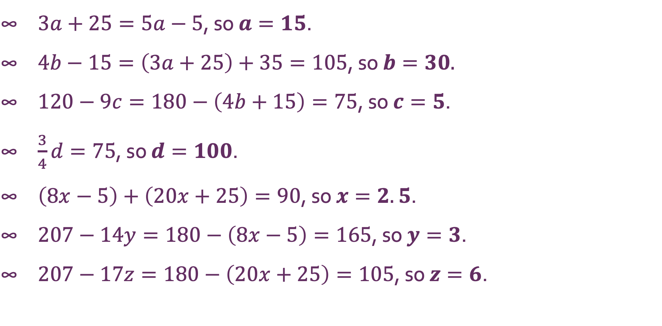
Parallel Lines
$3a+25=5a−5$, so $a=15$. $4b−15=\left(3a+25\right)+35=105$, so $b=30$. $120−9c=180−\left(4b+15\right)=75$, so $c=5$. $\frac{3}{4}d=75$, so $d=100$. $\left(8x−5\right)+\left(20x+25\right)=90$, so $x=2.5$. $207−14y=180−\left(8x−5\right)=165$, so $y=3$. $207−17z=180−\left(20x+25\right)=105$, so $z=6$.

