Slide 1
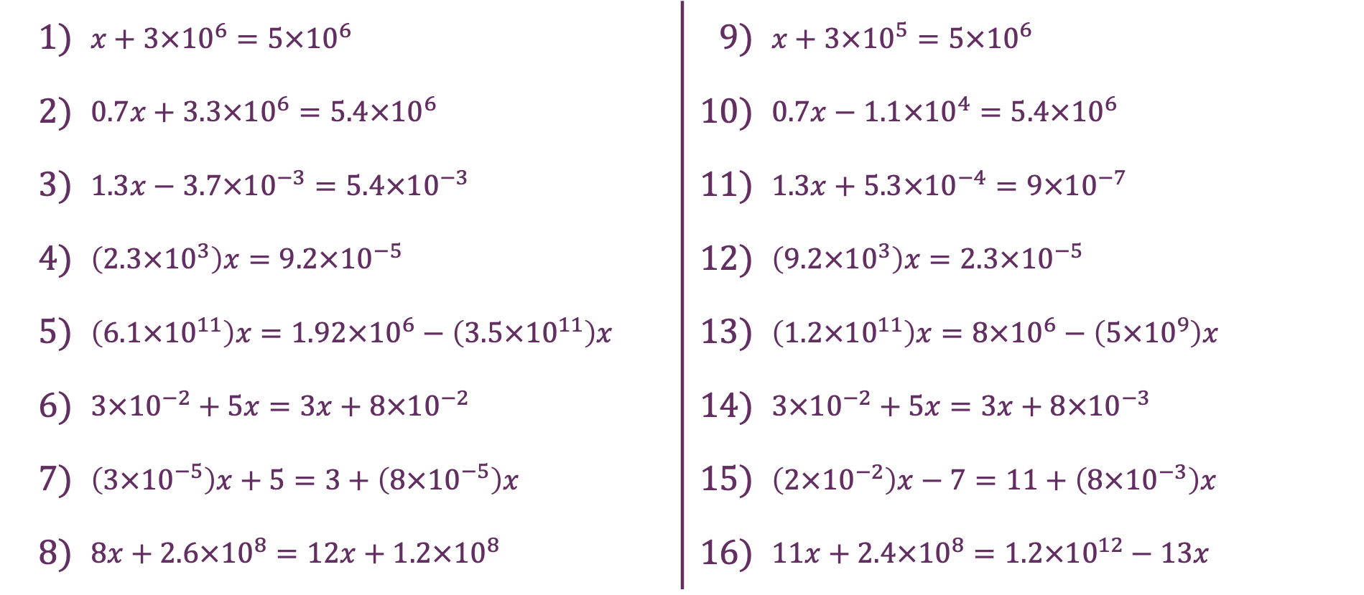
Standard Form
1) | $x+3×{10}^{6}=5×{10}^{6}$ | 9) | $x+3×{10}^{5}=5×{10}^{6}$
2) | $0.7x+3.3×{10}^{6}=5.4×{10}^{6}$ | 10) | $0.7x−1.1×{10}^{4}=5.4×{10}^{6}$
3) | $1.3x−3.7×{10}^{−3}=5.4×{10}^{−3}$ | 11) | $1.3x+5.3×{10}^{−4}=9×{10}^{−7}$
4) | $\left(2.3×{10}^{3}\right)x=9.2×{10}^{−5}$ | 12) | $\left(9.2×{10}^{3}\right)x=2.3×{10}^{−5}$
5) | $\left(6.1×{10}^{11}\right)x=1.92×{10}^{6}−\left(3.5×{10}^{11}\right)x$ | 13) | $\left(1.2×{10}^{11}\right)x=8×{10}^{6}−\left(5×{10}^{9}\right)x$
6) | $3×{10}^{−2}+5x=3x+8×{10}^{−2}$ | 14) | $3×{10}^{−2}+5x=3x+8×{10}^{−3}$
7) | $\left(3×{10}^{−5}\right)x+5=3+\left(8×{10}^{−5}\right)x$ | 15) | $\left(2×{10}^{−2}\right)x−7=11+\left(8×{10}^{−3}\right)x$
8) | $8x+2.6×{10}^{8}=12x+1.2×{10}^{8}$ | 16) | $11x+2.4×{10}^{8}=1.2×{10}^{12}−13x$

Slide 2
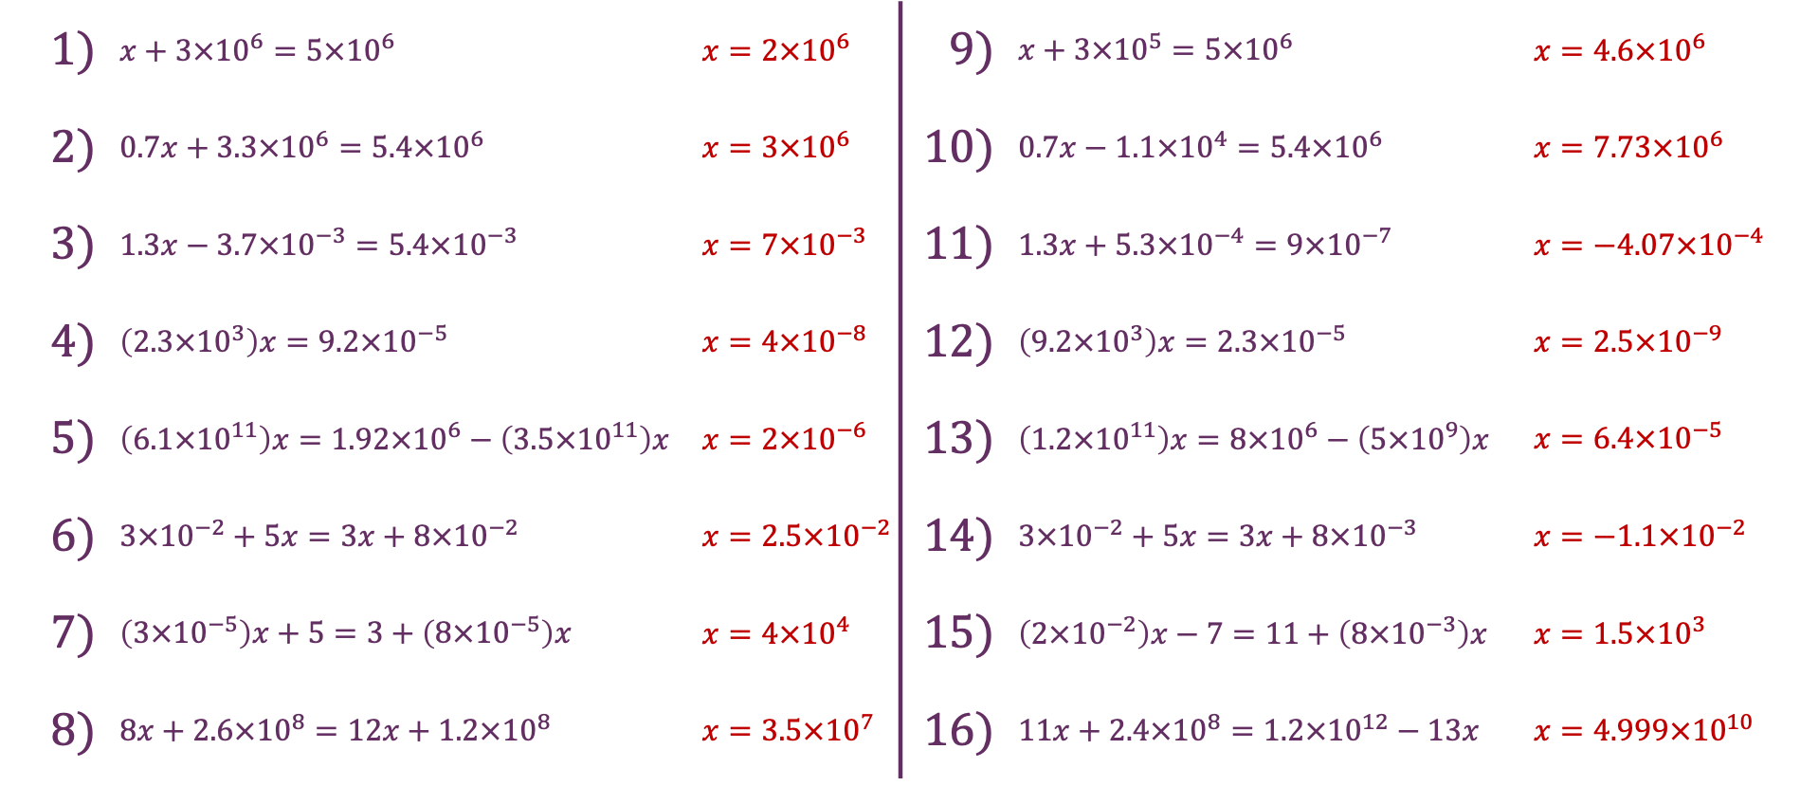
Standard Form
1) | $x+3×{10}^{6}=5×{10}^{6}$ | $x=2×{10}^{6}$ | 9) | $x+3×{10}^{5}=5×{10}^{6}$ | $x=4.6×{10}^{6}$
2) | $0.7x+3.3×{10}^{6}=5.4×{10}^{6}$ | $x=3×{10}^{6}$ | 10) | $0.7x−1.1×{10}^{4}=5.4×{10}^{6}$ | $x=7.73×{10}^{6}$
3) | $1.3x−3.7×{10}^{−3}=5.4×{10}^{−3}$ | $x=7×{10}^{−3}$ | 11) | $1.3x+5.3×{10}^{−4}=9×{10}^{−7}$ | $x=−4.07×{10}^{−4}$
4) | $\left(2.3×{10}^{3}\right)x=9.2×{10}^{−5}$ | $x=4×{10}^{−8}$ | 12) | $\left(9.2×{10}^{3}\right)x=2.3×{10}^{−5}$ | $x=2.5×{10}^{−9}$
5) | $\left(6.1×{10}^{11}\right)x=1.92×{10}^{6}−\left(3.5×{10}^{11}\right)x$ | $x=2×{10}^{−6}$ | 13) | $\left(1.2×{10}^{11}\right)x=8×{10}^{6}−\left(5×{10}^{9}\right)x$ | $x=6.4×{10}^{−5}$
6) | $3×{10}^{−2}+5x=3x+8×{10}^{−2}$ | $x=2.5×{10}^{−2}$ | 14) | $3×{10}^{−2}+5x=3x+8×{10}^{−3}$ | $x=−1.1×{10}^{−2}$
7) | $\left(3×{10}^{−5}\right)x+5=3+\left(8×{10}^{−5}\right)x$ | $x=4×{10}^{4}$ | 15) | $\left(2×{10}^{−2}\right)x−7=11+\left(8×{10}^{−3}\right)x$ | $x=1.5×{10}^{3}$
8) | $8x+2.6×{10}^{8}=12x+1.2×{10}^{8}$ | $x=3.5×{10}^{7}$ | 16) | $11x+2.4×{10}^{8}=1.2×{10}^{12}−13x$ | $x=4.999×{10}^{10}$

