Slide 1
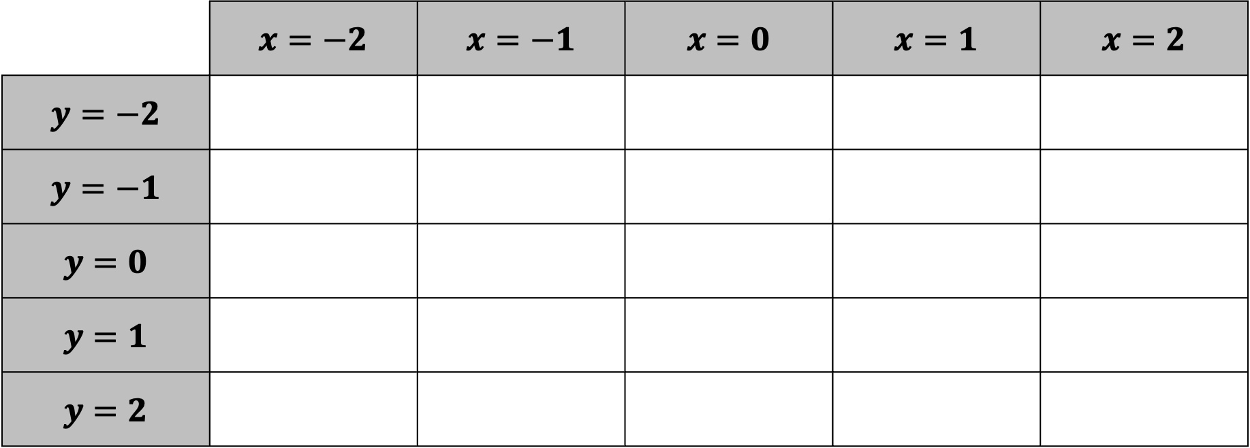
For each space in the table, write the equation of a line going through the point $(x,y)$.
You can not use the same line more than once.
 | $x=−2$ | $x=−1$ | $x=0$ | $x=1$ | $x=2$
$y=−2$
$y=−1$
$y=0$
$y=1$
$y=2$

Slide 2
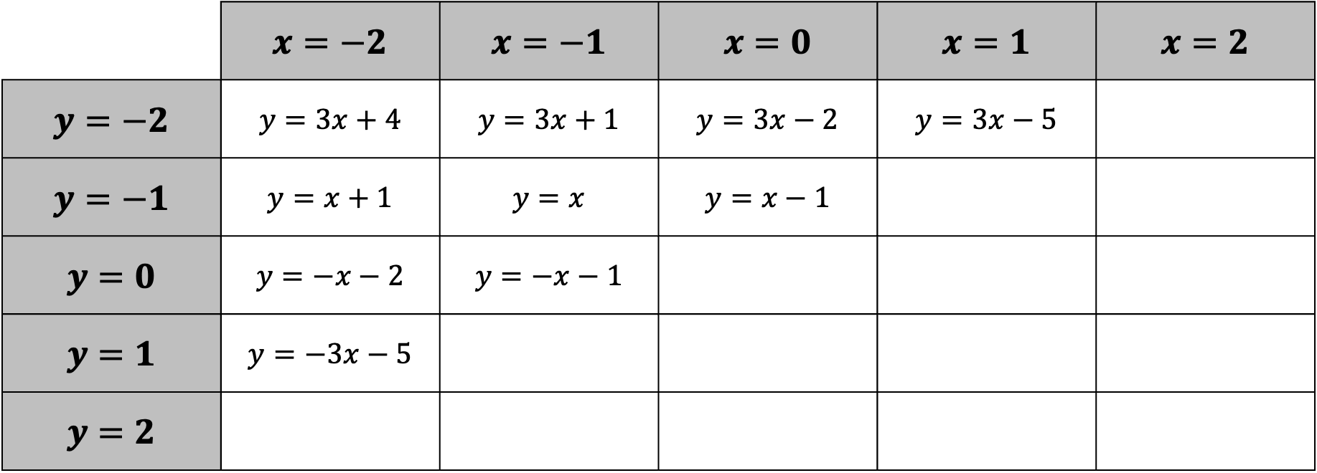
Jonny started his grid like this. Can you finish it?
 | $x=−2$ | $x=−1$ | $x=0$ | $x=1$ | $x=2$
$y=−2$ | $y=3x+4$ | $y=3x+1$ | $y=3x−2$ | $y=3x−5$
$y=−1$ | $y=x+1$ | $y=x$ | $y=x−1$
$y=0$ | $y=−x−2$ | $y=−x−1$
$y=1$ | $y=−3x−5$
$y=2$

Slide 3

Charlotte started her grid like this. Which boxes will she struggle to fill in with this pattern?
 | $x=−2$ | $x=−1$ | $x=0$ | $x=1$ | $x=2$
$y=−2$ |  |  | $y=x−2$
$y=−1$ |  |  | $y=x−1$
$y=0$ | $y=3x+6$ | $y=2x+2$ | $y=x$ | $y=2x−2$ | $y=3x−6$
$y=1$ |  |  | $y=x+1$
$y=2$ |  |  | $y=x+2$

Slide 4
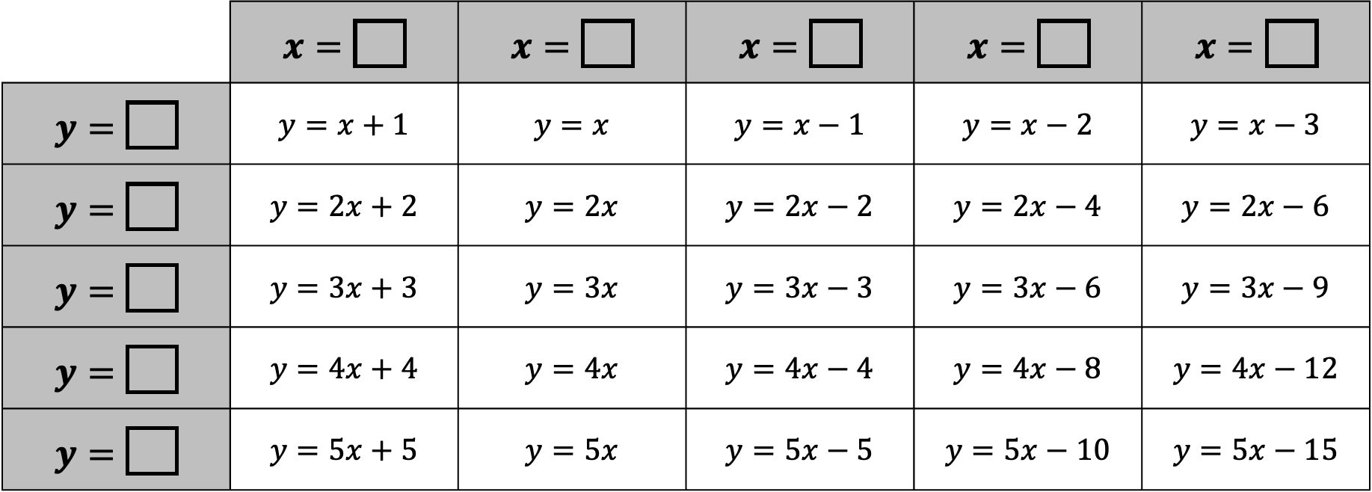
Justin completed a similar task, but with different values for $x$ and $y$.
Can you tell what values he completed it for?
 | $x=\boxed{}$ | $x=\boxed{}$ | $x=\boxed{}$ | $x=\boxed{}$ | $x=\boxed{}$
$y=\boxed{}$ | $y=x+1$ | $y=x$ | $y=x−1$ | $y=x−2$ | $y=x−3$
$y=\boxed{}$ | $y=2x+2$ | $y=2x$ | $y=2x−2$ | $y=2x−4$ | $y=2x−6$
$y=\boxed{}$ | $y=3x+3$ | $y=3x$ | $y=3x−3$ | $y=3x−6$ | $y=3x−9$
$y=\boxed{}$ | $y=4x+4$ | $y=4x$ | $y=4x−4$ | $y=4x−8$ | $y=4x−12$
$y=\boxed{}$ | $y=5x+5$ | $y=5x$ | $y=5x−5$ | $y=5x−10$ | $y=5x−15$

Slide 5
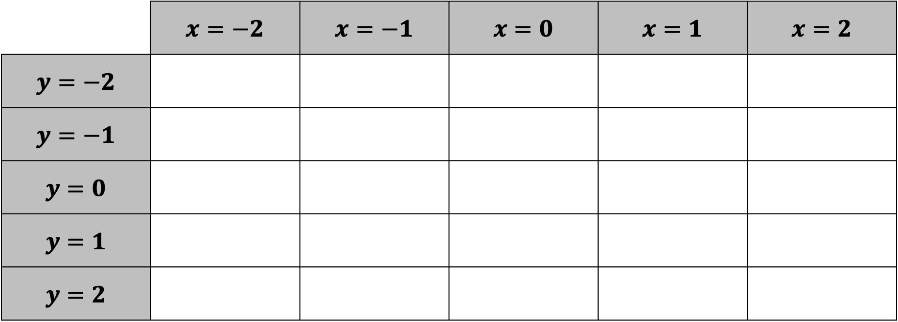

Kathryn likes lines that go through the origin.
For each space in the table, write the equation of the line going through both the point $(x,y)$ and the origin.
Which space could have multiple answers?
What patterns can you explain?
 | $x=−2$ | $x=−1$ | $x=0$ | $x=1$ | $x=2$
$y=−2$
$y=−1$
$y=0$
$y=1$
$y=2$

Slide 6
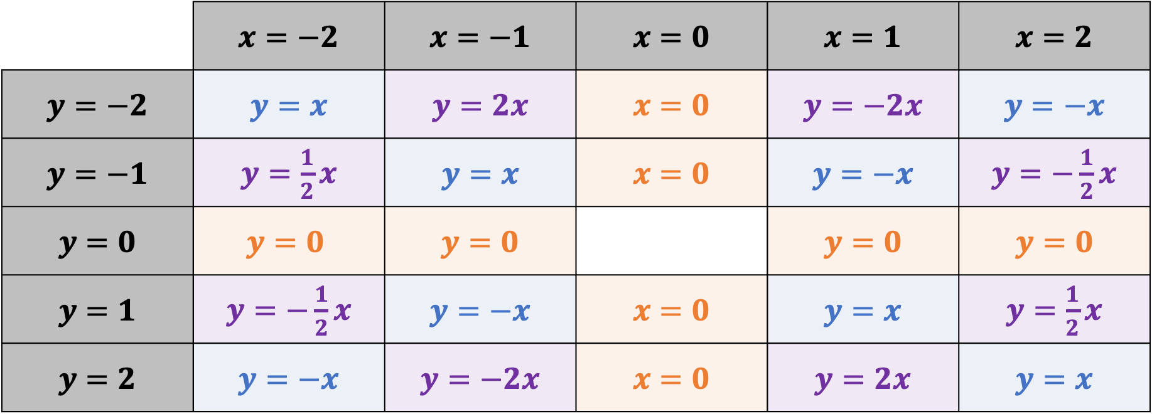
Kathryn likes lines that go through the origin.
For each space in the table, write the equation of the line going through both the point $(x,y)$ and the origin.
Which space could have multiple answers?
What patterns can you explain?
 | $x=−2$ | $x=−1$ | $x=0$ | $x=1$ | $x=2$
$y=−2$ | $y=x$ | $y=2x$ | $x=0$ | $y=−2x$ | $y=−x$
$y=−1$ | $y=\frac{1}{2}x$ | $y=x$ | $x=0$ | $y=−x$ | $y=−\frac{1}{2}x$
$y=0$ | $$y=0$$ | $y=0$ |  | $y=0$ | $y=0$
$y=1$ | $y=−\frac{1}{2}x$ | $y=−x$ | $x=0$ | $y=x$ | $y=\frac{1}{2}x$
$y=2$ | $y=−x$ | $y=−2x$ | $x=0$ | $y=2x$ | $y=x$

Slide 7
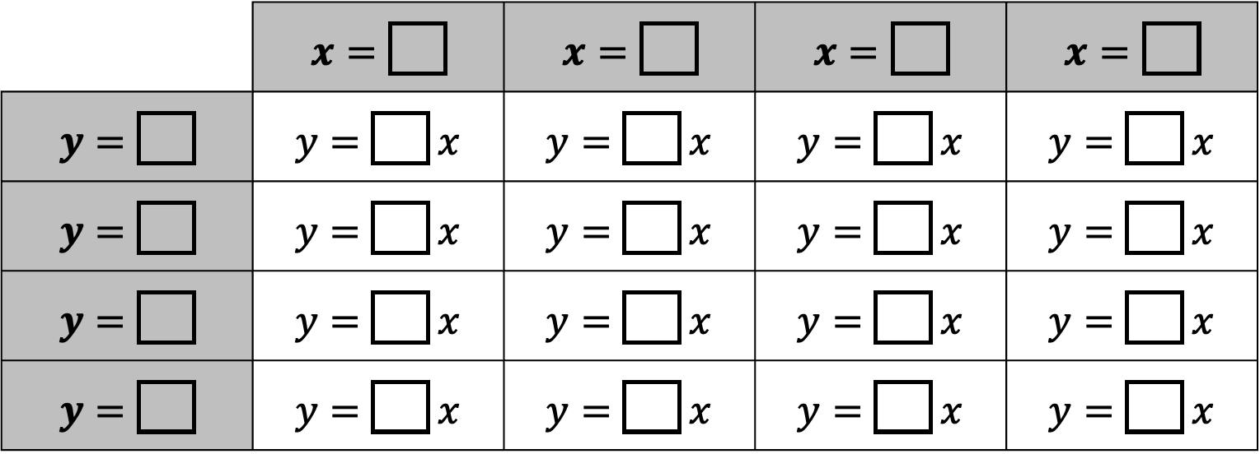
Fill in all the gaps with whole numbers so that each line goes through the point $\left(x,y\right)$.
Can you do it without repeating any numbers?
 | $x=\boxed{}$ | $x=\boxed{}$ | $x=\boxed{}$ | $x=\boxed{}$
$y=\boxed{}$ | $y=\boxed{} x$ | $y=\boxed{} x$ | $y=\boxed{} x$ | $y=\boxed{} x$
$y=\boxed{}$ | $y=\boxed{} x$ | $y=\boxed{} x$ | $y=\boxed{} x$ | $y=\boxed{} x$
$y=\boxed{}$ | $y=\boxed{} x$ | $y=\boxed{} x$ | $y=\boxed{} x$ | $y=\boxed{} x$
$y=\boxed{}$ | $y=\boxed{} x$ | $y=\boxed{} x$ | $y=\boxed{} x$ | $y=\boxed{} x$

Slide 8
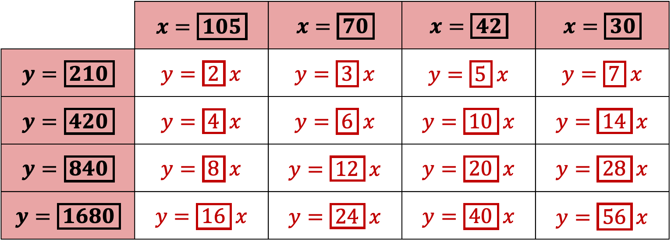

This is Nathan’s solution.
What is special about the number $210$?
Can you find a way to complete the grid with smaller numbers, but still with no repetitions?
 | $x=\boxed{105}$ | $x=\boxed{70}$ | $x=\boxed{42}$ | $x=\boxed{30}$
$y=\boxed{210}$ | $y=\boxed{2} x$ | $y=\boxed{3} x$ | $y=\boxed{5} x$ | $y=\boxed{7} x$
$y=\boxed{420}$ | $y=\boxed{4} x$ | $y=\boxed{6} x$ | $y=\boxed{10} x$ | $y=\boxed{14} x$
$y=\boxed{840}$ | $y=\boxed{8} x$ | $y=\boxed{12} x$ | $y=\boxed{20} x$ | $y=\boxed{28} x$
$y=\boxed{1680}$ | $y=\boxed{16} x$ | $y=\boxed{24} x$ | $y=\boxed{40} x$ | $y=\boxed{56} x$

