Slide 1
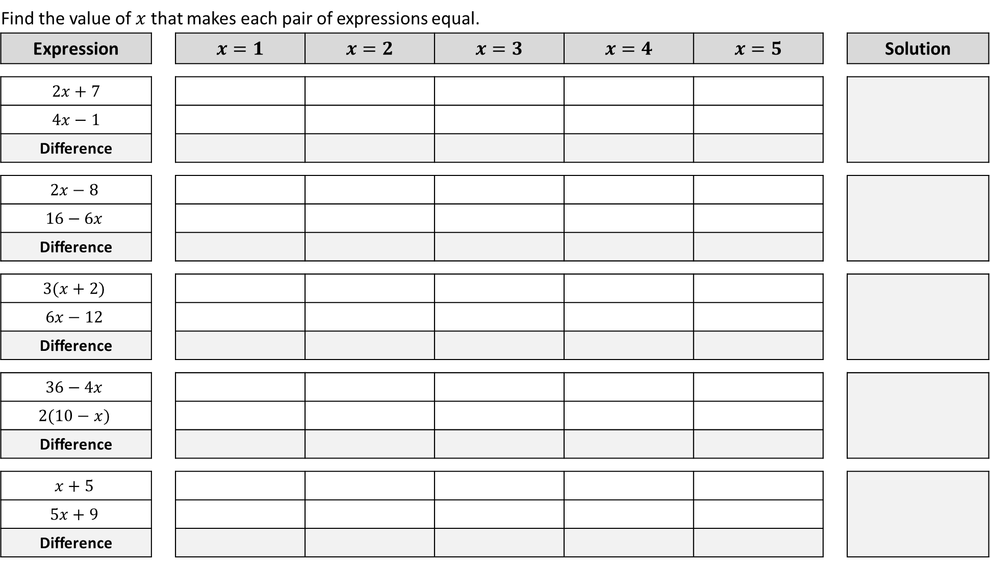
Find the value of $x$ that makes each pair of expressions equal.
Expression |  | $$x=1$$ | $$x=2$$ | $$x=3$$ | $$x=4$$ | $$x=5$$ |  | Solution
$$2x+7$$ |  | 9 | 11 | 13 | 15 | 17 |  | $$x=4$$
$$4x−1$$ |  | 3 | 7 | 11 | 15 | 19
Difference |  | 6 | 4 | 2 | 0 | ⁻2
$$2x−8$$ |  | ⁻6 | ⁻4 | ⁻2 | 0 | 2 |  | $$x=3$$
$$16−6x$$ |  | 10 | 4 | ⁻2 | ⁻8 | ⁻14
Difference |  | ⁻16 | ⁻8 | 0 | 8 | 16
$$3(x+2)$$ |  | 9 | 12 | 15 | 18 | 21 |  | $$x=6$$
$$6x−12$$ |  | ⁻6 | 0 | 6 | 12 | 18
Difference |  | 15 | 12 | 9 | 6 | 3
$$36−4x$$ |  | 32 | 28 | 24 | 20 | 16 |  | $$x=8$$
$$2(10−x)$$ |  | 18 | 16 | 14 | 12 | 10
Difference |  | 14 | 12 | 10 | 8 | 6
$$x+5$$ |  | 6 | 7 | 8 | 9 | 10 |  | $$x=\text{−}1$$
$$5x+9$$ |  | 14 | 19 | 24 | 29 | 34
Difference |  | 8 | 12 | 16 | 20 | 24

Slide 2
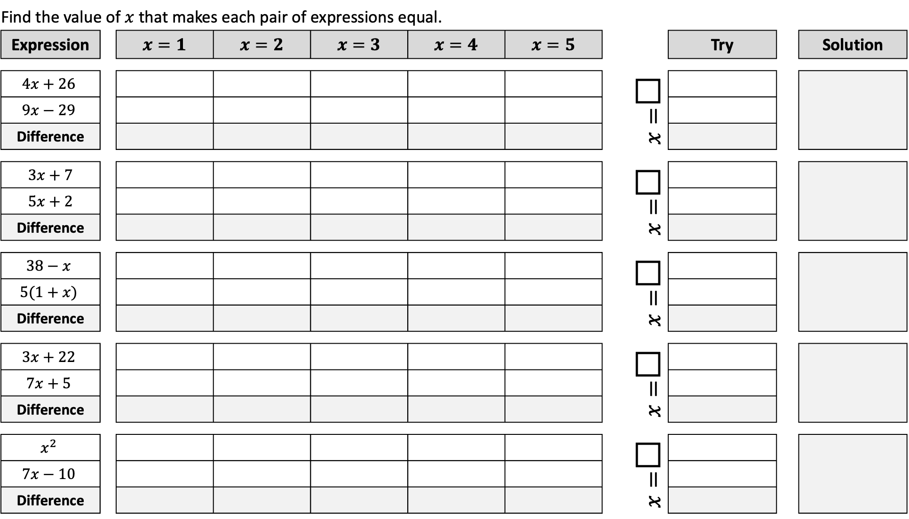
Find the value of $x$ that makes each pair of expressions equal.
Expression |  | $$x=1$$ | $$x=2$$ | $$x=3$$ | $$x=4$$ | $$x=5$$ |  |  | Try |  | Solution
$$4x+26$$ |  |  |  |  |  |  |  | $x=$□
$$9x−29$$
Difference
$$3x+7$$ |  |  |  |  |  |  |  | $x=$□
$$5x+2$$
Difference
$$38−x$$ |  |  |  |  |  |  |  | $x=$□
$$5(1+x)$$
Difference
$$3x+22$$ |  |  |  |  |  |  |  | $x=$□
$$7x+5$$
Difference
$$x^{2}$$ |  |  |  |  |  |  |  | $x=$□
$$7x−10$$
Difference

Slide 3
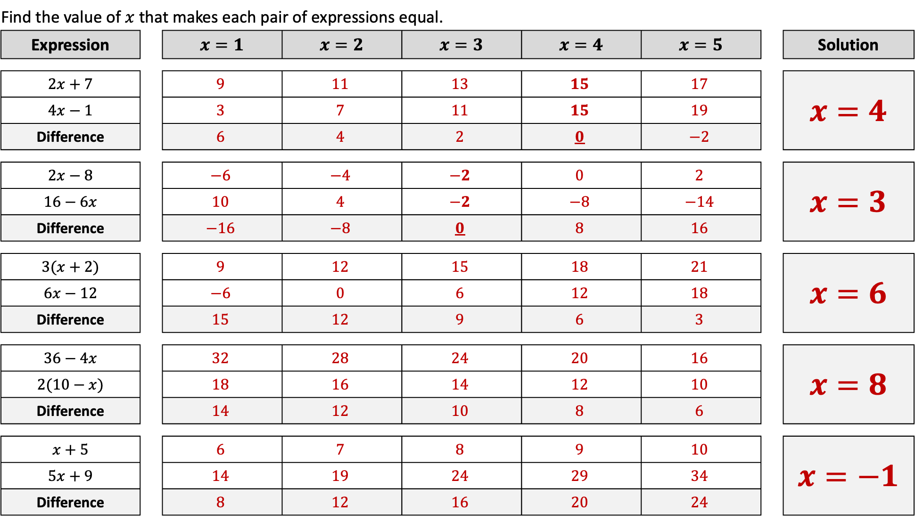
Find the value of $x$ that makes each pair of expressions equal.
Expression |  | $$x=1$$ | $$x=2$$ | $$x=3$$ | $$x=4$$ | $$x=5$$ |  | Solution
$2x+7$ |  | $$9$$ | $$11$$ | $$13$$ | $$15$$ | $$17$$ |  | $x=4$
$4x−1$ |  | $$3$$ | $$7$$ | $$11$$ | $$15$$ | $$19$$
Difference |  | $$6$$ | $$4$$ | $$2$$ | $$0$$ | $$−2$$
$2x−8$ |  | $$−6$$ | $$−4$$ | $$−2$$ | $$0$$ | $$2$$ |  | $x=3$
$16−6x$ |  | $$10$$ | $$4$$ | $$−2$$ | $$−8$$ | $$−14$$
Difference |  | $$−16$$ | $$−8$$ | $$0$$ | $$8$$ | $$16$$
$3(x+2)$ |  | $$9$$ | $$12$$ | $$15$$ | $$18$$ | $$21$$ |  | $x=6$
$6x−12$ |  | $$−6$$ | $$0$$ | $$6$$ | $$12$$ | $$18$$
Difference |  | $$15$$ | $$12$$ | $$9$$ | $$6$$ | $$3$$
$36−4x$ |  | $$32$$ | $$28$$ | $$24$$ | $$20$$ | $$16$$ |  | $x=8$
$2(10−x)$ |  | $$18$$ | $$16$$ | $$14$$ | $$12$$ | $$10$$
Difference |  | $$14$$ | $$12$$ | $$10$$ | $$8$$ | $$6$$
$x+5$ |  | $$6$$ | $$7$$ | $$8$$ | $$9$$ | $$10$$ |  | $x=−1$
$5x+9$ |  | $$14$$ | $$19$$ | $$24$$ | $$29$$ | $$34$$
Difference |  | $$8$$ | $$12$$ | $$16$$ | $$20$$ | $$24$$

Slide 4
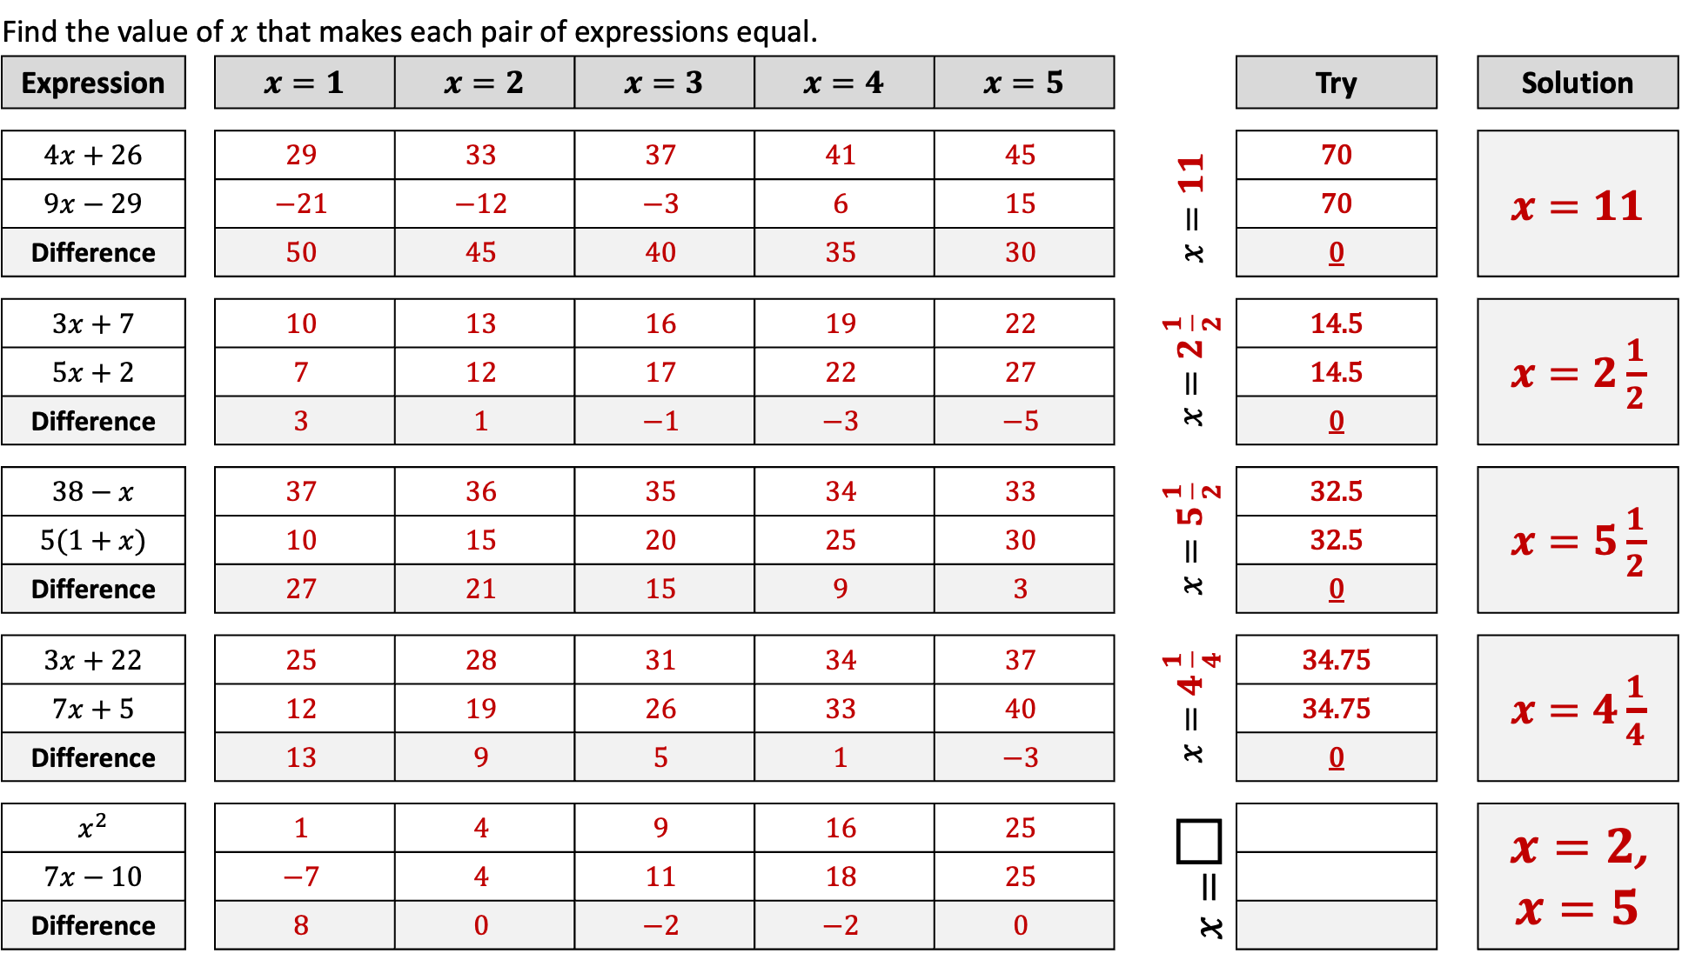
Find the value of $x$ that makes each pair of expressions equal.
Expression |  | $$x=1$$ | $$x=2$$ | $$x=3$$ | $$x=4$$ | $$x=5$$ |  |  | Try |  | Solution
$4x+26$ |  | $$29$$ | $$33$$ | $$37$$ | $$41$$ | $$45$$ |  | $$x=11$$ | 70 |  | $x=11$
$9x−29$ |  | $$−21$$ | $$−12$$ | $$−3$$ | $$6$$ | $$15$$ |  |  | 70
Difference |  | $$50$$ | $$45$$ | $$40$$ | $$35$$ | $$30$$ |  |  | 0
$3x+7$ |  | $$10$$ | $$13$$ | $$16$$ | $$19$$ | $$22$$ |  | $x=2\frac{1}{2}$ | 14.5 |  | $x=2\frac{1}{2}$
$5x+2$ |  | $$7$$ | $$12$$ | $$17$$ | $$22$$ | $$27$$ |  |  | 14.5
Difference |  | $$3$$ | $$1$$ | $$−1$$ | $$−3$$ | $$−5$$ |  |  | 0
$38−x$ |  | $$37$$ | $$36$$ | $$35$$ | $$34$$ | $$33$$ |  | $x=5\frac{1}{2}$ | 32.5 |  | $x=5\frac{1}{2}$
$5(1+x)$ |  | $$10$$ | $$15$$ | $$20$$ | $$25$$ | $$30$$ |  |  | 32.5
Difference |  | $$27$$ | $$21$$ | $$15$$ | $$9$$ | $$3$$ |  |  | 0
$3x+22$ |  | $$25$$ | $$28$$ | $$31$$ | $$34$$ | $$37$$ |  | $x=4\frac{1}{4}$ | 34.75 |  | $x=4\frac{1}{4}$
$7x+5$ |  | $$12$$ | $$19$$ | $$26$$ | $$33$$ | $$40$$ |  |  | 34.75
Difference |  | $$13$$ | $$9$$ | $$5$$ | $$1$$ | $$−3$$ |  |  | 0
$x^{2}$ |  | $$1$$ | $$4$$ | $$9$$ | $$16$$ | $$25$$ |  | $x=$□ |  |  | $x=2$, $x=5$
$7x−10$ |  | $$−7$$ | $$4$$ | $$11$$ | $$18$$ | $$25$$
Difference |  | $$8$$ | $$0$$ | $$−2$$ | $$−2$$ | $$0$$

