Slide 1
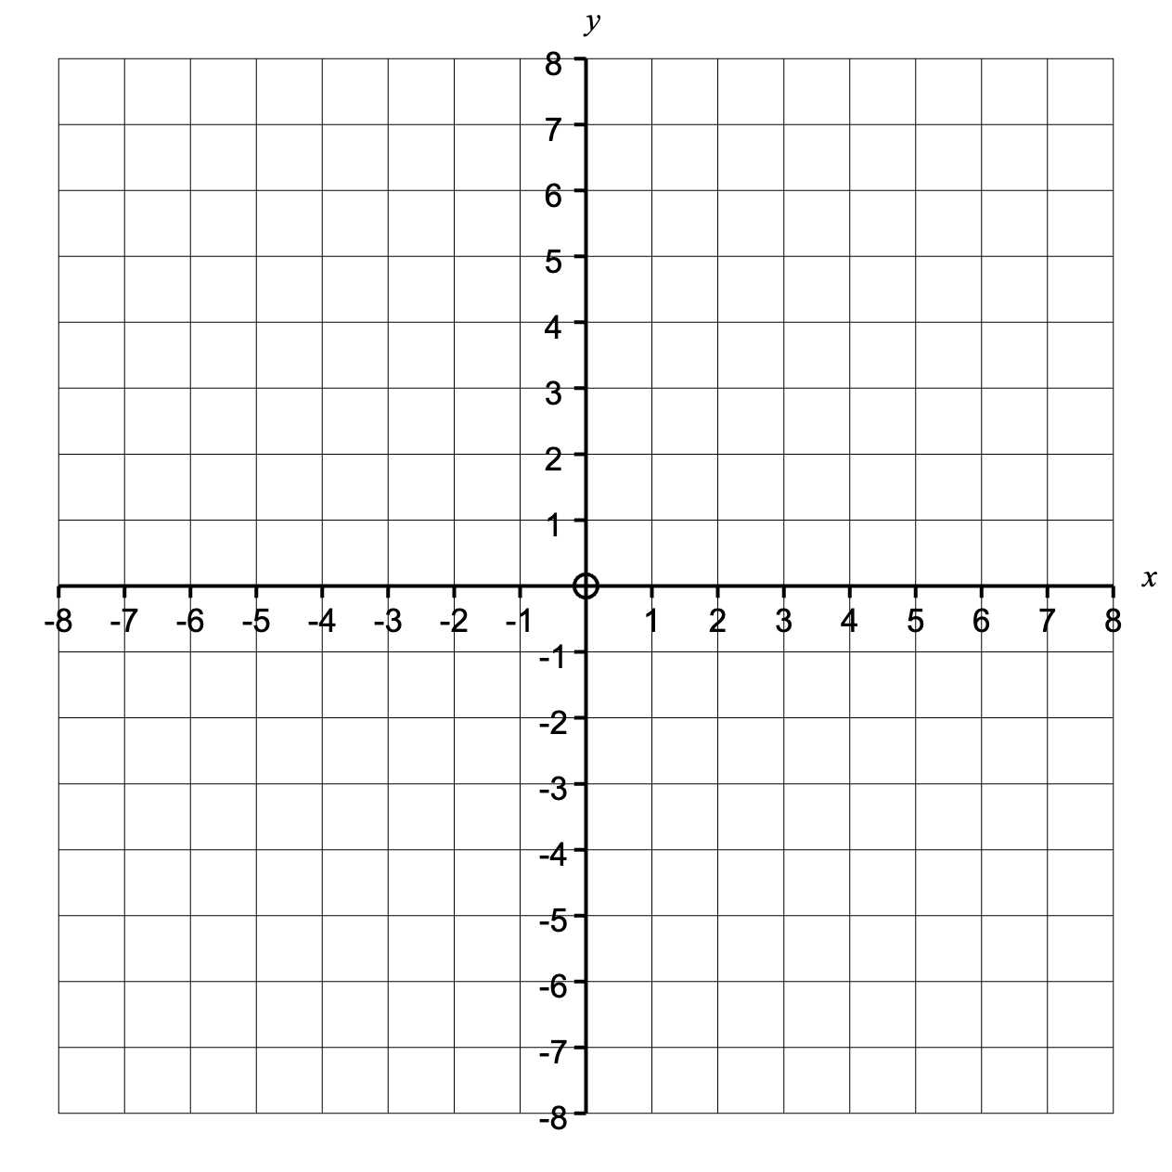
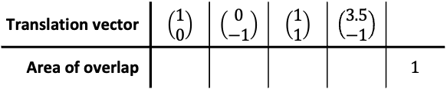

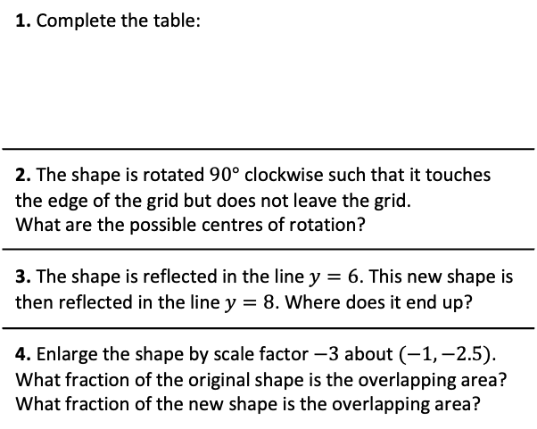
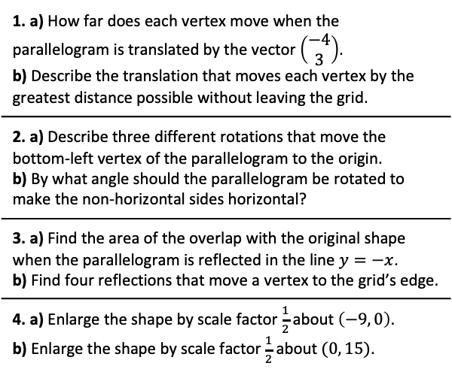
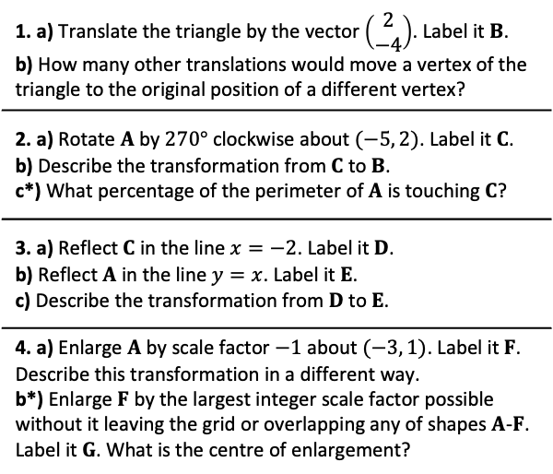
Tricky Transformations
1. a) Translate the triangle by the vector $\left(\begin{matrix}2 \\ −4\end{matrix}\right)$. Label it $B$. b) How many other translations would move a vertex of the triangle to the original position of a different vertex?
2. a) Rotate $A$ by $270°$ clockwise about $(−5, 2)$. Label it $C$. b) Describe the transformation from $C$ to $B$. c*) What percentage of the perimeter of $A$ is touching $C$?
3. a) Reflect $C$ in the line $x=−2$. Label it $D$. b) Reflect $A$ in the line $y=x$. Label it $E$. c) Describe the transformation from $D$ to $E$.
4. a) Enlarge $A$ by scale factor $−1$ about $(−3, 1)$. Label it $F$. Describe this transformation in a different way. b*) Enlarge $F$ by the largest integer scale factor possible without it leaving the grid or overlapping any of shapes $A$-$F$. Label it $G$. What is the centre of enlargement?
$A$
1. a) How far does each vertex move when the parallelogram is translated by the vector $\left(\begin{matrix}−4 \\ 3\end{matrix}\right)$. b) Describe the translation that moves each vertex by the greatest distance possible without leaving the grid.
2. a) Describe three different rotations that move the bottom-left vertex of the parallelogram to the origin. b) By what angle should the parallelogram be rotated to make the non-horizontal sides horizontal?
3. a) Find the area of the overlap with the original shape when the parallelogram is reflected in the line $y=−x$. b) Find four reflections that move a vertex to the grid’s edge.
4. a) Enlarge the shape by scale factor $\frac{1}{2}$ about $\left(−9, 0\right)$. b) Enlarge the shape by scale factor $\frac{1}{2}$ about $(0, 15)$.
1. Complete the table:
2. The shape is rotated $90°$ clockwise such that it touches the edge of the grid but does not leave the grid. What are the possible centres of rotation?
3. The shape is reflected in the line $y=6$. This new shape is then reflected in the line $y=8$. Where does it end up?
4. Enlarge the shape by scale factor $−3$ about $(−1,−2.5)$. What fraction of the original shape is the overlapping area? What fraction of the new shape is the overlapping area?
Translation vector | $\left(\begin{matrix}1 \\ 0\end{matrix}\right)$ | $\left(\begin{matrix}0 \\ −1\end{matrix}\right)$ | $\left(\begin{matrix}1 \\ 1\end{matrix}\right)$ | $\left(\begin{matrix}3.5 \\ −1\end{matrix}\right)$
Area of overlap |  |  |  |  | 1

Slide 2

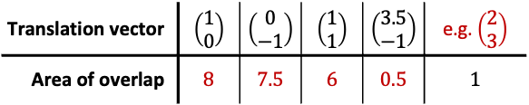


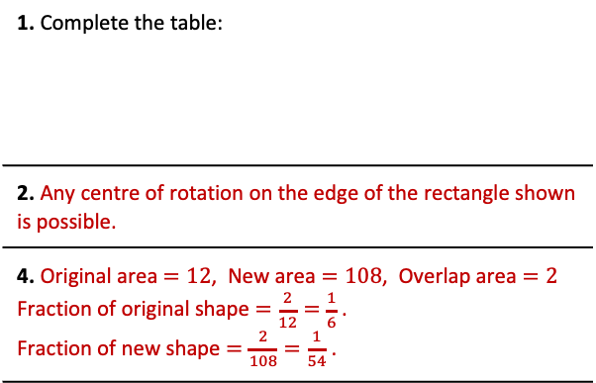


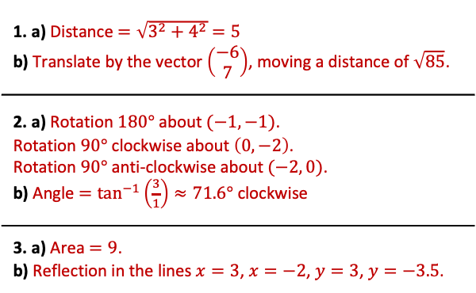

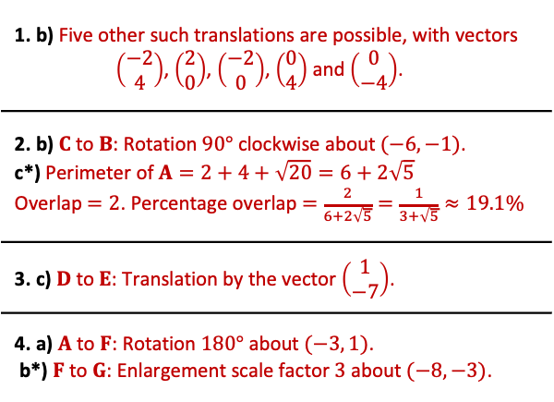

Tricky Transformations - Answers
$G$
1. b) Five other such translations are possible, with vectors $\left(\begin{matrix}−2 \\ 4\end{matrix}\right)$, $\left(\begin{matrix}2 \\ 0\end{matrix}\right)$, $\left(\begin{matrix}−2 \\ 0\end{matrix}\right)$, $\left(\begin{matrix}0 \\ 4\end{matrix}\right)$ and $\left(\begin{matrix}0 \\ −4\end{matrix}\right)$.
2. b) $C$ to $B$: Rotation $90°$ clockwise about $(−6,−1)$. c*) Perimeter of $A=2+4+\sqrt{20}=6+2\sqrt{5}$ Overlap $=2$. Percentage overlap $=\frac{2}{6+2\sqrt{5}}=\frac{1}{3+\sqrt{5}}≈19.1\%$
3. c) $D$ to $E$: Translation by the vector $\left(\begin{matrix}1 \\ −7\end{matrix}\right)$.
4. a) $A$ to $F$: Rotation $180°$ about $(−3, 1)$. b*) $F$ to $G$: Enlargement scale factor $3$ about $(−8,−3)$.
$C$
$A$
$D$
$F$
$B$
$E$
1b
4b
1. a) Distance $=\sqrt{3^{2}+4^{2}}=5$ b) Translate by the vector $\left(\begin{matrix}−6 \\ 7\end{matrix}\right)$, moving a distance of $\sqrt{85}$.
2. a) Rotation $180°$ about $(−1,−1)$. Rotation $90°$ clockwise about $\left(0, −2\right)$. Rotation $90°$ anti-clockwise about $(−2, 0)$. b) Angle $=\tan^{−1}\left(\frac{3}{1}\right)≈71.6°$ clockwise
3. a) Area $=9$. b) Reflection in the lines $x=3$, $x=−2$, $y=3$, $y=−3.5$.
4a
3a
1. Complete the table:
2. Any centre of rotation on the edge of the rectangle shown is possible.
4. Original area $=12$, New area $=108$, Overlap area $=2$ Fraction of original shape $=\frac{2}{12}=\frac{1}{6}$ . Fraction of new shape $=\frac{2}{108}=\frac{1}{54}$ .
Translation vector | $\left(\begin{matrix}1 \\ 0\end{matrix}\right)$ | $\left(\begin{matrix}0 \\ −1\end{matrix}\right)$ | $\left(\begin{matrix}1 \\ 1\end{matrix}\right)$ | $\left(\begin{matrix}3.5 \\ −1\end{matrix}\right)$ | e.g. $\left(\begin{matrix}2 \\ 3\end{matrix}\right)$
Area of overlap | 8 | 7.5 | 6 | 0.5 | 1
3

