Slide 1
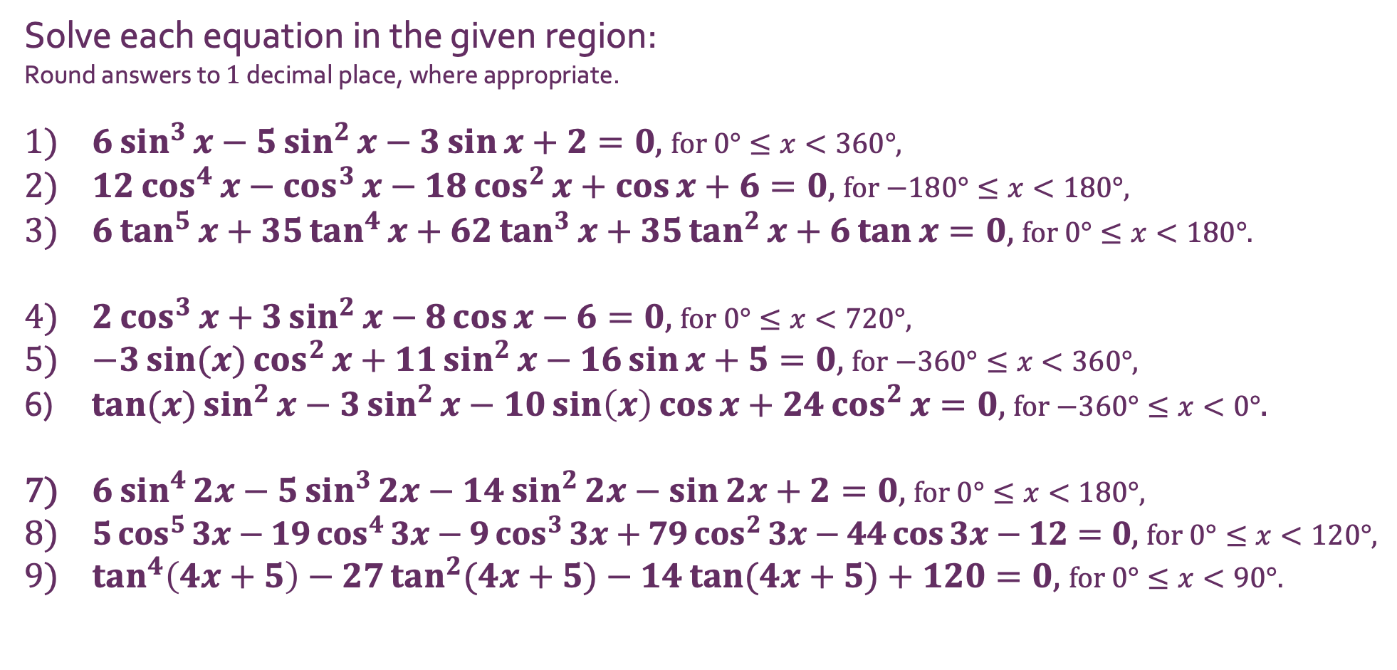
The Factor Theorem
Solving Trig Equations with…
Solve each equation in the given region:
Round answers to $1$ decimal place, where appropriate.
$6\sin^{3}{x}−5\sin^{2}{x}−3\sin{x}+2=0$, for $0°≤x<360°$,
$12\cos^{4}{x}−\cos^{3}{x}−18\cos^{2}{x}+\cos{x}+6=0$, for $−180°≤x<180°$,
$6\tan^{5}{x}+35\tan^{4}{x}+62\tan^{3}{x}+35\tan^{2}{x+6\tan{x}=0}$, for $0°≤x<180°$.
$2\cos^{3}{x}+3\sin^{2}{x}−8\cos{x}−6=0$, for $0°≤x<720°$,
$−3\sin{(x)}\cos^{2}{x}+11\sin^{2}{x}−16\sin{x}+5=0$, for $−360°≤x<360°$,
$\tan{(x)}\sin^{2}{x}−3\sin^{2}{x}−10\sin\left(x\right)cos⁡x+24\cos^{2}{x}=0$, for $−360°≤x<0°$.
$6\sin^{4}{2x}−5\sin^{3}{2x}−14\sin^{2}{2x}−\sin{2x}+2=0$, for $0°≤x<180°$,
$5\cos^{5}{3x}−19\cos^{4}{3x}−9\cos^{3}{3x}+79\cos^{2}{3x}−44\cos{3x}−12=0$, for $0°≤x<120°$,
$\tan^{4}\left(4x+5\right)−27\tan^{2}{(4x+5)}−14{\tan{(4x+5)}}+120=0$, for $0°≤x<90°.$

Slide 2
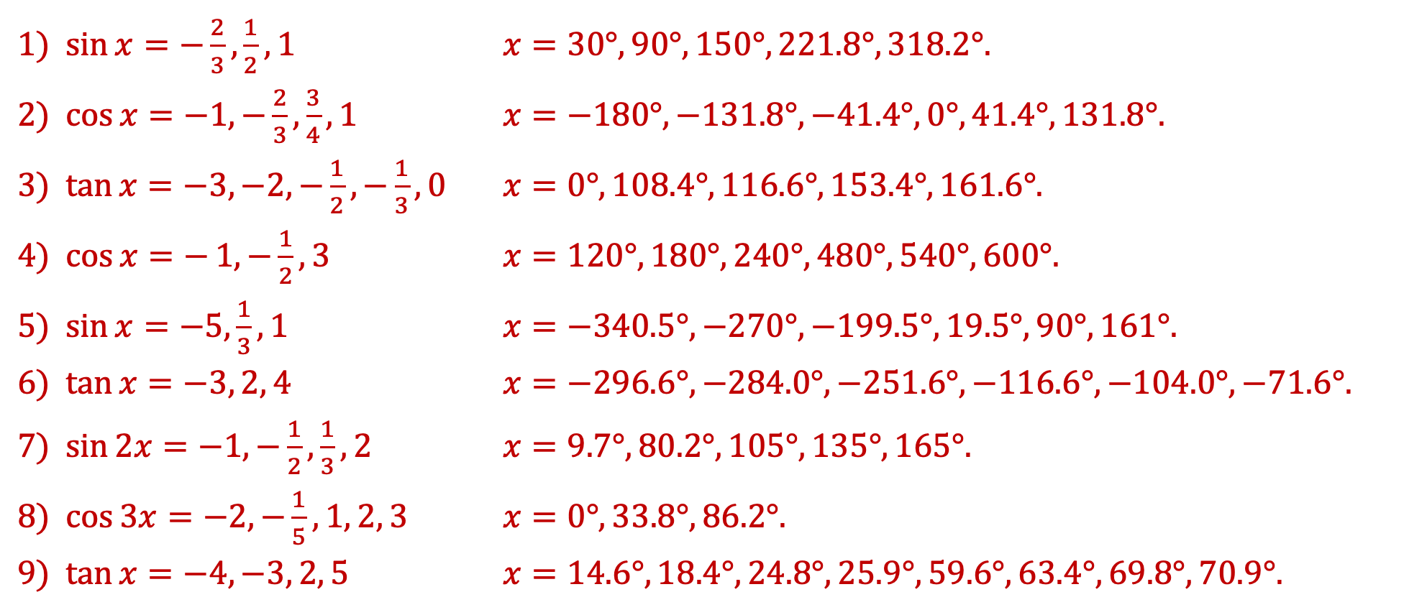
The Factor Theorem
Solving Trig Equations with…
$\sin{x}=−\frac{2}{3},\frac{1}{2}, 1$ $x=30°,90°,150°,221.8°,318.2°$.
$\cos{x}=−1, −\frac{2}{3},\frac{3}{4},1$ $x=−180°, −131.8°, −41.4°,0°,41.4°,131.8°$.
$\tan{x}=−3,−2,−\frac{1}{2},−\frac{1}{3},0$ $x=0°,108.4°, 116.6°, 153.4°,161.6°$.
$\cos{x=−}1, −\frac{1}{2}, 3$ $x=120°,180°,240°,480°,540°,600°$.
$\sin{x}=−5,\frac{1}{3}, 1$ $x=−340.5°,−270°,−199.5°,19.5°,90°,161°$.
$\tan{x}=−3, 2, 4$ $x=−296.6°,−284.0°,−251.6°,−116.6°,−104.0°,−71.6°$.
$\sin{2x}=−1,−\frac{1}{2},\frac{1}{3},2$ $x=9.7°,80.2°, 105°, 135°, 165°$.
$\cos{3x}=−2,−\frac{1}{5},1, 2, 3$ $x=0°, 33.8°, 86.2°$.
$\tan{x}=−4,−3, 2, 5$ $x=14.6°,18.4°, 24.8°, 25.9°, 59.6°, 63.4°, 69.8°, 70.9°$.

