Slide 1
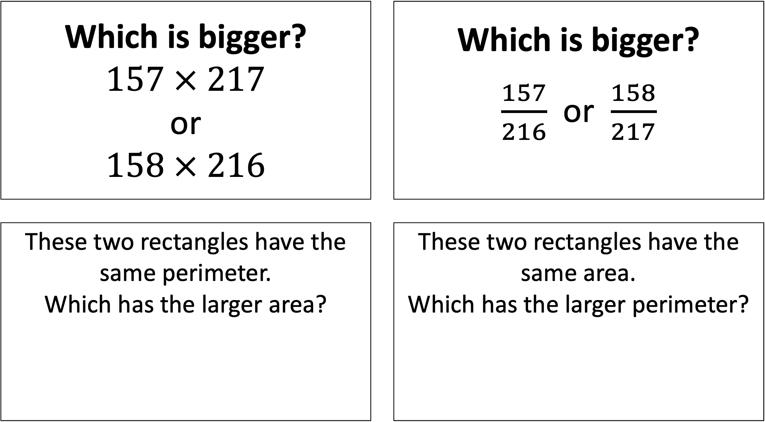
Which is bigger? $157 × 217$ or $158 × 216$ |  | Which is bigger? $\frac{157}{216}$ or $\frac{158}{217}$
These two rectangles have the same perimeter. Which has the larger area? |  | These two rectangles have the same area. Which has the larger perimeter?

Slide 2
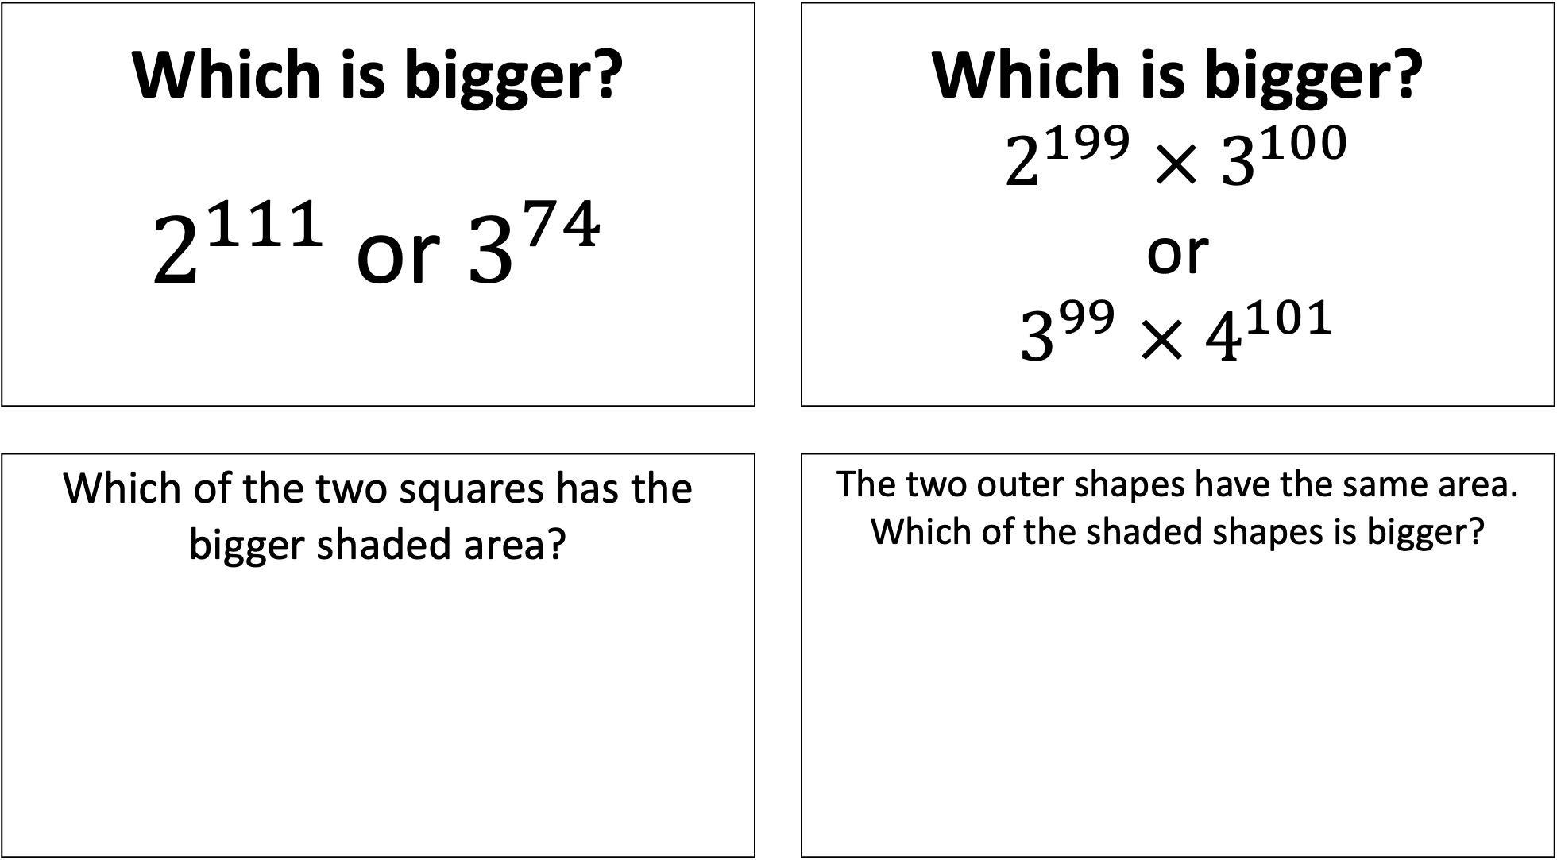
Which is bigger? $2^{111}$ or $3^{74}$ |  | Which is bigger? $2^{199} × 3^{100}$ or $3^{99} × 4^{101}$
Which of the two squares has the bigger shaded area? |  | The two outer shapes have the same area. Which of the shaded shapes is bigger?

Slide 3
Harold runs 17 laps in 16 minutes. Eric runs 18 laps in 17 minutes. Who is running faster? |  | Sandy makes pink paint with 13 parts red paint, 7 parts white paint. Betty makes pink paint with 17 parts red paint, 9 parts white paint. Whose paint is darker?
Which line is longer? |  | Which line is longer?

Slide 4
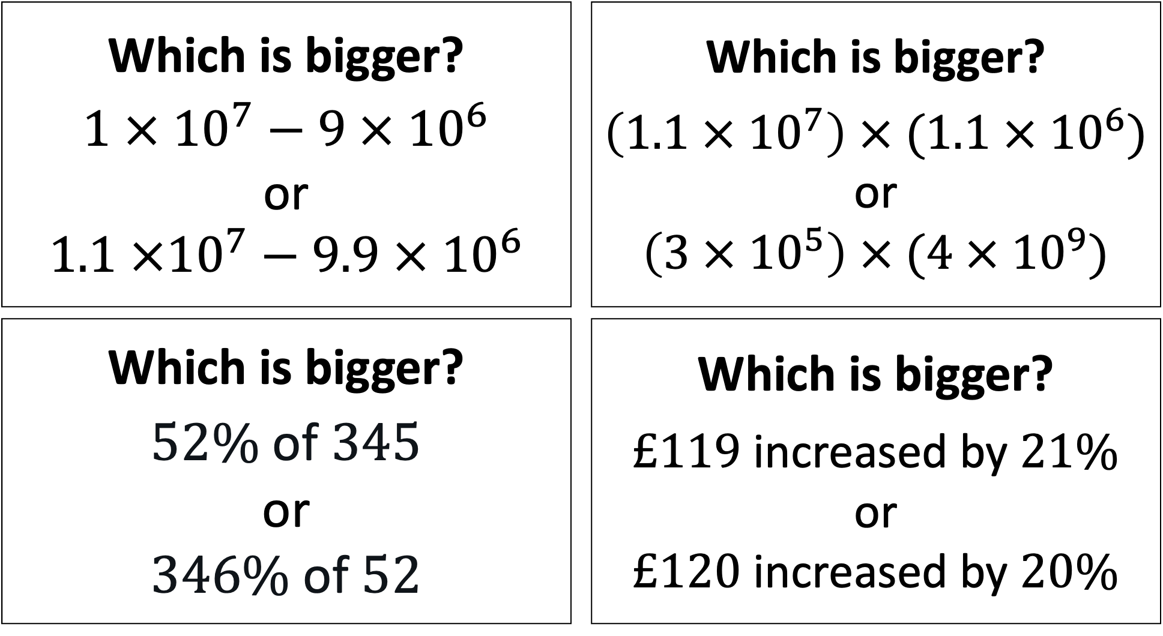
Which is bigger? $$1 × {10}^{7}−9 × {10}^{6}$$ or $$1.1 ×{10}^{7}−9.9 × {10}^{6}$$ |  | Which is bigger? $$\left(1.1 × {10}^{7}\right) × (1.1 × {10}^{6})$$ or $$\left(3 × {10}^{5}\right) × (4 × {10}^{9})$$
Which is bigger? $$\text{52\% }\text{of} \text{345}$$ or $$\text{346\% }\text{of} \text{52}$$ |  | Which is bigger? $£119$ increased by $21\%$ or $£120$ increased by $20\%$

